Slide 1
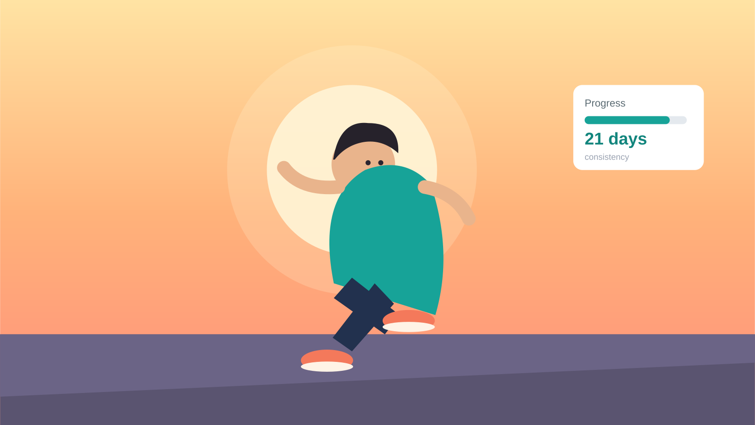
FITNESS APP · STORYBOARD
Every Step Counts
A character-driven fitness journey — following Arjun from “I'll start tomorrow” to a lasting habit.
8 panels · onboarding / journey sequence

Slide 2
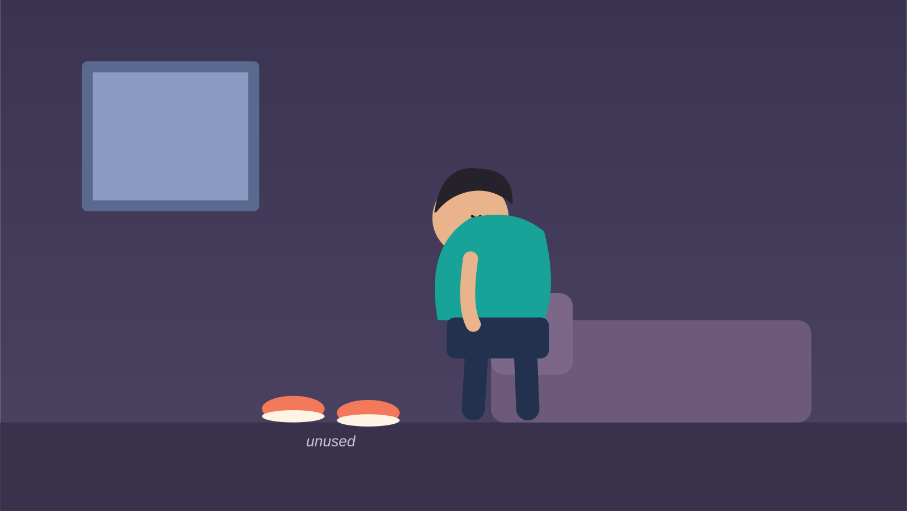
1
Panel 1 · Character Introduction — Arjun's Challenge
“I'll start tomorrow…”
PURPOSE Introduce the problem and the emotion.

Slide 3

2
Panel 2 · Turning Point — Health Wake-up Call
“Something has to change.”
PURPOSE The motivation for change.

Slide 4
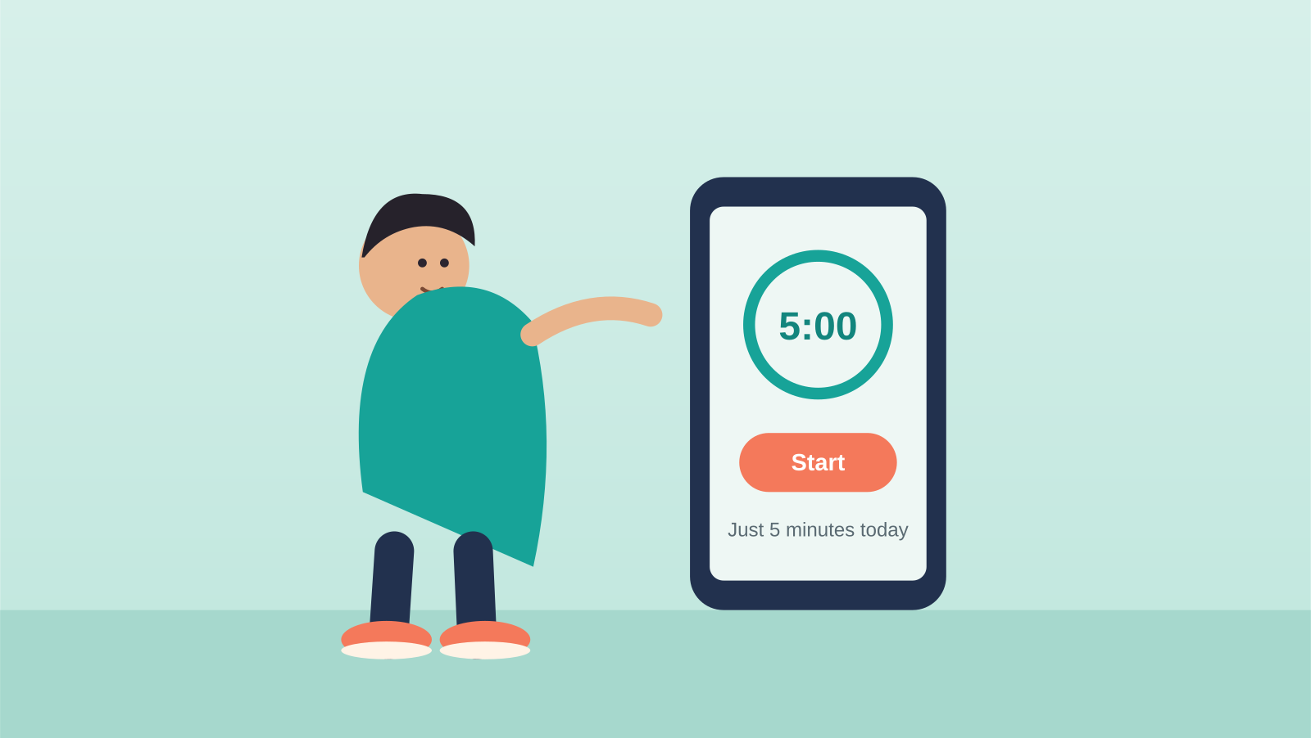
3
Panel 3 · App Onboarding — A Small First Goal
“Let's begin with just 5 minutes today.”
PURPOSE The app removes fear with a tiny, doable goal.

Slide 5

4
Panel 4 · First Success — Positive Reinforcement
“Great job! Day 1 complete.”
PURPOSE Positive reinforcement builds momentum.

Slide 6

5
Panel 5 · Setback — Compassionate Recovery
“Missed today? No worries — tomorrow is another chance.”
PURPOSE Empathy instead of guilt keeps him from quitting.

Slide 7

6
Panel 6 · Growth — Habit Formation
“7-day streak!”
PURPOSE Progress through consistency.

Slide 8

7
Panel 7 · Transformation — Stronger Than Yesterday
“You're stronger than yesterday.”
PURPOSE Emotional and physical improvement.

Slide 9
8
Panel 8 · Final Outcome — Sustainable Fitness Journey
“Fitness isn't perfection. It's progress.”
PURPOSE Ending on a sustainable, lasting lifestyle.

