Slide 1
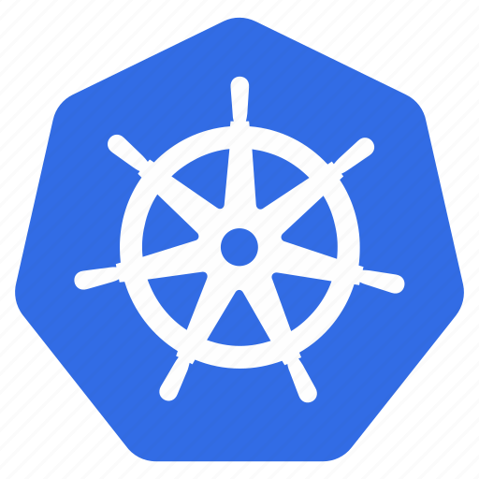
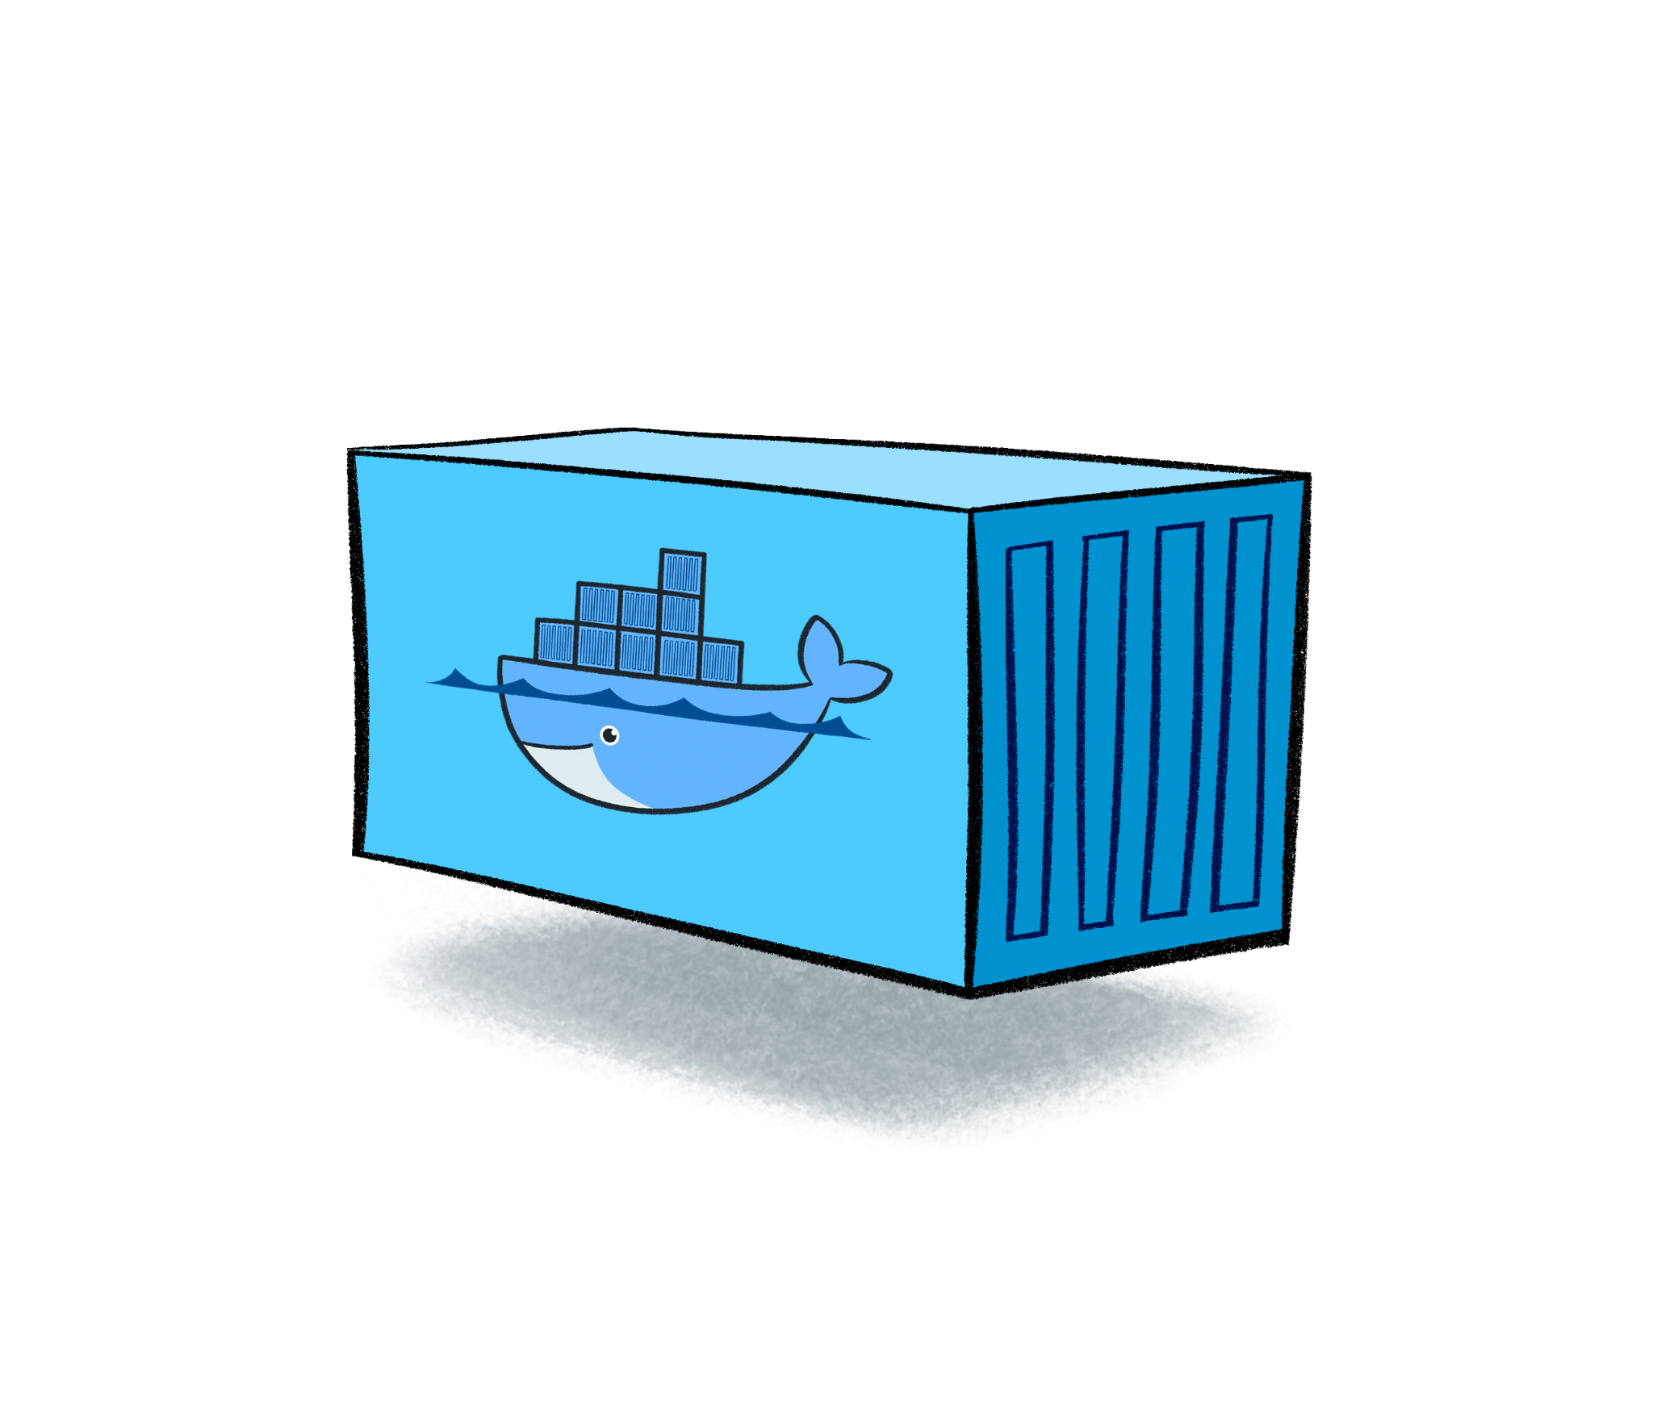
Google Kubernetes Engine
Cloud Computing Activity
[ 20CS704 ]
Darshan G 4MC20CS036
Darshan K 4MC20CS037
Jeevan Kumar J E 4MC20CS054
Joel Sequeira 4MC20CS055

Slide 2

What is Kubernetes?
Kubernetes is used to Orchestrate Containerized Cloud native Microservices Apps.
Kubernetes is a Greek word for Captain of a Ship / Helmsman .

Slide 3
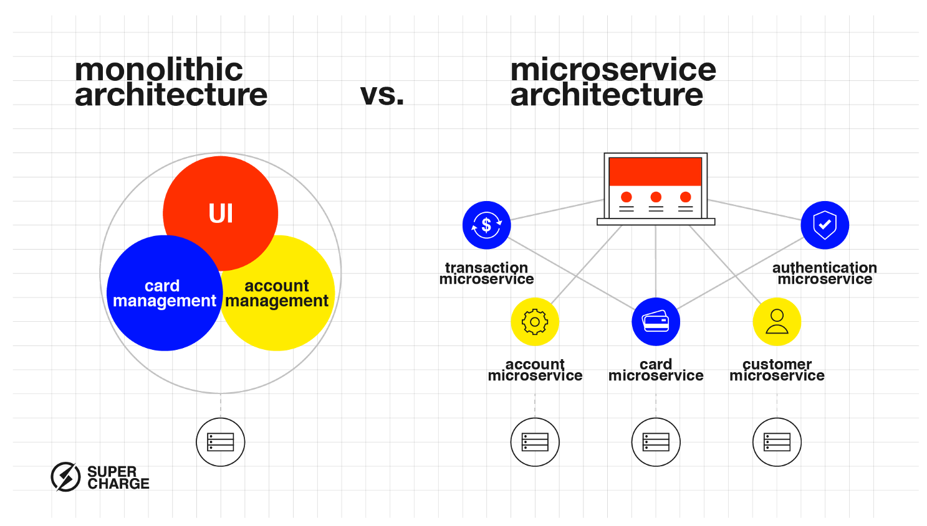
Why do we need Kubernetes?

Slide 4
Basic Architecture
CLUSTER
A Kubernetes cluster is a group of computers working together to run and manage containerized applications.
NODE
A node is a single computer within a Kubernetes cluster, serving as either a master or a worker.
POD
A Pod is the smallest deployable unit in Kubernetes, representing a group of one or more containers.
CONTAINER
A container is a lightweight package that includes everything needed to run a piece of software, ensuring consistency across different environments

Slide 5
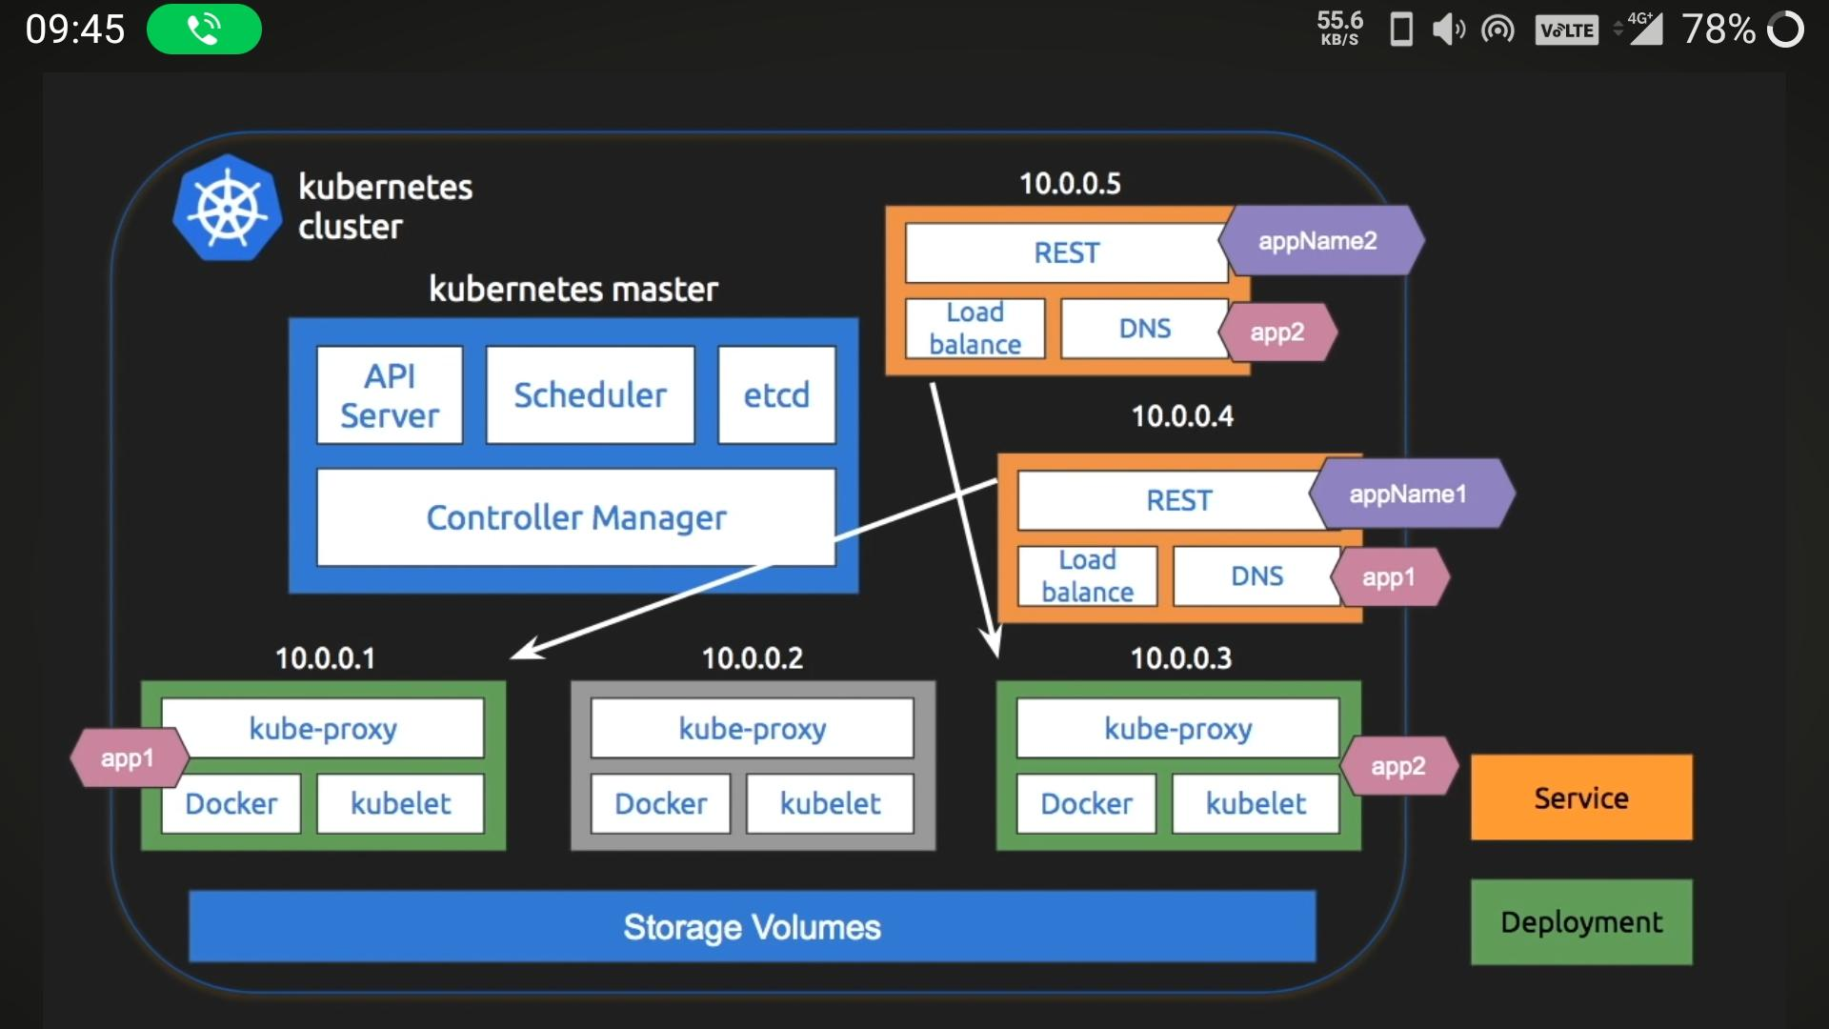
Kubernetes Basic Architecture

Slide 6
Advantages
01
Orchestration:
Efficiently deploy, scale, and manage containerized applications across a cluster of machines
02
Scalability:
Easily scale applications up or down based on demand, both manually and automatically
03
High Availability:
Provides mechanisms for ensuring high availability of applications, minimizing downtime

Slide 7
Advantages
04
Service Discovery and Load Balancing:
Automates service discovery within the cluster and provides built-in load balancing for optimal resource utilization.
05
Rolling Updates and Rollbacks:
Facilitates seamless updates and rollbacks of applications without service interruption
06
Self-Healing:
Automatically replaces and reschedules containers or nodes in the event of failures, ensuring application availability

Slide 8
Overview of Deployment Process
01
Create a Container for the Website:
Using a Dockerfile to define the container image, including necessary dependencies and configurations.
02
Push Container Image to Artifact Registry:
This is a private container image registry that allows secure storage and retrieval of container images.
03
Set Up GKE Cluster:
Create a GKE cluster using the Google Cloud Console or the gcloud command-line tool. Specify the number of nodes and other configurations as needed.

Slide 9
Overview of Deployment Process
04
Create Kubernetes Deployment:
Define a Kubernetes Deployment configuration file (typically in YAML). Specify details such as the container image, replicas, and other deployment settings
05
Expose the Deployment:
Create a Kubernetes Service to expose your deployment to external traffic. Use a Service of type LoadBalancer to obtain an external IP address for your application.
06
Clean Up Resources:
deleting the GKE cluster and other resources to avoid incurring unnecessary costs. Use the Google Cloud Console or the gcloud command-line tool for cleanup.

Slide 10
Thank You

