Slide 1
Mammogram detection Using different ML algorithms
The correct diagnosis of Breast Cancer and the classification of patients into malignant (highly effective) or benign (Not severe) groups is the subject of much research. To predict breast cancer is benign or malignant the machine learning algorithms gives a lot of aid

Slide 2
Reason why we picked this project
Mammograms have false positive (high-risk) results which show abnormal cells that can lead to unnecessary surgeries. Sometimes surgery done to remove lesions reveals that it is benign which is not harmful. This means that the patient will go through unnecessary painful and expensive surgery. Machine Learning techniques are a huge success in intelligent health care systems because of their accuracy.
Also, we can learn different ML algorithms and can compare them.

Slide 3
Input Dataset
We'll be using Wisconsin Breast Cancer Database from Kaggle. https://archive.ics.uci.edu/ml/datasets/Breast+Cancer+Wisconsin+(Diagnostic)
This data contains 699 instances of masses detected in mammograms, and contains the following attributes:
Sample code id number
Clump Thickness 1 - 10
Uniformity of Cell Size 1 - 10
Uniformity of Cell Shape 1 - 10
Marginal Adhesion 1 - 10
Single Epithelial Cell Size 1 - 10
Bare Nuclei 1 - 10
Bland Chromatin 1 - 10
Normal Nucleoli 1 – 10
Mitoses 1 – 10
Class: (2 for benign, 4 for malignant)

Slide 4
ML Algorithms Used:
Decision tree
Random forest
KNN (Optimal solution for different K values)
Naive Bayes
SVM (Linear, Poly, Sigmoid, rbf)
Logistic Regression

Slide 5
Phase 1: Data Exploration
We are using pandas library and it’s read_csv function to Visualize the data.
We can see the stats of the dataframe using describe() function of Pandas.
We saw that there were 16 null values in bare nuclei and no other feature had any null value.
As there is no correlation seen between bare nuclei and other feature, we can remove the columns having null values.
We also removed the ‘ID’ feature because there was no use of it in output.

Slide 6
Phase 2: Data Preprocessing
All the features were between 1-10 and output had two values 2 and 4.
As the data was not normalized, we scaled it using standardscaler from scikit preprocessing which creates 0 mean 1 variance output.
The data had to be converted to numpy array.
We split data into 9 feature inputs and 1 output class.
We are using the time library of python to calculate the runtime of different models.

Slide 7
Phase 3: Method of Implementation
We implement every algorithms in two types:
1. Partitioning the data using K-Fold Cross validation with K=10.
2. Partitioning the data into 90% train data and 10% test data
We maintain a random seed value so that the value doe not change on every runtime.
We use values like True Positive, True Negative, False Positive and False Negative to show output statistics which will be explained later.
We are keeping the Parameter C in SVM as C=1.
All algorithms used are based on supervised learning.

Slide 8
Decision Tree
In decision tree, we cannot guarantee the accuracy but we can visualize the algorithm as it is just a flow chart, which makes it easy to access.
It can handle large data easily and works very fast for big data.
Decision trees are prone to overfitting, especially when a tree has many layers. This is due to the amount of specificity we look at, leading to smaller sample of events that meet the previous assumptions. This small sample could lead to unsound conclusions.
It has the 2nd lowest accuracy (95%) in our dataset and the 2nd lowest runtime dor training (0.019s).

Slide 9
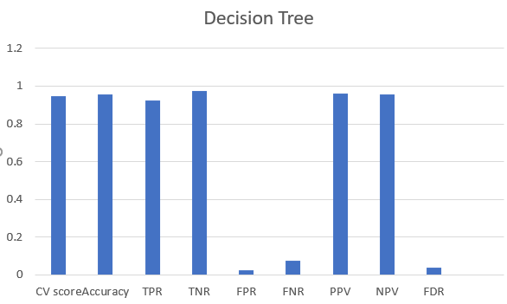
Decision Tree

Slide 10
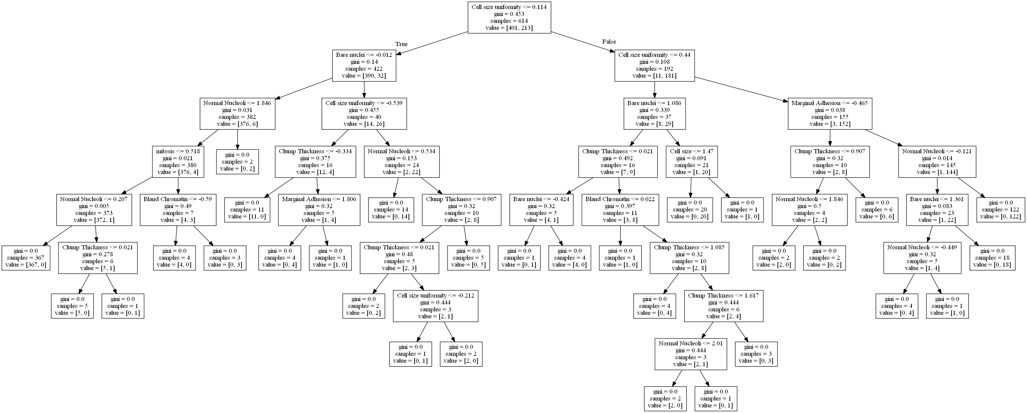
Decision Tree of our Project

Slide 11
Random Forest
It takes K random decision trees and find the best output which gives least error out of them.
It is a part of ensemble learning.
Hence, we expect Random Forest to have very high accuracy and very high runtime.
Acc. to results of our project, Random Forest had accuracy equal to SVM linear (96.64%) and highest runtime of 0.093s.

Slide 12
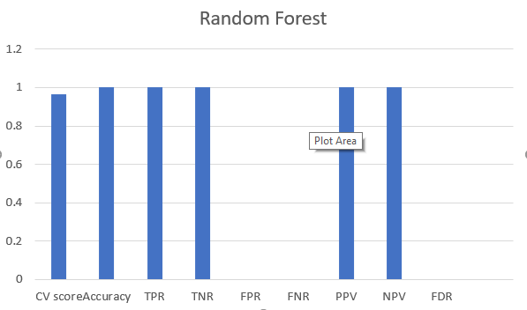
Random Forest

Slide 13
SVM
It checks whether the points are in a side of hyper-plane or not.
The hyper plane has higher dimensions (equal to features) and different kernel functions (shapes) of the hyper plane in model.
SVM has a feature to ignore outliers and find the hyper-plane that has maximum margin.
Due to its nature of Convex Optimization, the solution is global minimum not local minimum.
It is effective for data with high dimension.
It performs slow for large data and more features.

Slide 14
SVM
Surprisingly amongst the SVM kernels, for this dataset SVM linear has highest accuracy among SVM algorithms (96.64%) and highest runtime (0.043s) among them.
SVM RBF also has the highest accuracy (96.64%) and less runtime (0.040s).
SVM Sigmoid has least runtime among them (0.028s) and reasonable accuracy (96.2%).
SVM Polynomial has least accuracy (95.63%) among them and ok runtime(0.032s).

Slide 15
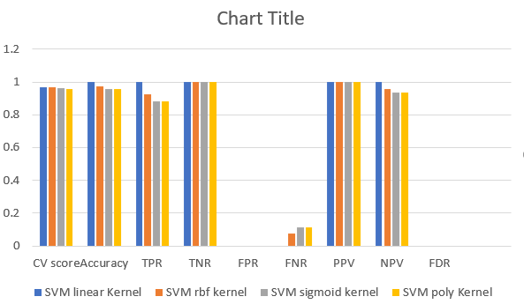
SVM for different kernel

Slide 16
Naïve Bayes
It is basically using conditional probability to predict output.
Model is actually a probability table that gets updated through your training data. To predict a new observation, you’d simply ”look up” the class probabilities in your ”probability table” based on its feature values
Due to their sheer simplicity, NB models are often beaten by models properly trained and tuned using the previous algorithms listed.
Based on our observations, it had the least accuracy (90.9%) among the algorithms we compared and least runtime (0.014s).

Slide 17
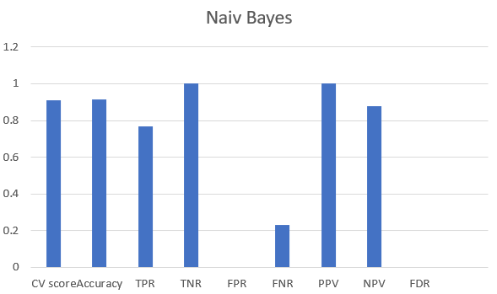
Naïve Bayes

Slide 18
K-Nearest Neighbours
K-nearest neighbours simply calculates the nearest K points to our concerned (new) data point through Euclidian distance and compares if the data(characteristics) of this new point is similar to the data of those K-points.
We may think that higher the k, more accurate the data is, but it is not true. If K is high, algorithm will compare new point to those points that are far too and the answer accuracy will decrease. Vice Versa for the case when K is small.
It had the highest accuracy (97.088%) for our dataset because we optimised the algorithm for the best value of K while other algorithms ran unoptimized with default parameters.
It had 2nd highest runtime (0.052s).

Slide 19
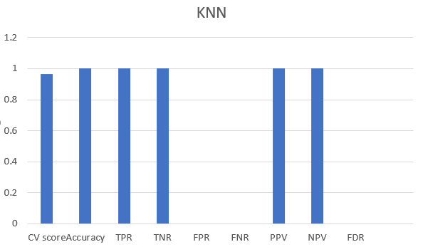
KNN

Slide 20
Logistic Regression
Logistic Regression is used when the dependent variable(target) is categorical. It gives very high output for categorical data.
It has low runtime because it is just a “regression”.
The cost function is not convex, i.e, it has both global minima and local minima different.
However, the cost function for logistic regression can be optimized for global minimum value.
For our dataset, the best algorithm was logistic regression with high accuracy (96.94%) which is nearly equal to KNN accuracy and a low runtime of 0.023s

Slide 21
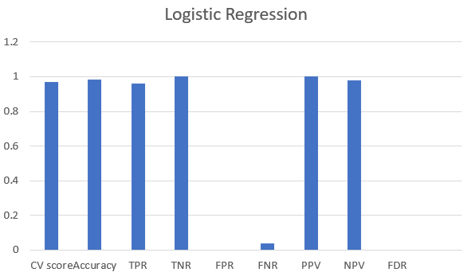
Logistic Regression

Slide 22
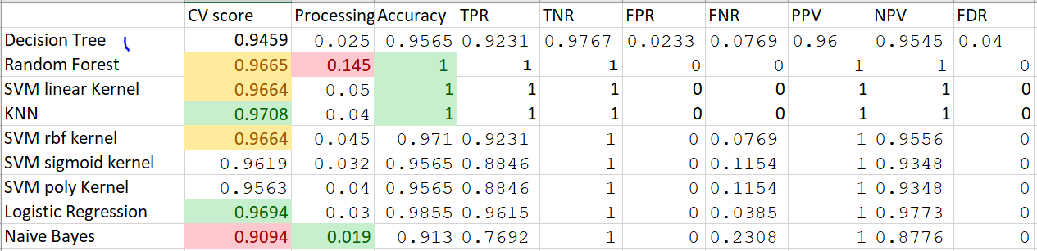
Results:

Slide 23
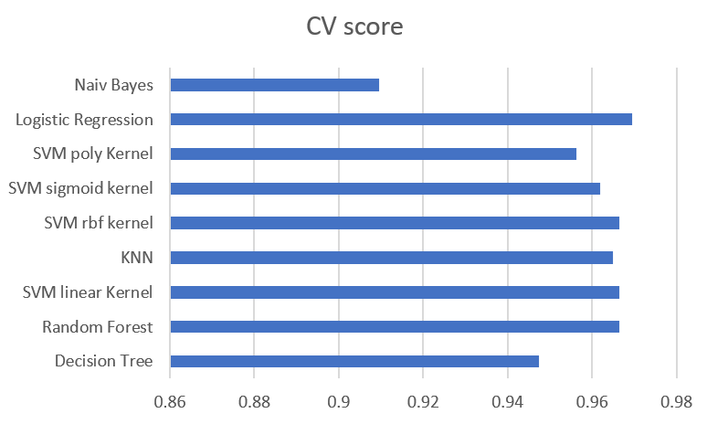
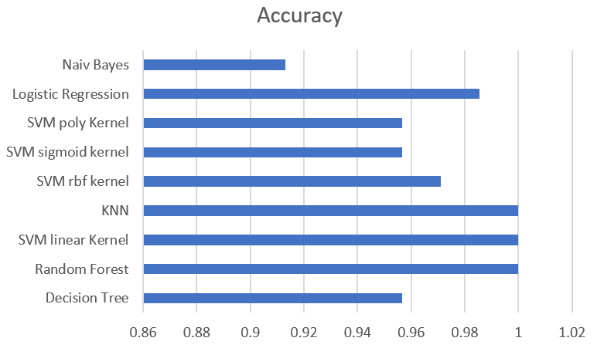
CV score vs Computed Accuracy

Slide 24
Conclusion
Our work mainly focused in comparing scikit ML algorithms for same parameters or default parameters (kernels maybe different). The results maybe different for different dataset, but it provides a rough comparison.
All presented ML algorithms exhibited high performance on the binary classification (2 for benign and 4 for malignant) of breast cancer. Every algorithm had good accuracy above 90%. Least accuracy was from Naïve Bayes (91%). However, SVM, logistic regression, Random forest and KNN provided highest accuracy around 97%. However, logistic regression has given good output because of uni-classification of output and KNN because of the optimal value of K, however they were not expected to give as good output as random forest and svm. KNN classifies data based on the distance metric whereas SVM need a proper phase of training. Also as a result of this study, a CV technique such as k-fold cross validation should be employed to improve accuracy. The application of such a technique will not only provide a more accurate measure of model prediction performance, but it will also assist in determining the most optimal hyper-parameters for the ML algorithms.

