Slide 1
Zeon: A Spatial KV store
Darshan Kapashi
Sagar Chordia

Slide 2
Zeon
Service to manage spatial points
set_data (Point p, Value v)
get_nearest (Point p)
Properties of Zeon
Scalable, distributed, fault-tolerant system
Intelligent dynamic load balancing

Slide 3
Motivation
Applications
Taxi calling service (drivers use set_data and passengers call get_nearest)
Nearby Friends based on realtime locations of people.
Characteristics
Very frequent writes and reads.
Real time and fast retrieval of nearby points.

Slide 4
Comparison
System | Pros | Cons
Consistent Hashing based KV (Chord) | Load balancing Easy addition/removal of nodes | Potentially query all servers
Content Addressable Network (CAN) | Queries only nearby servers | Lack of central intelligence: Suboptimal load balancing Suboptimal replication and performance
Zeon | All of above | None of above

Slide 5
Design Principles
Server
Acts as a master for a region.
Groundtruth of data for all points in its assigned region.
Writes:
Must go through master node
Option for sync write.
Reads:
High throughput for reads and writes is desired
Sync write on master node
Asnyc writes on replicas
Read from any replica
Availability is favored over consistency.
Garbage collector is used for cleanups

Slide 6
System Details
Global space of points divided into multiple regions
Server
Stores keys and values for all points in its assigned region
Maintains list of replicas and routing info for other points
Client
Given a query asks any nearby server to fetch it,
Incase of redirect send it to appropriate server
Leader
Maintains metadata of all servers
Manages load balancing and replication

Slide 7
Leader
Normal operation flow
Heartbeat message
Server 1
Server 2
Server 3

Slide 8
Leader
Normal operation flow
Heartbeat message
Server 1
Server 2
Server 3
Request
Client

Slide 9
Leader
Normal operation flow
Heartbeat message
Server 1
Server 2
Server 3
Redirect
Request
Client

Slide 10
Leader
Normal operation flow
Heartbeat message
Server 1
Server 2
Server 3
Redirect
Request
Request
Client

Slide 11
Leader
Normal operation flow
Heartbeat message
Server 1
Server 2
Server 3
Redirect
Request
Response
Request
Client

Slide 12
Rebalance flow
Leader
Server 1
Server 3
Server 2

Slide 13
Rebalance flow
Leader
Server 1
Server 3
Server 2

Slide 14
Rebalance flow
Leader
Server 1
Server 3
Server 2

Slide 15
Rebalance flow
Leader
Server 1
Server 3
Server 2

Slide 16
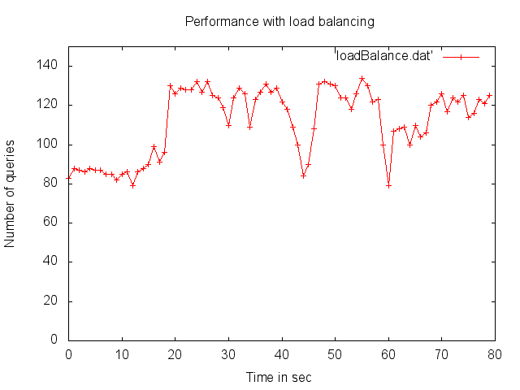
Evaluation – Load Balancing

Slide 17
Evaluation – Load Balancing
Rebalance

Slide 18
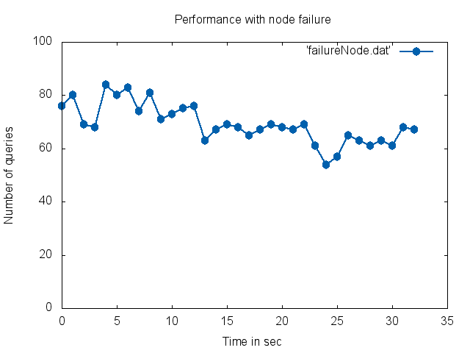
Evaluation – Node Failure

Slide 19
Evaluation – Node Failure
Server 1 fail
Server 2 fail

Slide 20
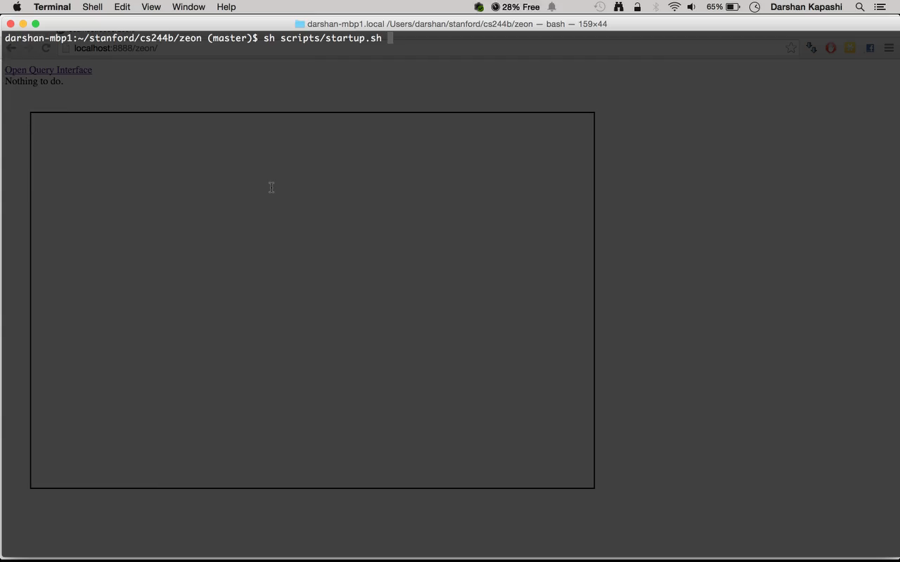
Demo

Slide 21
References
Sanjay Ghemawat, Howard Gobioff, and Shun-Tak Leung. The Google File System.
Giuseppe DeCandia et. al. Dynamo: Amazon’s Highly Available Key-value Store.
Sylvia Ratnasamy et al. A Scalable Content-Addressable Network
Thank you ☺

