Slide 1
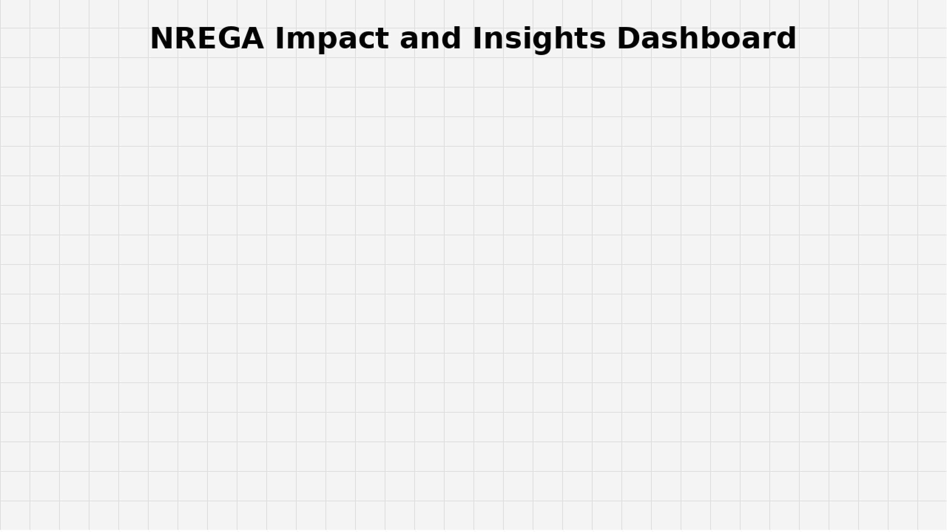
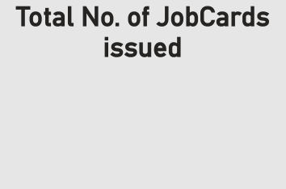
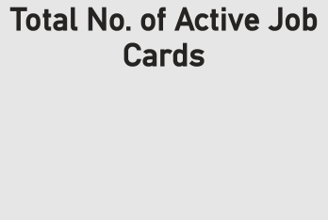
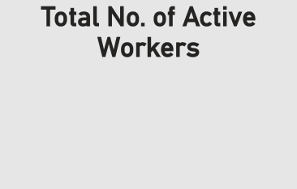

269M
Power BI Desktop
23K
156M 97M
175M
Total No. of Active Job Cards and Total No. of JobCards issued by state_name
Sum of Total No. of Active Job Cards Sum of Total No. of JobCards issued
20M
15M
10M
5M
0M
state_name
Sum of Total No. of Active Job Cards an…
BIHAR
ODISHA
ASSAM
KERALA
GUJARAT
PUNJAB
TRIPURA
HARYANA
MANIPUR
MIZORAM
SIKKIM
LADAKH
GOA
RAJASTHAN
KARNATAKA
TELANGANA
MEGHALAYA
NAGALAND
WEST BENGAL
TAMIL NADU
JHARKHAND
UTTARAKHAND
PUDUCHERRY
LAKSHADWEEP
UTTAR PRADESH
ANDHRA PRADESH
MAHARASHTRA
CHHATTISGARH
MADHYA PRADESH
HIMACHAL PRADESH
ARUNACHAL PRADESH
DN HAVELI AND DD
JAMMU AND KASHMIR
ANDAMAN AND NICOBAR

Slide 2


Power BI Desktop
Sum of Persondays of Ce…
Sum of SC persondays
Sum of ST persondays
Sum of Total No of …
Sum of Total No. …
Sum of Wome…
TAMIL NADU ANDHRA PRADESH UTTAR PRADESH
RAJASTHAN
BIHAR ODISHA
MADHYA PRADESH
KARNATAKA TELANGANA CHHATTISGARH
^{4M} 13M
67M
240M
0M
20M
46M
119M
198M
2M
24M
34M
49M
80M
186M
0M
51M
176M
2M
21M
64M
92M
92M
119M
0M
13M
31M _{45M}
_{0M} 12M
28M_{39M}
80M
79M
0M
13M
42M
0M
17M
49M
6M
22M _{35M}
65M
state_name
JHARKHAND ^{5M}14M _{27M}
57M
ASSAM MAHARASHTRA
KERALA GUJARAT TRIPURA PUNJAB NAGALAND
HIMACHAL PRADESH
MEGHALAYA MIZORAM UTTARAKHAND
JAMMU AND KASHMIR
^{3M} 12M _{25M}
43M
39M
51M
4M
20M
7M
_{2M 13M} 28M
3M
20M
17M
0M
15M
0M
_{1M} 10M
_{0M}9M
_{0M}8M
8M
6M
2M
0M
50M
100M
150M
200M
250M
300M
Sum of Persondays of Central Liability so far, Sum of SC persondays, Sum of ST persondays, Sum of Total …

Slide 3
Power BI Desktop
Sum of Wages(Rs. In Lakhs) by Approved Labour Budget
70K
Sum of Material and skille… Sum of Total Adm Expe… Sum of Total Exp(Rs. … Sum of Wages(…
UTTAR PRADESH ANDHRA PRADESH
BIHAR MADHYA PRADESH
TELANGANA TAMIL NADU KARNATAKA CHHATTISGARH
GUJARAT MAHARASHTRA JHARKHAND
ODISHA MEGHALAYA RAJASTHAN
HIMACHAL PRADESH
NAGALAND
PUNJAB ASSAM
JAMMU AND KASHMIR
TRIPURA UTTARAKHAND
KERALA MANIPUR MIZORAM
ARUNACHAL PRADESH
HARYANA
0.23M
0.17M
0.67M
0.68M
0.43M
0.49M
1.34M
1.36M
0.43M
0.33M
0.28M
0.29M
0.66M
0.86M
0.20M
60K
0.73M
0.24M
0.41M
0.55M
0.31M
0.20M
0.22M
0.61M
1.45M
0.61M
50K
0.16M
0.33M
Sum of Wages(Rs. In Lakhs)
0.19M 0.15M
0.38M
40K
state_name
0.27M 0.23M
0.10M
0.40M
0.10M
0.10M
0.13M
0.27M
0.06M
0.11M
0.06M
0.29M
0.04M
0.07M
0.03M
0.05M
0.53M
0.37M
0.80M
30K
20K
10K
0.0M 0.5M 1.0M 1.5M
Sum of Material and skilled Wages(Rs. In Lakhs), Sum of Total A…
0K
0M
5M
10M
Approved Labour Budget
15M
20M

Slide 4
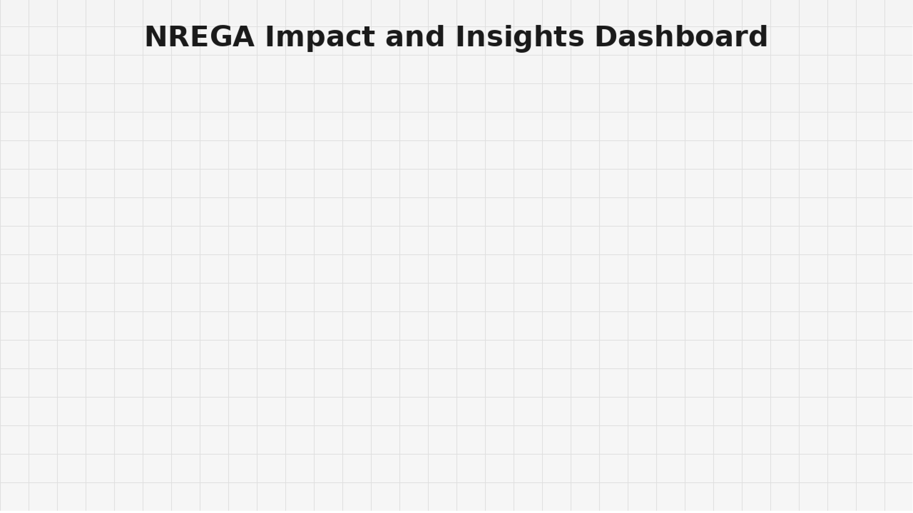
Power BI Desktop
Sum of Number of Completed Works by state_name
MADHYA PRADESH
JHARKHAND KARNATAKA
BIHAR UTTAR PRADESH TAMIL NADU
ASSAM ANDHRA PRADESH
RAJASTHAN MAHARASHTRA CHHATTISGARH
KERALA ODISHA TELANGANA
TRIPURA GUJARAT
JAMMU AND KASHMIR HIMACHAL PRADESH
PUNJAB UTTARAKHAND WEST BENGAL
LADAKH
0.0M
19.55K (40.63%)
Sum of % of Exp… Sum of % of NR…
28.56K (59.37%)
state_name
0.1M
0.2M 0.3M
Sum of Number of Completed Works
0.4M

Slide 5


