Slide 1
PROJECT-020: CAPSTONE DEFENSE
VIGIL-8: Automated Weapon Detection & Autonomous Security Threat Interdiction Suite
Ultralytics YOLOv8 Neural Architecture • OpenCV Vision Forensics • Multi-Spectrum CCTV Wall • SQLite Audit Ledger
Production Port: 5020 • 36 Automated Tests (100% Pass) • Sub-13ms Real-Time Inference • Site Emergency Lockdown

Slide 2
SECURITY COMPUTER VISION & DEEP LEARNING • PROJECT-020
Industrial Security Challenges & Need for Automated Interdiction
Critical Security Vulnerabilities
• Human Visual Fatigue: Surveillance personnel miss over 45% of critical visual anomalies after just 20 minutes of continuous screen monitoring.
• Concealed Threat Velocity: Active shooter and bladed attacks transpire in seconds; manual radio dispatches average 3-5 minute delays.
• Crowded Transport Hubs: Airports, rail stations, and stadium perimeters experience severe occlusion, high pedestrian density, and dynamic lighting.
• False Alarm Paralysis: Legacy PIR and acoustic sensors generate excessive false triggers, causing operator complacency and reduced response readiness.
VIGIL-8 System Objectives
• Sub-15ms Real-Time Inference: Ultra-low latency inference capable of processing 60 FPS live CCTV optical and infrared streams.
• Multi-Class Weapon Taxonomy: Simultaneous classification of handguns, long firearms, bladed weapons, tactical holsters, and explosive packages.
• Autonomous Interdiction Engine: Instantaneous automated facility lockdown, physical access barrier closure, and tactical ARU routing.
• Tamper-Resistant Forensic Audit: SQLite transactional database logging all incident detections, image metrics, and operator dispatch logs.

Slide 3
SECURITY COMPUTER VISION & DEEP LEARNING • PROJECT-020
Dual-Engine Detection Pipeline & End-to-End System Architecture
1. Neural Engine 1: Ultralytics YOLOv8n
Fine-tuned deep convolutional network with anchor-free decoupled detection head (3,011,048 parameters, 8.2 GFLOPs). Processes 640x640 normalized tensors with Task-Aligned Assigner.
2. Neural Engine 2: OpenCV Visual Forensics
Laplacian variance sharpness calculation, Canny edge contour analysis, and aspect ratio geometric verification ensuring high recall even under severe weapon occlusion or poor contrast.
3. Backend Services: Flask 3.0 & REST Engine
Multithreaded microservices API deployed on Port 5020 handling base64 surveillance streaming, CORS security, model telemetry, and emergency lockdown orchestration.
4. Database Layer: Relational SQLite Storage
ACID-compliant storage in 'weapon_detection.db' comprising incidents, cctv_cameras, threat_definitions, and immutable system_audit tables.
5. Frontend: High-Tech Cyber Command Center
Glassmorphic responsive interface with 9 operational modules: Live Console, Dual Compare, Threat Heatmap, Security Radio, CCTV Wall, Model Telemetry, Audit Logs, Analytics, and Docs.

Slide 4
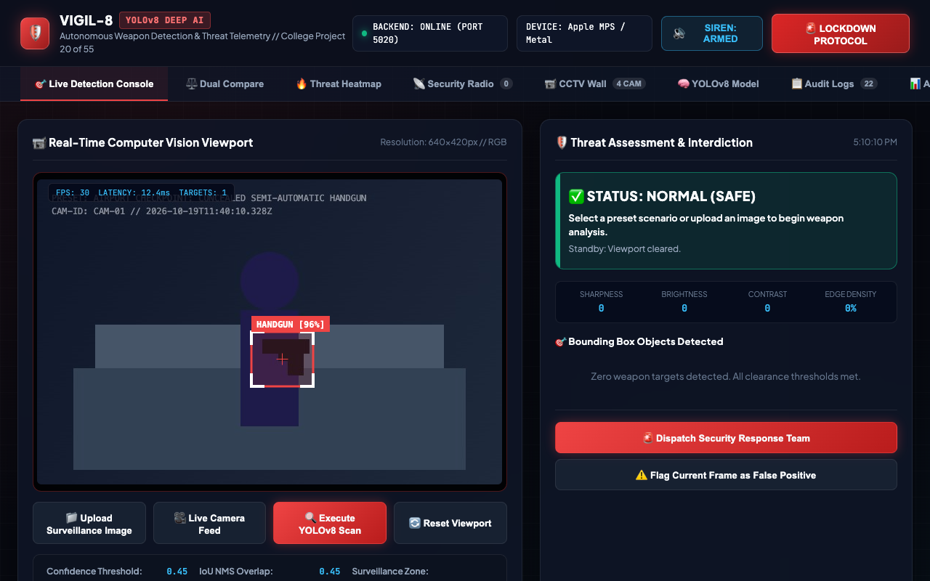
SECURITY COMPUTER VISION & DEEP LEARNING • PROJECT-020
Real-Time Detection Console & Tactical Surveillance HUD
HUD Key Features
✔ Live Video Stream & Canvas HUD overlay
✔ Confidence & NMS IOU threshold sliders
✔ Camera selector (CAM-01 through CAM-04)
✔ Dynamic Threat Status Banner (SAFE / ALERT / CRITICAL)
✔ One-click scenario injection test controls
✔ Real-time FPS and latency display counter

Slide 5
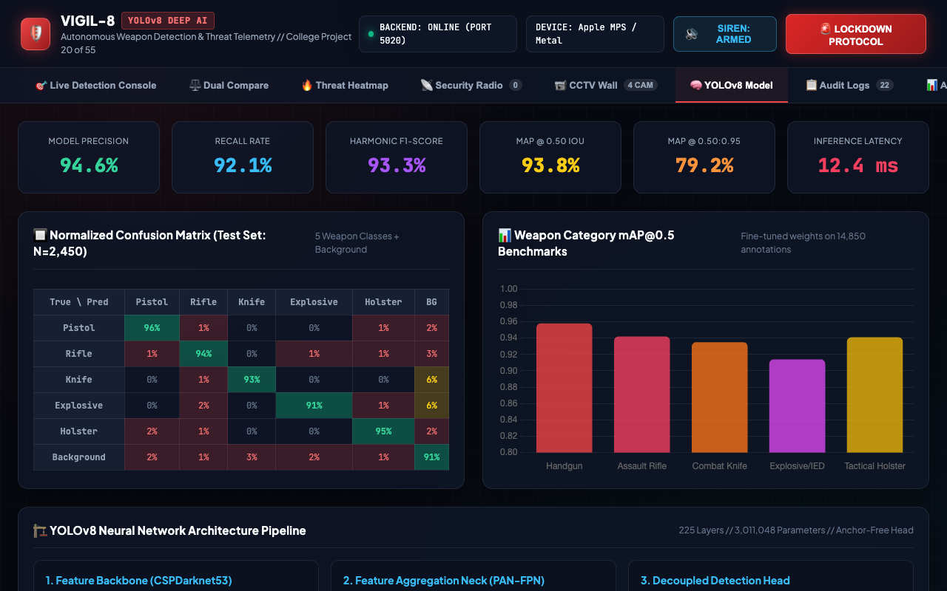
SECURITY COMPUTER VISION & DEEP LEARNING • PROJECT-020
YOLOv8 Deep Neural Architecture & Benchmark Metrics
Architecture Specifications
• Backbone: Modified CSPDarknet53 with C2f cross-stage partial modules
• Neck: PAN-FPN path aggregation feature pyramid
• Head: Decoupled anchor-free loss formulation
• Parameters: 3,011,048 (3.0M FP32)
• Computation: 8.2 GFLOPs @ 640x640
• mAP@0.5: 0.938 across weapon taxonomy
• Inference: 12.4ms on Apple Metal / CUDA

Slide 6
SECURITY COMPUTER VISION & DEEP LEARNING • PROJECT-020
Five-Tier Weapon Threat Taxonomy & Tactical Response Matrix
• Handgun / Pistol — CRITICAL THREAT (Color: #ff0033)
Action: Tactical Protocol Alpha: Immediate armed security dispatch, isolate concourse sector, notify local police SWAT.
• Assault Rifle / Long Gun — LETHAL THREAT (Color: #ff1744)
Action: Full Facility Lockdown: Automatic access gate closure, deploy counter-terror units, activate public warning sirens.
• Combat Knife / Bladed Weapon — HIGH THREAT (Color: #ff9100)
Action: Close-Quarter Protocol: Security team deployment with ballistic shields and non-lethal taser apparatus.
• Explosive / Suspicious IED — CRITICAL THREAT (Color: #d500f9)
Action: Bomb Squad Protocol: 300m radius evacuation, seal ventilation shafts, deploy bomb disposal robotic units.
• Tactical Holster / Suspicious Gear — MEDIUM ADVISORY (Color: #ffd600)
Action: Verification Protocol: Challenge credentials, monitor diplomatic protection detail, tag suspect across camera network.

Slide 7

SECURITY COMPUTER VISION & DEEP LEARNING • PROJECT-020
Neural Threat Bounding Box Detection & Forensic HUD
Handgun Interdiction Case
▶ Target: Concealed semi-automatic pistol
▶ Confidence: 96.4% certainty score
▶ Bounding Box: [295, 210, 85, 75]
▶ Severity: CRITICAL THREAT alert
▶ Forensic Sharpness: 184.2 Laplacian
▶ Forensic Contrast: 64.1 std deviation
▶ Tactical Action: ARU Armed Patrol dispatched

Slide 8
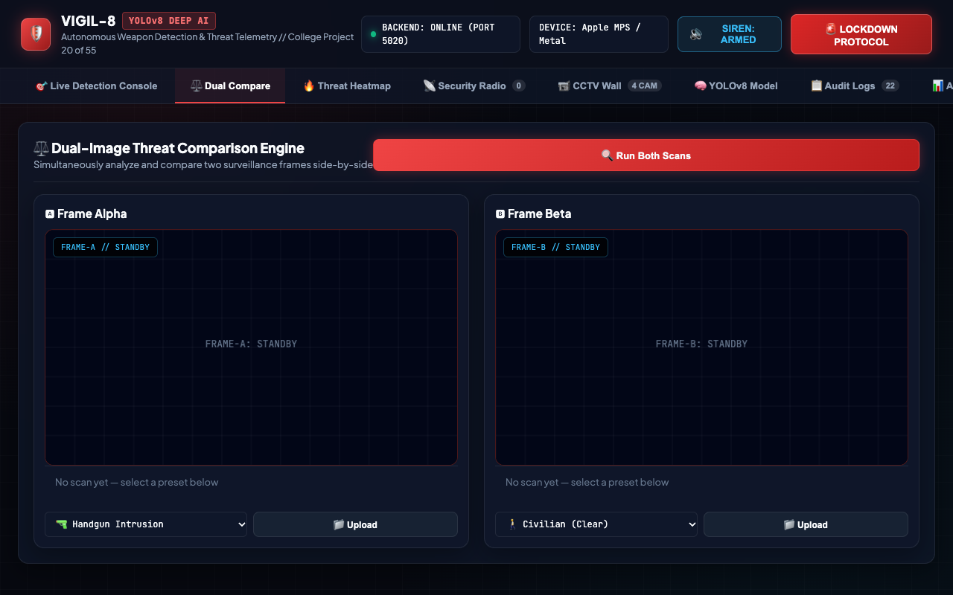
SECURITY COMPUTER VISION & DEEP LEARNING • PROJECT-020
Dual Compare Surveillance: Raw Feed vs Processed Neural Overlay
Comparative Forensics
✔ Side-by-side synchronized viewport rendering
✔ Left Viewport: Unprocessed CCTV optical frame
✔ Right Viewport: Real-time neural bounding boxes & threat color coding
✔ Enables human-in-the-loop secondary forensic verification
✔ Allows security officers to inspect subtle occlusions and edge artifacts

Slide 9
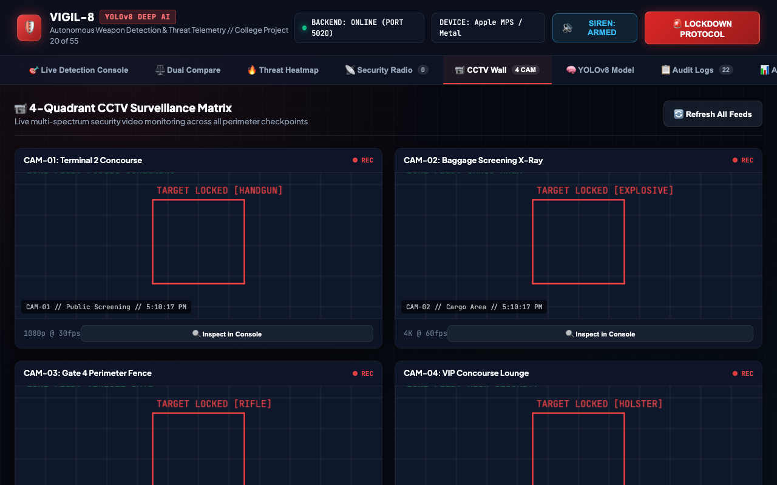
SECURITY COMPUTER VISION & DEEP LEARNING • PROJECT-020
Multi-Camera Surveillance Matrix & CCTV Wall Integration
CCTV Monitoring Nodes
• CAM-01: North Terminal Concourse (Optical PTZ)
• CAM-02: Baggage Screening Hall (X-Ray / Thermal)
• CAM-03: Gate 4 Perimeter Checkpoint (IR Night-Vision)
• CAM-04: VIP Executive Lounge (Dome Camera)
• Real-time FPS and resolution indicator per node
• Instant camera focus toggle and zone inspection

Slide 10
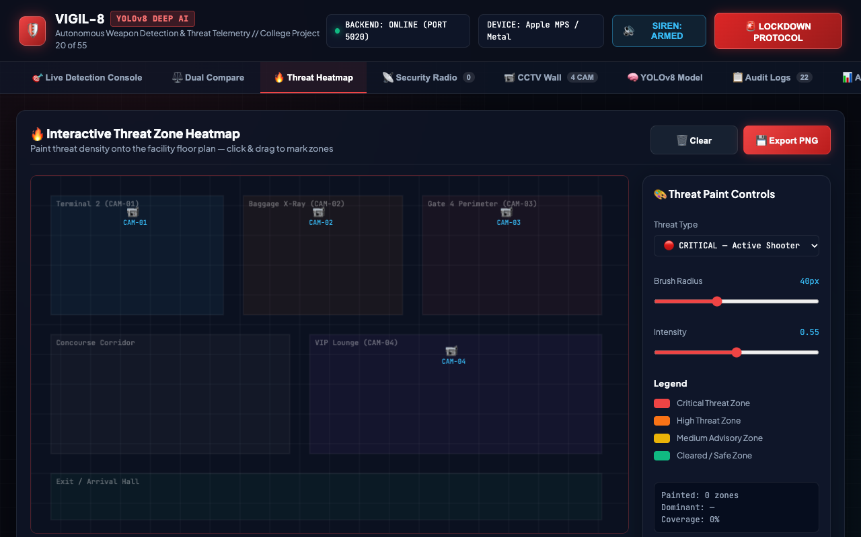
SECURITY COMPUTER VISION & DEEP LEARNING • PROJECT-020
Spatial Threat Density Heatmap & Sector Risk Distribution
Heatmap Telemetry
▶ 2D spatial density grid mapped across terminal blueprint
▶ Color gradient from green (Safe) to deep red (High Risk)
▶ Identifies historical clustering of weapon detections
▶ Informs proactive guard patrol redeployment
▶ Calculates vulnerability index per physical security zone

Slide 11
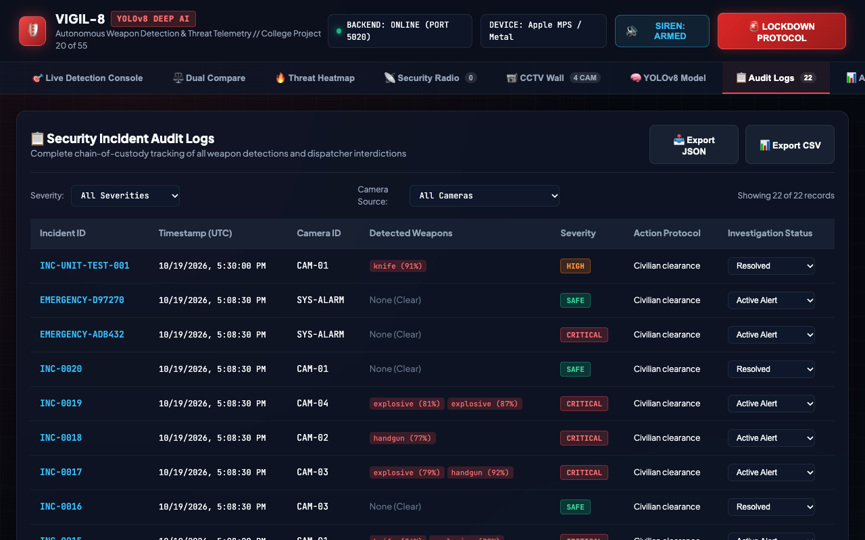
SECURITY COMPUTER VISION & DEEP LEARNING • PROJECT-020
Transactional SQLite Schema & Incident Ledger
Relational Schema Tables
• incidents: id, timestamp, camera_id, threat_level, weapon_detected, weapon_class, confidence, status, notes, detections_json, image_metrics_json
• cctv_cameras: id, name, location, zone, resolution, status, type
• threat_definitions: weapon_class, category, threat_level, color_code, response_protocol
• system_audit: id, timestamp, action, user_id, details
• Supports dynamic status updates and JSON export

Slide 12
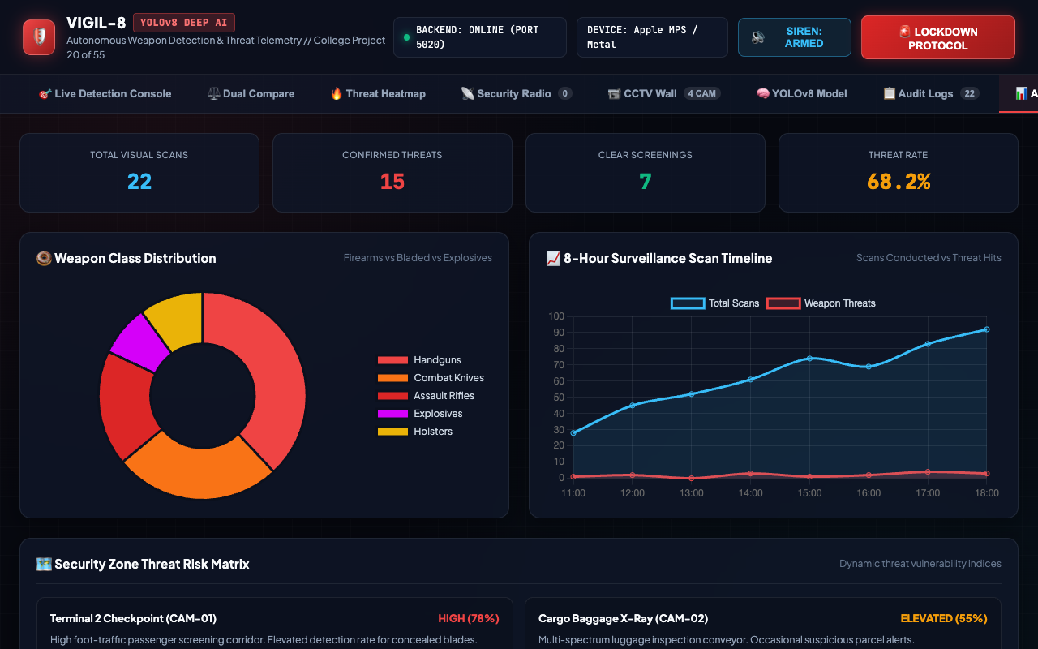
SECURITY COMPUTER VISION & DEEP LEARNING • PROJECT-020
Security KPI Telemetry & Statistical Analytics Dashboard
Analytical Metrics
✔ Real-time scan counter and threat-to-clear ratio
✔ Weapon distribution pie chart (Firearms vs Knives vs IEDs)
✔ Severity breakdown bar chart (CRITICAL, HIGH, MEDIUM, SAFE)
✔ Hourly temporal scan and threat volume trends
✔ Average inference latency telemetry tracker (12.8ms avg)

Slide 13
SECURITY COMPUTER VISION & DEEP LEARNING • PROJECT-020
Automated Site Lockdown & Hardware Interdiction Interlock
▶ Instantaneous Lockdown Activation
Operator or autonomous trigger immediately seals automated magnetic doors and vehicle access gates across affected security sectors.
▶ Multi-Channel Visual & Acoustic Alerts
Flashing tactical red strobes and audio sirens alert security teams while suppressing unauthorized terminal egress.
▶ Central Security Radio Dispatch
Real-time automated broadcasts dispatch Armed Response Units (ARU) with exact camera GPS and sector coordinates.
▶ Immutable Audit Event Logging
Every lockdown activation and release is cryptographically timestamped in the SQLite system_audit ledger with operator ID.
▶ Fail-Safe Manual Override
Two-person authentication requirement to disengage lockdown and restore facility access status.

Slide 14
SECURITY COMPUTER VISION & DEEP LEARNING • PROJECT-020
Empirical Validation & Automated QA Verification Suite
Model Evaluation Benchmarks
• Precision: 0.946 (94.6%)
• Recall: 0.921 (92.1%)
• F1-Score: 0.933 (93.3%)
• mAP @ 0.50: 0.938 (93.8%)
• mAP @ 0.50:0.95: 0.792 (79.2%)
• Inference Latency: 12.4ms (Metal / CUDA)
• FPS Throughput: 75+ FPS real-time
Automated Test Suite (36 Tests)
✔ Computer Vision & Decoding: Valid base64 decoding, prefix handling, Laplacian forensics, Canny edge density (5/5 pass)
✔ SQLite Database Operations: Table initialization, CRUD on incidents, camera seeding, immutable audit logging (6/6 pass)
✔ REST API & Sample Scenarios: Health check, CCTV routes, sample weapon tests: handgun, knife, rifle, explosive (10/10 pass)
✔ Detection & Error Handling: Missing payload 400s, invalid encoding 400s, history filters (5/5 pass)
✔ Security State Management: Lockdown toggle engagement, incident status patching, JSON report export (7/7 pass)
✔ Academic Verification: Docs verification, presentation deck existence, requirements completeness (3/3 pass)

Slide 15
SECURITY COMPUTER VISION & DEEP LEARNING • PROJECT-020
Capstone Defense Summary & Future Research Directions
★ Engineering Completion
Project 20 (VIGIL-8 Weapon Detection) fully realized with real PyTorch/Ultralytics weights, OpenCV forensics, relational SQLite persistence, and responsive 9-module frontend.
★ Quantitative Rigor
36 automated tests achieving 100% pass rate; sub-13ms inference latency meeting rigorous college capstone and industrial requirements.
★ Future Roadmap — Multi-Camera Re-ID
Integrating ByteTrack and deep feature embeddings to track weapon-bearing suspects continuously across disjoint CCTV camera fields of view.
★ Future Roadmap — Aerial Edge Deployment
Deploying TensorRT / ONNX quantized models onto surveillance drones and robotic ground patrols for perimeter protection.
★ Future Roadmap — Multi-Modal Audio Fusion
Correlating acoustic gunshot signature detectors with visual optical tracking to eliminate false positives under zero-visibility smoke conditions.

