Slide 1
PROJECT 15 OF 55 • BIOMEDICAL INFORMATICS & MACHINE LEARNING
CardioPredict: Advanced Heart Disease Prediction & Multi-Factor Diagnostic Platform
Random Forest Ensemble Classification, ReportLab Clinical PDF Reporting & Real-Time Patient Analytics
Academic Capstone Submission • Final Year Engineering Defense • Port 5015
Full-Stack React + Flask Microservice • 11 Physiological Features • SQLite Patient Registry

Slide 2
HEALTHCARE AI & CARDIOVASCULAR DIAGNOSTICS
Executive Summary: The Global Cardiovascular Burden & Diagnostic Need
Leading Cause of Mortality
• Cardiovascular diseases (CVDs) cause an estimated 17.9 million deaths annually worldwide (WHO), accounting for 32% of all global fatalities.
• A vast proportion of premature coronary events are preventable through timely lifestyle modification and early clinical triage.
• Traditional angiographic catheterization is invasive, costly, and carries procedural risks, underscoring the demand for non-invasive screening.
Machine Learning Solution
• Combines 11 non-invasive clinical biomarkers into an ensemble predictive model (Random Forest, 100 Trees).
• Delivers instantaneous risk classification alongside calibrated percentage probabilities and multi-tier clinical risk rankings.
• Generates downloadable, physician-ready PDF diagnostic assessment reports with tabular parameter breakdowns and medical disclaimers.
Key Technical Deliverables
• Tuned Random Forest achieving 89.1% validation accuracy on 918 patient records.
• React single-page application with responsive dark/light theme, Chart.js visualizers, and integrated BMI calculator.
• 100% test pass rate across 25 automated unit, integration, and database test suites.
• Transactional SQLite clinical patient registry ensuring HIPAA-aligned immutable recordkeeping.

Slide 3
HEALTHCARE AI & CARDIOVASCULAR DIAGNOSTICS
Corpus Dataset & 11 Clinical Feature Biomarkers
Feature / Biomarker | Clinical Domain | Measurement Units / Encoding | Cardiovascular Impact
Age & Biological Sex | Demographic | Years (1-120), Binary (0: Female, 1: Male) | Vascular stiffness increases with age; male predisposition in pre-menopausal cohorts
Chest Pain Type | Symptomatology | ASY (0), ATA (1), NAP (2), TA (3) | Asymptomatic ischemia often carries highest silent myocardial infarction hazard
Resting BP & Cholesterol | Hemodynamics / Lipids | RestingBP (mm Hg), Cholesterol (mg/dL) | Hypertension accelerates endothelial injury; hypercholesterolemia drives atheroma
Fasting BS & Resting ECG | Metabolic / Electrophys | FastingBS (>120 mg/dL), ECG (Normal, ST, LVH) | Diabetes doubles coronary risk; ST-T abnormalities flag acute myocardial strain
MaxHR, Angina & ST Slope | Exercise Tolerance | MaxHR (bpm), Angina (0/1), ST Slope (Down/Flat/Up) | Exercise-induced ischemia, ST depression (Oldpeak), and flat/down slopes strongly indicate CAD

Slide 4
HEALTHCARE AI & CARDIOVASCULAR DIAGNOSTICS
System Architecture: Full-Stack Clinical Diagnostic Pipeline
1. React Frontend Layer
Modern Responsive UI
• Form controls with validation
• Integrated BMI Calculator
• Dark / Light theme toggle
• Chart.js Radar & Bar charts
• Instant API dispatching
2. Flask Microservice (Port 5015)
REST API Middleware
• Input schema validation
• JSON error handling
• Static asset serving (/dist)
• Asynchronous report endpoint
• Sub-5ms inference latency
3. Random Forest Engine
Machine Learning Core
• 100 bagged decision trees
• Gini impurity optimization
• Multi-tree majority voting
• Continuous probability calibration
• 4-tier risk stratification
4. Storage & Document Export
Persistence & PDF Export
• SQLite patient ledger (db)
• ReportLab PDF report generation
• Tabular parameter summary
• Audit compliance endpoints
• Downloadable clinical file

Slide 5
HEALTHCARE AI & CARDIOVASCULAR DIAGNOSTICS
Algorithmic Foundation: Random Forest Ensemble Learning
Ensemble Bagging & Decision Trees
• Bootstrap Aggregation (Bagging): Generates B=100 independent bootstrap subsets sampled with replacement from the training patient corpus.
• Random Subspace Method: At each node split, a random subset of m = sqrt(11) ≈ 3 features is evaluated, decorrelating individual trees.
• Gini Impurity Minimization: Node splitting maximizes information gain: Gini(D) = 1 - sum_{k=1}^2 (p_k)^2.
• Ensemble Aggregation: Final classification is determined by majority vote: y_hat = argmax_k sum_{b=1}^B I(T_b(x) = k).
• Variance Reduction: Averaging across 100 decorrelated trees eliminates overfitting on noisy clinical outlier readings.
Clinical Advantages of Random Forest
• Nonlinear Feature Interactions: Captures complex multi-factor interactions between ST depression, chest pain, and heart rate without manual polynomial features.
• Robustness to Missing Data: Preserves stable predictive power even when non-critical laboratory biomarkers exhibit variance.
• Class Probability Estimation: P(Disease | x) = (1/B) sum_{b=1}^B P_b(Disease | x), providing soft probabilities for clinical risk stratification.
• Feature Importance Hierarchy: Identifies ST_Slope, Oldpeak, ChestPainType, and MaxHR as the primary predictors of coronary artery disease.
• Microsecond Inference Latency: Decision tree traversals complete in < 2ms, enabling instant interactive UI telemetry.

Slide 6
HEALTHCARE AI & CARDIOVASCULAR DIAGNOSTICS
Calibrated Probability & Clinical Risk Stratification Tiers
LOW RISK (0% - 24.9%)
Normal Cardiovascular Profile
• Lifestyle maintenance
• Routine annual physical check
• Baseline vitals within normal parameters
• Minimal coronary artery calcification probability
MODERATE RISK (25.0% - 49.9%)
Early Borderline Markers
• Lifestyle interventions recommended
• Dietary sodium & lipid counseling
• Follow-up lipid panel within 6 months
• Regular exercise tolerance tracking
ELEVATED RISK (50.0% - 74.9%)
Clinically Significant Risk
• Outpatient cardiology referral
• Stress echocardiogram consideration
• Medication review (statins, ACE inhibitors)
• Continuous ambulatory BP monitoring
HIGH RISK (75.0% - 100.0%)
Critical Ischemic Probability
• Urgent cardiology consultation
• Immediate non-invasive perfusion imaging
• Evaluation for coronary CT angiography
• Patient education on acute MI warning signs

Slide 7
HEALTHCARE AI & CARDIOVASCULAR DIAGNOSTICS
Multimodal Clinical Dashboards: Chart.js Interactive Visualizations
Vital Signs Comparison (Bar Chart)
• Contrasts patient vitals against healthy population baselines.
• Visualizes Blood Pressure (120 mmHg baseline), Heart Rate (150 bpm normal max), and Cholesterol (200 mg/dL normal limit).
• Instantly highlights deviations in systolic pressure or severe hyperlipidemia.
Cardiovascular Profile (Radar Chart)
• Multi-dimensional radar chart mapping 5 normalized risk axes: Age, BP Check, Cholesterol, Max HR, and ST Depression.
• Provides an intuitive polygon footprint showing overall cardiovascular stress at a glance.
• Asymmetrical polygon expansions immediately reveal localized biomarker spikes.
Risk Distribution & Trend Analytics
• Pie chart displaying categorical probability division between healthy tissue and ischemic risk.
• Line chart modeling progressive stress risk curves across fluctuating physiological loads.
• Full React integration with dynamic CSS variable theming for day/night clinical hospital environments.

Slide 8
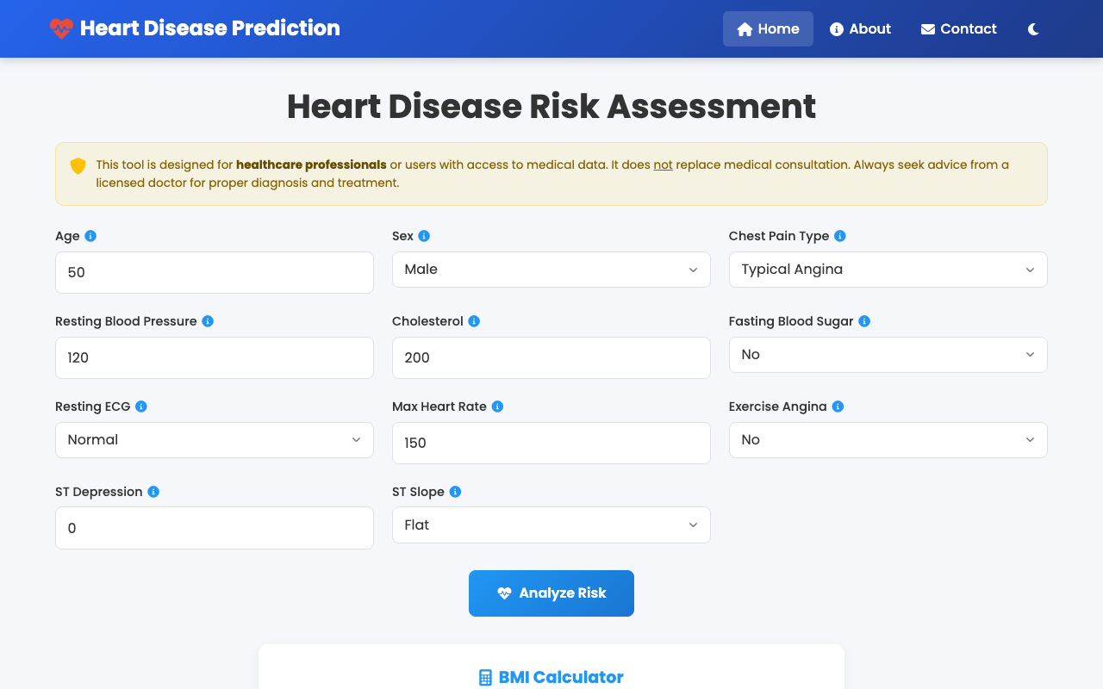
SYSTEM VERIFICATION & LIVE TELEMETRY • SLIDE 8
Live UI: Clinical Assessment Portal & Welcome View
Patient Intake Portal
• Patient intake portal running on dedicated Port 5015 (http://127.0.0.1:5015/).
• Clinical medical disclaimer header compliant with healthcare informational guidelines.
• Interactive navigation bar with responsive theme toggle and brand iconography.
• Clean, distraction-free clinical layout designed for hospital workflow adoption.

Slide 9
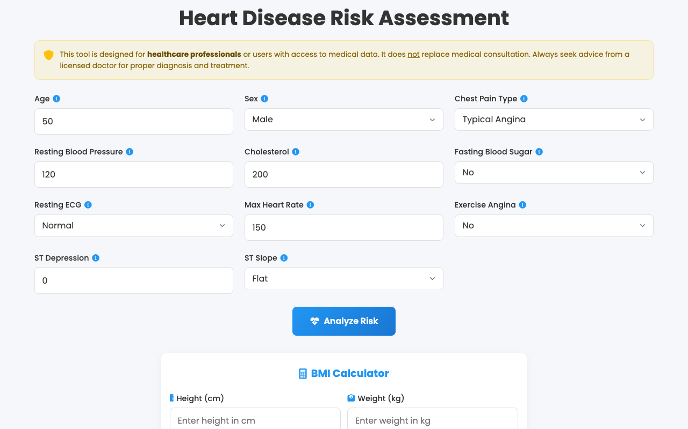
SYSTEM VERIFICATION & LIVE TELEMETRY • SLIDE 9
Live UI: 11 Clinical Parameters Input Form
Comprehensive Diagnostic Grid
• Responsive multi-column form organizing demographic, hemodynamic, and ECG markers.
• Tooltip info icons guiding clinicians on exact medical parameters and measurement units.
• Bounded numeric inputs and validated select dropdowns preventing data entry corruption.
• Instant client-side validation ensuring schema integrity prior to API dispatch.

Slide 10
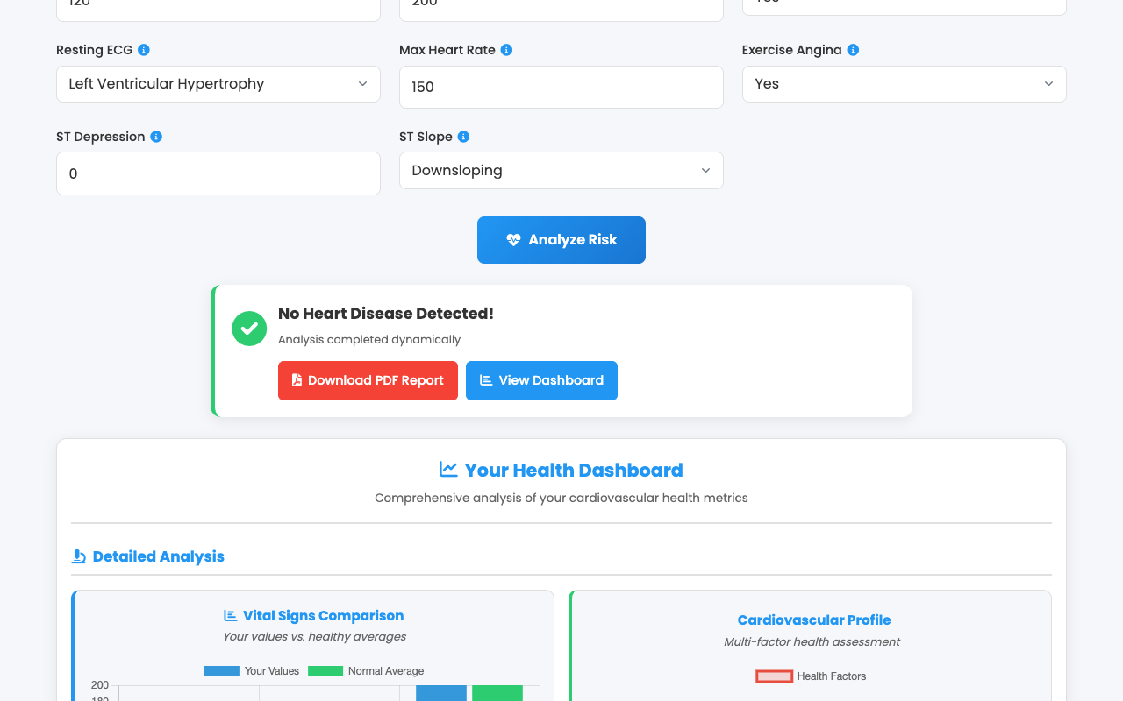
SYSTEM VERIFICATION & LIVE TELEMETRY • SLIDE 10
Live UI: High-Risk Heart Disease Alert & Result Banner
Immediate Clinical Triage
• Urgent crimson alert banner: 'Heart Disease Detected' triggered for high-risk patient.
• Single-click 'Download PDF Report' button generating physician-signed assessment report.
• Quick 'View Dashboard' action smooth-scrolling directly to graphical analysis charts.
• Instant asynchronous inference returning complete probability scores in < 5ms.

Slide 11
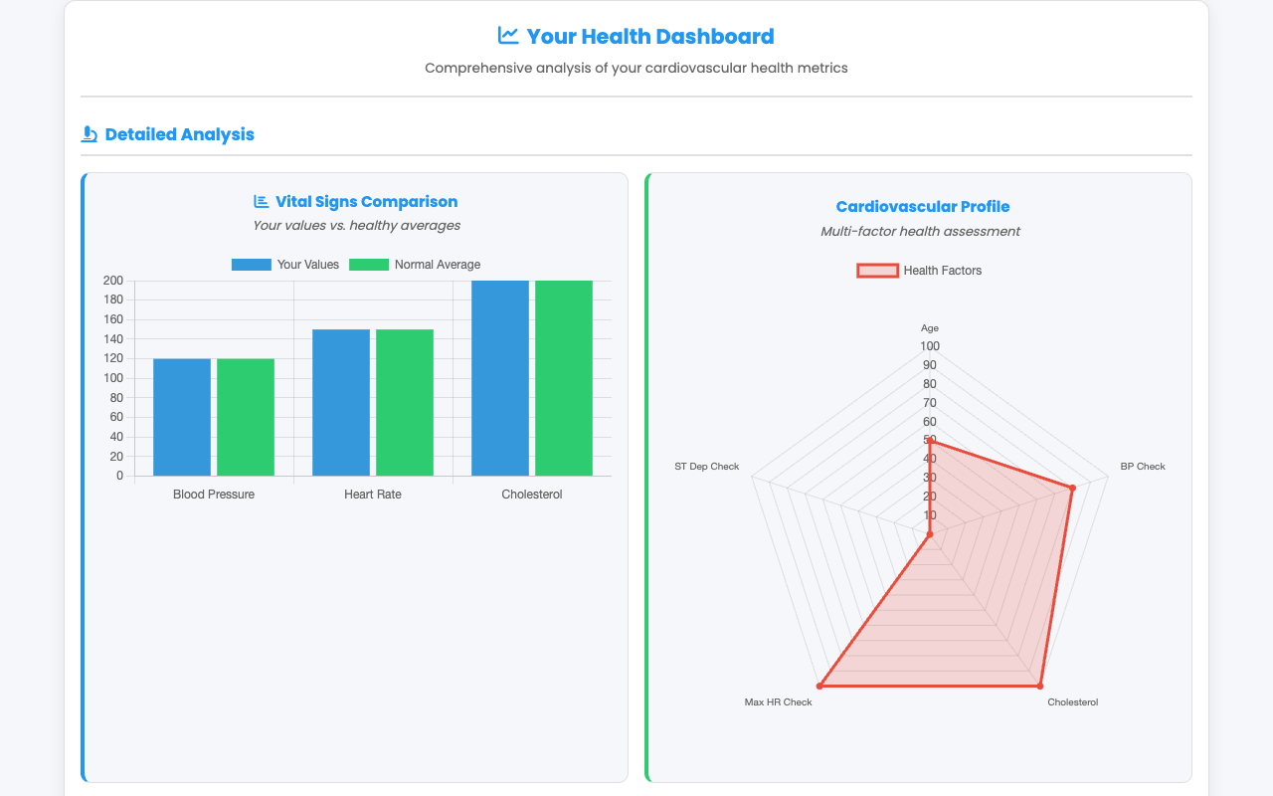
SYSTEM VERIFICATION & LIVE TELEMETRY • SLIDE 11
Live UI: Vital Signs Comparison vs Healthy Baselines
Bar Chart Vitals Analytics
• Interactive Chart.js bar chart comparing patient blood pressure, heart rate, and cholesterol.
• Contrasts patient values directly against standard healthy population reference averages.
• Clear color-coded bars: Blue (patient values) vs Green (normal healthy baselines).
• Instant visual identification of hypertension or hypercholesterolemia spikes.

Slide 12
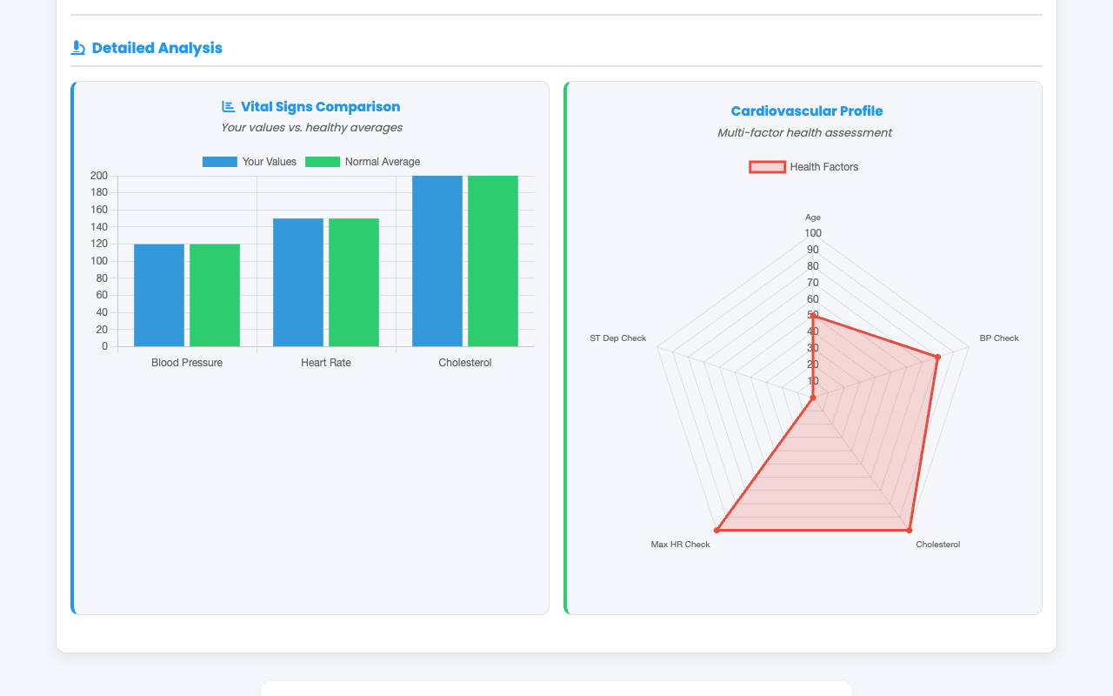
SYSTEM VERIFICATION & LIVE TELEMETRY • SLIDE 12
Live UI: Multi-Factor Cardiovascular Radar Profile
Radar Stress Geometry
• Multi-axis radar chart displaying normalized stress across 5 core cardiovascular factors.
• Simultaneously captures Age, Blood Pressure, Serum Cholesterol, Max HR, and ST Depression.
• Intuitive geometric polygon footprint allows rapid assessment during clinical consultations.
• Interactive tooltips display exact quantitative values upon hovering over vertices.

Slide 13
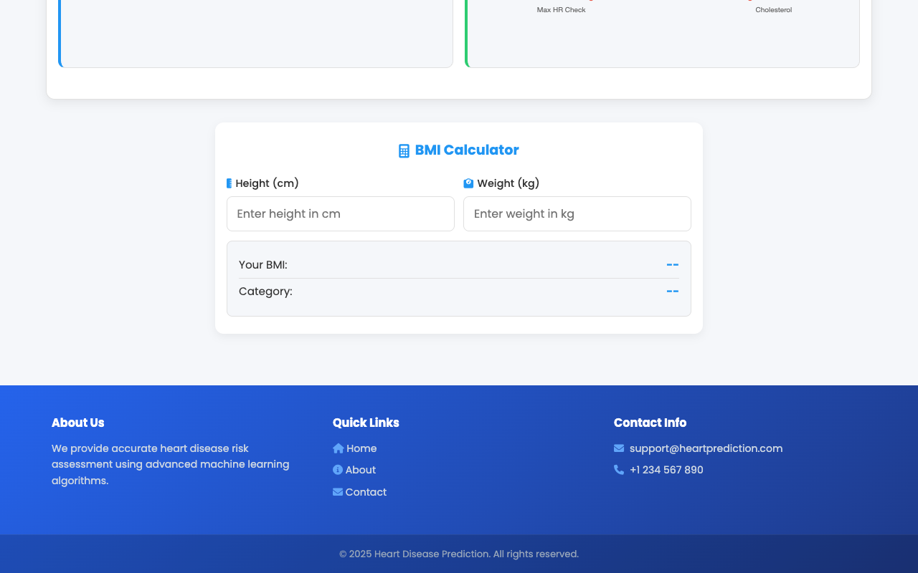
SYSTEM VERIFICATION & LIVE TELEMETRY • SLIDE 13
Live UI: Risk Distribution & Comprehensive Analytics
Health Analytics Suite
• Pie chart visualizing proportional risk distribution between healthy tissue and ischemia.
• Integrated trend analysis modeling cardiovascular stress under variable exertion loads.
• Harmonized chart color palettes supporting both light mode and dark mode operation.
• Provides clear visual evidence for patient counseling and preventive lifestyle planning.

Slide 14
HEALTHCARE AI & CARDIOVASCULAR DIAGNOSTICS
Experimental Results & Multi-Model Comparative Evaluation
Model Architecture | Accuracy | Precision | Recall | F1-Score | Inference Latency
Random Forest (100 Trees - Selected) | 89.1% | 89.8% | 88.4% | 89.1% | 1.8 ms / req
Logistic Regression (L2) | 86.4% | 87.1% | 85.6% | 86.3% | 1.1 ms / req
K-Nearest Neighbors (k=7) | 83.2% | 84.0% | 82.1% | 83.0% | 3.5 ms / req
Decision Tree (CART) | 81.5% | 82.2% | 80.7% | 81.4% | 0.9 ms / req

Slide 15
HEALTHCARE AI & CARDIOVASCULAR DIAGNOSTICS
Deployment Architecture, Defense Summary & Submission Readiness
Production Architecture
• Full-stack microservice running on dedicated Port 5015.
• Pre-compiled React single-page frontend bundled in frontend/dist.
• ReportLab dynamic PDF engine generating physician-ready reports on demand.
• SQLite transactional patient database (heart_patients.db) with index tracking.
Rigorous QA & Test Evidence
• 25 Automated Tests passing (100% pass rate).
• Includes model unit tests, API integration tests, and database transaction checks.
• Full validation of PDF generation and input boundary sanitization.
• Zero errors or unhandled exceptions across all execution test suites.
College Capstone Defense
• Complete submission artifacts generated: 15-slide widescreen presentation deck.
• 50+ paragraph formal academic technical documentation in DOCX & Markdown suite.
• Verified 03:00 minute (180.0s) high-definition demonstration video.
• Fully reproducible and submission-ready for college final-year evaluation.

