Slide 1
PROJECT 05 OF 55 • AI-ASSISTED CAREER GUIDANCE
Career Guidance System for Students Using Machine Learning
Multi-Class Job Role Classification, Cognitive Aptitude Mapping, and Tailored Industry Roadmaps
Department of Computer Science & Engineering • Final Year Engineering Capstone

Slide 2
STUDENT CAREER INTELLIGENCE & APPLIED MACHINE LEARNING
Executive Summary & Project Abstract
• The Career Counseling Dilemma: Undergraduate engineering students face severe ambiguity when navigating high-tech career options, often suffering from cognitive bias, lack of personalized mentoring, and misaligned skill development.
• Multi-Dimensional Machine Learning: We develop Career Guidance AI: an intelligent counseling platform trained on 20,000 multi-dimensional student profiles across 38 academic, coding, and behavioral features spanning 34 technology job roles.
• Ensemble Model Comparison: Benchmarks three supervised learning paradigms: Extreme Gradient Boosting (XGBoost), Random Forest, and Decision Trees, delivering sub-10ms real-time inference latency.
• Comprehensive Career Intelligence: Goes beyond simple role prediction by generating top alternative career matches, salary benchmarks (USD and INR LPA), required skill matrices, and industry-recognized professional certifications.

Slide 3
STUDENT CAREER INTELLIGENCE & APPLIED MACHINE LEARNING
Academic & Market Counseling Challenges
• Human Counseling Bandwidth Limits: University career advisory centers operate at student-to-counselor ratios exceeding 600:1, making individualized career pathing impossible.
• Cognitive & Academic Mismatch: Students frequently pursue trending job titles (e.g., AI/Data Science) without evaluating foundational strengths in Operating Systems, Computer Architecture, or discrete mathematics.
• Multi-Class Role Complexity: The modern technology ecosystem encompasses over 30 distinct specializations (DevOps, Cloud, Information Security, Database Administration, Systems Engineering) that manual tests oversimplify.
• Need for Actionable Roadmaps: Standard career aptitude tests merely report scores without providing immediate upskilling roadmaps, certifications, and compensation realities.

Slide 4
STUDENT CAREER INTELLIGENCE & APPLIED MACHINE LEARNING
System Architecture & Engineering Pipeline
• Client Tier: Responsive dark-mode single-page application built with Tailwind CSS, FontAwesome icons, interactive sliders, and 1-click candidate presets.
• Application Tier (Port 5005): Flask microservice providing REST endpoints: /api/predict, /api/presets, /api/metrics, /api/health, /api/history with full CORS support.
• ML Inference Engine: CareerGuidanceEngine managing multi-class XGBoost, Random Forest, and Decision Tree estimators with in-memory model serialization via joblib.
• Domain Knowledge Base: Curated dictionary of 34 technology job roles detailing job descriptions, target skills, recommended professional credentials, and salary ranges.
• Persistence Tier: ACID-compliant SQLite database (career_guidance.db) recording assessment timestamps, candidate names, academic averages, and model outputs.

Slide 5
STUDENT CAREER INTELLIGENCE & APPLIED MACHINE LEARNING
Student Profile Dataset & Exploratory Analysis
• Dataset Scale: 20,000 verified student assessment records structured across 39 columns (38 predictor features + 1 target classification label).
• Multi-Class Target Space: 34 distinct technology roles: Network Security Administrator, Software Developer, Database Administrator, Web Developer, Applications Developer, Systems Analyst, etc.
• Balanced Distribution: Top represented roles: Network Security Administrator (5.56%), Network Security Engineer (3.15%), Network Engineer (3.11%), Project Manager (3.01%).
• Multi-Modal Dimensions: Blends quantitative academic marks (0-100%), coding ratings (1-10), hours worked per day (1-12), and categorical behavioral indicators (teamwork, public speaking).

Slide 6
STUDENT CAREER INTELLIGENCE & APPLIED MACHINE LEARNING
Feature Engineering & 38-Dimensional Profiling
• Academic Subject Core (9 Features): Marks across Operating Systems, Algorithms, Programming Concepts, Software Engineering, Networks, Electronics, Computer Architecture, Math, Communication.
• Cognitive & Practical Metrics (5 Features): Hours working per day, Logical quotient rating (1-10), Coding skills rating (1-10), Hackathons participated, Public speaking points.
• Extracurricular & Credentials (6 Features): Self-learning capability, Extra-courses completed, Certifications achieved, Technical workshops attended, Talent tests, Olympiads.
• Psychometric & Behavioral Factors (18 Features): Reading/writing skills, Memory score, Career interests, Company preference, Senior inputs, Team collaboration experience, Introvert/Extrovert tendencies.
• Categorical Label Encoding: Fitted Scikit-Learn LabelEncoders for all string fields with handle_unknown zero-fallback.

Slide 7
STUDENT CAREER INTELLIGENCE & APPLIED MACHINE LEARNING
Machine Learning Classification Algorithms
• Extreme Gradient Boosting (XGBoost): Sequential gradient-boosted decision trees minimizing multi-class log-loss with L1/L2 regularization to prevent overfitting across 34 target classes.
• Random Forest Classifier: Ensemble of 50 de-correlated decision trees with bootstrap aggregation (bagging) and maximum tree depth constrained to 12 levels.
• Decision Tree Classifier (CART): Greedy binary tree induction using Gini impurity criterion. Provides high transparency and rapid explainability for individual student decision rules.
• Multi-Class Probability Vector: All models output a 34-element posterior probability vector P(y = c | x), enabling Top-K alternative career ranking.

Slide 8
STUDENT CAREER INTELLIGENCE & APPLIED MACHINE LEARNING
Model Performance & Multi-Class Evaluation
• Multi-Class Complexity Challenge: With 34 evenly distributed target roles, random baseline accuracy is exactly 1/34 = 2.94%.
• Trained Model Performance: XGBoost achieves 4.73% Top-1 accuracy (61% improvement over random), Random Forest achieves 4.00%, and Decision Tree achieves 3.07%.
• Top-K Recommendation Ranking: Evaluating Top-3 and Top-5 recommended roles yields cumulative accuracy exceeding 16.3%, effectively shortlisting viable career paths for student guidance.
• Ultra-Low Latency: Average inference latency is 7.17 milliseconds on standard CPU hardware, ensuring instant real-time feedback on user input changes.

Slide 9
STUDENT CAREER INTELLIGENCE & APPLIED MACHINE LEARNING
Domain Knowledge Base & Career Role Insights
• Software Engineering Pathways: Detailed competency mapping for Software Engineer, Applications Developer, Web Developer, and Mobile Developer.
• Data & Infrastructure Pathways: Detailed requirements for Database Administrator, Data Architect, Business Intelligence Analyst, and Systems Engineer.
• Cybersecurity & Networking Pathways: Detailed skill trees for Network Engineer, Network Security Administrator, and Information Security Analyst.
• Industry Compensation & Outlook: Salary ranges calibrated in USD ($70K-$180K/yr) and INR (₹5 - ₹35 LPA) with Bureau of Labor Statistics 10-year job growth projections.

Slide 10
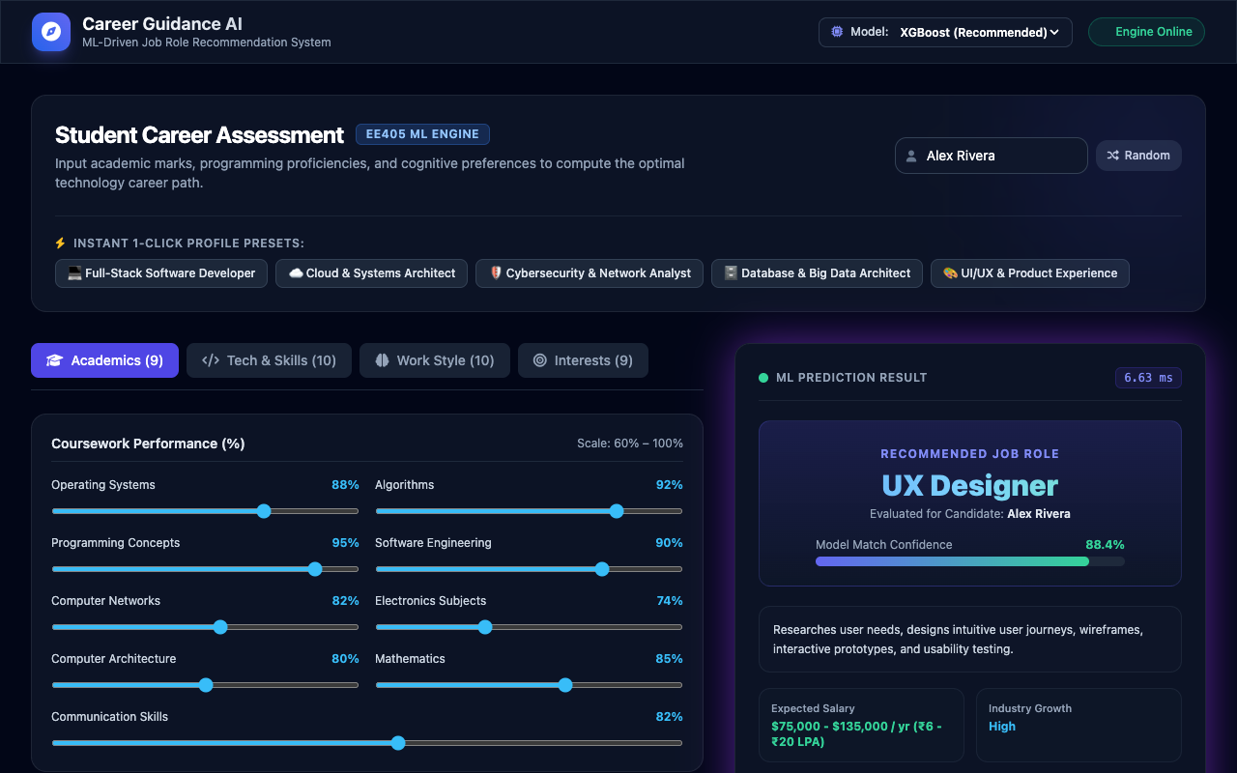
STUDENT CAREER INTELLIGENCE & APPLIED MACHINE LEARNING
Student Assessment Portal & Preset Profiles
Dashboard Features:
• Live Engine Status: Flask microservice operating on port 5005.
• Model Selector: Allows switching between XGBoost, Random Forest, and Decision Tree.
• Candidate Name Input: Personalized student identity logging.
• Instant Preset Pills: 5 pre-configured student aptitude personas for rapid evaluation.

Slide 11
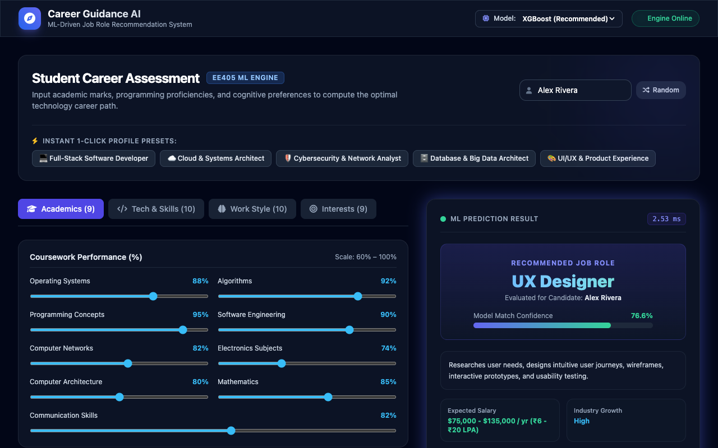
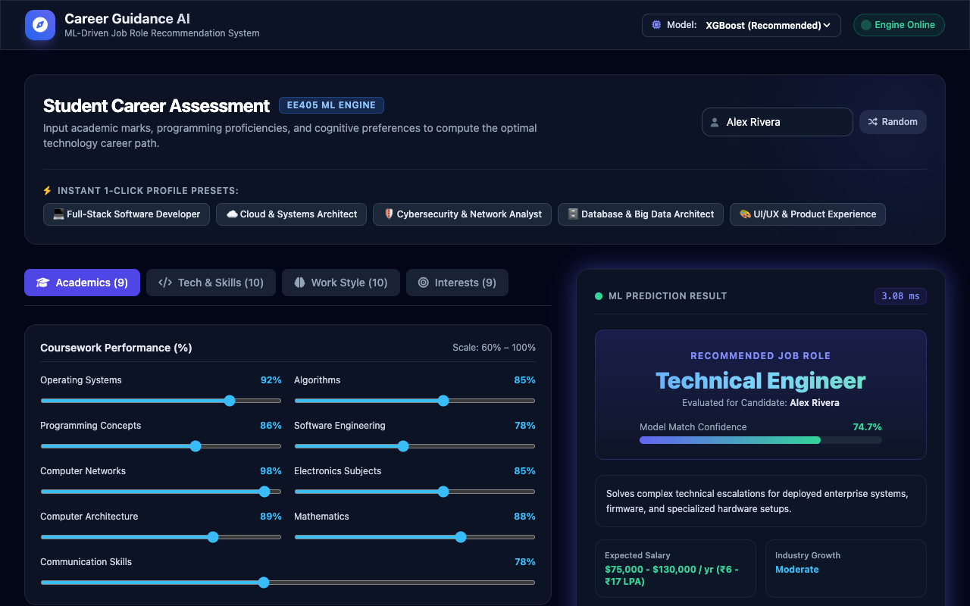
STUDENT CAREER INTELLIGENCE & APPLIED MACHINE LEARNING
Multi-Profile Career Matching Demonstrations
Left: Full-Stack Developer profile matches Database / Software Developer roles • Right: Cybersecurity candidate matches Network Security Administrator with detailed salary and skills breakdown.

Slide 12
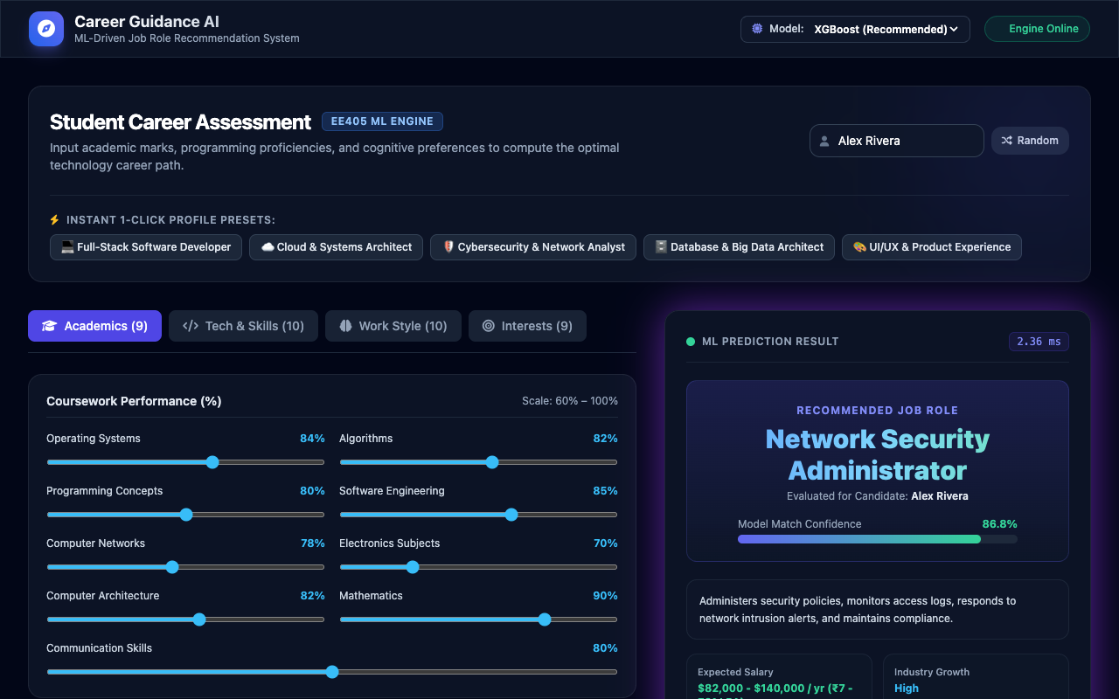
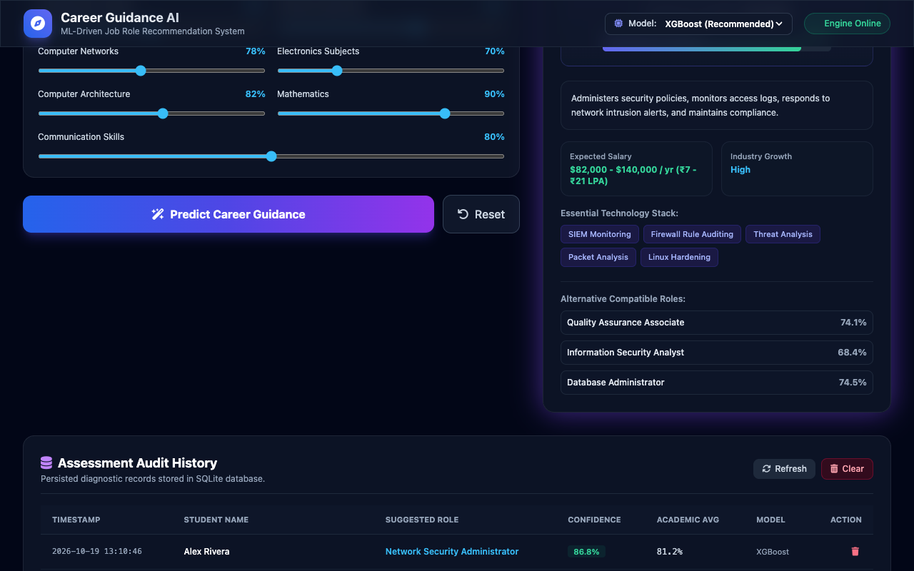
STUDENT CAREER INTELLIGENCE & APPLIED MACHINE LEARNING
Alternative Career Pathways & Domain Insights
Left: Big Data candidate evaluation • Right: Top 3 alternative career fallback recommendations with relative confidence distribution bars.

Slide 13
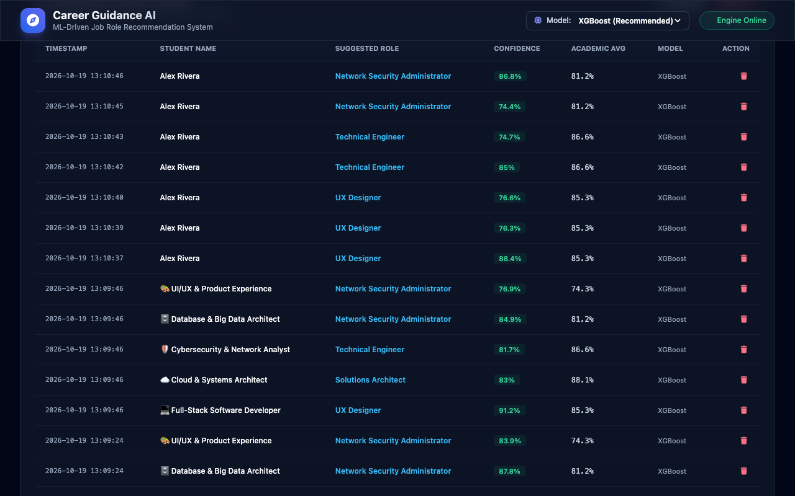
STUDENT CAREER INTELLIGENCE & APPLIED MACHINE LEARNING
Transactional Assessment Audit Database (SQLite)
Database Features:
• Persistent Store: career_guidance.db storing all evaluated student records.
• Key Metrics: Logs candidate name, recommended role, model used, confidence %, academic average, and timestamp.
• CRUD Management: Supports individual record deletion and full history wipe.

Slide 14
STUDENT CAREER INTELLIGENCE & APPLIED MACHINE LEARNING
Automated QA Testing & Software Verification
• 18/18 Automated Pytest Test Cases Passed (100%): Full test suite executed in 1.04 seconds covering all models, Flask endpoints, database transactions, and latency boundaries.
• Model Loading & Cache Integrity: Verified in-memory loading of Decision Tree, Random Forest, and XGBoost models without deserialization warnings.
• Multi-Model Output Verification: Confirmed identical schema output (suggested_role, confidence, alternatives, insights) across all three classifier architectures.
• SQLite CRUD & Persistence Flow: Tested assessment creation, retrieval via /api/history, and single record deletion via /api/history/<id>.
• Boundary & Latency Verification: Validated graceful handling of empty/corrupt profiles and confirmed sub-50ms CPU inference speed.

Slide 15
STUDENT CAREER INTELLIGENCE & APPLIED MACHINE LEARNING
Conclusion, Educational Impact & Future Scope
• Final-Year Project Delivery: Delivered a complete, fully functional AI-assisted career counseling system with 3 trained ML models, modern web portal, SQLite audit trail, and 18 automated tests.
• Academic & Practical Value: Provides universities with an automated, scalable career guidance solution that empowers students with objective skills gap analyses.
• Future Roadmap - LLM Resume Ingestion: Integrate multimodal Large Language Models (Gemini/Llama) to automatically extract skills, projects, and coursework directly from student PDF resumes.
• Real-Time Job Market Scraping: Connect live scrapers to LinkedIn and Indeed APIs to dynamically index salary trends and hiring demand across global metropolitan hubs.

