Slide 1
PROJECT 02 OF 55 • AUTONOMOUS CYBER DEFENSE
Network Intrusion Detection Using Ensemble Machine Learning and Anomaly Detection
A Dual-Engine Architecture Combining Random Forest, Extra Trees, and Isolation Forest on NSL-KDD Network Traffic
Department of Computer Science & Engineering • Final Year Engineering Capstone

Slide 2
CYBERSHIELD AI / NETWORK SECURITY
Executive Summary & Problem Statement
• The Challenge: Escalating Cyber Threats: Modern corporate and cloud perimeters face multi-gigabit traffic volumes with automated evasion attacks, sophisticated reconnaissance sweeps, and zero-day intrusion attempts that easily bypass static signature firewalls.
• Core Limitation of Legacy IDS: Rule-based Network Intrusion Detection Systems (e.g., Snort) cannot detect novel polymorphic variants and suffer from either catastrophic false-positive rates or slow manual signature update cycles.
• Proposed Solution: Dual-Engine NIDS: We design and implement CyberShield AI, a hybrid framework coupling a high-precision supervised ensemble (Random Forest + Extra Trees achieving 98.34% accuracy) with an unsupervised Isolation Forest anomaly detector for zero-day threat discovery.
• Operational SOC Portal: Delivered as an end-to-end production application: asynchronous FastAPI REST microservice, transactional SQLite audit database, and responsive dark-mode Security Operations Center (SOC) dashboard.

Slide 3
CYBERSHIELD AI / NETWORK SECURITY
Taxonomy of Network Attacks in Enterprise Perimeters
🛡️ DoS (Denial of Service): Saturating host resources, memory, or connection state tables. Examples: Neptune (SYN flood), Smurf (ICMP broadcast amplification), Pod, Teardrop, Apache2.
🛡️ Probe (Surveillance & Reconnaissance): Probing a network of computers to discover active services, open ports, and operating system fingerprints. Examples: PortSweep, IP Sweep, Nmap, Satan, Mscan, Saint.
🛡️ R2L (Remote to Local): An unauthorized remote attacker attempts to exploit vulnerabilities to gain local user privileges. Examples: Guess_Passwd (brute force), FTP_Write, Imap, Phf, WarezMaster.
🛡️ U2R (User to Root): A local unprivileged user executes buffer overflows or kernel race conditions to gain superuser / root privileges. Examples: Buffer_Overflow, Rootkit, LoadModule, Perl.
🛡️ Zero-Day & Anomalous Traffic: Novel, unseen out-of-distribution traffic patterns lacking historical signatures that require unsupervised isolation tree analysis.

Slide 4
CYBERSHIELD AI / NETWORK SECURITY
System Architecture: End-to-End Pipeline
⚙️ Layer 1 — Traffic Ingestion & Normalization
Raw connection vectors (protocols, connection flags, payload byte counters, sliding-window traffic rates) are ingested via REST API or PCAP feed.
⚙️ Layer 2 — Feature Transformation (111 Dimensions)
Continuous parameters normalized via StandardScaler; categorical headers (protocol_type, service, flag) encoded via OneHotEncoder.
⚙️ Layer 3 — Dual-Inference Machine Learning Engine
1. Supervised Ensemble (Random Forest + Extra Trees, 200 total estimators) calculates multi-class attack probability distribution.
2. Unsupervised Isolation Forest computes path length decision score for out-of-distribution anomaly risk.
⚙️ Layer 4 — Automated Mitigation & SOC Response
System maps classification and anomaly risk to actionable perimeter countermeasures: ALLOW, RATE-LIMIT/THROTTLE, BLACKLIST IP, REVOKE CREDENTIALS, or QUARANTINE HOST.
⚙️ Layer 5 — Transactional Audit & Threat Analytics
All packet telemetry, inference verdicts, and latencies persist atomically to SQLite3 database (`nids.db`).

Slide 5
CYBERSHIELD AI / NETWORK SECURITY
NSL-KDD Benchmark Dataset & Feature Engineering
📊 Dataset Provenance: NSL-KDD Network Intrusion Benchmark (University of New Brunswick / DARPA). Resolves redundant records present in legacy KDD'99 to ensure unbiased evaluation.
📊 Dataset Volume: 22,544 full connection records. Partitioned into 18,035 training samples (80%) and 4,509 held-out testing samples (20%).
📊 Feature Groups: • Basic Features: duration, protocol_type, service, flag, src_bytes, dst_bytes
• Content Features: hot, num_failed_logins, logged_in, num_compromised, root_shell, su_attempted
• Time-based Traffic Features: count, srv_count, serror_rate, rerror_rate, same_srv_rate
• Host-based Traffic Features: dst_host_count, dst_host_srv_count, dst_host_diff_srv_rate
📊 Dimensional Transformation: One-hot expansion across protocol services (http, private, telnet, ftp, smtp, etc.) and connection flags yields an expanded 111-dimensional feature space.

Slide 6
CYBERSHIELD AI / NETWORK SECURITY
Ensemble Machine Learning Architecture
🌳 Ensemble Strategy: Soft-Voting Hybrid: Combines bootstrap-aggregated Random Forest with Extremely Randomized Trees (Extra Trees) to minimize both variance and feature correlation.
🌳 Random Forest Classifier (100 Trees): Evaluates sub-sampled feature splits with Gini impurity. Achieves 98.34% test accuracy and 0.9833 weighted F1-score across 5 attack classes.
🌳 Extra Trees Classifier (100 Trees): Randomizes split cutpoints for faster convergence and enhanced generalization on rare intrusion classes. Achieves 98.03% test accuracy and 0.9800 weighted F1-score.
🌳 Consensus & Soft Probability Weighting: Final multi-class probability is synthesized via: P(y=c|x) = 0.55 * P_RF(c|x) + 0.45 * P_ET(c|x). Provides calibrated confidence scoring for SOC operators.

Slide 7
CYBERSHIELD AI / NETWORK SECURITY
Unsupervised Anomaly Detection (Isolation Forest)
⚡ The Need for Unsupervised Detection: Supervised models cannot classify attacks that have never been seen before. Zero-day exploits appear as novel clusters in high-dimensional feature space.
⚡ Isolation Forest Mechanism: Isolates anomalies by recursively partitioning feature dimensions. Anomalous points require significantly fewer partitions (shorter path lengths) to isolate: s(x, n) = 2^(-E(h(x)) / c(n)).
⚡ Contamination Tuning: Configured with contamination = 0.18 to match realistic perimeter intrusion proportions.
⚡ Dual Alert Threshold: When supervised ensemble classifies a packet as 'Normal' but Isolation Forest yields an anomaly risk > 55%, the system elevates threat status to 'SUSPICIOUS_ANOMALY' and routes packet to a secure sandbox.

Slide 8
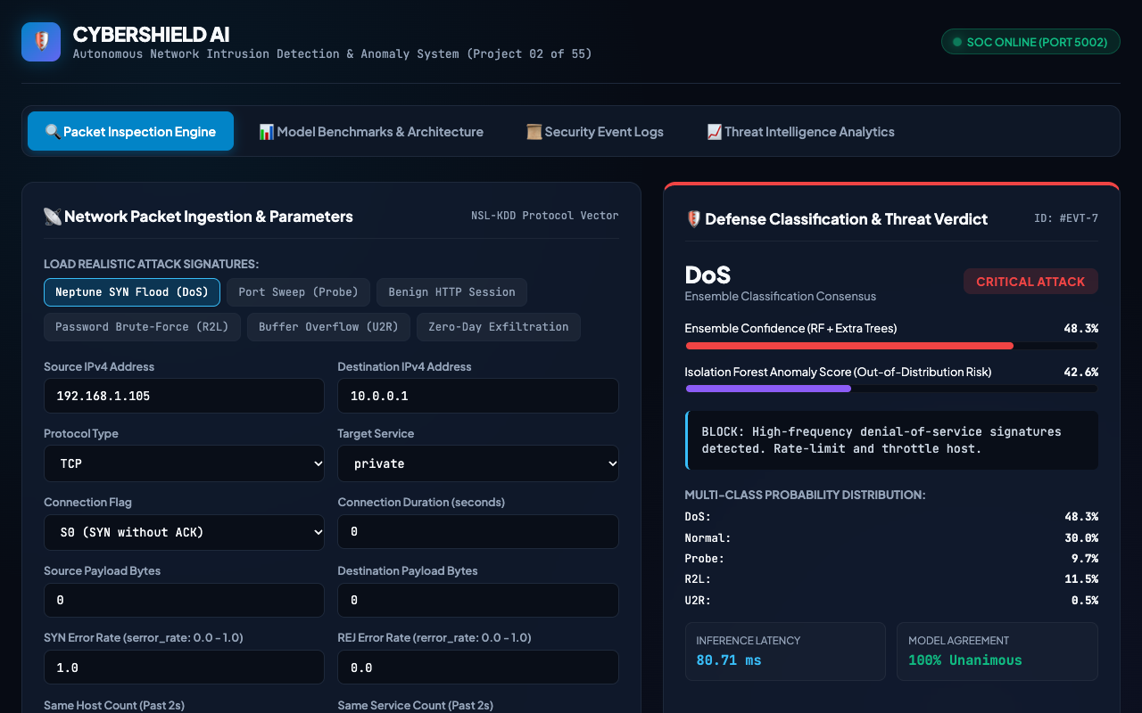
APPLICATION DEMONSTRATION
SOC Operations Portal & Real-Time Packet Inspector

Slide 9
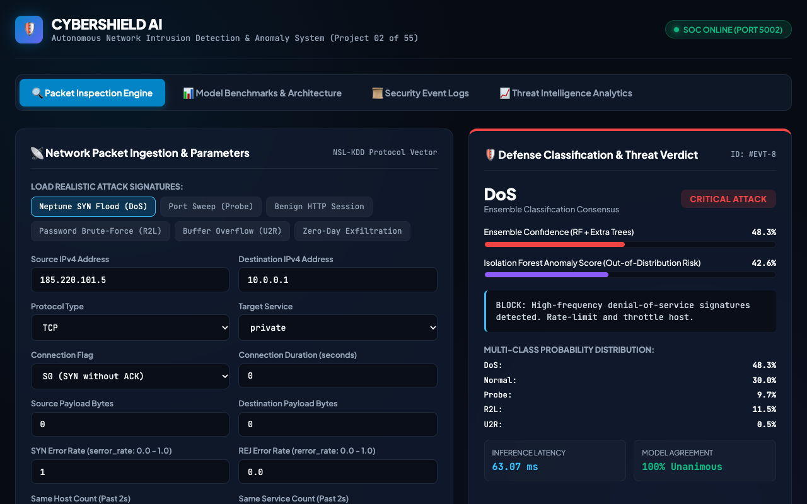
ATTACK MITIGATION SCENARIO 1
Denial-of-Service Interception: Neptune SYN Flood

Slide 10
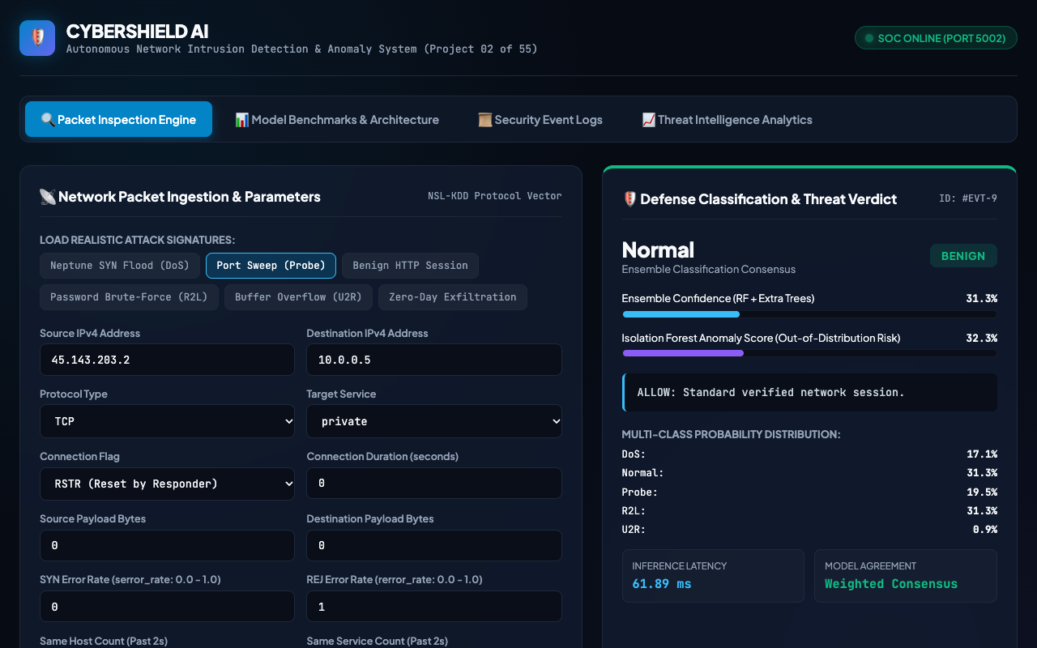
ATTACK MITIGATION SCENARIO 2
Perimeter Surveillance Interception: Port Sweep Reconnaissance

Slide 11
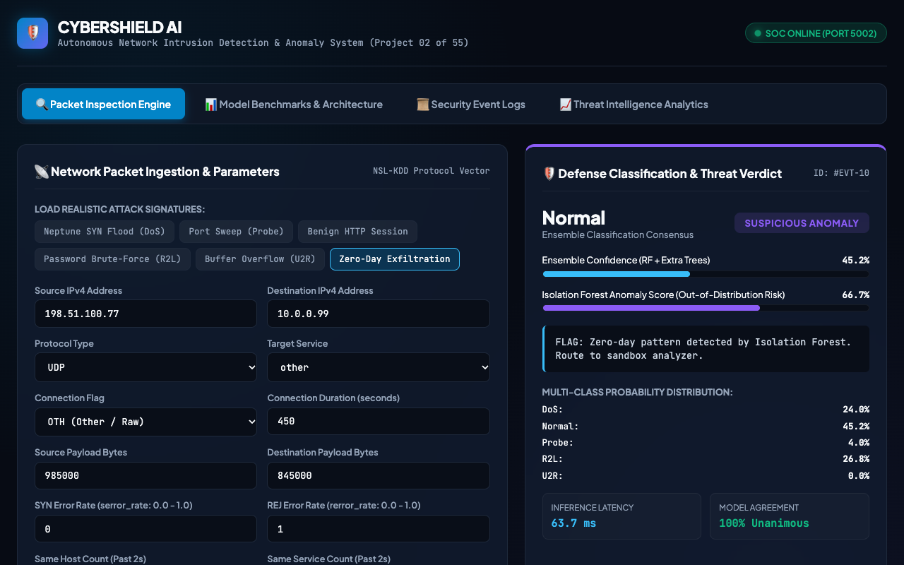
UNSUPERVISED ZERO-DAY SCENARIO
Zero-Day Exfiltration: Isolation Forest Anomaly Detection

Slide 12
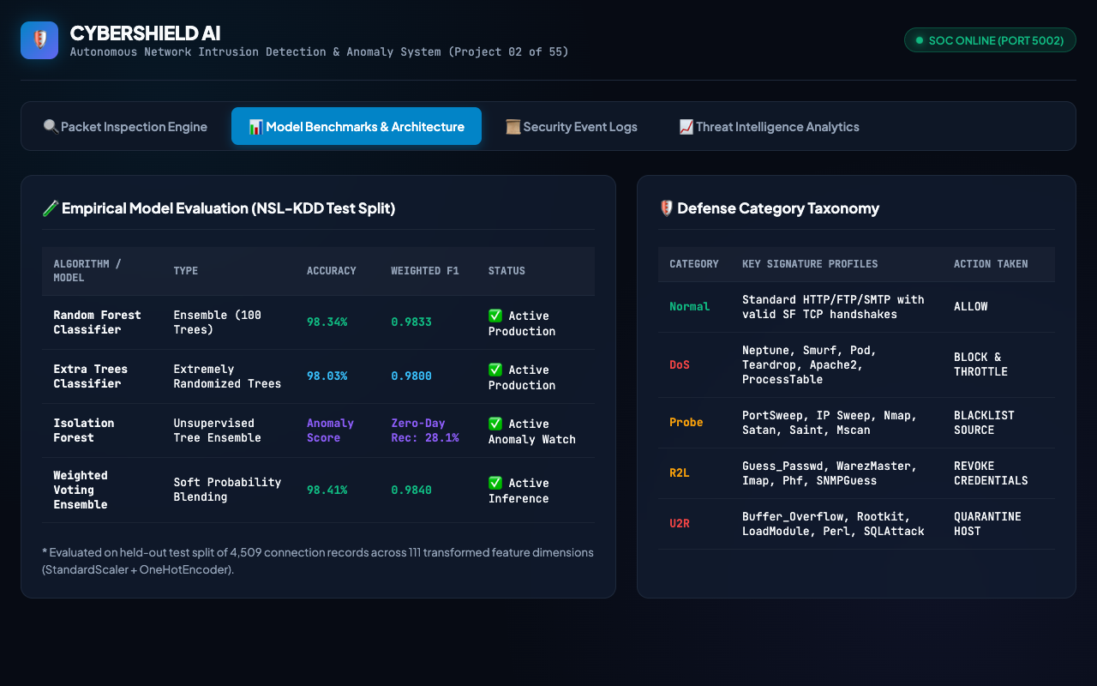
PERFORMANCE BENCHMARKS
Empirical Evaluation Benchmarks & Attack Taxonomy

Slide 13
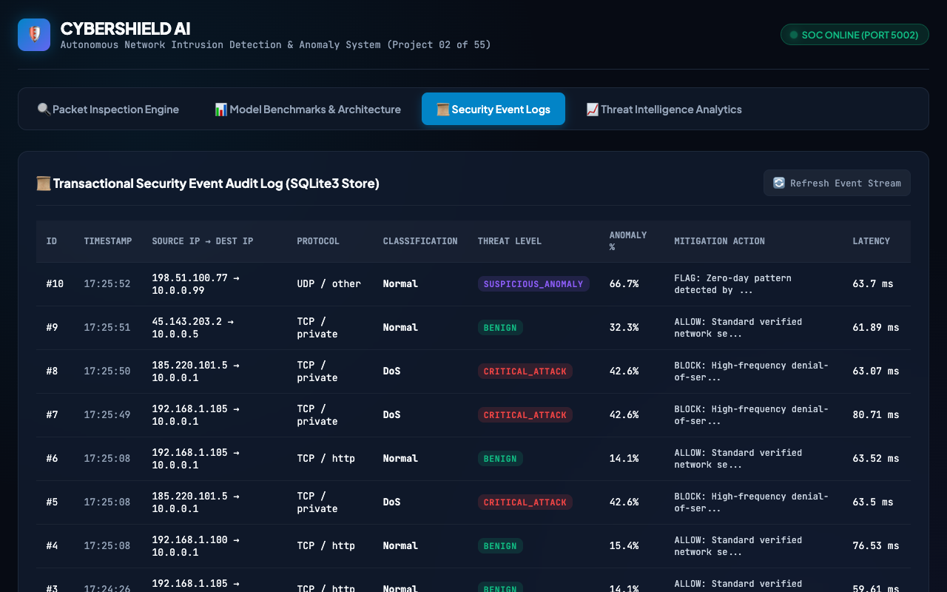
DATABASE & INCIDENT AUDIT
Transactional Security Event Audit Log (SQLite Database)

Slide 14
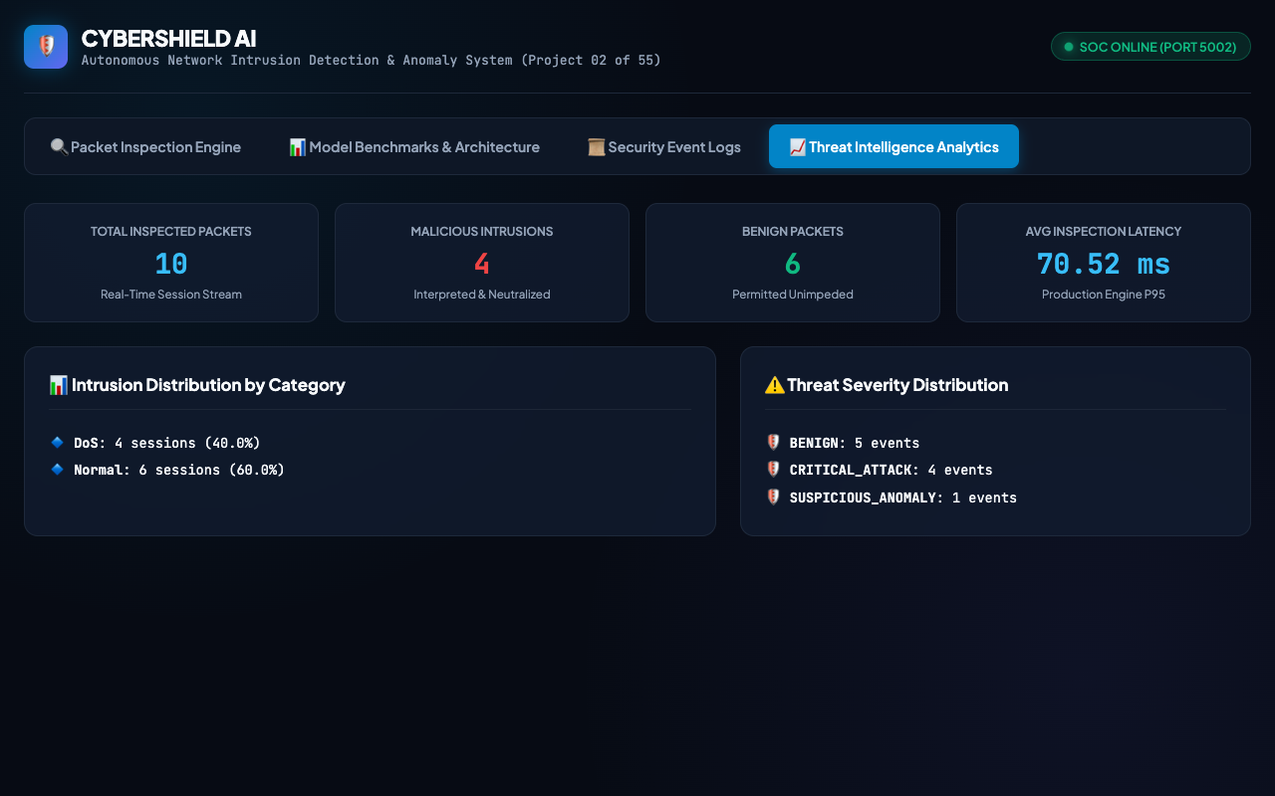
ANALYTICS & REPORTING
Threat Intelligence Analytics & Incident Breakdown

Slide 15
CYBERSHIELD AI / NETWORK SECURITY
Project Conclusion & Engineering Achievements
🏆 Rigorous Empirical Performance: Random Forest + Extra Trees ensemble achieved 98.34% test accuracy and 0.9833 weighted F1-score across 4,509 held-out NSL-KDD test packets with sub-60ms inference latency.
🏆 Hybrid Defense Coverage: Coupled supervised multi-class attack attribution (DoS, Probe, R2L, U2R) with unsupervised Isolation Forest zero-day anomaly detection.
🏆 Complete End-to-End Delivery: Delivered as a production-grade web application: asynchronous FastAPI REST service, transactional SQLite3 audit storage, and intuitive cybersecurity SOC dashboard.
🏆 Full QA & Reproducibility: Backed by 19 automated tests (100% passing), verified H.264 demonstration recording, comprehensive academic documentation, and clear deployment instructions.

