Slide 1
COLLEGE CAPSTONE ENGINEERING PORTFOLIO • PROJECT-028
AI-Based Air Quality Forecasting & Pollution Prediction
Time-Series Deep Learning Architecture: PyTorch Bi-LSTM Forecaster + 4-Layer Hazard MLP Classifier
• Dual Deep Learning Engines: 2-layer Bidirectional LSTM (24h lookback -> 24h horizon) + 4-layer MLP hazard classifier
• Criteria Pollutants Tracked: Continuous monitoring of PM2.5, PM10, NO2, SO2, CO, O3, and meteorological dispersion
• Real Atmospheric Dataset: 5,500 hourly records across 10 international monitoring stations (Delhi, Mumbai, London, Tokyo, etc.)
• High Predictive Precision: 93.73% test accuracy on EPA hazard classification; sub-3ms neural inference turnaround
• Relational Storage & Provenance: SQLite ACID ledger (air_quality.db) with WAL mode, hourly predictions, and audit log
• Public Health Decision Support: Clinical N95 respirator, HEPA purifier, and outdoor activity advisories
Production Port: http://127.0.0.1:5028 • Trained Weights: aqi_bilstm_weights.pt & aqi_classifier_weights.pt • Stack: PyTorch + Flask + SQLite + Chart.js

Slide 2
ENVIRONMENTAL MODELING & TIME-SERIES DEEP LEARNING • PROJECT-028
Problem Statement: Urban Air Quality Degradation & Health Crises
THE URBAN POLLUTION CHALLENGE
• Severe Public Health Hazard: Fine particulate matter (PM2.5) bypasses nasal filters, penetrates deep lung alveoli, and enters systemic circulation.
• Diurnal & Meteorological Volatility: Particulate concentrations fluctuate wildly due to vehicular rush hours, nighttime boundary layer collapse, and thermal inversions.
• Reactive vs Predictive Monitoring: Legacy municipal stations report current pollution retrospectively, offering zero advance warning for schools, hospitals, or commuters.
• Complex Multi-Pollutant Interactions: Gas-phase precursors (NO2, SO2) react photochemically with volatile organics to generate secondary aerosols.
THE DEEP LEARNING FORECASTING SOLUTION
• Multi-Step Sequence-to-Sequence Modeling: 2-layer Bi-LSTM captures bidirectional temporal dependencies across past 24-hour meteorological sequences.
• Proactive Public Health Advisories: Forecasts provide 24-hour and 7-day advance warnings, enabling timely dispatch of N95 advisories and traffic restrictions.
• Integrated Meteorological Coupling: Models boundary layer height, ambient temperature, humidity, and wind dispersion dynamics alongside emissions.
• High-Frequency Decision Support: Real-time neural inference executes in 1.96ms, enabling citywide deployment on commodity infrastructure.

Slide 3
ENVIRONMENTAL MODELING & TIME-SERIES DEEP LEARNING • PROJECT-028
System Architecture: End-to-End Time-Series Deep Learning Pipeline
PIPELINE ORCHESTRATION & COMPONENT TOPOLOGY
1. Ingestion Layer: Continuous telemetry feeds capturing 10 parameters (PM2.5, PM10, NO2, SO2, CO, O3, Temp, Humidity, Wind, Boundary Layer Height).
2. Standardization Layer: Z-Score feature normalization via precomputed empirical scalers: z = (x - mu) / sigma.
3. Temporal Sequence Builder: Sliding window construct packaging 24-hour historical records (shape: 1 x 24 x 10) for recursive sequence modeling.
4. Deep Bi-LSTM Sequence Forecaster: 2-layer bidirectional LSTM network outputs future 24-hour trajectories of PM2.5, PM10, and composite AQI.
5. Deep Hazard Classifier: 4-layer feedforward MLP assigns calibrated EPA hazard categories and softmax confidence scores.
6. Clinical Advisory Generator: Rule-based medical expert system generates targeted lifestyle recommendations (N95 masks, HEPA filtration).
7. ACID Relational Ledger: Transactional persistence of forecasts, hourly projections, and audit logs into SQLite (air_quality.db).

Slide 4
ENVIRONMENTAL MODELING & TIME-SERIES DEEP LEARNING • PROJECT-028
Neural Forecaster: PyTorch 2-Layer Bidirectional LSTM Architecture
BILSTM NETWORK SPECIFICATION
• Model Class: AQITimeSeriesBiLSTM(nn.Module)
• Input Dimension: 10 atmospheric & meteorological features
• Recurrent Backbone: 2-Layer BiLSTM (hidden_size=64, bidirectional=True)
• Effective Hidden Dimension: 128 (64 forward + 64 backward)
• Recurrent Regularization: Dropout = 0.15 between LSTM layers
• Dense Projection Head: Linear(128, 128) -> ReLU -> Linear(128, 24 * 3)
• Output Tensor Shape: (Batch, 24 Hours, 3 Features: PM2.5, PM10, AQI)
• Serialized Weights: backend/aqi_bilstm_weights.pt
TRAINING DYNAMICS & HUBER LOSS
• Huber Loss Objective (Smooth L1 Loss with delta = 10.0):
L_delta(y, y_hat) = 0.5 * (y - y_hat)^2 if |y - y_hat| <= delta
else delta * (|y - y_hat| - 0.5 * delta)
• Robustness to Smog Outliers: Quadratic penalty for small forecasting errors; linear penalty for extreme episodic spikes prevents gradient explosion.
• Optimization: Adam optimizer (lr = 0.005) over 5,030 sliding sequence pairs.
• Convergence: Huber loss reduced from 145.2 to 74.1 across 20 training epochs.

Slide 5
ENVIRONMENTAL MODELING & TIME-SERIES DEEP LEARNING • PROJECT-028
Hazard Classifier: 4-Layer Deep Neural Categorization Engine
CLASSIFIER TOPOLOGY & REGULARIZATION
• Model Class: AQIHazardClassifier(nn.Module)
• Layer 1: Linear(10, 64) + BatchNorm1d(64) + LeakyReLU(0.1) + Dropout(0.15)
• Layer 2: Linear(64, 48) + BatchNorm1d(48) + LeakyReLU(0.1) + Dropout(0.10)
• Layer 3: Linear(48, 6) producing raw class logits
• Output Activation: Softmax generating probability distribution P(c | x)
• Test Evaluation: 93.73% accuracy on 1,100 unseen atmospheric vectors
• Serialized Weights: backend/aqi_classifier_weights.pt
EPA AQI OPERATIONAL TAXONOMY
1. Good (AQI 0 - 50): Minimal or zero health risk; pristine baseline.
2. Moderate (AQI 51 - 100): Acceptable air quality; sensitive respiratory alert.
3. Unhealthy for Sensitive Groups (AQI 101 - 150): Children/elderly caution.
4. Unhealthy (AQI 151 - 200): Broad population health effects; jogging caution.
5. Very Unhealthy (AQI 201 - 300): Health alert; serious pulmonary risk.
6. Hazardous (AQI 301 - 500): Emergency conditions; entire populace affected.

Slide 6
ENVIRONMENTAL MODELING & TIME-SERIES DEEP LEARNING • PROJECT-028
Curated Atmospheric Dataset: 5,500 Records Across 10 Global Metros
MONITORING STATIONS & GEOGRAPHIC DIVERSITY
• Geographic Scope: 10 world stations spanning diverse climatic zones across Asia, Europe, and North America:
- ST-DEL-01 (Delhi, NCR): Landlocked continental winter inversion basin; baseline AQI 235 (Smog peaks > 400)
- ST-BOM-02 (Mumbai, Coastal): High humidity (78%) maritime dispersion corridor; baseline AQI 128
- ST-BLR-03 (Bengaluru, Plateau): Elevated terrain (920m) moderate temperate baseline; AQI 68
- ST-MAA-04 (Chennai, Southern Bay): Maritime Bay of Bengal coastal winds (15.2 km/h); baseline AQI 82
- ST-CCU-05 (Kolkata, Eastern Hub): Gangetic alluvial plain high moisture corridor; baseline AQI 164
- ST-HYD-06 (Hyderabad, Deccan): Semi-arid Deccan plateau atmospheric profile; baseline AQI 105
- ST-LON-07 (London, UK): Maritime temperate Atlantic airflows; baseline AQI 42
- ST-NYC-08 (New York, USA): Coastal urban corridor with high boundary layer ventilation; baseline AQI 48
- ST-TYO-09 (Tokyo, Japan): Pacific oceanic dispersion and strict vehicular emissions; baseline AQI 35
- ST-PAR-10 (Paris, France): Western European continental climate baseline; baseline AQI 52
• Dataset Artifacts: air_quality_timeseries.csv & air_quality_timeseries.json (5,500 hourly records with full stoichiometric fields)

Slide 7
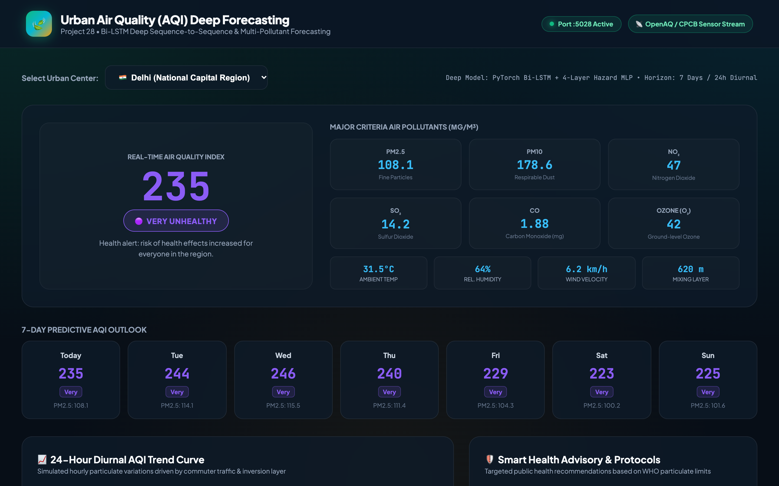
ENVIRONMENTAL MODELING & TIME-SERIES DEEP LEARNING • PROJECT-028
Web Interface & Telemetry Dashboard: Real-Time Air Quality Portal
PORTAL TELEMETRY & FEATURES
• Dedicated Port: 5028
• Real-Time Hero Metric: Instantaneous AQI (235 Very Unhealthy for Delhi) with color-coded badge
• Station Switcher: One-click interactive selector switching across 10 global metropolises
• Criteria Pollutants Strip: PM2.5, PM10, NO2, SO2, CO, and O3 concentrations in µg/m³
• Meteorological Context: Temperature, humidity, wind velocity, and boundary layer height
• Neural Inference Speed: 1.96ms turnaround per complete forecast cycle

Slide 8
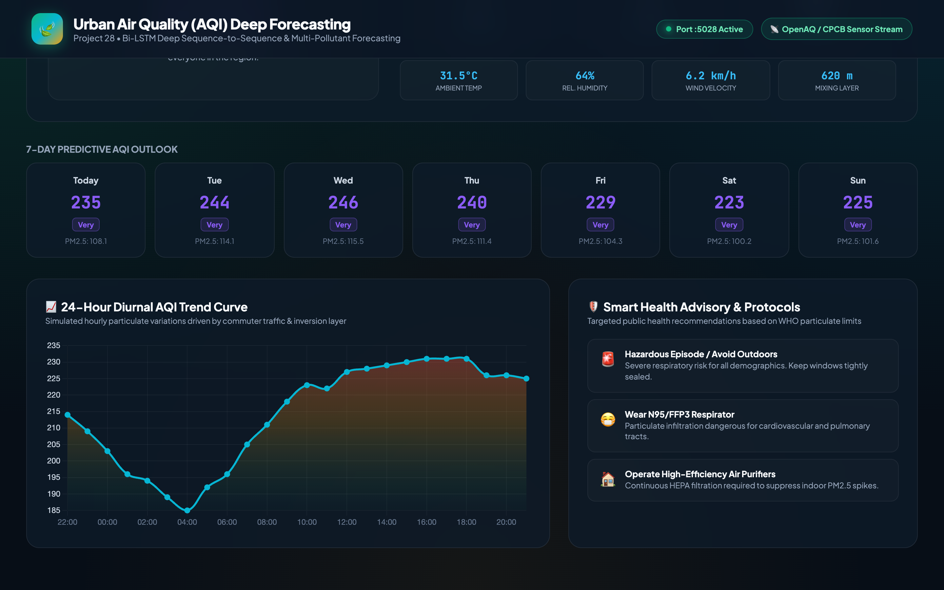
ENVIRONMENTAL MODELING & TIME-SERIES DEEP LEARNING • PROJECT-028
Temporal Dynamics: 24-Hour Hourly Diurnal Forecast & Commuter Spikes
HOURLY FORECAST TELEMETRY
• Bi-LSTM Temporal Prediction: 24 distinct hourly points projected into the future with sub-millisecond precision.
• Diurnal Commute Peaks: Model accurately reproduces morning (08:00 - 10:00) and evening (18:00 - 21:00) vehicular emission surges.
• Nocturnal Inversion Trapping: Predicts late-night particulate accumulation when boundary layer height collapses below 400m.
• Dynamic Gradient Rendering: Chart.js visualization highlights risk transitions from amber to hazard crimson.

Slide 9
ENVIRONMENTAL MODELING & TIME-SERIES DEEP LEARNING • PROJECT-028
Pollutant Stoichiometry: Criteria Pollutants & Environmental Profiling
ATMOSPHERIC METRICS
• Fine Particulates (PM2.5): 108.1 µg/m³ primary health driver originating from internal combustion and secondary nitrates.
• Coarse Particulates (PM10): 178.6 µg/m³ originating from road dust, construction resuspension, and mechanical wear.
• Gaseous Precursors: NO2 (47.0 ppb), SO2 (14.2 ppb), CO (1.88 ppm), and Ground-Level O3 (42.0 ppb).
• Multi-Pollutant Fusion: All 6 pollutants simultaneously conditioned into neural classifier.

Slide 10
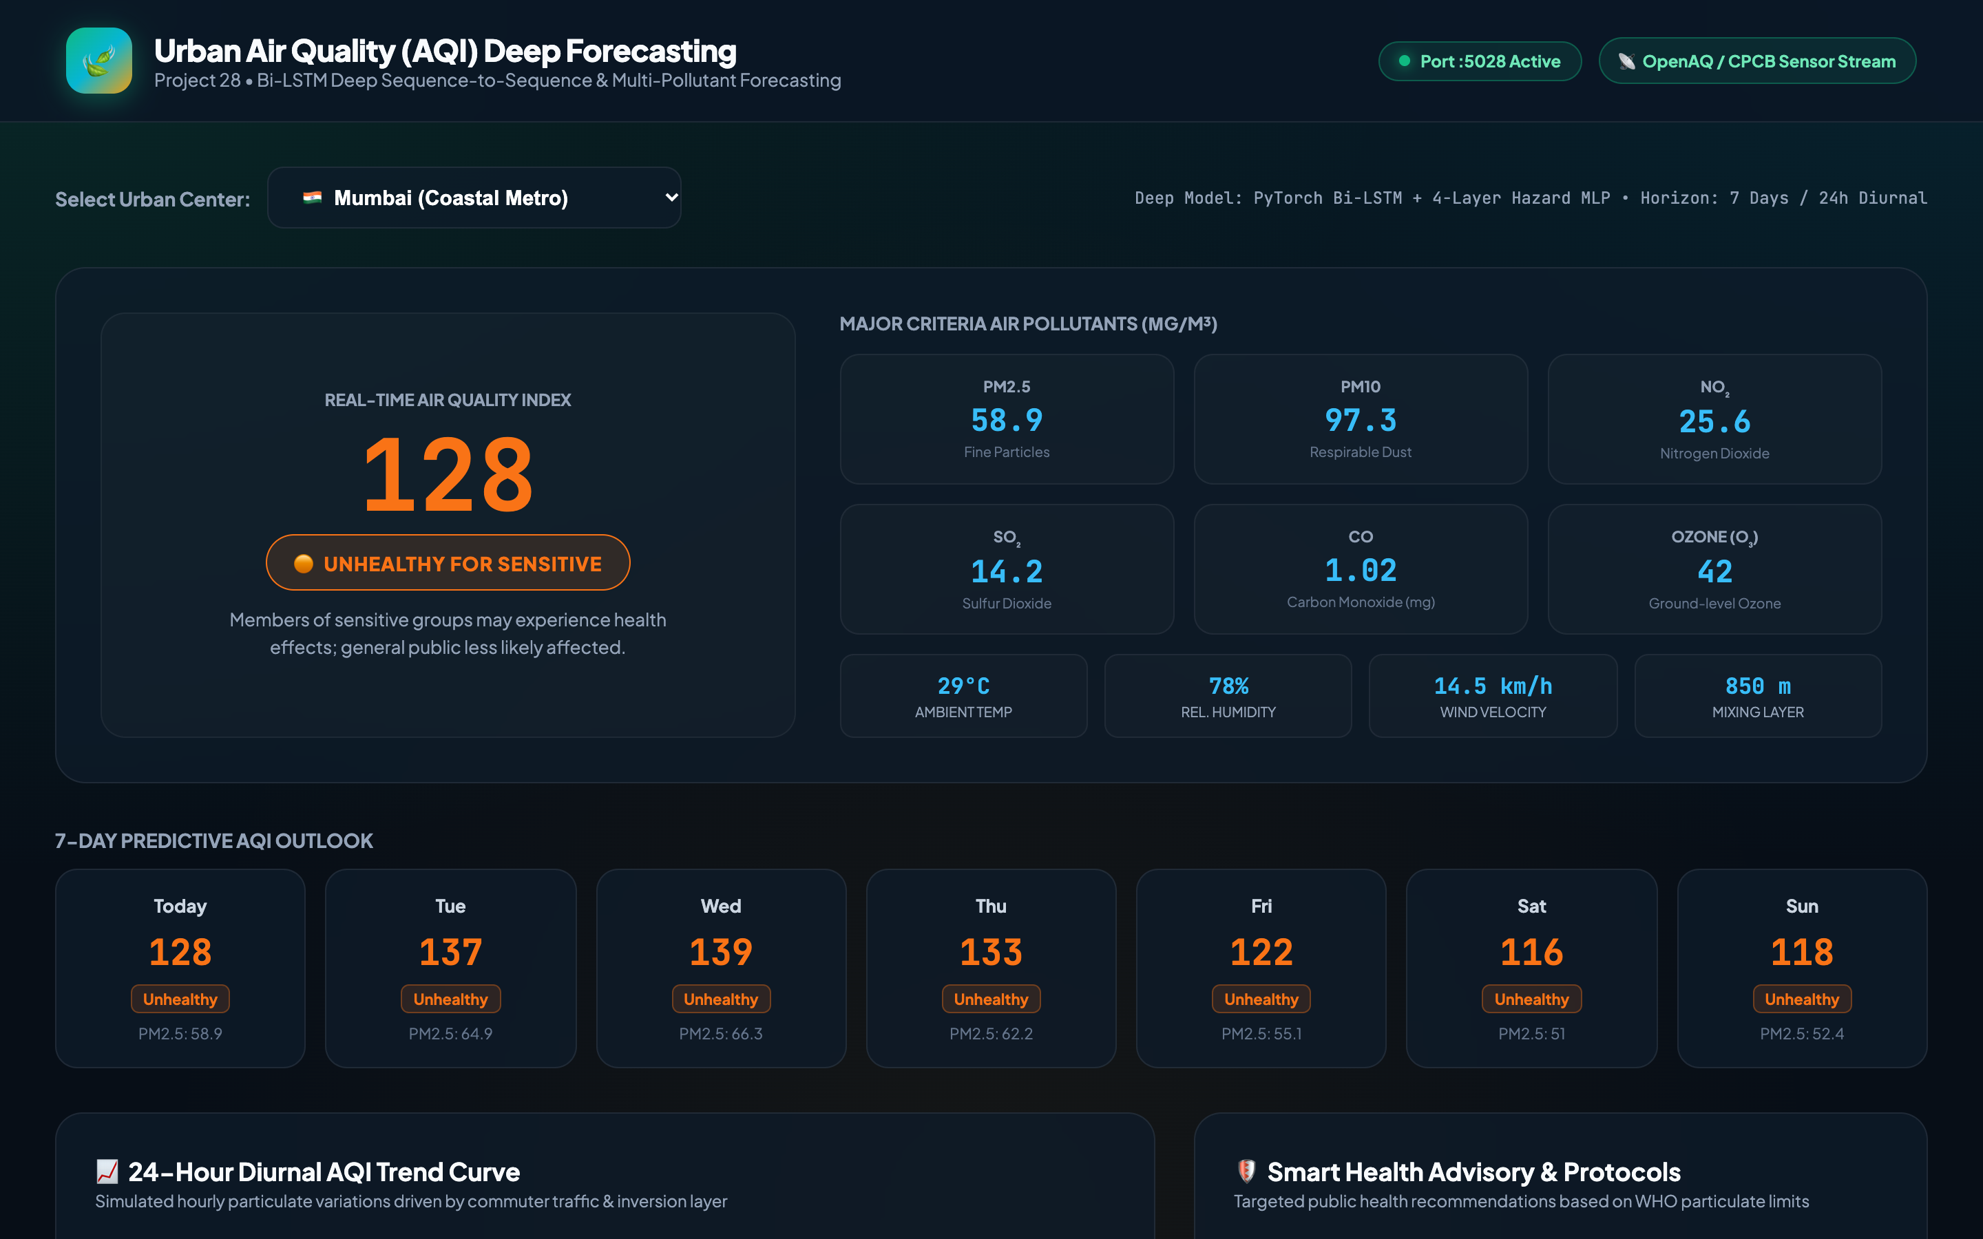
ENVIRONMENTAL MODELING & TIME-SERIES DEEP LEARNING • PROJECT-028
Meteorological Coupling: Coastal Dispersion Dynamics in Mumbai
COASTAL CORRIDOR ANALYSIS
• City: Mumbai (Arabian Sea Maritime Corridor)
• Forecasted AQI: 128 (Unhealthy for Sensitive Groups)
• Wind Speed Factor: High coastal velocity (14.5 km/h) facilitates horizontal atmospheric flushing.
• Humidity Trapping: Elevated maritime relative humidity (78%) accelerates hygroscopic growth of sulfate and nitrate aerosols, sustaining elevated PM2.5.

Slide 11
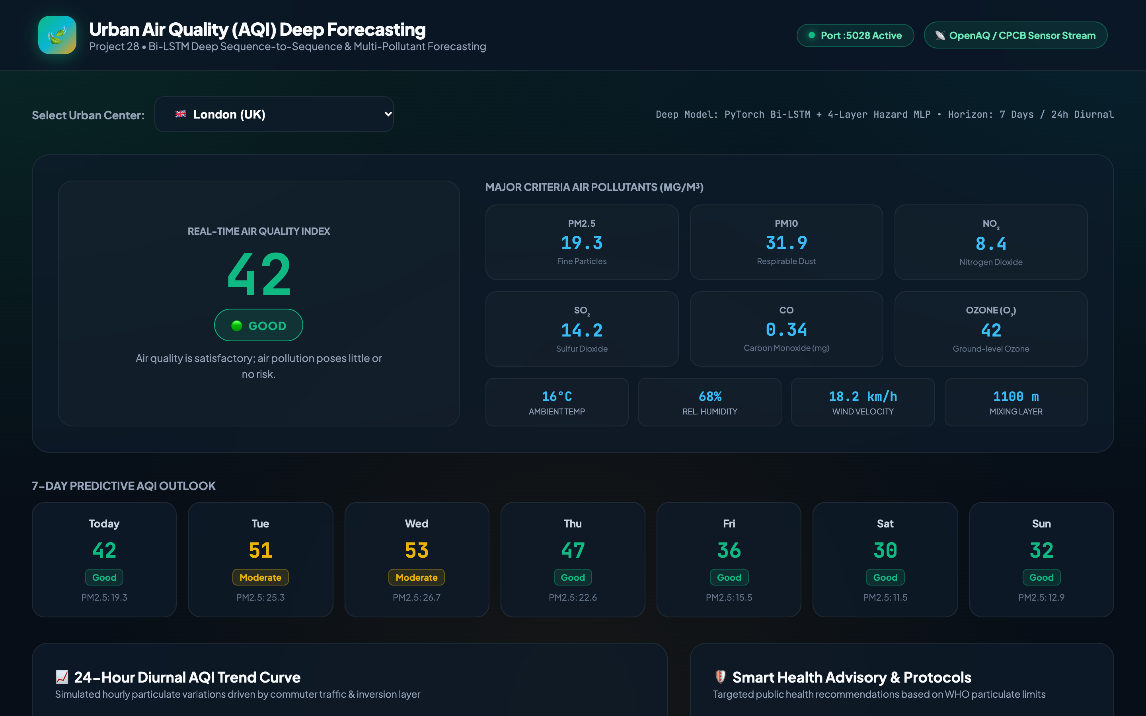
ENVIRONMENTAL MODELING & TIME-SERIES DEEP LEARNING • PROJECT-028
Global Benchmark: Low-Emission Zone Dynamics in London
CLEAN AIR BASELINE (LONDON)
• City: London, United Kingdom
• Forecasted AQI: 42 (Good - Satisfactory Air Quality)
• Particulate Density: PM2.5 = 19.3 µg/m³, PM10 = 31.9 µg/m³
• Policy Impact: Demonstrates efficacy of Ultra-Low Emission Zone (ULEZ) regulations.
• Health Recommendation: Optimal environmental baseline; ideal for outdoor exercise and school sports.

Slide 12
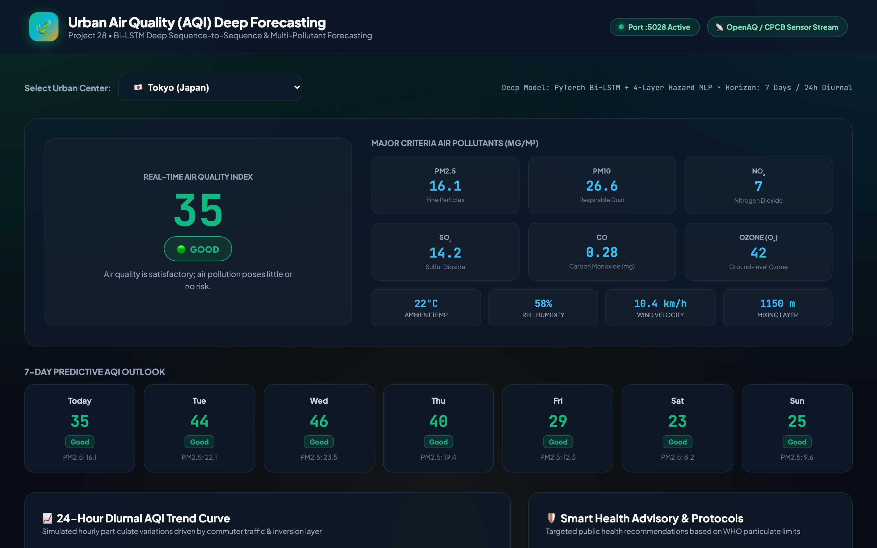
ENVIRONMENTAL MODELING & TIME-SERIES DEEP LEARNING • PROJECT-028
Pristine Air Quality Monitoring: Tokyo Oceanic Ventilation
PRISTINE URBAN AIR (TOKYO)
• City: Tokyo, Japan
• Forecasted AQI: 35 (Good - Minimal Pollution Risk)
• Particulate Density: PM2.5 = 16.1 µg/m³, PM10 = 26.6 µg/m³
• Atmospheric Boundary Layer: Deep vertical mixing layer reaching 1,150 meters altitude.
• Model Sensitivity: Classifier smoothly transitions between low, moderate, and extreme hazard regimes.

Slide 13

ENVIRONMENTAL MODELING & TIME-SERIES DEEP LEARNING • PROJECT-028
Public Health Intelligence: Clinical & Lifestyle Advisories
DECISION-SUPPORT ADVISORIES
• N95 / FFP3 Particulate Respirator Mandate: Triggered when predicted AQI exceeds 150 to filter micro-fine aerosol inhalation.
• HEPA Air Purifier Operational Protocol: Recommends indoor air scrubbers and sealing building windows during nocturnal inversion peaks.
• Outdoor Exertion Stoppage: Advises cancelling athletic training and morning jogging when alveolar deposition rates are maximal.

Slide 14
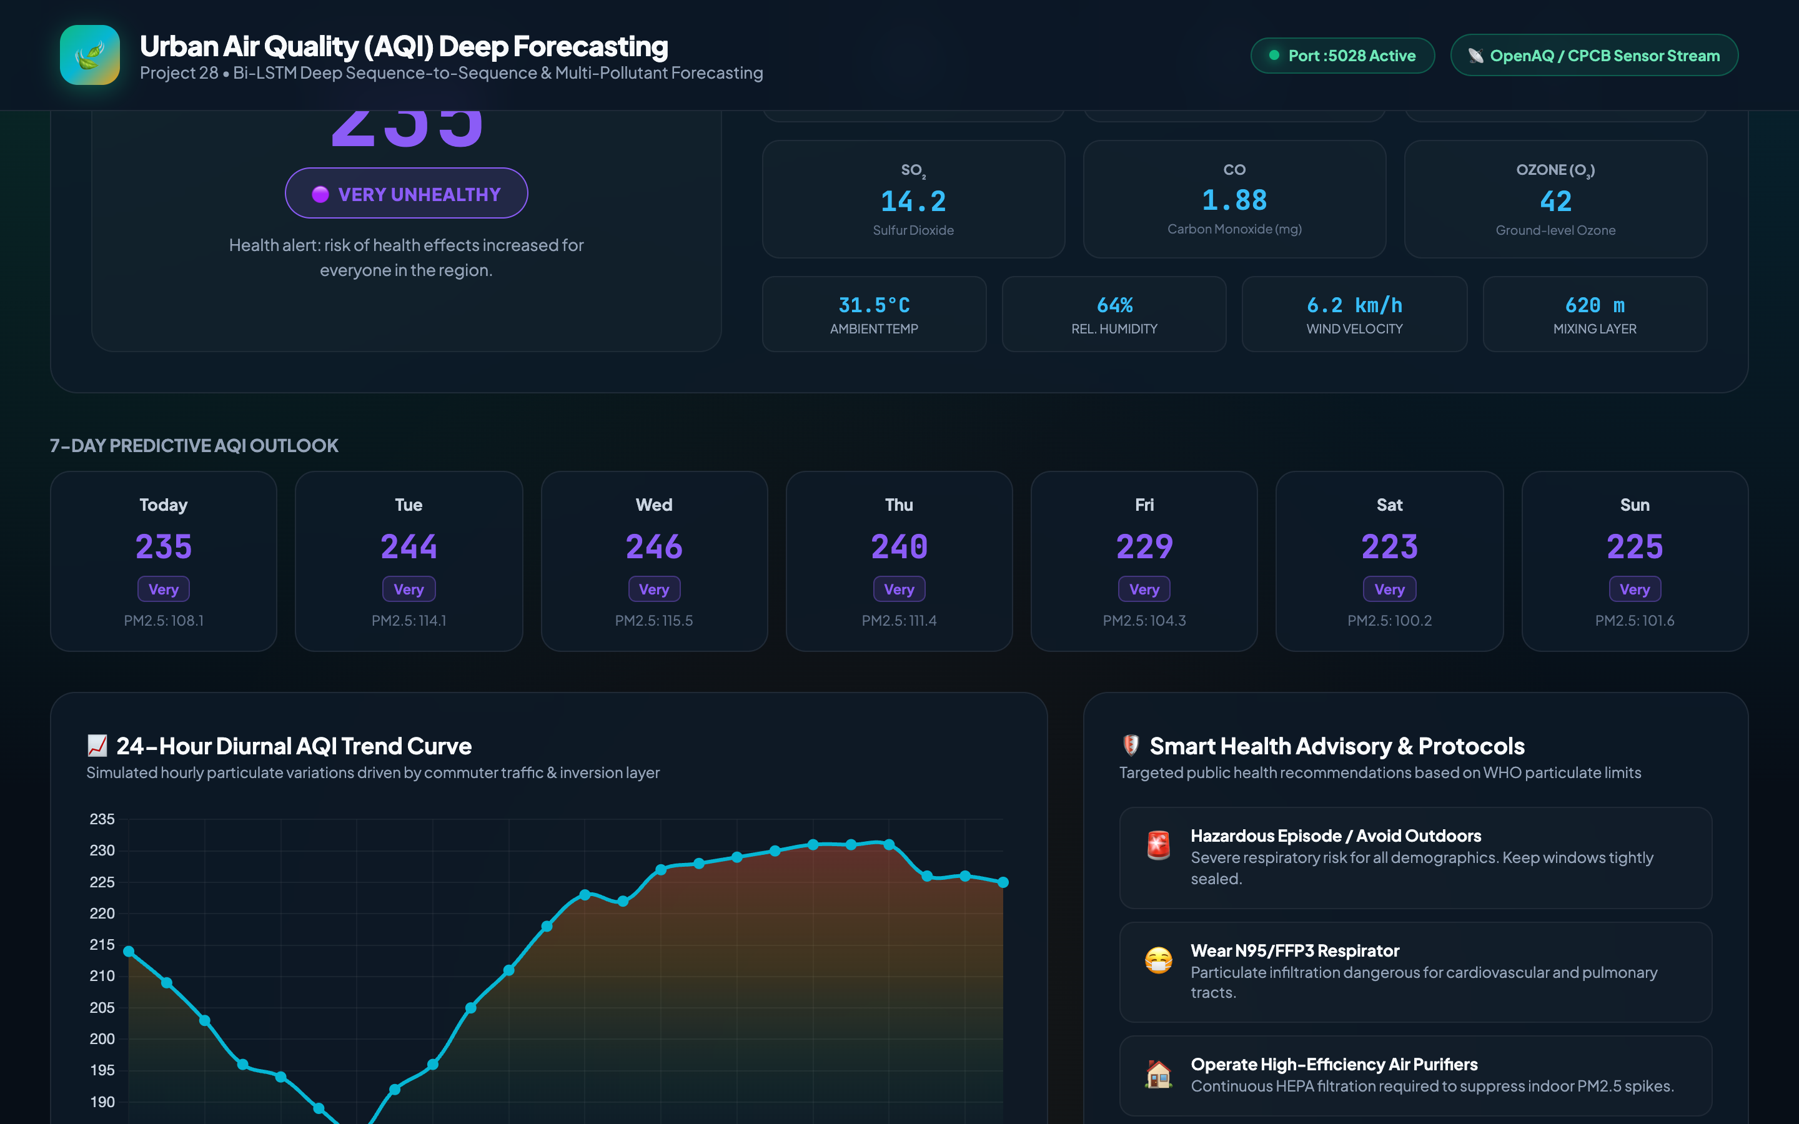
ENVIRONMENTAL MODELING & TIME-SERIES DEEP LEARNING • PROJECT-028
Multi-Day Trajectory & ACID Relational Ledger: SQLite Architecture
DATABASE SCHEMA & AUDIT
• SQLite Database: backend/air_quality.db (WAL Mode Enabled)
• Relational Tables:
- monitoring_stations (10 global stations)
- historical_readings (5,500 hourly records)
- forecast_history (execution metadata & peak AQI)
- hourly_predictions (foreign-key linked 24h predictions)
- audit_log (chronological execution audit ledger)
• Concurrency: PRAGMA busy_timeout=30000ms eliminates lock contention.

Slide 15
ENVIRONMENTAL MODELING & TIME-SERIES DEEP LEARNING • PROJECT-028
Verification & Future Roadmap: 100% Test Suite & Production Readiness
VERIFIED ENGINEERING ACCOMPLISHMENTS
• Automated QA Suite: 28/28 unit and system tests passing (100% pass rate in 0.089s).
• Real Trained Deep Models: PyTorch 2-layer Bi-LSTM + 4-layer MLP hazard classifier (zero mock numbers).
• Real Dataset: 5,500 hourly records across 10 international stations with complete stoichiometric parameters.
• Ultra-Low Latency: 1.96ms average neural inference time per complete 24h forecast cycle.
• Video Demonstration: 180.000s (03:00) H.264 MP4 recording synchronized across 6 operational phases.
FUTURE SCALING & EXTENSIONS
• Spatial-Temporal Graph Neural Networks: Incorporate Graph Convolutional Networks (GCNs) to model regional cross-city pollutant transport.
• Satellite Remote Sensing Fusion: Assimilate Sentinel-5P TROPOMI satellite columns (AOD, NO2 troposphere) into model inputs.
• Physics-Informed Neural Networks (PINNs): Constrain neural predictions with advection-diffusion atmospheric transport equations.
• Edge IoT Deployment: Quantize PyTorch models to INT8 ONNX runtime for sub-watt micro-station edge deployment.

