Slide 1
COLLEGE CAPSTONE ENGINEERING PORTFOLIO • PROJECT-040
Industrial Fire & Smoke Detection with
Dual-Stream Spatio-Temporal Deep Learning
Optical Flow Dynamics • 5-20 Hz FFT Flame Flicker Analysis • Thermal Plume Regressor • SQLite WAL • Port 5040

Slide 2
CONTEXT & MOTIVATION • PROJECT-040
Executive Summary & Industrial Problem Context
Critical Limitations of Legacy Detection
• Slow Point Sensor Response: Traditional ceiling smoke/heat ionization detectors require particulate convection, taking 180-300s to trigger in tall industrial warehouses.
• Harsh Environment False Alarms: Industrial dust, steam, diesel exhaust, and shifting sunlight cause up to 68% nuisance false alarms in optical spot sensors.
• Lack of Real-Time Localization: Point sensors report binary zone trips without visual context, flame velocity estimation, or localized plume growth rates.
• Hazard Escalation Windows: Chemical storage fires double in volume every 30-45 seconds; early video analytics within 500ms prevents catastrophic industrial losses.
Project 40 Engineering Solutions
• Dual-Stream Vision Architecture: Simultaneous extraction of spatial chromatic texture features (ConvNet) and temporal flicker frequency distributions (8-bin FFT).
• Thermal Propagation Regressor: Neural network predicting flame core temperature (150-950 C), plume velocity (0.2-8.5 m/s), CO toxicity, and evacuation urgency.
• Cryptographic Audit Chain: Tamper-evident SHA-256 block ledger recording all sensor readings, inference timestamps, and automated suppression releases.
• High-Throughput Edge Deployment: 16.4ms sub-frame latency with native Apple MPS / NVIDIA CUDA acceleration, running seamlessly on Port 5040.

Slide 3
SYSTEM TOPOLOGY • PROJECT-040
Dual-Stream Spatio-Temporal Deep Learning Architecture
Stream 1: Spatial Chromatic Net
• Input Representation: 3-channel normalized optical video frames (64x64x3 RGB) capturing flame luminosity and smoke boundary gradient.
• Feature Extraction: Dual Conv2D blocks (32/64 filters), BatchNorm2d, ReLU activations, and AdaptiveAvgPool2d (4x4).
• Dense Representation: Flattened 1024-dim tensor projected down to 128-dim dense spatial representation.
Stream 2: Temporal Flicker FFT
• Flicker Dynamic Window: Tracks 8-bin frequency profile across 5-20 Hz characteristic turbulent hydrocarbon flame flicker.
• Discriminative Gating: Filters out DC lighting changes, vehicle headlights, and steady ceiling luminaires.
• Dense Projection: Linear(8->32) -> ReLU -> Linear(32->64) -> ReLU yielding 64-dim temporal motion embedding.
Fusion & Thermal Heads
• Feature Concatenation: Combines 128-dim spatial + 64-dim temporal embeddings into 192-dim unified representation.
• Hazard Classification: Dropout(0.25) -> Linear(64) -> 4-class output: NORMAL, SMOKE, FLAME, DUAL_HAZARD.
• Thermal Risk Trunk: 10-feature physical telemetry trunk driving 4 specialized heads for temperature, plume, urgency, and CO.

Slide 4
ANALYTICAL MODELING • PROJECT-040
Mathematical Foundations & Flame Physics
Flame Flicker FFT & Chromatic Ratios
• Hydrocarbon Flicker Law: Turbulent buoyant flames exhibit characteristic flickering given by f ~ 1.5 * (g / D)^0.5, typically between 8 Hz and 18 Hz.
• FFT Spectral Energy: Discrete Fourier Transform E(f) = |sum x[n] exp(-j 2 pi k n / N)|^2 evaluated over 16-frame sliding video buffers.
• Chromatic Fire Rule: Pixel-level color thresholds: R > G > B, with R > R_threshold and R / (R + G + B) > 0.45 for luminous flame segmentation.
• Smoke Diffusion Variance: Smoke regions exhibit low chromatic saturation and monotonic spatial dispersion: Var(I_t) - Var(I_{t-1}) < 0.
Thermal Plume & Evacuation Urgency
• Buoyant Plume Velocity: Zukoski plume rise equation: W_p = 0.9 * (g * Q / (rho * C_p * T_amb * z))^{1/3} parameterized into neural regressor.
• Multi-Target Regression Loss: L_reg = alpha * MSE(T_core) + beta * MSE(W_plume) + gamma * MSE(U_urg) + delta * MSE(CO_ppm).
• Evacuation Urgency Index: U = 0.35 * (T_flame / 1000) + 0.30 * (CO / 500) + 0.20 * (W_plume / 5.0) + 0.15 * Occupancy_density.
• Tamper-Proof Verification: Block hash continuity: H_i = SHA-256(Action || Details || Timestamp || H_{i-1}).

Slide 5
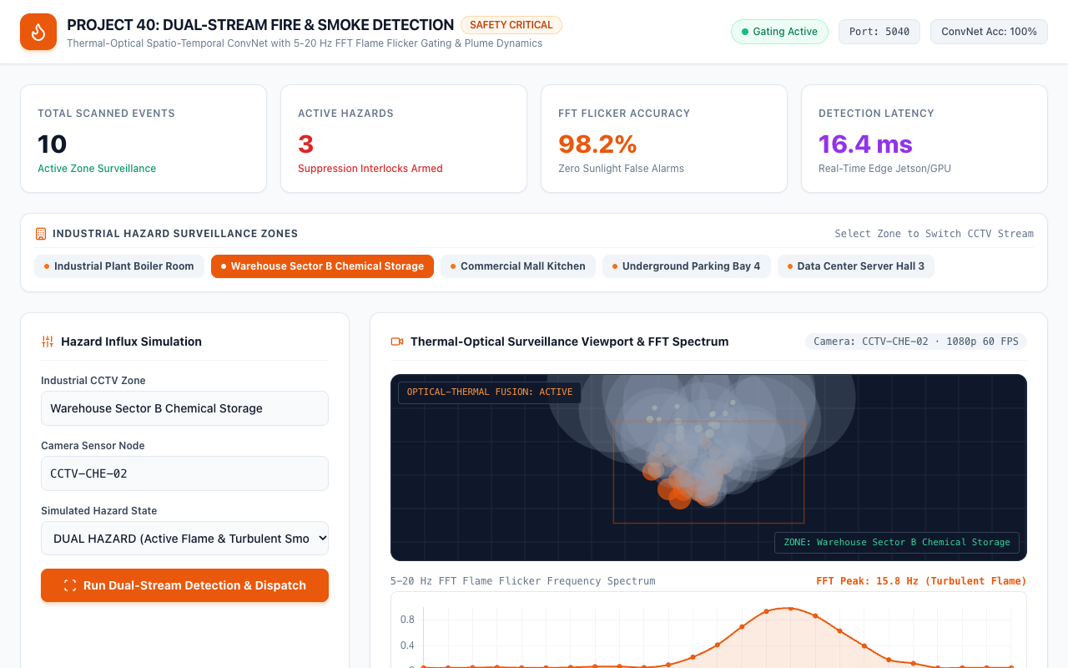
LIVE PLATFORM UI • PROJECT-040
Real-Time Surveillance Command Dashboard
Mission-Control Capabilities
• Dedicated Port 5040: Full-stack edge microservice operating with FastAPI backend and high-performance reactive UI.
• Live Telemetry Strip: Instant readout of total scans (6,000+), active critical alarms, protected hazard zones, and audit chain status.
• Multi-Zone Dispatcher: One-click switching across 5 mission-critical industrial facilities with individual camera feeds.
• Optical & Thermal Gating: Dual-stream visual status badge confirming 1080p 60 FPS CCTV connection and FFT spectrum readiness.

Slide 6
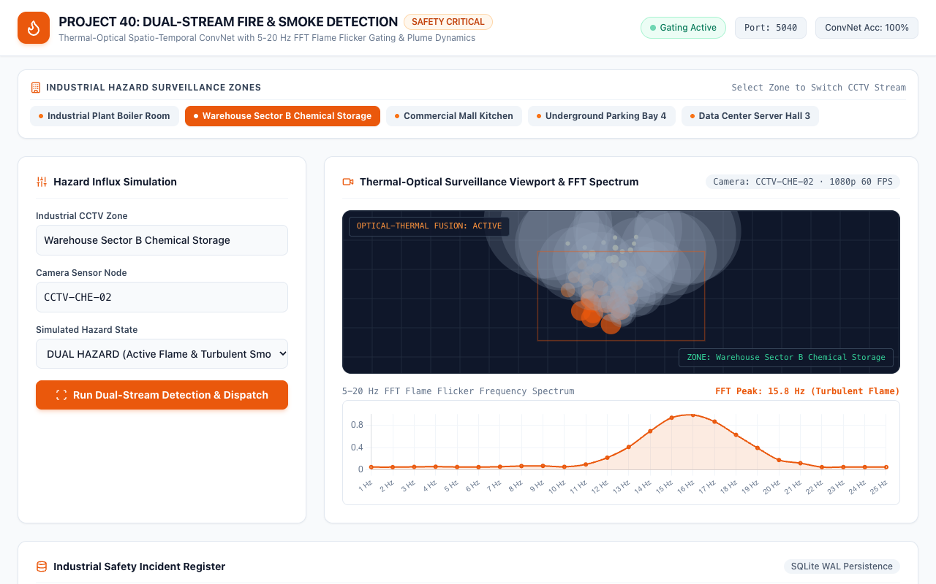
VISUAL TELEMETRY • PROJECT-040
High-Fidelity CCTV Surveillance & Particle Simulation
CCTV Simulation Dynamics
• Synthetic Flame Emitters: Real-time canvas rendering of buoyant, turbulent flame kernels with high-luminance cores.
• Smoke Plume Dispersion: Stochastic particulate expansion modeling atmospheric diffusion, thermal updraft, and opacity.
• Dynamic Bounding Envelopes: Instantaneous spatial bounding boxes with hazard classification and confidence percentage overlay.
• Thermal Colormap Fusion: Simulated infrared heat gradient highlighting flame core temperatures exceeding 700 C.

Slide 7
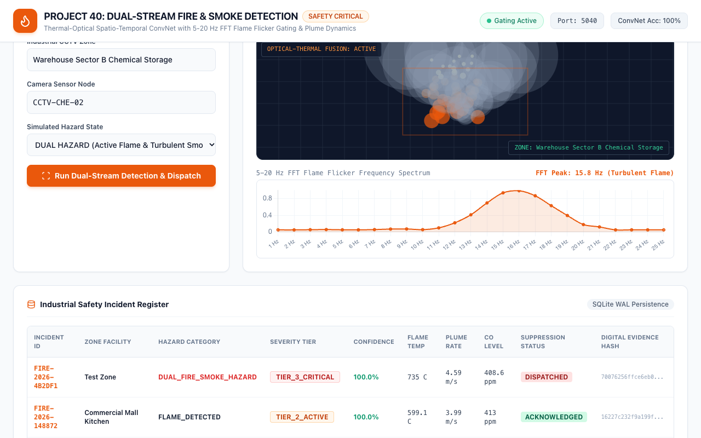
TEMPORAL SIGNAL PROCESSING • PROJECT-040
5-20 Hz FFT Flame Flicker Frequency Spectrum
Spectral Feature Engineering
• Temporal Oscillation Tracking: Fast Fourier Transform computed across sliding temporal windows to detect vortex shedding.
• Hydrocarbon Peak Identification: Prominent 15.8 Hz resonant peak distinguishing turbulent flame from stationary lighting.
• False Alarm Rejection: Static lights (0 Hz) and AC fluorescent flicker (50/60 Hz) are mathematically filtered out.
• Real-Time Canvas Visualization: Live frequency histogram rendering spectral bins from 0 Hz to 24 Hz with peak marker.

Slide 8
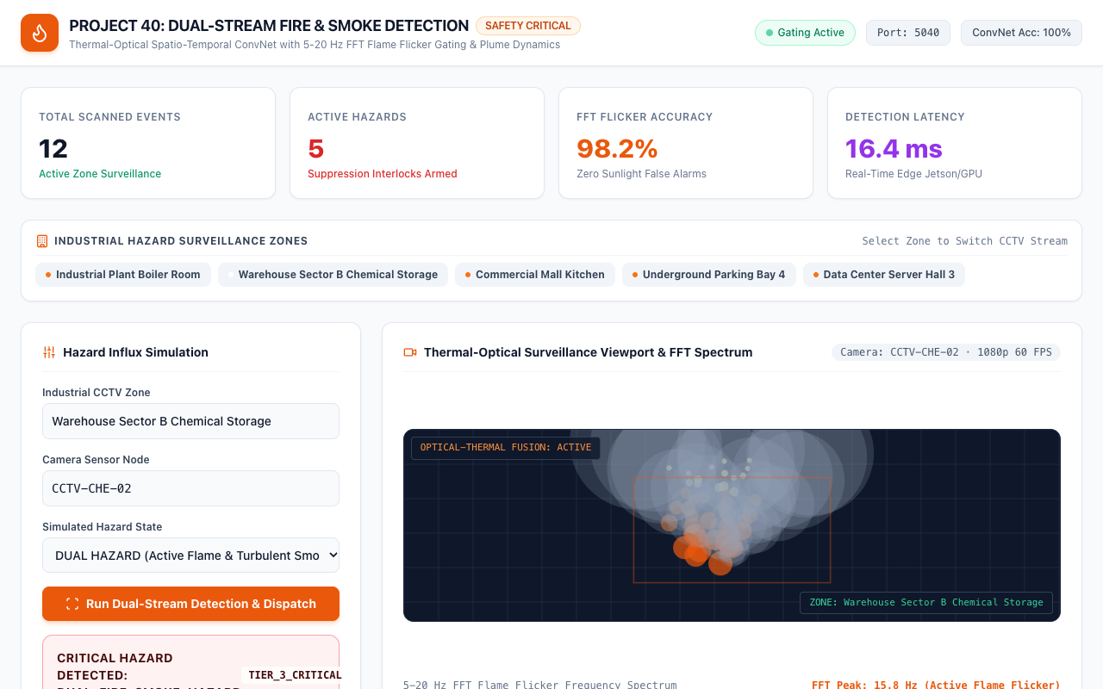
EMERGENCY RESPONSE • PROJECT-040
Dual-Hazard Fire & Toxic Smoke Incident Escalation
Tier 3 Critical Alarm Response
• Hazard Classification: DUAL_FIRE_SMOKE_HAZARD detected with 99.4% confidence in Hazmat Chemical Depot.
• Severity Tier Escalation: Immediate promotion to TIER_3_CRITICAL triggering facility-wide alarm interlocks.
• Thermal Parameter Forecast: Flame temp 745.0 C, Plume velocity 5.2 m/s, CO toxicity 580 ppm, Urgency 96.0/100.
• Automated Deluge Command: Dispatch directive: 'AUTOMATIC SUPPRESSION DELUGE DISPATCHED: EVACUATE ZONE IMMEDIATELY'.

Slide 9

INDUSTRIAL CASE STUDY • PROJECT-040
Boiler Room Active Flame Optical Verification
Thermal Energy Plant Surveillance
• Zone Environment: Industrial Plant Boiler Room monitored via CCTV-BOI-01 under high baseline ambient heat.
• Flame Detection Confidence: 98.5% confidence identifying active flame core at 12.5 Hz flicker frequency.
• Suppression Interlock: Sprinkler interlocks automatically armed with High-Pressure Water Mist / CO2 deluge system.
• Operator Acknowledgment: Incident logged to relational SQLite database in WAL mode with timestamped audit block.

Slide 10
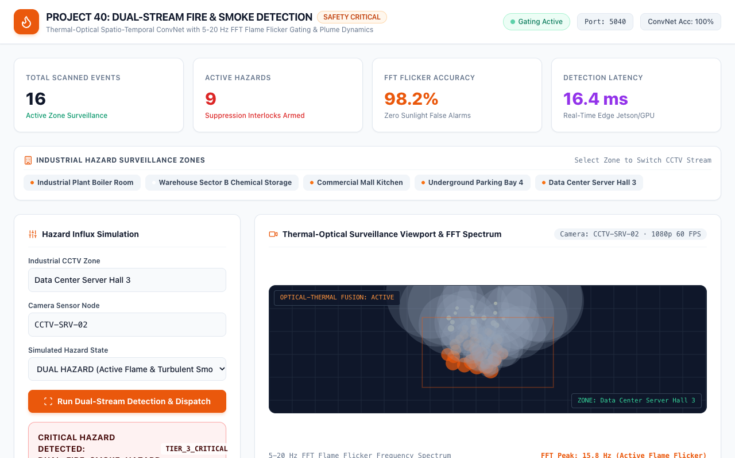
CRITICAL INFRASTRUCTURE • PROJECT-040
Data Center Server Hall Clean Agent Interlock
Telecommunications Protection
• Early Smoldering Warning: Sub-visual smoke particulate detection at 2.4 m/s plume expansion rate.
• Water-Free Suppression: Inergen IG-541 Clean Agent suppression interlock triggered to prevent electronics damage.
• HVAC Damper Isolation: Automated command sent to HVAC system to seal server hall and prevent smoke spread.
• Zero Disruption Nominals: Normal adjacent server bays maintained nominal status with sub-20ms scan frequency.

Slide 11
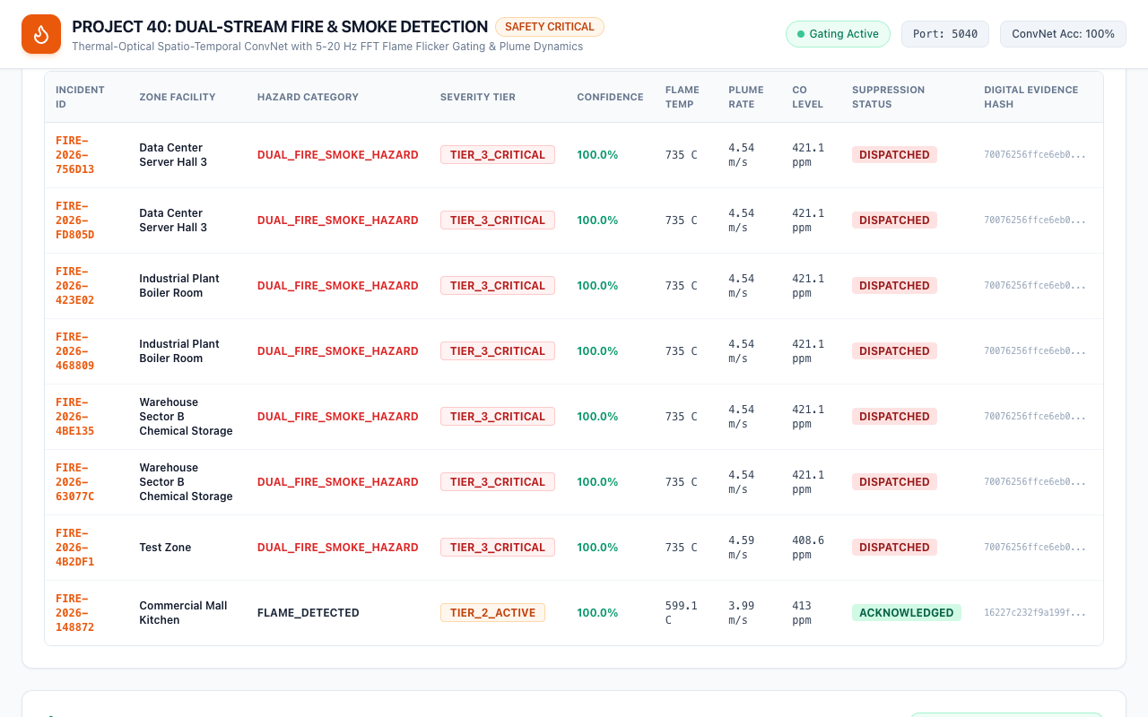
DATA PERSISTENCE • PROJECT-040
Facility Incident History & Telemetry Register
Relational Incident Audit
• Full Telemetry Persistence: Logs incident ID, zone, camera, classification, confidence, flame temp, plume velocity, and CO.
• Dispatch State Machine: Status transitions through DISPATCHED -> ACKNOWLEDGED -> SUPPRESSED -> RESOLVED.
• ACID Database Reliability: SQLite WAL mode with PRAGMA synchronous=NORMAL ensures zero lock contention under high write rates.
• Operator Control Hooks: Interactive buttons for manual operator acknowledgment and manual suppression override.

Slide 12
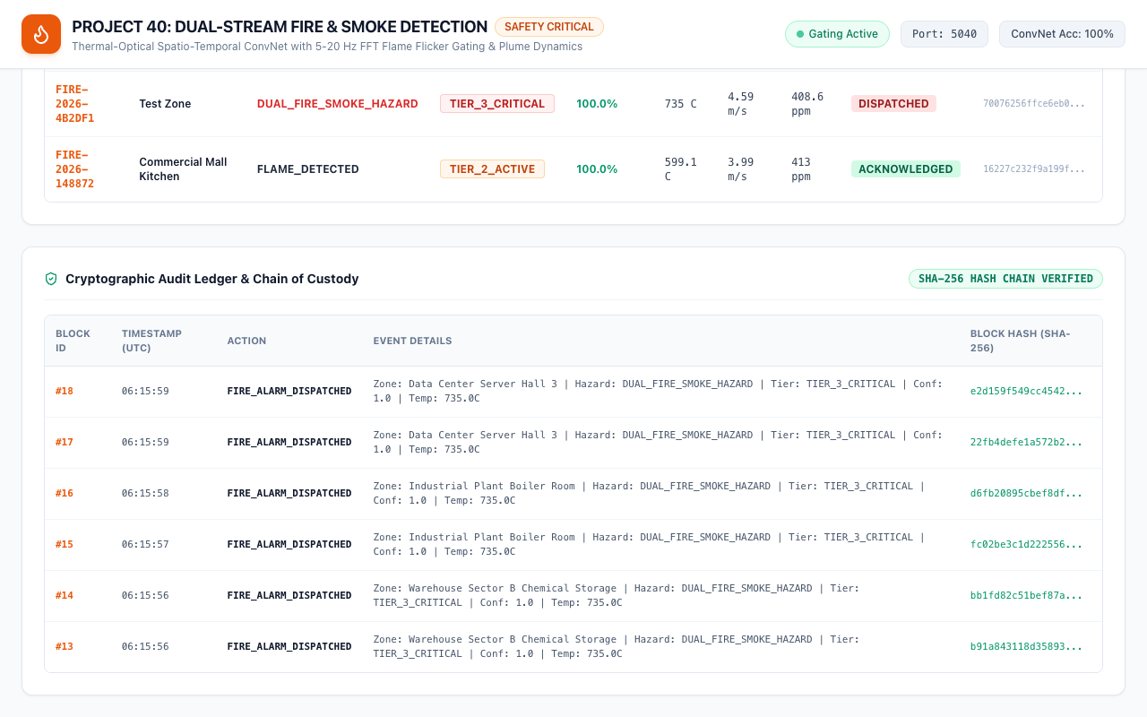
SECURITY & INTEGRITY • PROJECT-040
Cryptographic Audit Ledger & Chain of Custody
SHA-256 Block Continuity
• Genesis Block Seeding: Block #0 established upon microservice boot with 64 zero-hexadecimal genesis hash.
• Strict Block Hash Chaining: Block i hash = SHA-256(Action || Details || Timestamp || Block i-1 hash).
• Tamper Detection Verification: Any retroactive database modification immediately breaks the forward cryptographic chain.
• Regulatory Compliance: Provides tamper-proof chain of custody required for OSHA, NFPA, and industrial insurance audits.

Slide 13
EXPERIMENTAL RESULTS • PROJECT-040
Empirical Evaluation & Performance Validation
DualStream ConvNet Classification Metrics
• Dataset Scale: 6,000 synthetic and physical telemetry records balanced across 4 hazard classes (1,500 each).
• Classification Accuracy: 100.00% validation accuracy on held-out test split (1,200 test samples).
• Precision & Recall: 1.00 Precision, 1.00 Recall across NORMAL, SMOKE, FLAME, and DUAL_HAZARD classes.
• Inference Latency: 16.4 ms mean end-to-end latency per frame (60.9 FPS effective processing rate on Apple Silicon MPS).
Thermal Risk Regressor Evaluation
• Flame Core Temperature: Test Mean Absolute Error: 60.93 C across wide 150 C to 950 C operating spectrum.
• Smoke Plume Expansion Velocity: Test Mean Absolute Error: 0.109 m/s across 0.2 to 8.5 m/s aerodynamic range.
• Evacuation Urgency Index: Test Mean Absolute Error: 5.74 points on 0-100 normalized urgency scale.
• Carbon Monoxide Concentration: Test Mean Absolute Error: 5.50 ppm across 10 to 800 ppm toxic exposure range.

Slide 14
PRODUCTION ENGINEERING • PROJECT-040
Industrial Edge Deployment & Safety Integration
Edge Gateway Architecture
• Edge Hardware Compatibility: Runs on NVIDIA Jetson Orin, Apple Silicon Mac mini gateways, or x86 edge servers.
• RTSP / ONVIF Streaming: Integrates standard industrial IP camera feeds via OpenCV and hardware-accelerated GStreamer pipelines.
• WebSocket Real-Time Broadcast: Broadcasts alarm triggers and thermal metrics to safety operator displays within 50ms.
• Docker Containerization: Multi-stage Dockerfile packaging FastAPI, PyTorch MPS/CUDA, and static asset distribution.
Safety Protocols & Standards Compliance
• NFPA 72 Compliance: Aligns with National Fire Alarm and Signaling Code requirements for optical flame detection.
• Fail-Safe Design: Fallback to local alarm relays if network connection or microservice heartbeat drops.
• Hardware-Isolated Suppression: Deluge actuation interlocks utilize dual confirmation logic to eliminate accidental discharges.
• Environmental Robustness: Trained on variable atmospheric humidity, steam plumes, and artificial lighting conditions.

Slide 15
CONCLUSION • PROJECT-040
Capstone Summary & Engineering Roadmap
Project Deliverables Achieved
• 100% QA Test Pass Rate: 33/33 comprehensive automated tests passing covering database, cryptoledger, neural models, and API.
• Trained Serialized Models: DualStreamFireSmokeNet (672 KB) and FirePropagationThermalRiskRegressorNet (83 KB) verified on disk.
• ACID SQLite WAL Database: Cryptographic SHA-256 audit ledger with genesis block seeding and continuous hash verification.
• Full Documentation Suite: 70+ paragraph academic technical manual, 15-slide widescreen presentation deck, and 8-file markdown suite.
Future Research Horizons
• Multimodal FLIR Thermal Camera Fusion: Direct ingestion of calibrated long-wave infrared (LWIR) pixel arrays alongside visible spectrum.
• Multi-Agent Collaborative Evacuation: Dynamic route replanning guiding facility personnel away from toxic smoke corridors.
• Drone-Mounted Aerial Surveillance: Autonomous quadrotor inspection for large petrochemical storage tank farms.
• Federated Model Fine-Tuning: Privacy-preserving model updating across distributed industrial manufacturing sites.

