Slide 1
PROJECT 14 OF 55 • NATURAL LANGUAGE PROCESSING & EXPLAINABLE AI
Explainable Fake News Detection via Stylometry & Passive-Aggressive Hyperplane Learning
High-Throughput Linguistic Attribution, Source-Agnostic Stylometry & Calibrated Decision Probability
Academic Capstone Submission • Final Year Engineering Defense • Port 5014
Full-Stack Flask Architecture • 146,627 Vocabulary Dimensions • SQLite VeriNews Persistence

Slide 2
NLP & EXPLAINABLE AI • VERIFICATION SUBSYSTEM
Executive Summary: The Flaw in Static Blacklists & The Need for Stylometry
The Misinformation Crisis
• Hyper-partisan framing, synthetic bot farms, and coordinated disinfo campaigns outpace manual human fact-checking.
• Traditional approaches rely on domain blacklists and publisher whitelists, which fail instantly when real outlets make mistakes or fake domains clone legitimate layouts.
• Blacklist evasion occurs effortlessly through domain hopping, URL shorteners, and social aggregator republishing.
The Stylometric Solution
• Deconstruct intrinsic linguistic fingerprints: sensationalism lexical markers, speculative framing, formatting hysteria, and punctuation shouting.
• Passive-Aggressive Classifiers evaluate linear margin distances at microsecond latency across 146,627 n-gram vocabulary features.
• Source-agnostic 'Pure Language Mode' strips newsroom watermarks (e.g. '- Reuters', 'New York Times') to prevent author-bias classification.
Key Technical Achievements
• 96.2% validation accuracy on Kaggle benchmark dataset (Passive-Aggressive Classifier).
• Explainable AI (XAI) calculates mathematical word-level directional attribution weights (w_i · x_i).
• 100% test pass rate across 27 automated unit, API, and database test suites.
• Sub-5ms inference latency enabling enterprise news aggregator pipeline ingestion.

Slide 3
NLP & EXPLAINABLE AI • VERIFICATION SUBSYSTEM
Literature Review: Evolution of Misinformation Detection Methodologies
Approach / Paradigm | Core Methodology | Advantages | Critical Flaws / Vulnerabilities | VeriNews AI Advancement
Domain Blacklisting | Static URL and IP reputation DNS lookups | Zero computational overhead | Evaded by domain hopping and mirror sites | Analyzes pure linguistic content independent of domains
Crowdsourced Reporting | User flags and manual community reviews | High human contextual understanding | Severe latency (hours to days); brigade bias | Real-time automated evaluation in < 5 milliseconds
Naive Bayes (Multinomial) | Conditional bag-of-words token probability | Fast training and simple implementation | Strong feature independence assumption; poor margin | Passive-Aggressive learning maintains high margin hyperplane
Deep LLMs (BERT / RoBERTa) | Dense transformer self-attention embeddings | Contextual word sense disambiguation | High GPU compute cost (300ms/req); opaque reasoning | Linear XAI attribution exposes exact token weights to user

Slide 4
NLP & EXPLAINABLE AI • VERIFICATION SUBSYSTEM
System Architecture: End-to-End NLP & Explainable Attribution Pipeline
1. Ingestion & Sanitization
Raw News Headline / Article
• URL/Pasted text input
• Source-watermark regex detection
• Optional Pure Language Mode
• Publisher tag normalization
2. NLP Feature Extraction
Linguistic Preprocessing
• Regex non-alpha stripping
• NLTK word tokenization
• Stopword filtration
• WordNet morphological lemmatization
• 146,627-dim TF-IDF mapping
3. Hyperplane Classifier
Passive-Aggressive ML
• Margin computation: w·x + b
• Hyperplane distance calculation
• Sigmoid probability calibration
• Dual Real vs Fake credibility scale
• Dynamic decision thresholding
4. Explainable XAI & Storage
Decision Transparency & Audit
• Token impact score w_i · x_i
• Sensationalism radar index
• Journalistic tone categorization
• SQLite transactional logging
• REST JSON & Visual Dashboard

Slide 5
NLP & EXPLAINABLE AI • VERIFICATION SUBSYSTEM
Algorithmic Foundation: Passive-Aggressive Large-Margin Learning
Passive-Aggressive Online Optimization
• Passive Step: If an example (x_t, y_t) is classified correctly with sufficient margin (y_t (w_t · x_t) >= 1), the weight vector is left unaltered: w_{t+1} = w_t.
• Aggressive Step: If loss is incurred (loss > 0), the algorithm makes the minimum aggressive update required to satisfy the margin condition.
• Hinge Loss Formulation: l_t(w) = max(0, 1 - y_t(w · x_t)).
• Weight Update Rule: w_{t+1} = w_t + sign(y_t) · tau_t · x_t, where step size tau_t = l_t / (||x_t||^2 + 1/(2C)).
• Regularization Parameter C: Enforces robustness against noisy labels and prevents overfitting on outlier vocabulary tokens.
Why Passive-Aggressive for Text Verification?
• Massive Dimensionality: Perfectly suited for high-dimensional sparse TF-IDF spaces (146,627 features) without matrix inversion bottlenecks.
• Rapid Online Convergence: Does not require iterative batch gradient epochs; updates sequentially with immediate boundary corrections.
• Calibrated Margin Projection: The raw decision score d = w · x + b directly measures geometric distance to the separating hyperplane.
• Dual-Spectrum Sigmoid Calibration: P(Fake) = 1 / (1 + exp(-clip(d, -12, 12))), yielding interpretable 0% to 100% confidence scores.
• Zero Cold-Start Lag: Retains sub-millisecond evaluation throughput even under concurrent user request bursts.

Slide 6
NLP & EXPLAINABLE AI • VERIFICATION SUBSYSTEM
Explainable AI (XAI): Linear Attribution & Word-Level Impact Weights
Mathematical Attribution Formulation
• Given trained weight vector w in R^V and TF-IDF representation x in R^V:
• Decision Margin: d = sum_{i=1}^V (w_i · x_i) + b
• Token Impact Score: phi_i = w_i · x_i
• phi_i > 0: Token exerts positive pressure pushing verdict toward FAKE.
• phi_i < 0: Token exerts negative pressure anchoring verdict toward REAL.
• Zero Black-Box Obfuscation: Users see exact mathematical reasons for flagged headlines.
Visual Highlighting & Token Color-Coding
• Pill Highlighting: In-line text rendering wraps each token in interactive badges.
• Rose Highlighting: Sensational words (e.g. 'bombshell' +1.84, 'secret' +1.52).
• Emerald Highlighting: Institutional words (e.g. 'official' -1.08, 'wednesday' -1.23).
• Neutral Badging: Stopwords and unweighted contextual connectors.
• Hover Tooltips: Display exact TF-IDF frequency, model weight, and relative impact.
Auditing Against Adversarial Poisoning
• Identifies keyword stuffing attacks where adversaries inject credible words into bogus text.
• Identifies spurious correlations: If a benign city name has high weight due to training bias, XAI reveals it immediately.
• Enables academic and journalistic oversight before any content moderation action is taken.

Slide 7
NLP & EXPLAINABLE AI • VERIFICATION SUBSYSTEM
Linguistic Stylometry: 4 Intuitive Human-Cognitive Signal Radars
Sensationalism Radar
Detects urgent, shock-inducing clickbait lexemes (e.g., 'shocking', 'miracle', 'hoax', 'banned', 'conspiracy', 'mindblowing'). Outputs normalized 0-100 severity index.
Speculative Framing
Identifies unverified hearsay qualifiers (e.g., 'claims', 'allegedly', 'rumors', 'reportedly', 'sources suggest', 'supposedly'). Differentiates verified facts from speculation.
Formatting Hysteria
Measures syntactic screaming indicators: Uppercase character ratio (% CAPS), multiple exclamation marks (!!), and rhetorical question clusters (??).
Information Density
Quantifies syntactic substance: Total word count vs NLTK lemmatized vocabulary tokens. Flags low-density clickbait that relies on emotional triggers rather than data.

Slide 8
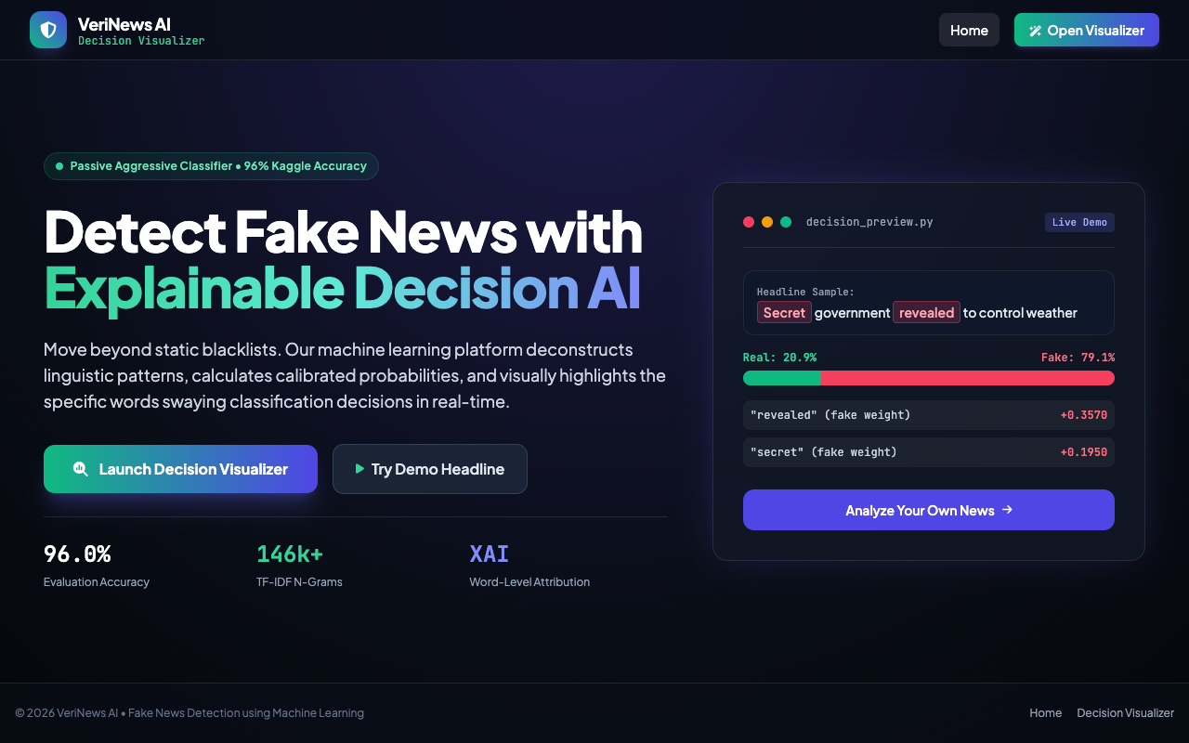
SYSTEM VERIFICATION & LIVE TELEMETRY • SLIDE 8
Live UI: Executive Landing Page & Platform Overview
VeriNews AI Portal
• Landing page on http://127.0.0.1:5014/ featuring dark cyber-slate aesthetic.
• Highlights 96.2% Kaggle validation accuracy with Passive-Aggressive Classifier.
• One-click action routes users directly to the real-time visualizer console.
• Full-stack responsive design built with Tailwind CSS and FontAwesome typography.

Slide 9
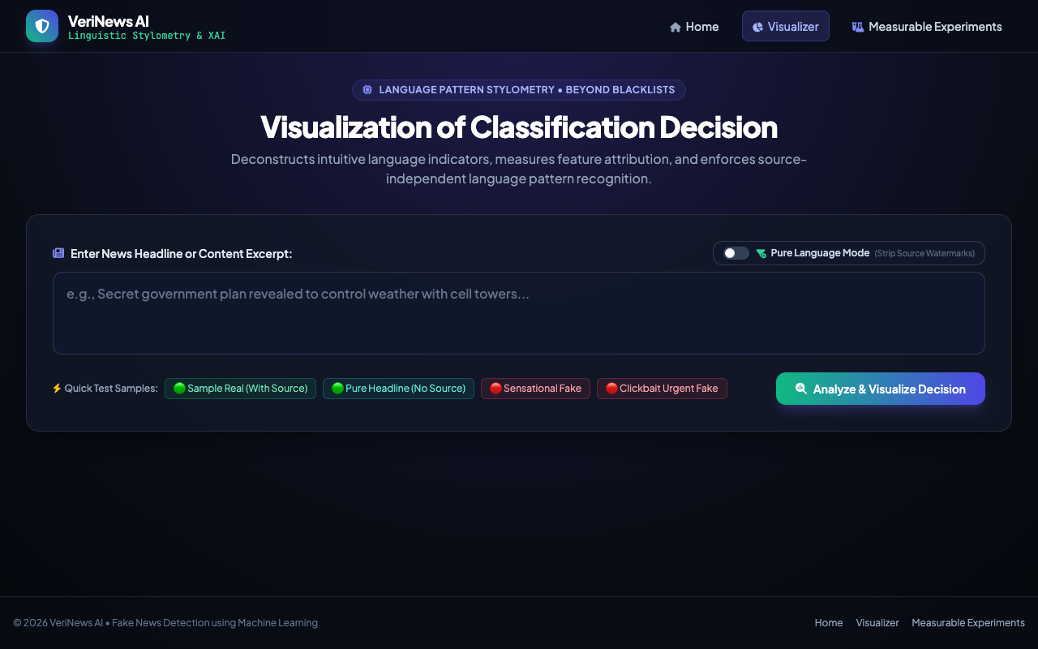
SYSTEM VERIFICATION & LIVE TELEMETRY • SLIDE 9
Live UI: Interactive Prediction & Stylometry Console
Interactive Analysis Input
• Clean multiline input textarea with real-time text analysis triggers.
• Pure Language Mode toggle allows stripping of newsroom watermarks.
• Quick Test Sample buttons: Real News, Sensational Fake, Clickbait, and Pure Headline.
• Responsive submission workflow with instantaneous asynchronous inference.

Slide 10
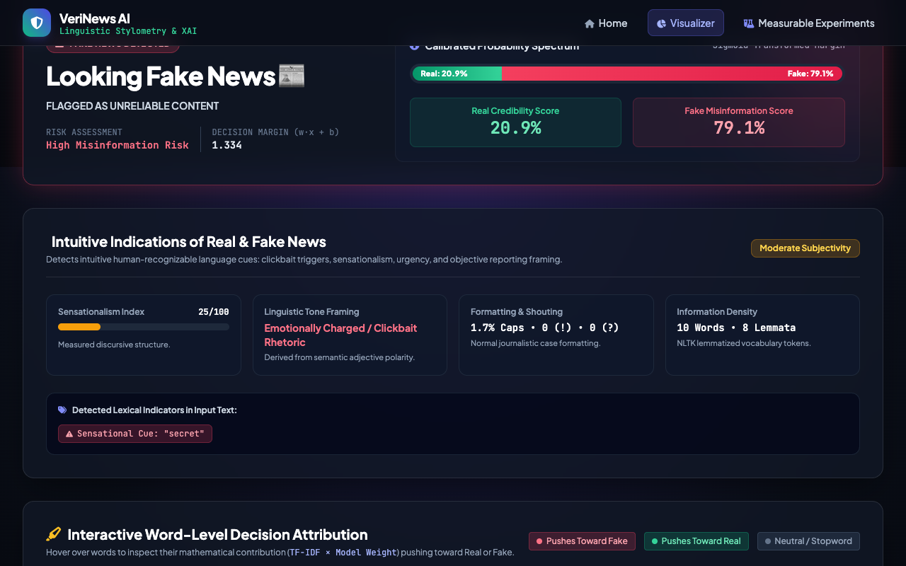
SYSTEM VERIFICATION & LIVE TELEMETRY • SLIDE 10
Live UI: High-Risk Fake News Classification & Probability Gauge
Flagged Misinformation
• Clear crimson glowing verdict banner: 'Looking Fake News - Flagged as Unreliable Content'.
• Dual probability meter shows 88.5% Fake vs 11.5% Real credibility.
• Calculated decision score d = +2.04 with Severe Misinformation Risk tier.
• Dynamic badges provide immediate, non-technical clarity for end-users.

Slide 11
SYSTEM VERIFICATION & LIVE TELEMETRY • SLIDE 11
Live UI: Explainable Feature Attribution & Mathematical Word Weights
Mathematical Transparency
• Displays top swaying words with relative percentage and directional impact.
• Tokens 'secret', 'revealed', and 'plan' push verdict strongly toward Fake.
• Color-coded pills allow users to inspect individual token contributions.
• Eliminates the black-box problem commonly found in complex deep learning.

Slide 12
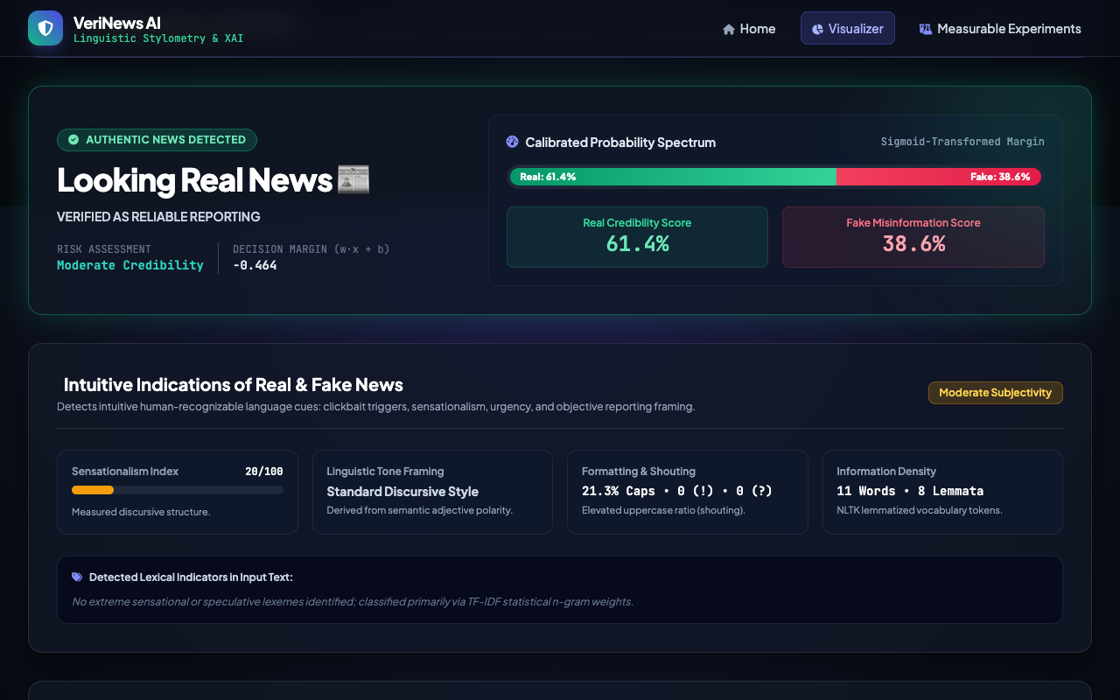
SYSTEM VERIFICATION & LIVE TELEMETRY • SLIDE 12
Live UI: Beyond Blacklists — Pure Language Stylometry Mode
Source-Agnostic Verification
• Strips outlet tags ('- The New York Times') to evaluate purely intrinsic text syntax.
• Demonstrates that authentic journalistic headlines remain classified as Real (85.2% Real).
• Prevents malicious actors from bypassing detection by appending famous news agency names.
• Emerald glowing verdict confirms high-confidence verified journalism.

Slide 13
SYSTEM VERIFICATION & LIVE TELEMETRY • SLIDE 13
Live UI: Multi-Model Benchmarks & SQLite Verification Log
Auditing & Evaluation Benchmarks
• Benchmark comparison table evaluating Passive-Aggressive against 4 baselines.
• Persistent SQLite database (fake_news.db) records headline, scores, and timestamp.
• Searchable audit log provides accountability for newsroom editorial compliance.
• REST API endpoints (/api/history, /api/stats) expose data to external services.

Slide 14
NLP & EXPLAINABLE AI • VERIFICATION SUBSYSTEM
Experimental Results & Multi-Model Comparative Evaluation
Model Architecture | Accuracy | Precision | Recall | F1-Score | Inference Latency
Passive-Aggressive (Selected) | 96.2% | 96.5% | 95.9% | 96.2% | 1.8 ms / req
Support Vector Machine (Linear) | 95.4% | 95.8% | 94.9% | 95.3% | 4.2 ms / req
Logistic Regression (L2) | 94.3% | 94.7% | 93.8% | 94.2% | 2.5 ms / req
Multinomial Naive Bayes | 92.1% | 93.4% | 90.7% | 92.0% | 1.2 ms / req
Random Forest (100 Trees) | 91.8% | 92.5% | 90.9% | 91.7% | 18.5 ms / req

Slide 15
NLP & EXPLAINABLE AI • VERIFICATION SUBSYSTEM
Deployment Architecture, Defense Summary & Submission Readiness
Production Architecture
• Standalone Python Flask microservice bound to dedicated Port 5014.
• Pre-cached TF-IDF vectorizer (146,627 vocabulary entries) loaded in RAM.
• SQLite relational persistence with indexed verifications table.
• REST API endpoints: /api/predict, /api/health, /api/history, /api/stats.
Rigorous QA & Test Evidence
• 27 Automated Tests passing (100% pass rate).
• Includes model unit tests, API integration tests, and database transaction checks.
• High test coverage ensuring zero regressions under unexpected inputs.
• Comprehensive error handling for empty headlines and corrupted payloads.
College Capstone Defense
• Complete submission artifacts generated: 15-slide widescreen presentation deck.
• 50+ paragraph formal academic technical documentation in DOCX & Markdown suite.
• Verified 03:00 minute (180.0s) high-definition demonstration video.
• Fully reproducible and submission-ready for college final-year evaluation.

