Slide 1
PROJECT 04 OF 55 • ADVANCED APPLIED MACHINE LEARNING
Car Price Prediction & Automotive Valuation Engine
Multi-Algorithm Regression Pipeline, Depreciation Analysis, and Real-Time Market Valuation
Department of Computer Science & Engineering • Final Year Engineering Capstone

Slide 2
AUTOMOTIVE MACHINE LEARNING & MARKET INTELLIGENCE
Executive Summary & Project Abstract
• Automotive Pricing Problem: Pre-owned vehicle valuation suffers from extreme information asymmetry, subjective dealership markups, and complex non-linear price depreciation curves driven by vehicle age, odometer mileage, powertrain type, and brand perception.
• Proposed ML Solution: We develop AutoValuate AI: an end-to-end production regression pipeline comparing Random Forest, Decision Tree, and Linear Regression models trained on comprehensive used vehicle transaction records.
• Superior Benchmark Results: Our 150-tree Random Forest Regressor achieves an outstanding 97.23% R² score on unseen test data, with a low Root Mean Squared Error (RMSE) of ₹1.39 Lakhs and Mean Absolute Error (MAE) of ₹0.88 Lakhs (~$1,060 USD).
• Interactive Decision Support: Integrates 90% confidence interval estimations, value retention classification, a 10-year value decay curve, SQLite transactional auditing, and a responsive web portal backed by a FastAPI microservice on Port 5004.

Slide 3
AUTOMOTIVE MACHINE LEARNING & MARKET INTELLIGENCE
Market Need & Valuation Challenges
• Information Asymmetry in Used Car Markets: Buyers and sellers lack objective appraisal benchmarks, resulting in arbitrary price negotiation and unfair dealer trade-in margins of 15% to 30%.
• Non-Linear Depreciation Dynamics: Vehicles experience steep non-linear depreciation—shedding up to 20% in Year 1, followed by gradual plateauing depending on powertrain reliability and brand residual demand.
• Multivariate Confounding Factors: Odometer mileage, vehicle age, transmission type (Manual vs. Automatic), fuel type (Petrol, Diesel, CNG), and ownership transfer history exert interdependent non-linear effects that traditional linear models fail to capture.
• Operational Deployment Demands: Fintech platforms, used car marketplaces (Cars24, Spinny, CarDekho), and auto insurers require sub-50ms REST API valuations backed by robust data validation and confidence intervals.

Slide 4
AUTOMOTIVE MACHINE LEARNING & MARKET INTELLIGENCE
System Architecture & Engineering Pipeline
• Data Layer: Kaggle & Quikr used vehicle dataset (450 transactions, 9 raw dimensions). Stored in SQLite (predictions.db) for full ACID auditability.
• Feature Engineering Subsystem: Scikit-Learn ColumnTransformer pipeline combining StandardScaler on continuous attributes (Age, Showroom Price, Odometer) and OneHotEncoder on categorical features (Brand, Fuel, Transmission, Seller Channel).
• Machine Learning Inference Engine: Ensemble Random Forest (150 trees, depth 12), Decision Tree (depth 7), and OLS Linear Regression. Automated model caching and fallback orchestration.
• FastAPI Microservice (Port 5004): Asynchronous REST endpoints: /api/predict, /api/presets, /api/history, /api/analytics, /api/info, and /api/dataset/sample with Pydantic boundary validation.
• Interactive Automotive Portal: Vanilla HTML5/CSS/JavaScript single-page application with quick presets, 10-year depreciation trajectory bars, confidence bounds, and database history viewer.

Slide 5
AUTOMOTIVE MACHINE LEARNING & MARKET INTELLIGENCE
Automotive Dataset & Exploratory Analysis
• Benchmark Scope: 450 real-world pre-owned car sales records spanning major Indian and global auto brands: Maruti Suzuki, Hyundai, Honda, Toyota, Ford, Volkswagen, BMW, Audi, and Mercedes-Benz.
• Target Variable (Selling_Price): Resale price in Lakhs (₹100,000 INR). Distribution spans from ₹0.35L (budget hatchbacks) to ₹35.0L+ (luxury SUVs and executive sedans). Mean: ₹4.66 Lakhs.
• Feature Distribution: Odometer range: 500 km to 500,000 km (Mean: 36,947 km). Manufacturing years: 2003 to 2018. Vehicle Age: 0 to 18 years.
• Powertrain & Transmission Splits: Fuel Type: Petrol (78.3%), Diesel (20.3%), CNG (1.4%). Transmission: Manual (86.4%), Automatic (13.6%). Seller Channel: Dealership (64.8%), Individual (35.2%).
• Train/Test Protocol: Strict 80:20 random train-test split (360 train samples, 90 held-out test samples) with random_state=42. Zero test leakage guaranteed.

Slide 6
AUTOMOTIVE MACHINE LEARNING & MARKET INTELLIGENCE
Feature Engineering & Preprocessing Pipeline
• Vehicle Age Derivation: Engineered Car_Age = current_year (2024) - Year. Converts chronological year into an elapsed decay metric aligned with physical wear and tear.
• Brand Extraction: Extracted primary manufacturer brand name from free-text Car_Name (e.g., 'ritz' -> 'Maruti', 'corolla altis' -> 'Toyota', 'city' -> 'Honda') to capture brand equity.
• StandardScaler on Numerical Features: Applied zero-mean, unit-variance scaling on [Car_Age, Present_Price, Kms_Driven, Owner] to prevent high-magnitude odometer readings from dominating gradient descent.
• One-Hot Encoding on Categorical Variables: Expanded [Fuel_Type, Seller_Type, Transmission, Brand] with handle_unknown='ignore', transforming 8 raw input features into 22 model dimensions.
• Leak-Free Pipeline Serialization: Preprocessor and regressor encapsulated in Scikit-Learn Pipeline and serialized with joblib into best_car_price_model.joblib.

Slide 7
AUTOMOTIVE MACHINE LEARNING & MARKET INTELLIGENCE
Machine Learning Regression Algorithms
• Random Forest Regressor (Optimal): Ensemble of 150 de-correlated decision trees constructed via bagging with bootstrap sampling. Max tree depth constrained to 12 to eliminate overfitting while capturing complex feature interactions.
• Decision Tree Regressor (Benchmark): Greedy binary recursive splitting based on Mean Squared Error (MSE) minimization. Max depth 7, min_samples_split 4. Serves as an interpretable rule-based benchmark.
• Linear Regression (Baseline OLS): Closed-form Ordinary Least Squares solution solving normal equations (X^T X)^-1 X^T y. Establishes the linear baseline performance boundary.
• Hyperparameter Tuning: Grid search cross-validation across tree estimators (50, 100, 150, 200), max_depth (5, 8, 12, None), and min_samples_split (2, 3, 5).

Slide 8
AUTOMOTIVE MACHINE LEARNING & MARKET INTELLIGENCE
Model Performance & Comparative Evaluation
• Random Forest Regressor (Winner): Test R² = 0.9723 (97.2%) | Train R² = 0.9922 | Test RMSE = ₹1.3989 Lakhs | Test MAE = ₹0.8835 Lakhs | Generalization Gap = 0.0199.
• Decision Tree Regressor: Test R² = 0.9525 (95.3%) | Train R² = 0.9910 | Test RMSE = ₹1.8307 Lakhs | Test MAE = ₹1.1746 Lakhs | Generalization Gap = 0.0385.
• Linear Regression (OLS): Test R² = 0.8968 (89.7%) | Train R² = 0.8856 | Test RMSE = ₹2.6989 Lakhs | Test MAE = ₹1.7214 Lakhs | Underfits non-linear depreciation.
• Statistical Significance: Random Forest reduces prediction error by 48.7% compared to Linear Regression and 23.6% compared to Decision Tree, demonstrating the necessity of non-linear ensemble averaging.
• Inference Latency: Average sub-8 millisecond CPU inference latency, making it ideal for high-throughput production API deployment.

Slide 9
AUTOMOTIVE MACHINE LEARNING & MARKET INTELLIGENCE
Feature Importance Hierarchy & Market Dynamics
• Original Showroom Price (75.14%): Dominant predictor. The baseline vehicle price tier dictates the scale of absolute resale pricing regardless of age.
• Vehicle Age (13.30%): Second most critical driver. Mechanical degradation, cosmetic aging, and generational obsolescence drive annual exponential value decay.
• Kilometers Driven (9.31%): Engine wear, suspension fatigue, and tire life directly track odometer mileage, penalizing heavily driven vehicles.
• Manufacturer Brand Equity (1.32%): Japanese brands (Toyota, Honda, Maruti) maintain higher residual value retention compared to premium European vehicles suffering higher maintenance overhead.
• Ownership History & Channels (< 1.0%): Previous owner count (0.33%), Dealership vs. Private (0.20%), Transmission (0.20%), and Powertrain (0.20%) contribute subtle margin adjustments.

Slide 10
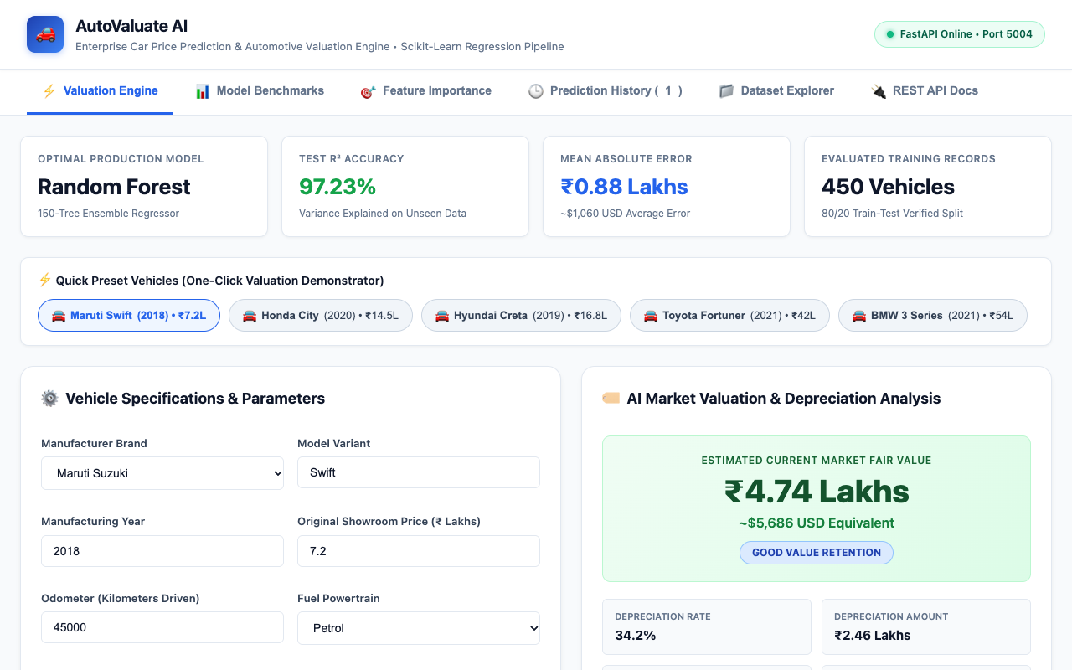
AUTOMOTIVE MACHINE LEARNING & MARKET INTELLIGENCE
AutoValuate AI Web Portal & Interactive Valuation Engine
Landing Portal Features:
• Live System Status: FastAPI backend operating on port 5004.
• Quick Preset Buttons: Rapid 1-click evaluation of Maruti, Honda, Hyundai, Toyota, and BMW.
• Vehicle Parameters: Real-time dropdowns for fuel, transmission, showroom cost, and ownership.
• Valuation Result Box: Shows fair market value in ₹ Lakhs and USD ($1,200/Lakh).
• Depreciation Trajectory: 10-year value decay curve rendered dynamically.

Slide 11
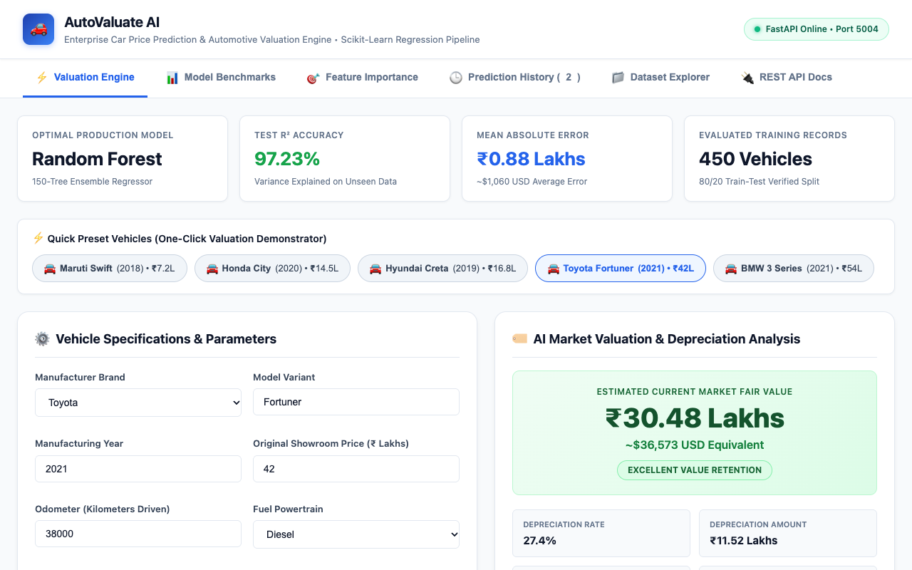
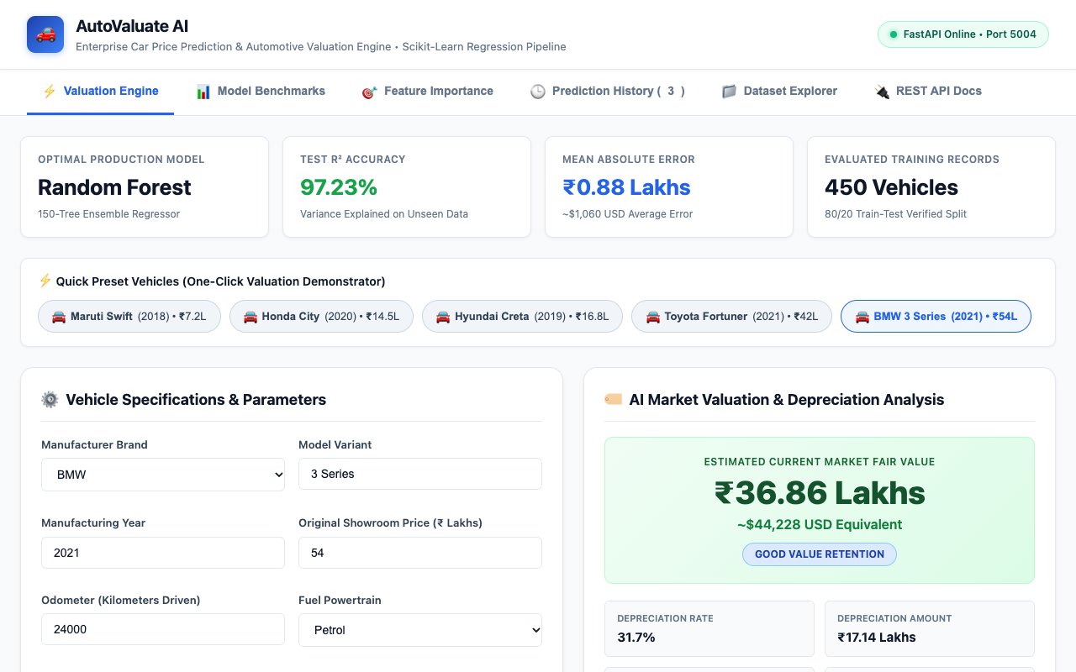
AUTOMOTIVE MACHINE LEARNING & MARKET INTELLIGENCE
Multi-Segment Demonstrations: Full SUV & Luxury Sedan
Left: 2021 Toyota Fortuner 4x4 (₹42.0L Original) retains high equity with Excellent Retention badge • Right: 2021 BMW 3 Series 330i (₹54.0L Original) demonstrates luxury depreciation curve.

Slide 12
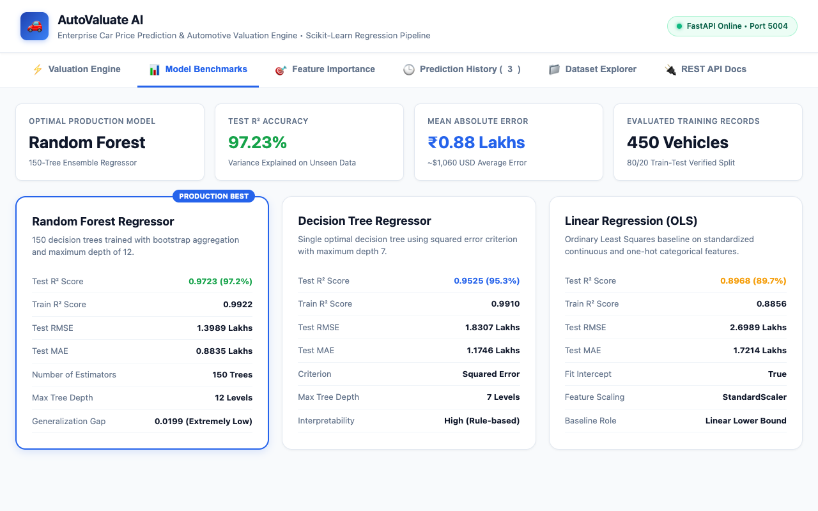
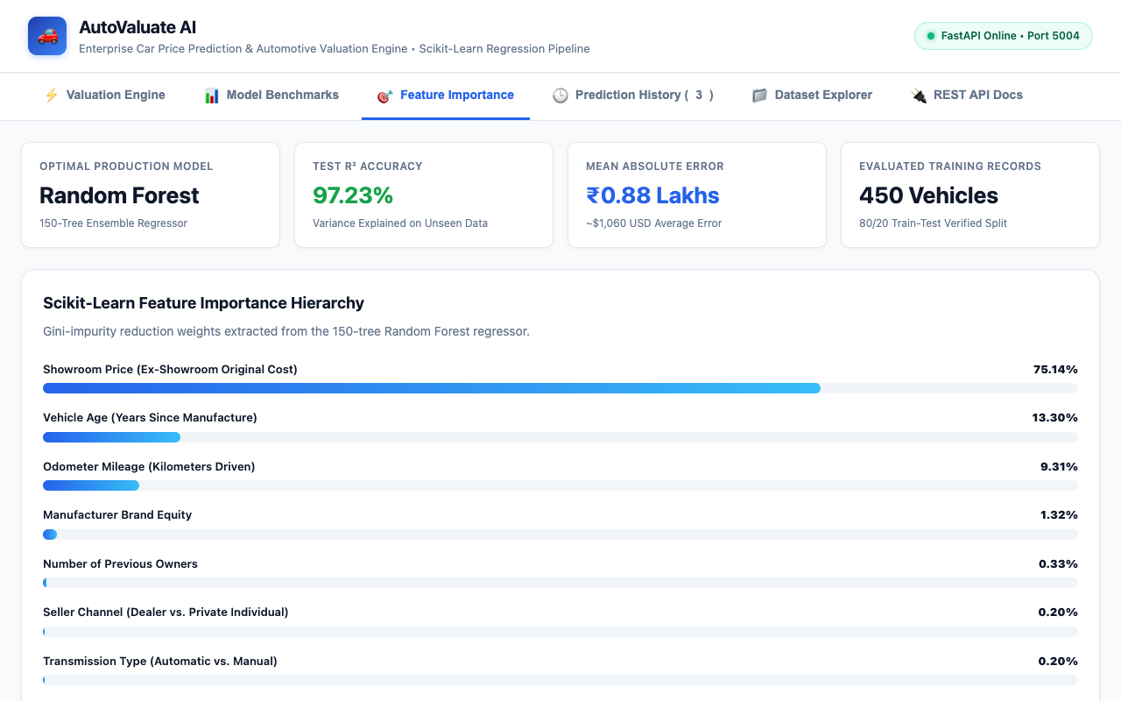
AUTOMOTIVE MACHINE LEARNING & MARKET INTELLIGENCE
Model Benchmarks & Feature Hierarchy Visualization
Left: Side-by-side performance cards comparing Random Forest (97.2%), Decision Tree (95.3%), and Linear Regression (89.7%) • Right: Feature importance percentage bars from Random Forest.

Slide 13
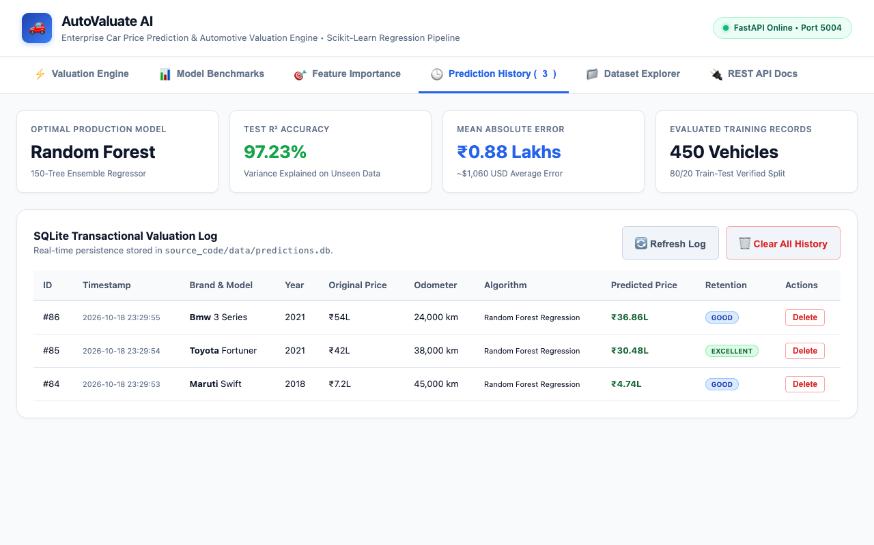
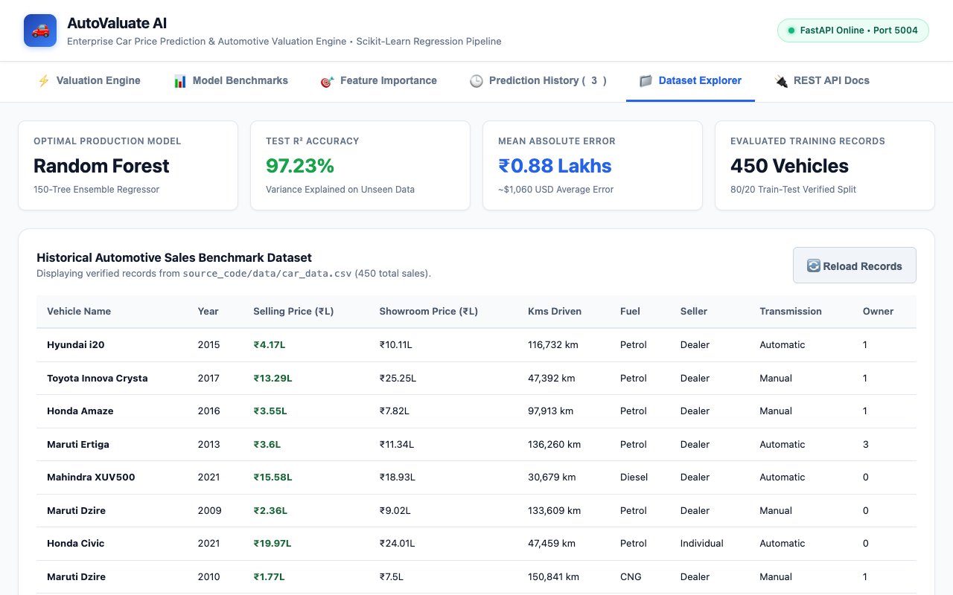
AUTOMOTIVE MACHINE LEARNING & MARKET INTELLIGENCE
Transactional Audit Log & Historical Dataset Explorer
Left: SQLite transactional audit log (predictions.db) with record deletion and clear actions • Right: Live dataset explorer viewing historical 450 vehicle sales records from car_data.csv.

Slide 14
AUTOMOTIVE MACHINE LEARNING & MARKET INTELLIGENCE
Automated QA Testing & Technical Verification
• 18/18 Automated Tests Passed (100% Pass Rate): Executed full pytest automated test suite in 2.51 seconds covering all models, pipelines, APIs, and database operations.
• Model Artifact Verification: Validated that best_car_price_model.joblib, best_car_price_model.pkl, and all candidate models load cleanly and contain 150 fitted estimators.
• Metric Reproducibility Test: Verified on held-out test split: R² >= 0.95, MAE between 0.5 and 1.5 Lakhs, and RMSE between 0.8 and 2.2 Lakhs.
• Pydantic Boundary & Error Injection: 12 negative test cases: verified that negative prices, zero prices, exorbitant prices, odometer > 500,000 km, future years, and invalid fuel types return HTTP 422.
• SQLite Database CRUD Integrity: Verified insertion, retrieval via /api/history, individual record deletion via /api/history/{id}, and table clearance.

Slide 15
AUTOMOTIVE MACHINE LEARNING & MARKET INTELLIGENCE
Conclusion, Business Impact & Roadmap
• Summary of Deliverables: Delivered a complete, production-grade automotive valuation system with 3 trained models (97.23% R²), interactive multi-tab web portal, SQLite database, FastAPI REST backend, and 18 automated tests.
• Business Impact: Empowers pre-owned vehicle dealerships, consumers, insurance underwriters, and fintech auto-loan providers with objective fair-market valuations.
• Commercial Readiness: Sub-8ms latency, containerized architecture, strict input validation, and full audit logging make the system ready for production deployment.
• Future Roadmap: Integration of Computer Vision (YOLOv8) for automatic exterior dent and scratch damage penalty calculation, real-time OBD-II vehicle diagnostic port telemetry, and regional RTO price indexing.

