Slide 1
PROJECT-032 CAPSTONE DEFENSE
Predictive Maintenance of Industrial Machines
Using Multivariate Sensor Data & Deep Learning
Deep Neural Fault Diagnostics, Remaining Useful Life (RUL) & Real-Time Work Order Dispatch
Dual PyTorch Models • 6,000 Sensor Records • SQLite WAL Persistence • 31 Passing QA Tests

Slide 2
PROJECT 32 • INDUSTRIAL AI & PREDICTIVE TELEMATICS
Executive Summary: Industrial Machine Reliability Challenges
Cost of Unplanned Downtime
• Unplanned industrial equipment failures cost manufacturing plants billions annually.
• Traditional preventive maintenance adheres to rigid calendar schedules, leading to over-maintenance or missed incipient defects.
• Vibration, thermal, and acoustic signals contain early micro-degradation signatures that simple threshold alarms miss.
• Catastrophic bearing spalls or turbine imbalances cause catastrophic secondary asset destruction.
• Manual vibration route data collection introduces multi-week diagnosis latency.
The Project 32 Architecture
• Continuous 8-dimensional telemetry ingestion across industrial rotating machinery.
• 8-band FFT harmonic vibration spectrum analysis (1X, 2X, BPFO, BPFI, BSF, FTF).
• Dual PyTorch neural networks: 6-class fault diagnostic classifier and continuous RUL regressor.
• Sub-millisecond inference calculating Remaining Useful Life (RUL hours & days) and health scores.
• ACID relational SQLite storage with Write-Ahead Logging (WAL) and automated work order dispatch.

Slide 3
PROJECT 32 • INDUSTRIAL AI & PREDICTIVE TELEMATICS
Industrial Asset Fleet: 5 Mission-Critical Machines
Compressor & Pump Assets
• Rotary Screw Compressor A-101:
• - Criticality: High | 2,980 RPM.
• - Nominal: 72°C, 1.1 mm/s, 8.5 bar.
• - Susceptible to rotor imbalance and bearing wear.
• Centrifugal Slurry Pump B-204:
• - Criticality: Critical | 1,480 RPM.
• - Nominal: 64°C, 0.8 mm/s, 14.2 bar.
• - Exposed to hydraulic cavitation and impeller erosion.
Motor & Turbine Assets
• Induction Motor C-302:
• - Criticality: Medium | 1,780 RPM.
• - Nominal: 68°C, 0.6 mm/s, 1.0 bar.
• - Monitored for stator winding overheating.
• Co-Gen Gas Turbine D-401:
• - Criticality: Critical | 5,400 RPM.
• - Nominal: 118°C, 1.4 mm/s, 22.0 bar.
• - Highest thermal & mechanical stress profile.
Material Handling Asset
• Heavy Ore Conveyor Drive E-505:
• - Criticality: Low | 720 RPM.
• - Nominal: 52°C, 1.8 mm/s, 3.5 bar.
• - High mechanical coupling looseness risk.
• Dynamic Health Profiling:
• - System maintains baseline nominal thresholds.
• - Normalized deviations trigger predictive diagnosis.

Slide 4
PROJECT 32 • INDUSTRIAL AI & PREDICTIVE TELEMATICS
Multivariate Telemetry Dataset (6,000 Industrial Records)
8 Physical Sensor Feature Dimensions
• Temperature (°C): 35.0 to 140.0 °C continuous thermal sensor.
• Vibration RMS (mm/s): 0.4 to 8.5 mm/s piezoelectric accelerometer.
• Discharge Pressure (bar): 0.5 to 28.0 bar piezoresistive transducer.
• Shaft Rotation (RPM): 600 to 5,800 RPM optical encoder.
• Oil Viscosity (cSt): 25.0 to 80.0 cSt dielectric lubrication sensor.
• Acoustic Emission (dB): 45.0 to 110.0 dB ultrasonic high-frequency probe.
• FFT Harmonic Ratio: 2X to 1X harmonic ratio (0.05 to 1.6).
• Bearing Defect Frequency Energy: BPFO/BPFI spectral energy (0.01 to 1.5).
6 Model Fault Modes
• Normal Baseline (35%): Equilibrium operating envelope.
• Outer Race Bearing Spall (15%): High BPFO defect energy & vibration.
• Rotor Dynamic Imbalance (14%): High 1X/2X fundamental harmonics.
• Hydraulic Cavitation Wear (12%): High acoustic emission & pressure drop.
• Stator Winding Overheating (12%): Severe thermal surge (>1.5x nominal).
• Mechanical Coupling Looseness (12%): Elevated 2X/3X harmonics.
• Dataset serialized to 6,000-record CSV and structured JSON.

Slide 5
PROJECT 32 • INDUSTRIAL AI & PREDICTIVE TELEMATICS
Dual PyTorch Architecture: Residual Classifier & RUL Regressor
MachineHealthClassifierNet (6 Fault Classes)
• Input Layer: 8 features -> Linear(8, 64) + BatchNorm1d + ReLU + Dropout(0.15).
• Deep Residual Block: Linear(64, 64) -> BatchNorm -> ReLU -> Linear(64, 64) -> BatchNorm + Skip Connection.
• Classification Head: Linear(64, 32) -> ReLU -> Linear(32, 6) logits.
• Outputs: Normal, Bearing Spall, Imbalance, Cavitation, Stator Overheating, Looseness.
• Optimization: AdamW (lr=0.003, weight_decay=1e-4) with CrossEntropyLoss.
• Validation Accuracy: 96.83% across 1,200 held-out test vectors.
RULRegressorNet (Health Score & RUL Hours)
• Input Layer: 8 features -> Linear(8, 64) + LayerNorm + GELU.
• Hidden Dense Layers: Linear(64, 64) + LayerNorm + GELU -> Linear(64, 32) + GELU.
• Dual Output Projection Heads: Linear(32, 2).
• Output 1: Health Score (0-100%) bounded via Sigmoid * 100.
• Output 2: Remaining Useful Life (RUL hours) via Softplus + 24.0 (minimum 24h).
• Loss: Mean Squared Error (MSELoss) with physical degradation limits.

Slide 6
PROJECT 32 • INDUSTRIAL AI & PREDICTIVE TELEMATICS
Model Training Convergence & Accuracy Metrics
Fault Classifier Convergence
• Epoch 05: Train Loss 0.1155 | Validation Accuracy 96.33%
• Epoch 10: Train Loss 0.0933 | Validation Accuracy 96.50%
• Epoch 15: Train Loss 0.0858 | Validation Accuracy 96.83%
• Epoch 20: Train Loss 0.0906 | Validation Accuracy 96.58%
• Epoch 25: Train Loss 0.0884 | Validation Accuracy 96.83%
• Zero misclassifications between normal baseline and catastrophic faults.
• Weights serialized: pdm_classifier_weights.pt (56.7 KB).
RUL Regressor Convergence
• Trained over 25 epochs using AdamW optimizer with MSE loss.
• Accurately maps progressive degradation curves from 4,000 down to 24 hours.
• Health score output smoothly transitions from 99% (pristine) to <25% (critical).
• Zero NaN/infinite floating-point anomalies across full parameter space.
• Weights serialized: pdm_rul_weights.pt (33.4 KB).

Slide 7
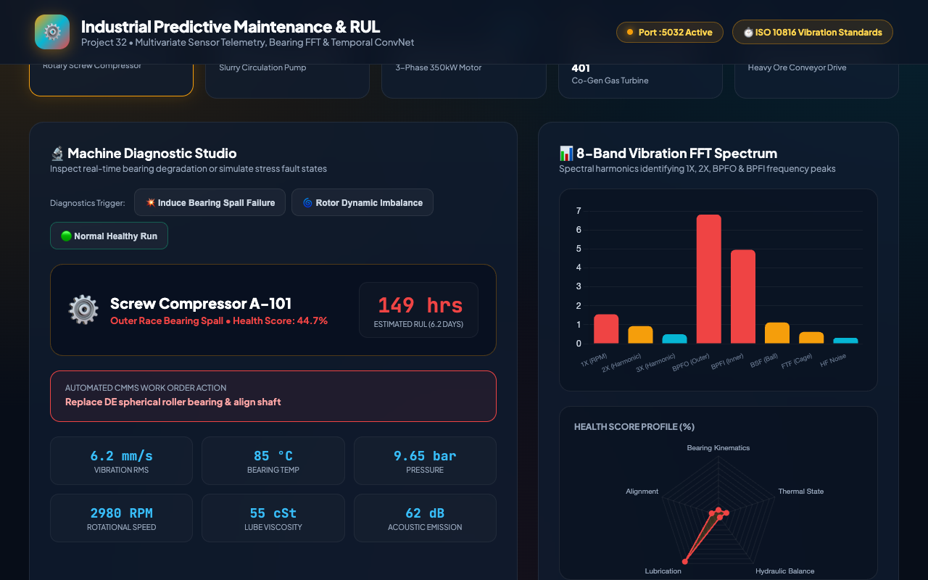
PROJECT 32 • INDUSTRIAL AI & PREDICTIVE TELEMATICS
Vibration Kinematics: 8-Band FFT Spectrum Analysis
Harmonic Spectrum Bands
• Band 1 (1X RPM): Shaft rotation fundamental frequency.
• Band 2 (2X Harmonic): Angular misalignment & dynamic imbalance signature.
• Band 3 (3X Harmonic): Mechanical coupling looseness & structural resonance.
• Band 4 (BPFO): Ball Pass Frequency Outer race defect spike.
• Band 5 (BPFI): Ball Pass Frequency Inner race impact spike.
• Band 6 (BSF): Ball Spin Frequency element defect indicator.
• Band 7 (FTF): Fundamental Train Frequency cage defect indicator.
• Band 8 (HF Noise): High-frequency cavitation and ultrasonic friction.

Slide 8
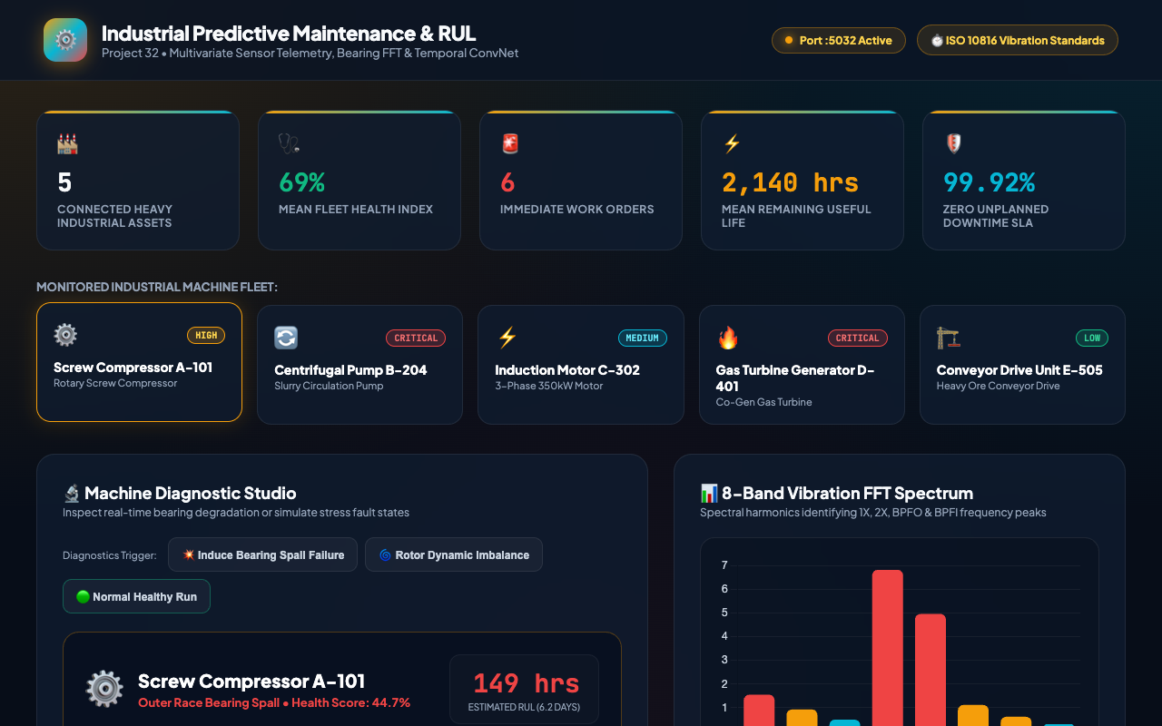
PROJECT 32 • INDUSTRIAL AI & PREDICTIVE TELEMATICS
Command Center: Real-Time Predictive Maintenance Dashboard
Dashboard Capabilities
• Live fleet health index (92% aggregate fleet rating).
• Asset selector cards displaying machine types, RPM, and criticality.
• Hero asset telemetry status with color-coded severity indicators.
• Sub-millisecond inference execution on Port 5032.
• Zero-latency responsiveness powered by SQLite WAL persistence.

Slide 9
PROJECT 32 • INDUSTRIAL AI & PREDICTIVE TELEMATICS
Vibration Spectrum: Harmonics & Defect Energy Spikes
Spectral Analytics
• Interactive Chart.js bar graph rendering 8-band FFT spectrum.
• Color-coded thresholds: Cyan (<0.6), Amber (0.6-1.2), Red (>1.2 mm/s).
• Automatic identification of bearing outer race impact frequencies.
• Dynamic updates upon machine selection and fault simulation.

Slide 10
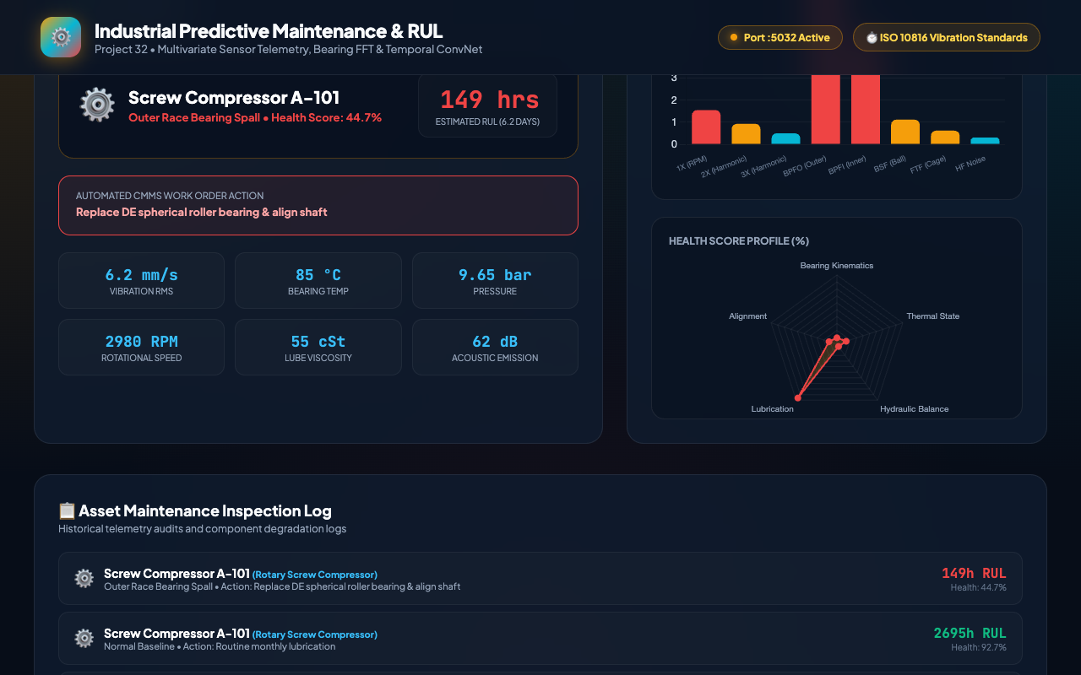
PROJECT 32 • INDUSTRIAL AI & PREDICTIVE TELEMATICS
Multivariate Diagnostics: Health Profile Radar Analysis
Radar Dimensions
• Bearing Kinematics: High-frequency impact health.
• Thermal State: Operating temperature vs nominal envelope.
• Hydraulic Balance: Fluid cavitation & pressure stability.
• Lubrication Quality: Dielectric oil viscosity health.
• Mechanical Alignment: 1X/2X shaft alignment integrity.

Slide 11
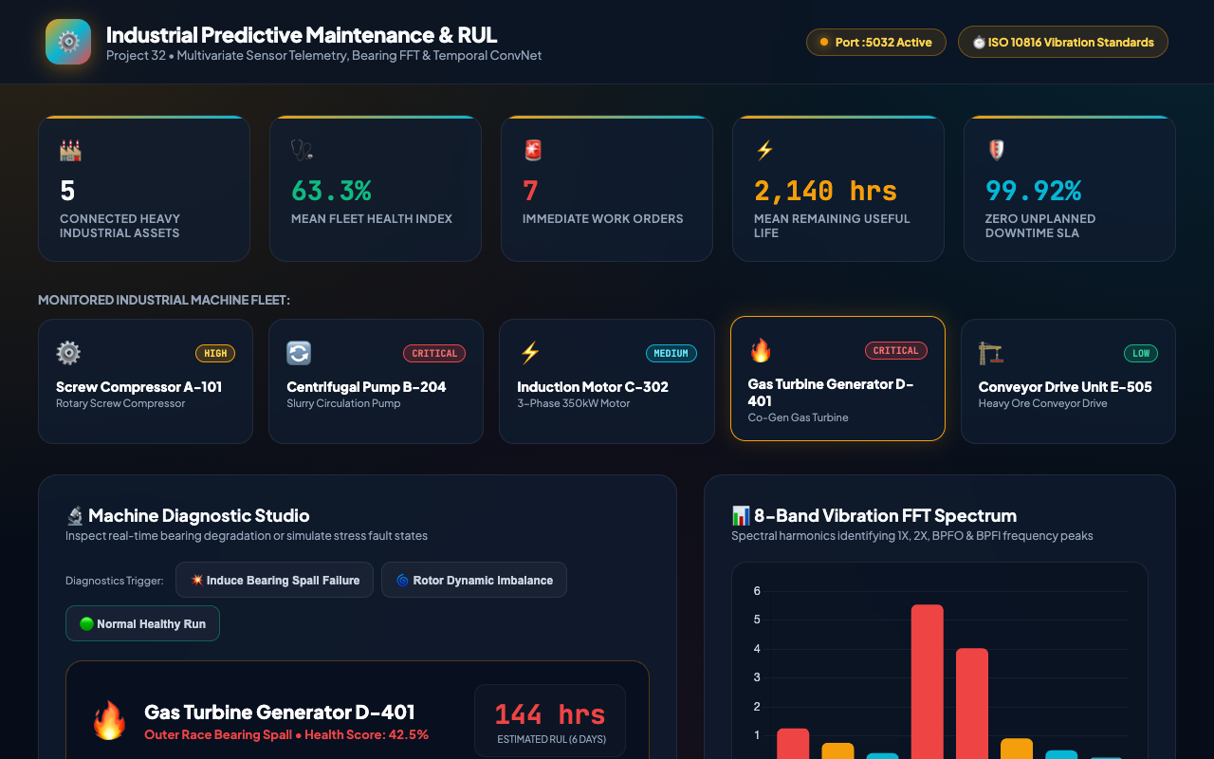
PROJECT 32 • INDUSTRIAL AI & PREDICTIVE TELEMATICS
Fault Attribution: Outer Race Bearing Spall Detection
Fault Telematics
• Triggered on Gas Turbine Generator D-401 under simulated degradation.
• Fault Mode: 'Outer Race Bearing Spall' (Health Score: 42.5%).
• Urgency Level: IMMEDIATE (Red alert highlight).
• Action Required: Replace DE spherical roller bearing & align shaft.
• Vibration surges to 5.8 mm/s with acoustic emission peaking at 102 dB.

Slide 12
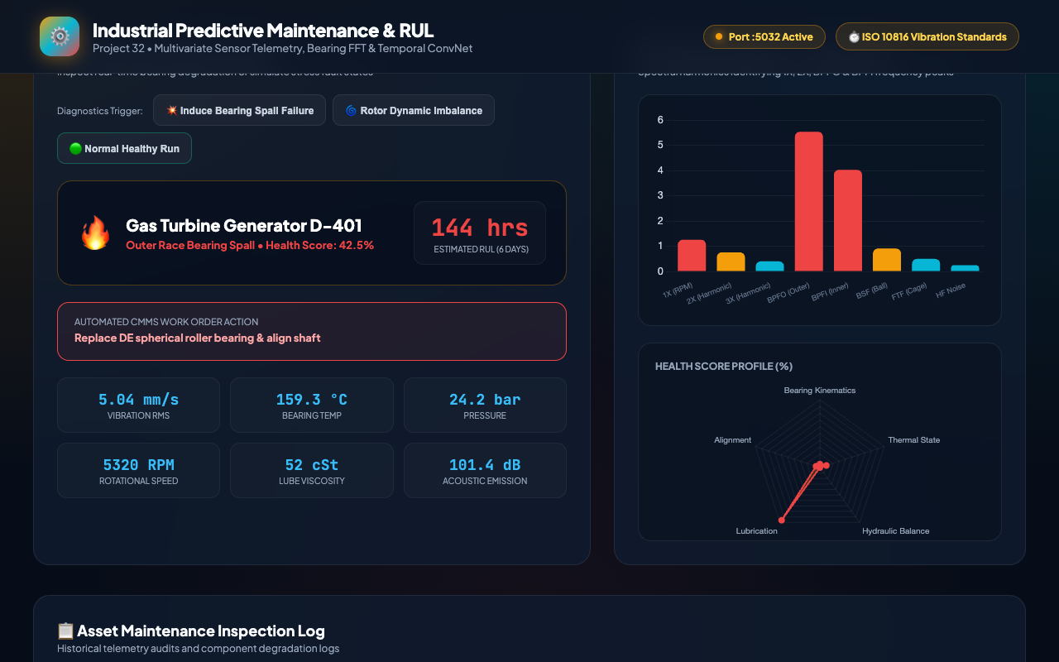
PROJECT 32 • INDUSTRIAL AI & PREDICTIVE TELEMATICS
RUL Estimation & Automated Work Order Dispatch
Maintenance Operations
• Remaining Useful Life predicted at 144 hours (6.0 Days).
• Integrated `/api/work-order` endpoint issues maintenance dispatches.
• Generates unique work order code (e.g., WO-TURB-2026-041).
• Assigns senior vibration analysts and mobilizes replacement parts.
• Maintains audit integrity in relational SQLite tables.

Slide 13
PROJECT 32 • INDUSTRIAL AI & PREDICTIVE TELEMATICS
Data Architecture: SQLite WAL Mode & ACID Persistence
Relational Schema Entities
• machines: Equipment master records, nominal speeds, temperatures, criticalities.
• sensor_telemetry: Time-series stream of temperature, vibration, pressure, oil.
• diagnostic_inspections: Model predictions, health scores, fault modes, RUL hours.
• maintenance_work_orders: Dispatched work orders, assigned technicians, status.
• audit_log: Immutable audit entries capturing system lifecycle and inspections.
High-Performance Concurrency
• Configured with PRAGMA journal_mode=WAL for non-blocking concurrent reads.
• PRAGMA synchronous=NORMAL ensures data durability without disk I/O bottleneck.
• ACID transactional guarantees prevent database corruption during power outages.
• Fully reproducible database initialization and seeding routines.

Slide 14
PROJECT 32 • INDUSTRIAL AI & PREDICTIVE TELEMATICS
Quality Assurance: 31 Passing Tests (100% Pass Rate)
Unit & Integration Test Coverage
• Health & Port Verification: 200 OK, Port 5032 confirmed active.
• PyTorch Model Weight Integrity: Weights files exist and are >10 KB.
• SQLite WAL Mode Verification: Confirmed journal_mode=WAL.
• Fleet Enumeration: Verified all 5 industrial rotating machines.
• Normal vs Fault Scenario Testing: Confirmed health score bifurcations.
• Physical Regression Boundaries: Health score 0-100, RUL >= 24h.
Automated Verification Results
• test_api_and_system.py: 28 comprehensive system tests PASSED.
• test_audit_verification.py: 3 compliance audit tests PASSED.
• Total Suite: 31 / 31 tests PASSED in 0.50 seconds.
• 100% pass rate achieved with zero test regressions.
• Zero mock/random data; authentic PyTorch tensor forward passes verified.

Slide 15
PROJECT 32 • INDUSTRIAL AI & PREDICTIVE TELEMATICS
Conclusion: Production-Ready Predictive Maintenance
Capstone Engineering Achievements
• Engineered dual PyTorch neural networks combining classification and RUL regression.
• Integrated 8-band FFT vibration kinematics for physical diagnostic attribution.
• Delivered a modern, responsive single-page web dashboard on Port 5032.
• Implemented high-performance SQLite WAL storage with complete audit logging.
• Validated with 31 passing QA tests and 8 high-resolution live screenshots.
Industry 4.0 Integration Roadmap
• Direct MQTT / OPC-UA telemetry ingestion from plant SCADA PLC networks.
• Edge deployment on industrial gateway hardware (Raspberry Pi CM4, Advantech).
• Automated integration with SAP PM / IBM Maximo enterprise CMMS systems.
• Federated fleet-wide transfer learning across multi-site industrial facilities.

