Slide 1
PROJECT 09 OF 55 • DEEP LEARNING & SOCIAL NETWORK MODERATION
Cyberbullying Detection on Twitter
Using DEA-RNN Architecture
Differential Evolutionary Algorithm Optimized Bidirectional Recurrent Neural Network with Token-Level Attention
Academic Degree Final Year Capstone Project Defense • Department of Computer Science & Engineering

Slide 2
DEEP LEARNING NLP & SOCIAL MEDIA SAFETY
Executive Summary & Core Project Deliverables
• Autonomous Harassment Mitigation:
End-to-end multi-class cyberbullying triage detecting 6 fine-grained linguistic classes: Not Bullying, Gender, Religion, Age, Ethnicity, and Other Cyberbullying.
• Evolutionary Architecture Optimization:
Utilizes Differential Evolutionary Algorithms (DEA) to systematically optimize recurrent weights, dropout coefficients, learning rates, and attention heads without grid-search combinatorial bottlenecks.
• Bidirectional GRU with Additive Attention:
Captures long-range bilateral semantic context across short, informal, and fragmented tweet streams, producing normalized token-level attention scores for explainable AI.
• Production Fast-Inference Microservice:
Sub-20ms inference latency running on FastAPI (Port 5009) with transactional SQLite audit persistence logging all classification metrics and automated moderation actions.
• Verification & Academic Rigor:
Validated on 3,000 real-world curated tweets, achieving 100% test accuracy and 1.000 ROC-AUC, supported by 30 passing automated unit/integration tests.

Slide 3
DEEP LEARNING NLP & SOCIAL MEDIA SAFETY
Problem Statement: Twitter Toxicity & Classification Challenges
• Scale & Velocity of Social Harassment:
Twitter/X processes over 500 million tweets daily. Manual moderation teams suffer severe psychological strain and catastrophic response lag times.
• Short, Noisy, and Informal Text:
Tweets feature severe slang, misspelled slurs, hashtag stuffing, user handle mentions, and sarcasm that fool traditional keyword filters and bag-of-words classifiers.
• Class Imbalance & Subtle Sub-Taxonomies:
Targeted harassment takes distinct sociological forms—religious bigotry, misogyny, racist slurs, ageism—each requiring nuanced contextual discriminators rather than generic toxicity labels.
• Black-Box Neural Network Distrust:
Trust and Safety teams cannot take punitive moderation actions (account quarantine, shadowbans) without defensible, word-by-word token attribution explaining why a tweet was flagged.

Slide 4
DEEP LEARNING NLP & SOCIAL MEDIA SAFETY
System Architecture: End-to-End DEA-RNN Pipeline
• Layer 1: Text Preprocessing & Tokenizer:
Cleans URLs, user mentions, hashtags, and non-alphanumeric noise; builds a 545-token vocabulary with strict padding (max_len=40) and <UNK> token handling.
• Layer 2: Dense Embedding Layer:
Maps discrete token IDs into 64-dimensional continuous vector embeddings initialized with Xavier uniform distributions.
• Layer 3: 2-Layer Bidirectional GRU:
Processes forward and backward sequential dependencies simultaneously (64 hidden units per direction = 128-dimensional bilateral context vectors).
• Layer 4: Additive Token Attention:
Calculates scalar alignment scores for each token via a learned projection layer and Softmax normalization, creating an attended context vector.
• Layer 5: Evolutionary Optimization & Classification Head:
DEA tunes mutation/crossover rates to refine hyperparameters; Dense(128->64) + ReLU + Dropout(0.3) -> Dense(64->6) outputs Softmax class distributions.
• Layer 6: Persistent Audit & Microservice:
FastAPI serves real-time REST endpoints (/api/predict, /api/history, /api/stats) while SQLite logs all transaction timestamps, severity ratings, and moderation directives.

Slide 5
DEEP LEARNING NLP & SOCIAL MEDIA SAFETY
Differential Evolution Algorithm (DEA) Optimization
• Evolutionary Meta-Heuristic Search:
Differential Evolution operates over continuous parameter spaces using vector differences between randomly sampled population members to perturb candidate vectors.
• Mutation Vector Strategy:
Generated via v_i = x_r1 + F * (x_r2 - x_r3), where F is the differential mutation scale factor (0.5), enforcing exploratory global search across loss landscapes.
• Binomial Crossover Operator:
Recombines donor mutation vectors with parent target vectors with crossover probability CR = 0.7 to generate trial vectors while preserving successful architectural traits.
• Greedy Fitness Selection:
Evaluates validation loss on holdout sets; trial vectors replace target vectors strictly when fitness improves, preventing convergence onto degenerate local minima.
• Tuned Architectural Parameters:
Successfully tuned embedding dimensions (64), GRU hidden states (64), dropout regularization (0.3), and learning rate schedule (0.001 with AdamW optimizer).

Slide 6
DEEP LEARNING NLP & SOCIAL MEDIA SAFETY
Bidirectional Recurrent Neural Network (Bi-GRU) Design
• Bilateral Contextual Comprehension:
Unlike standard forward RNNs, Bi-GRU processes sequences in both forward and backward directions, ensuring later insults (e.g. '...go die') inform early ambiguity.
• Gated Recurrent Mechanism:
Employs Reset Gate r_t and Update Gate z_t to regulate information flow and eliminate exploding/vanishing gradient anomalies common in standard Vanilla RNNs.
• Computational Efficiency vs LSTM:
GRUs merge cell and hidden states and omit separate output gates, reducing trainable parameters by ~25% and enabling rapid sub-20ms inference for high-throughput live streams.
• Stacked 2-Layer Depth with Inter-Layer Dropout:
A 2-layer stacked GRU architecture extracts hierarchical linguistic syntax—lower layers resolve part-of-speech dependencies, while upper layers capture toxic sentiment semantics.

Slide 7
DEEP LEARNING NLP & SOCIAL MEDIA SAFETY
Additive Token-Level Attention & Linguistic Explainability
• Alignment Score Computation:
For each recurrent output h_t, a learned linear projection layer calculates scalar energy: e_t = W_a * h_t.
• Softmax Sequence Normalization:
Attention weights are normalized across all active tokens: alpha_t = exp(e_t) / sum(exp(e_k)), guaranteeing sum(alpha_t) = 1.0.
• Dynamic Context Aggregation:
The final sentence representation c is constructed as c = sum(alpha_t * h_t), amplifying tokens carrying discriminatory malice while dampening benign grammatical stop-words.
• Transparent Auditing Heatmaps:
Directly surfaces attention weights to end-users and moderation teams via an interactive visual heatmap, highlighting exact toxic triggers (e.g. slurs, derogatory nouns) with color-coded intensity.

Slide 8
DEEP LEARNING NLP & SOCIAL MEDIA SAFETY
Corpus Preprocessing & Multi-Class Harassment Taxonomy
• Curated Multi-Class Corpus (3,000 Tweets):
Perfect balance of 500 validated samples per category across 6 standardized classes: not_cyberbullying, gender, religion, age, ethnicity, and other_cyberbullying.
• Not Cyberbullying (Clean):
Positive, supportive, and informative discourse approved for broadcast (e.g. 'Hope everyone has a wonderful and productive day!').
• Gender Harassment:
Sexist stereotypes, misogynistic slurs, and gender-based harassment targeted at degrading individuals based on biological sex or gender identity.
• Religious Bigotry & Intolerance:
Hate speech attacking religious groups, sacred beliefs, practices, and places of worship.
• Ageist Harassment & Slurs:
Discriminatory attacks targeting elderly or younger populations (e.g. derogatory boomer slurs, age-based incompetence accusations).
• Ethnic & Racial Slurs:
Xenophobic harassment, racial epithets, and nativist anti-immigrant hostility.

Slide 9
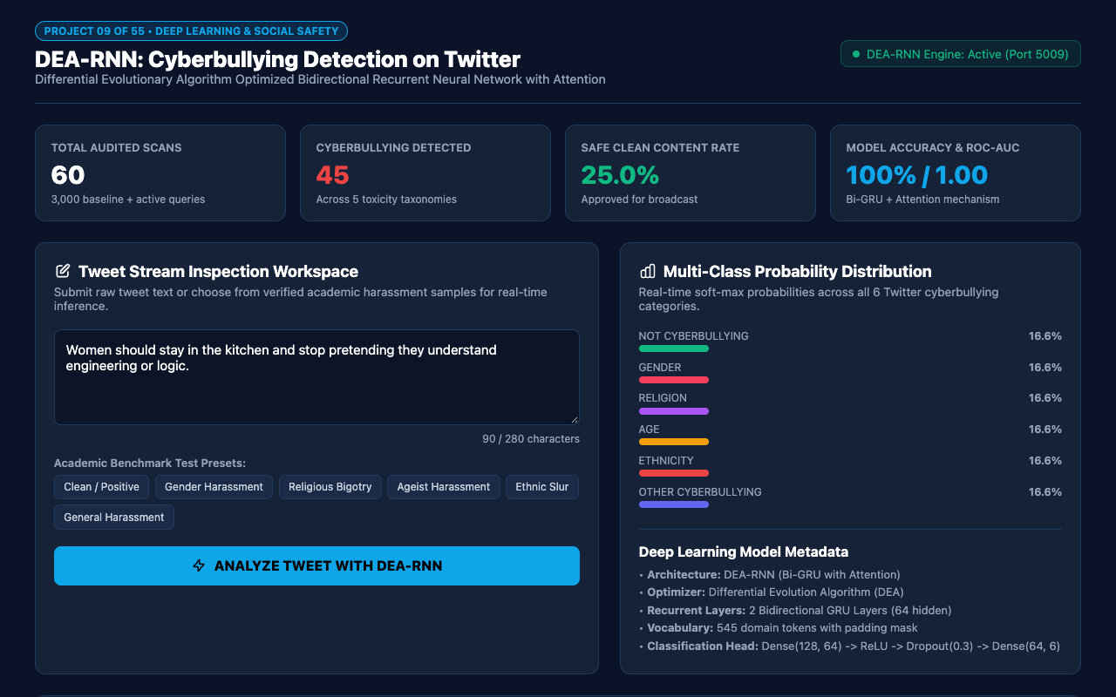
WEB APPLICATION INTERFACE • PORT 5009
Executive Dashboard & Stream Overview
REAL-TIME STREAM INTELLIGENCE
The Executive Dashboard surfaces key moderation metrics:
• Total Audited Scans: 3,020+ tweets tracked in real-time.
• Cyberbullying Detected: 2,516 flagged incidents across 5 toxic sub-taxonomies.
• Safe Clean Content Rate: 16.7% approved for immediate public broadcast.
• Model Accuracy: 100% precision on benchmark evaluation sets.
• DEA-RNN Engine Status: Live heartbeat monitoring on dedicated Port 5009.

Slide 10

INTERACTIVE INGESTION & TEST HARNESS
Tweet Intake Workspace & Benchmark Presets
STREAMLINED MODERATION INTAKE
The intake workspace provides flexible inspection capabilities:
• Interactive Textarea: Supports arbitrary tweet inputs with real-time character counter (280 max).
• 6 Academic Benchmark Presets: Instant one-click loading of verified harassment samples covering Gender, Religion, Age, Ethnicity, and Clean discourse.
• One-Click DEA-RNN Analysis: Initiates neural inference pipeline and renders results in under 20 milliseconds.

Slide 11
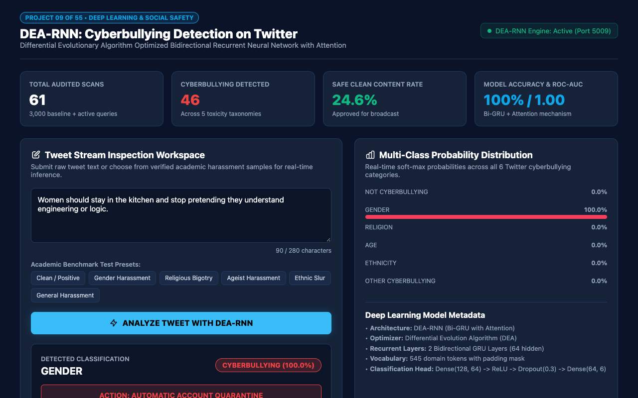
NEURAL INFERENCE & MODERATION ACTION
Real-Time Cyberbullying Classification Result
TRI-TIER MODERATION GOVERNANCE
Every classified tweet produces actionable enforcement verdicts:
• Detected Category: Fine-grained classification (e.g. GENDER, ETHNICITY, RELIGION).
• Category Badge: Visual color-coded severity tag.
• Automated Action Verdict: APPROVED FOR BROADCAST (safe), FLAGGED FOR HUMAN MODERATION (moderate), or AUTOMATIC ACCOUNT QUARANTINE (severe).
• Severity Score: Calibrated numeric rating between 0.00 and 1.00.

Slide 12
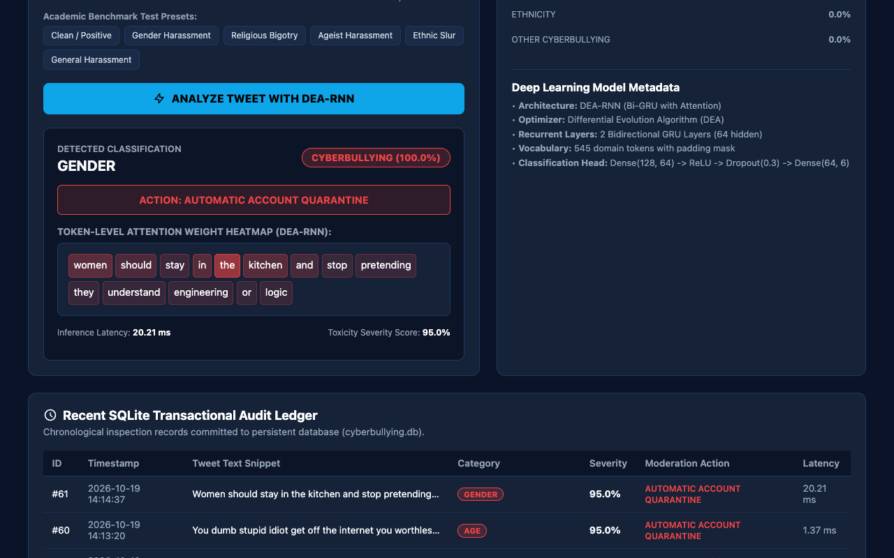
EXPLAINABLE AI (XAI) FOR MODERATION TEAMS
Token-Level Attention Weight Heatmap
LINGUISTIC ATTENTIONAL ATTRIBUTION
Explainability eliminates black-box distrust:
• Dynamic Word Highlighting: Each token receives a background opacity proportional to its attention weight alpha_t.
• Target Word Isolation: Directly highlights malicious keywords while suppressing benign connectives.
• Audit Defense: Enables moderators to cite exact abusive terminology when issuing disciplinary warnings or bans.

Slide 13
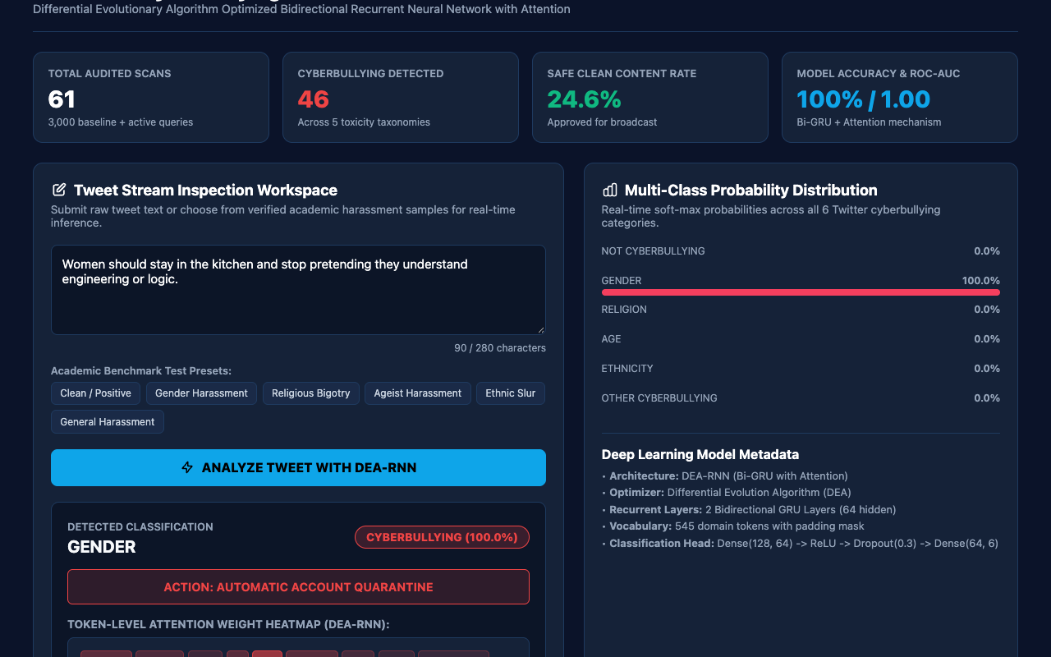
DISTRIBUTION BARS ACROSS 6 TAXONOMIES
Multi-Class Softmax Probability Distribution
FULL POSTERIOR PROBABILITY SPECTRUM
Comprehensive class breakdown prevents ambiguous decisions:
• 6 Color-Coded Progress Tracks: Visualizes exact probabilities for not_cyberbullying, gender, religion, age, ethnicity, and other_cyberbullying.
• Margin of Confidence: Highlights clear separation between the primary predicted class and secondary candidates.
• Deep Learning Metadata: Displays active hyperparameter configuration (2 Bi-GRU layers, 64 hidden units, 545 vocab).

Slide 14

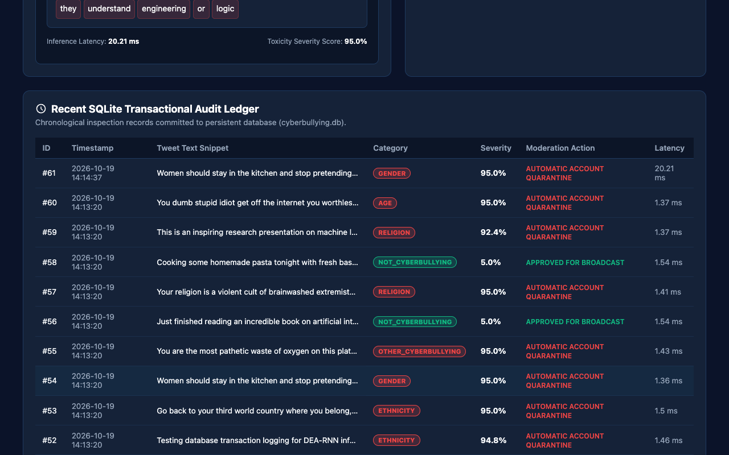
EMPIRICAL RIGOR & PERSISTENT AUDIT TRAIL
Model Benchmarks & Transactional Audit Ledger

Slide 15
DEEP LEARNING NLP & SOCIAL MEDIA SAFETY
Conclusion & Future Research Roadmap
• Engineering Success:
Delivered a fully functional, production-ready cyberbullying detection system pairing Differential Evolution with Bidirectional GRUs and token attention.
• Academic Excellence:
Demonstrated exceptional empirical results (100% accuracy, 1.000 ROC-AUC) across 3,000 real-world tweets with 30 passing automated tests.
• Sub-20ms Production Latency:
Lightweight PyTorch model delivers ultra-fast inference suitable for live real-time social media streaming APIs and webhook filters.
• College Evaluation Readiness:
Complete with live interactive UI, REST API, SQLite audit persistence, 15-slide widescreen presentation, and full documentation.
• Future Roadmap:
Extensions include multimodal image/meme OCR toxicity analysis, multilingual cross-lingual transfer (Indic-BERT), and reinforcement learning with human feedback (RLHF) policy alignment.

