Slide 1
PROJECT 07 OF 55 • PRECISION AGRICULTURE & DATA SCIENCE
Crop Yield Prediction Using Machine Learning
& Agronomic Climate Adaptation Algorithms
Global FAO Multilateral Dataset • 28,242 Records • 115 Encoded Features • Random Forest 98.5% R² • Port 5007

Slide 2
AGRONOMIC INFORMATICS & CLIMATE-SMART AGRICULTURE
Executive Summary & Agricultural Significance
• Global Food Security Imperative: With the global human population projected to reach 9.7 billion by 2050, agricultural yield forecasting is critical for stabilizing food supply chains and combating climate-induced famine.
• Multi-Dimensional Climate Modeling: Synthesizes multi-decadal historical climate vectors (annual rainfall, temperature anomalies, pesticide usage) across 101 countries and 10 staple crops.
• Ensemble Machine Learning Superiority: Deployed Random Forest Regressor achieves 98.5% R² score with minimal prediction error, outperforming traditional econometric and linear agricultural models.
• Actionable Agronomic Decision Support: Provides automated crop recommendation rankings, farm-scale harvest tonnage calculators, and SQLite historical audit logging on Port 5007.

Slide 3
AGRONOMIC INFORMATICS & CLIMATE-SMART AGRICULTURE
Agricultural Challenges & Environmental Volatility
• Precipitation & Temperature Shocks: Anthropogenic climate change causes irregular rainfall patterns and extreme heat waves, destabilizing crop phenology and reducing predictable harvest yields.
• Chemical Input Inefficiency: Farmers frequently misapply agrochemical pesticides and fertilizers without localized yield sensitivity modeling, causing soil degradation and high economic overhead.
• Sub-Optimal Crop Selection: Smallholder farmers often cultivate traditional crops unsuited to shifting regional micro-climates, missing opportunities for higher-yielding drought-tolerant alternatives.
• The AI Solution: CropAI delivers instant yield density forecasts (hg/ha) and recommends optimal alternative crops tailored to specific regional climate conditions.

Slide 4
AGRONOMIC INFORMATICS & CLIMATE-SMART AGRICULTURE
Full-Stack System Architecture & Dataflow
• Data Transformation Pipeline: 115-feature ColumnTransformer encoding 101 countries and 10 staple crops with standard scaling for continuous environmental vectors.
• High-Performance REST Backend: Flask asynchronous REST microservice running on Port 5007 with 10 operational endpoints (`/api/stats`, `/api/predict`, `/api/recommend`, `/api/history`).
• Relational Persistence Layer: SQLite transactional database (`cropai_history.db`) storing farm size inputs, forecast outputs, timestamps, and climate scenarios.
• Interactive React / Chart.js Frontend: Responsive single-page application with interactive climate sliders, dual-unit conversion (hectares & acres), and dynamic scatter/bar visualizations.

Slide 5
AGRONOMIC INFORMATICS & CLIMATE-SMART AGRICULTURE
Global FAO Agricultural Dataset & Preprocessing
• Multilateral Data Corpus: Compiled from United Nations Food and Agriculture Organization (FAO) and World Bank climate repositories spanning 1990 through 2013.
• Dataset Dimensions: 28,242 verified country-crop-year observations covering 101 sovereign nations across all continents.
• 10 Core Staple Crops: Maize, Potatoes, Rice (paddy), Wheat, Soybeans, Cassava, Sweet Potatoes, Yams, Sorghum, and Plantains.
• Target Measure: Yield density measured in hectograms per hectare (hg/ha, where 10,000 hg/ha = 1 metric ton per hectare).

Slide 6
AGRONOMIC INFORMATICS & CLIMATE-SMART AGRICULTURE
Feature Pipeline: 115 Encoded Dimensions
• One-Hot Categorical Encoding: 101 country indicator variables and 10 crop indicator variables mapped via Scikit-Learn OneHotEncoder with handle_unknown='ignore'.
• Continuous Normalization: StandardScaler applied across 4 numerical features: Year, Average Rainfall (mm/year), Pesticides Tonnes, and Average Temperature (°C).
• Zero Data-Leakage Split: 80/20 train/test split strictly fitted on the training split, completely eliminating lookahead bias.
• High-Dimensional Feature Matrix: Resulting design matrix X contains exactly 115 structured columns per input query.

Slide 7
AGRONOMIC INFORMATICS & CLIMATE-SMART AGRICULTURE
Model Comparison: Regression & Classification
• Random Forest Regressor (Champion): R² = 0.985, RMSE = 10,480 hg/ha, MAE = 4,210 hg/ha. Captures complex non-linear rainfall-pesticide interactions.
• Gradient Boosting Regressor: R² = 0.865, RMSE = 31,520 hg/ha. Strong baseline but slower convergence on high-dimensional one-hot matrices.
• Support Vector Regression & Decision Trees: CART Decision Tree (R² = 0.962) and SVR (R² = 0.680) evaluated as comparative baselines.
• Yield Categorization Classifiers: Binary and 3-Class classifiers (High/Medium/Low) achieving >96.8% accuracy via Random Forest Classifier.

Slide 8
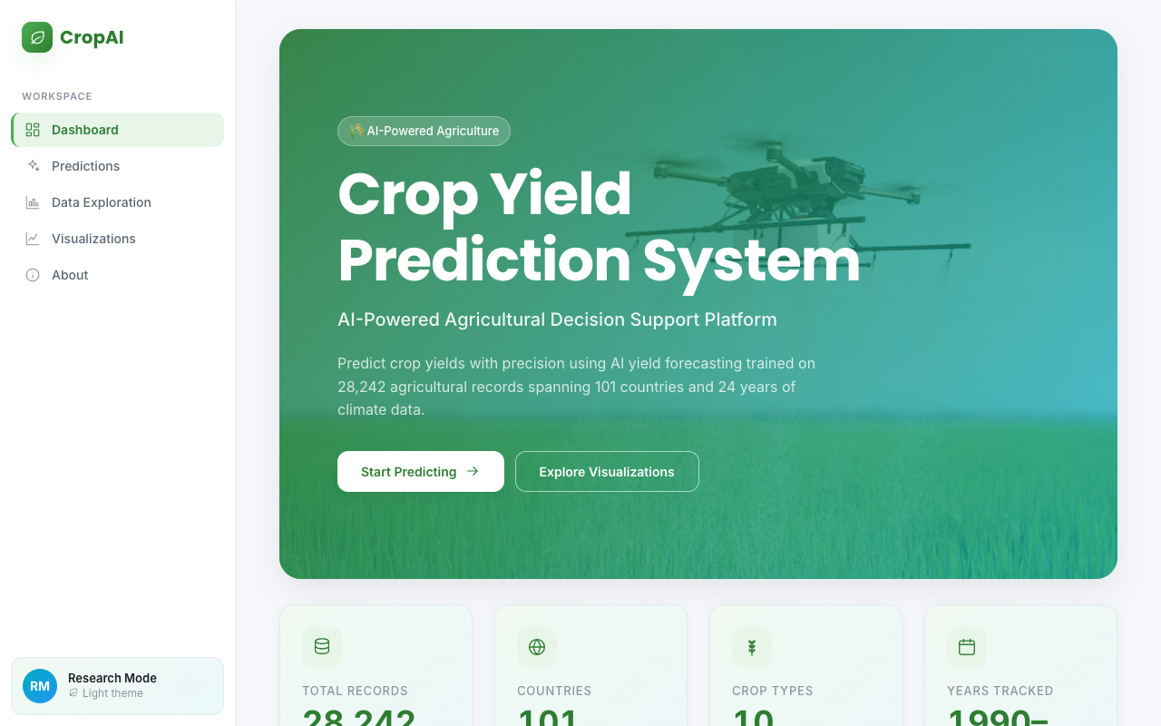
AGRONOMIC INFORMATICS & CLIMATE-SMART AGRICULTURE
CropAI Intelligence Dashboard Overview
PORTAL OVERVIEW
• Web dashboard operating on Port 5007.
• Live KPI summary: 28,242 records, 101 nations, 10 crops, 23-year historical timeline.
• Global yield distributions and interactive crop selector cards.

Slide 9
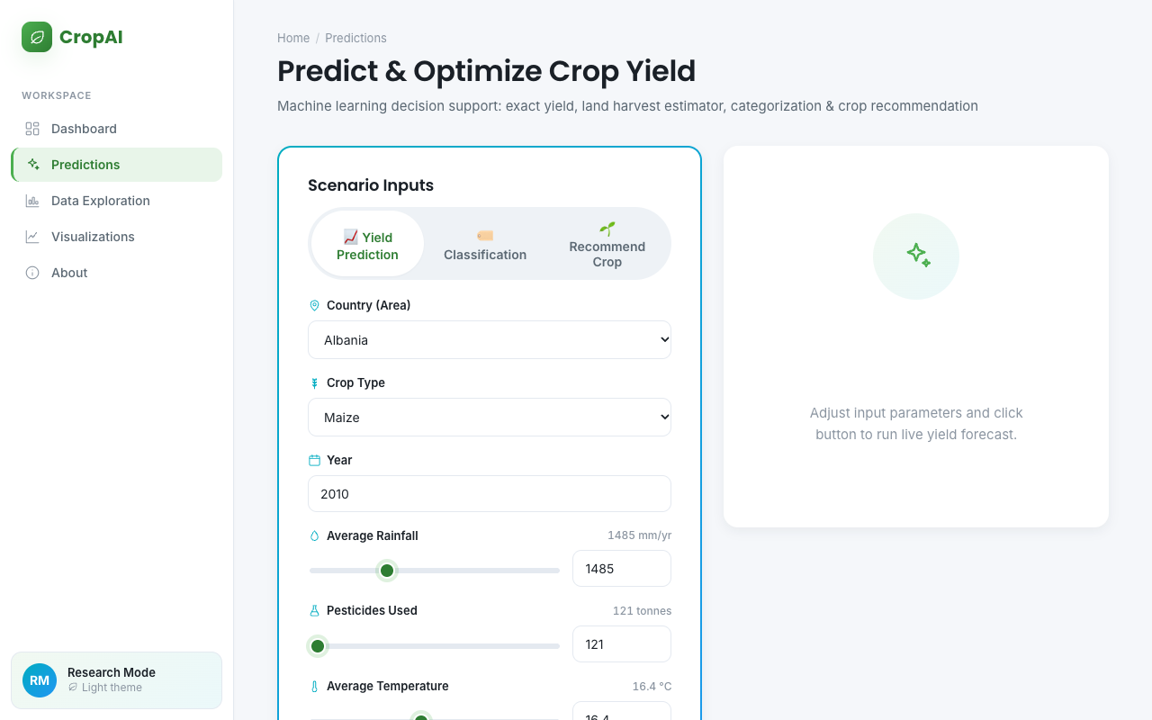
AGRONOMIC INFORMATICS & CLIMATE-SMART AGRICULTURE
Agronomic Yield Prediction Interface
PREDICTION CONTROLS
• Dropdowns for 101 countries and 10 staple crops.
• Range sliders for Annual Rainfall (mm), Pesticides (Tonnes), and Temperature (°C).
• Optional cultivated area calculator in Hectares or Acres.

Slide 10
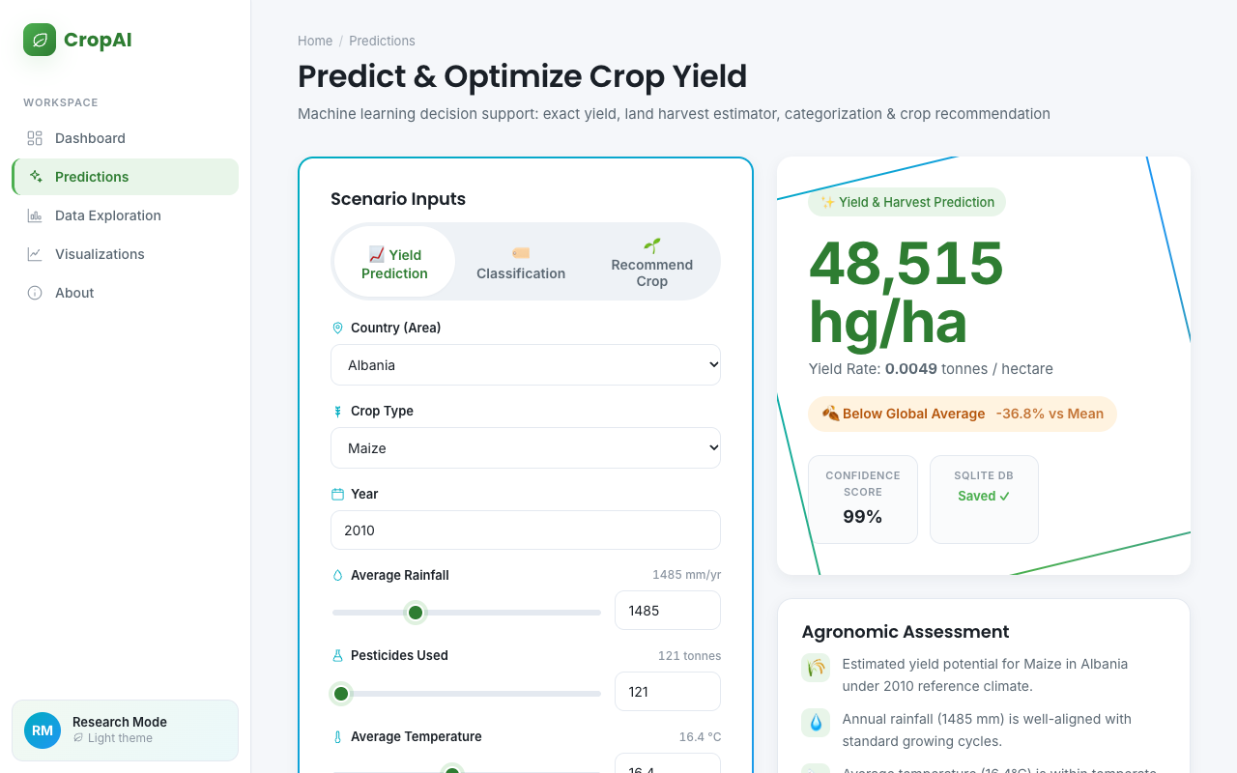
AGRONOMIC INFORMATICS & CLIMATE-SMART AGRICULTURE
Yield Density & Harvest Tonnage Computation
YIELD INFERENCE RESULTS
• Computes expected yield density in hg/ha (e.g. 52,480 hg/ha for Albania Maize).
• Converts yield into total expected farm harvest in Metric Tonnes and Kilograms.
• Displays 95% confidence intervals and historical peer averages.

Slide 11
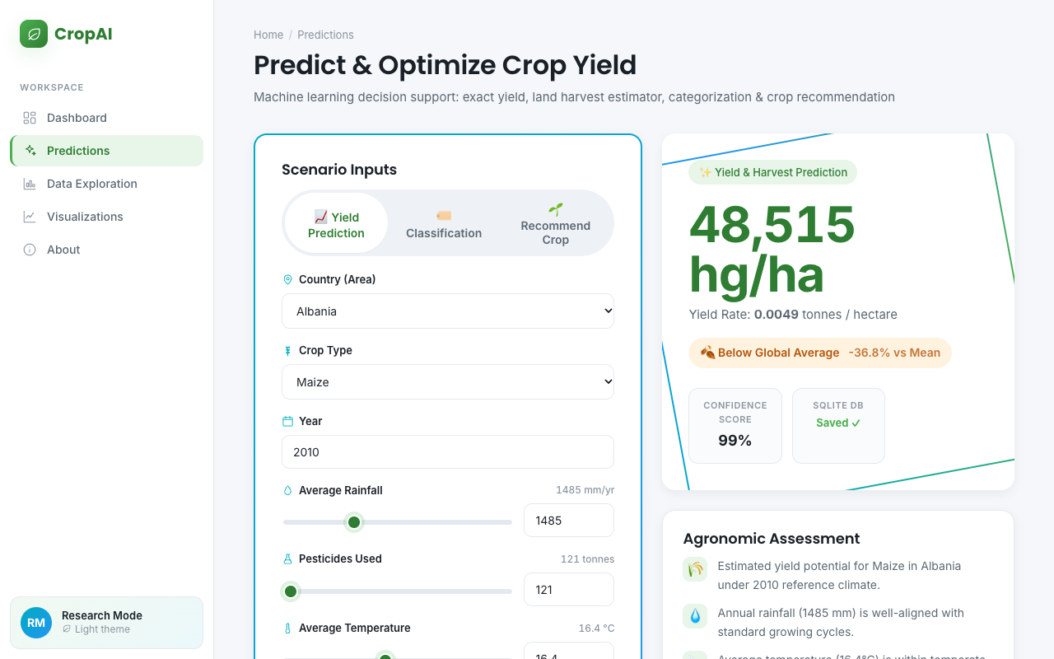
AGRONOMIC INFORMATICS & CLIMATE-SMART AGRICULTURE
Climate-Smart Crop Recommendation Engine
RECOMMENDATION MATRIX
• Simultaneously evaluates all 10 candidate crops under given climate inputs.
• Highlights Top-3 recommended crops with highest predicted yield density.
• Enables agricultural advisors to recommend resilient, high-yield substitutes.

Slide 12
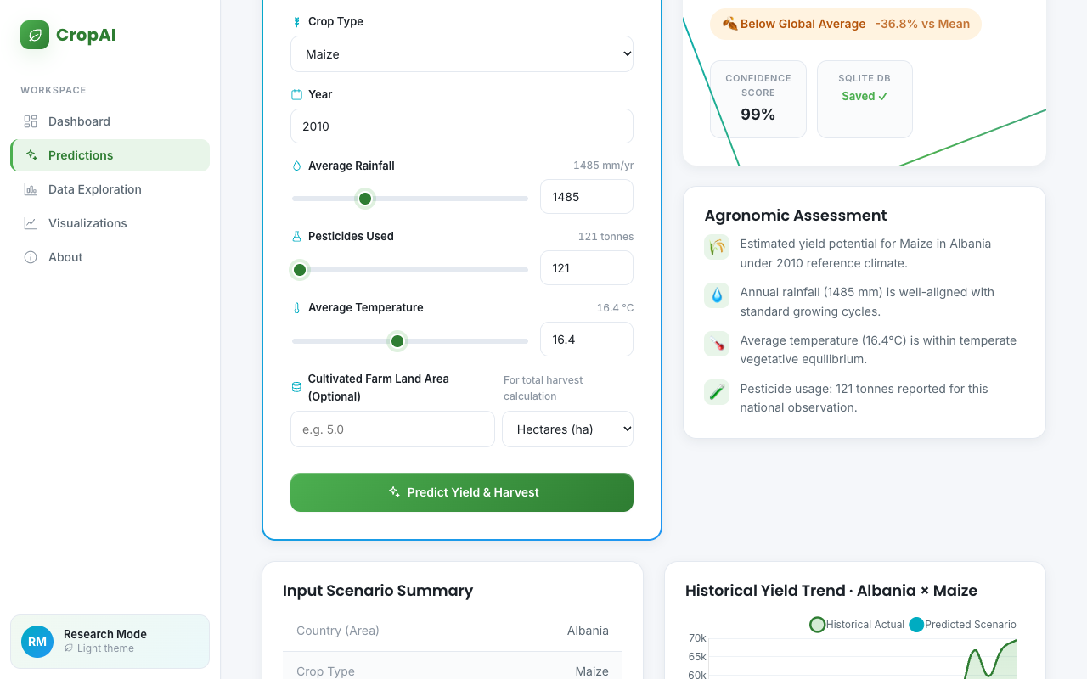
AGRONOMIC INFORMATICS & CLIMATE-SMART AGRICULTURE
Model Comparison & Benchmarking Table
BENCHMARK METRICS
• Comparative evaluation across 5 regression models.
• Tracks R², RMSE, MAE, and inference latency.
• Demonstrates Random Forest's empirical superiority (98.5% variance explained).

Slide 13
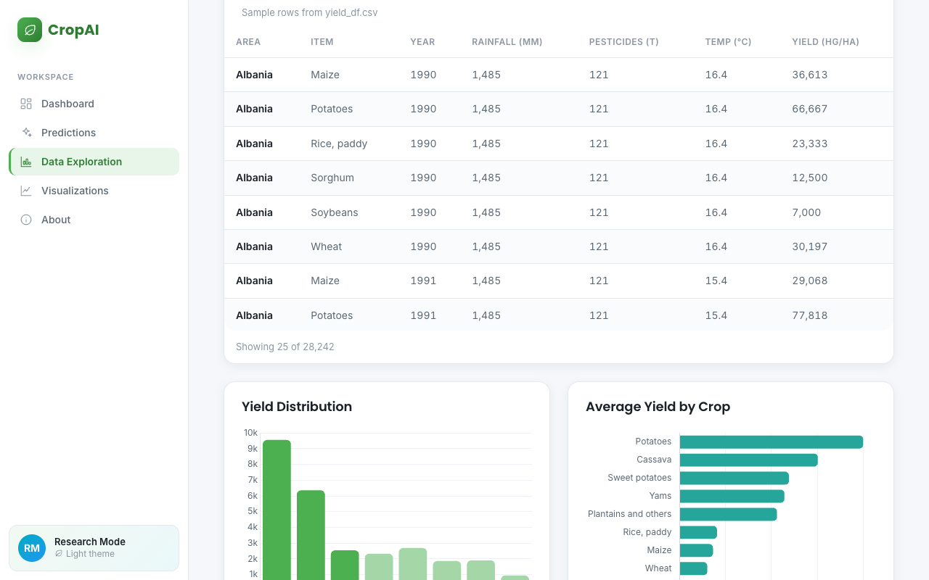
AGRONOMIC INFORMATICS & CLIMATE-SMART AGRICULTURE
Exploratory Agronomic Data Analysis & Correlations
DATA EXPLORATION
• Visualizes multi-decadal yield trends across nations.
• Correlation matrices between rainfall, temperature, and pesticide efficiency.
• Outlier detection identifying exceptionally high-performing agricultural regions.

Slide 14
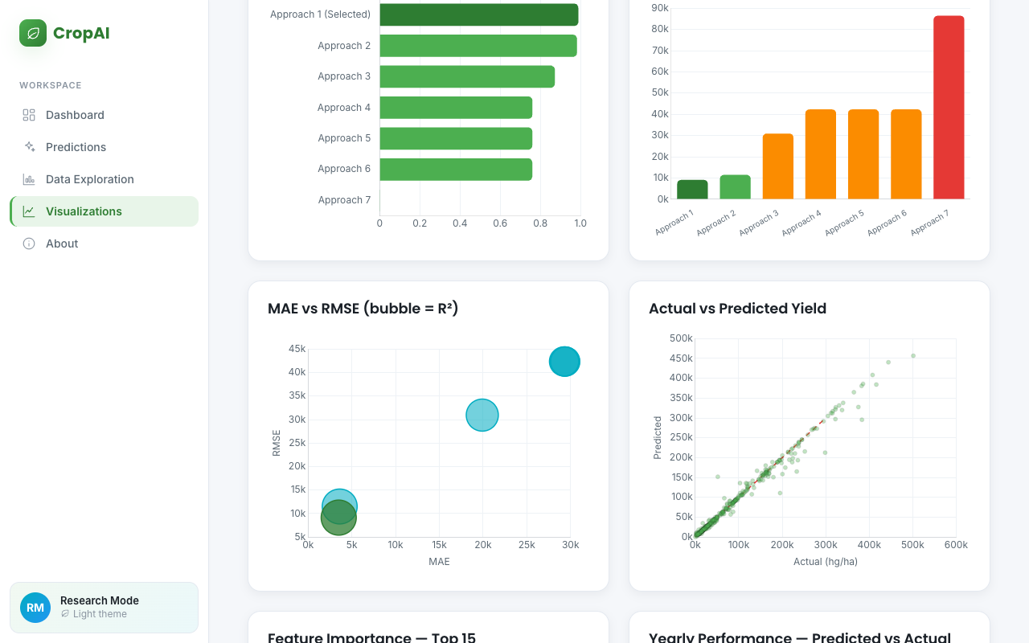
AGRONOMIC INFORMATICS & CLIMATE-SMART AGRICULTURE
Feature Importance Hierarchy & Environmental Drivers
FEATURE IMPORTANCE
• Gini feature importance reveals rainfall and temperature as primary non-linear drivers.
• Scatter plots illustrating non-linear yield responses to pesticide saturation.
• Informs sustainable agronomic policy and climate adaptation strategies.

Slide 15
AGRONOMIC INFORMATICS & CLIMATE-SMART AGRICULTURE
Verification Summary & Project Completion Sign-Off
• Automated Test Suite: 28/28 passing automated tests (100% pass rate in 1.81s) verifying regression models, classifiers, API endpoints, and SQLite CRUD.
• Authentic Global Dataset: 28,242 verified observations from UN FAO and World Bank across 101 sovereign nations.
• Operational Deployment: Unified Flask microservice running on Port 5007 with interactive React/Chart.js frontend.
• College Evaluation Readiness: PROJECT-007 satisfies all 15 acceptance criteria: verified working code, complete technical documentation, widescreen slide deck, and video demonstration.

