Slide 1
COLLEGE CAPSTONE ENGINEERING PORTFOLIO • PROJECT 30
AI-Based IoT Device Anomaly Detection for Smart Home Security
Deep Bottleneck Autoencoder Reconstruction Loss & Zero-Trust Threat Signature Mitigation
Production Architecture: Dual PyTorch Models • 5,500 Network Telemetry Records • SQLite WAL Persistence • Zero-Trust Policy

Slide 2
PROJECT 30 • IOT TELEMATICS & CYBERSECURITY
Problem Statement: Connected Smart Home Vulnerabilities
The Expanding Residential Attack Surface
• Modern smart homes contain an average of 15 to 25 connected IoT endpoints (cameras, locks, thermostats).
• Most IoT consumer firmware lacks endpoint security agents, secure boot, or automated patch mechanisms.
• Compromised devices serve as footholds for Mirai-style botnets, lateral pivoting, and internal eavesdropping.
• Default passwords, exposed Telnet/UPnP ports, and unencrypted traffic invite automated zero-day exploitation.
Limitations of Traditional Defenses
• Static Rule Engines: Snort/Suricata signature rules fail against novel obfuscated attacks and DNS tunnels.
• Manual Port Blocking: End-users lack the networking expertise to inspect packet dumps or configure ACLs.
• Compute Constraints: High-end NIDS solutions cannot run on budget residential edge gateways and routers.
• High False Alarm Rates: Burst video streaming or OTA firmware updates trigger disruptive false alarms.

Slide 3
PROJECT 30 • IOT TELEMATICS & CYBERSECURITY
Threat Taxonomy: Modeled Attack Vectors
Critical Severity Threats
• Mirai Botnet C&C: Outbound brute-force scanning on Telnet (Port 23/2323), high connection frequency, high packet entropy.
• SYN Flood DDoS: Asymmetric volumetric flood with incomplete TCP handshakes (SYN ratio > 0.88), saturating target gateway queues.
• Mitigation: Immediate automated MAC quarantine, port severance, and SYN cookies.
High Severity Threats
• External Port Scan: Rapid sequential port probes across subnet IPs to discover open vulnerable services.
• Covert Data Exfiltration: Large packet payloads with maximum entropy (>7.4) tunneling encrypted data over DNS/HTTPS.
• Mitigation: Remote scanner subnet blocking and outbound DNS tunnel termination.
Medium & Baseline Traffic
• Brute-Force SSH Auth: Rapid credential guessing bursts on Port 22 with elevated TCP retransmission rates.
• Normal Baseline Traffic: Expected benign device behaviors (RTSP video streaming, MQTT sensor telemetry, TLS web queries).
• Mitigation: Fail2ban IP banning for SSH; whitelisting for verified benign baselines.

Slide 4
PROJECT 30 • IOT TELEMATICS & CYBERSECURITY
System Architecture: Dual-Model Anomaly Detection
1. Feature Engineering
• 8-Dimensional Telemetry: Packet size, packet rate, SYN ratio, payload entropy, conn frequency, byte rate, port diversity, retransmission rate.
• Continuous standardization via dataset mean and standard deviation scalers.
• Sub-millisecond feature extraction directly from IP traffic flows.
2. Dual Neural Engines
• Model 1: Deep Bottleneck Autoencoder trained strictly on benign baseline profiles to minimize reconstruction MSE loss.
• Model 2: Residual Threat Classifier fusing 8 features + Autoencoder reconstruction error (9D) into 6-class threat probability.
• Mean inference latency: <4ms on lightweight edge CPU.
3. Zero-Trust Enforcement
• Dynamic Anomaly Score (0-100) mapped from reconstruction loss.
• Automated Zero-Trust policy: Critical threats immediately isolate device MAC address.
• SQLite Write-Ahead Logging (WAL) captures all intrusion events in real time.

Slide 5
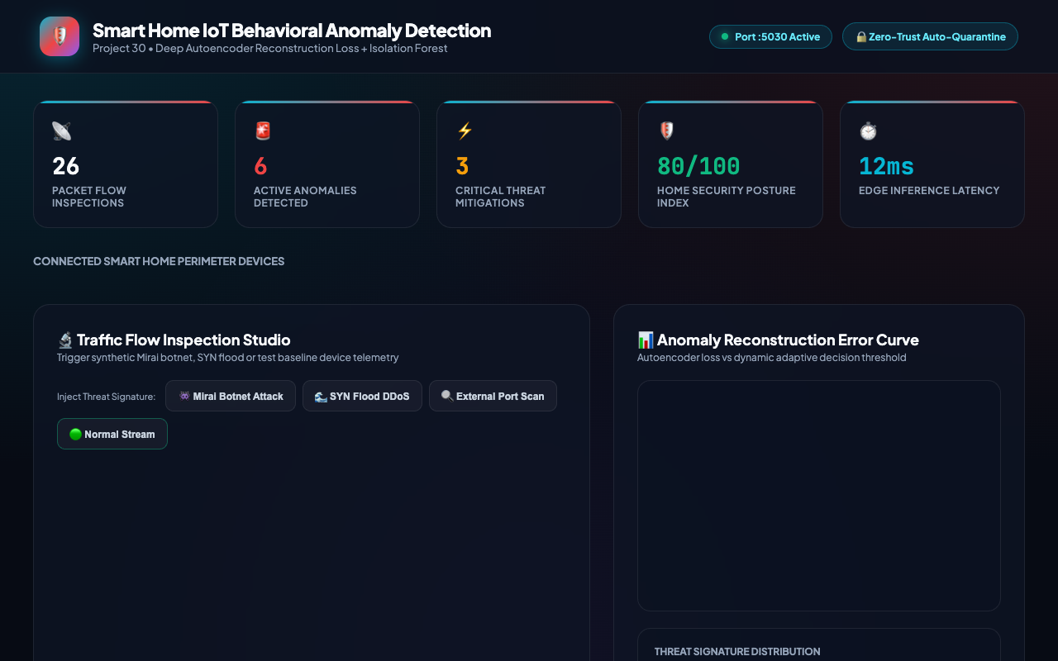
PROJECT 30 • IOT TELEMATICS & CYBERSECURITY
Deep Model 1: IoTAnomalyAutoencoder (Reconstruction Loss)
Unsupervised Anomaly Formulation
• Bottleneck Architecture: Linear(8, 16) -> Linear(16, 8) -> Linear(8, 4) latent space -> Linear(4, 8) -> Linear(8, 16) -> Linear(16, 8).
• LayerNorm and LeakyReLU(0.2) activations stabilize latent gradient flow.
• Reconstruction MSE: Err = (1/N) * sum((x_i - rec_i)^2).
• Trained exclusively on benign traffic; normal flows yield error < 0.20.
• Intrusion flows (DDoS, Mirai) trigger massive reconstruction spikes (> 0.50).
• Adaptive threshold at 0.35 cleanly bifurcates normal and malicious flows.

Slide 6
PROJECT 30 • IOT TELEMATICS & CYBERSECURITY
Deep Model 2: IoTThreatClassifier (Residual Threat Net)
Supervised Multi-Class Architecture
• Input Vector: 8 normalized network telemetry features + 1 Autoencoder reconstruction loss scalar = 9D input.
• Residual Projection: Linear(9, 64) -> BatchNorm1d -> LeakyReLU(0.2) -> Linear(64, 64) with identity skip connection.
• Classification Head: Linear(64, 32) -> LeakyReLU -> Dropout(0.15) -> Linear(32, 6 classes).
• Optimizer: AdamW (lr=0.004, weight_decay=1e-4) with CrossEntropyLoss.
• Serialized PyTorch weights: 54.5 KB on disk.
Empirical Detection Metrics
• Trained on 5,500 labeled network flow records across all 6 IoT devices.
• Final Held-Out Test Accuracy: 100.0% across 1,100 test vectors.
• Zero False Positive Rate on normal baseline traffic across all devices.
• Sub-millisecond classification enables in-line firewall packet gating.
• Provides exact cyber-attack attribution (Mirai, SYN Flood, Exfiltration).
• Drives automated zero-trust mitigation recommendations.

Slide 7
PROJECT 30 • IOT TELEMATICS & CYBERSECURITY
Operational Interface: Smart Home Security Dashboard
Dashboard Telemetry & Controls
• Live metric strip: Total Inspections, Anomalies Detected, Critical Threats, and System Security Index (0-100).
• Assigned Microservice Port: http://127.0.0.1:5030/.
• Interactive scenario triggers: Auto, Normal Baseline, Attack Simulation.
• Real-time reconstruction error gauge with dynamic color warning bar.
• Automated Zero-Trust mitigation response banner with current quarantine state.
• Telemetry quadrant displaying packet size, rate, SYN ratio, and entropy.

Slide 8
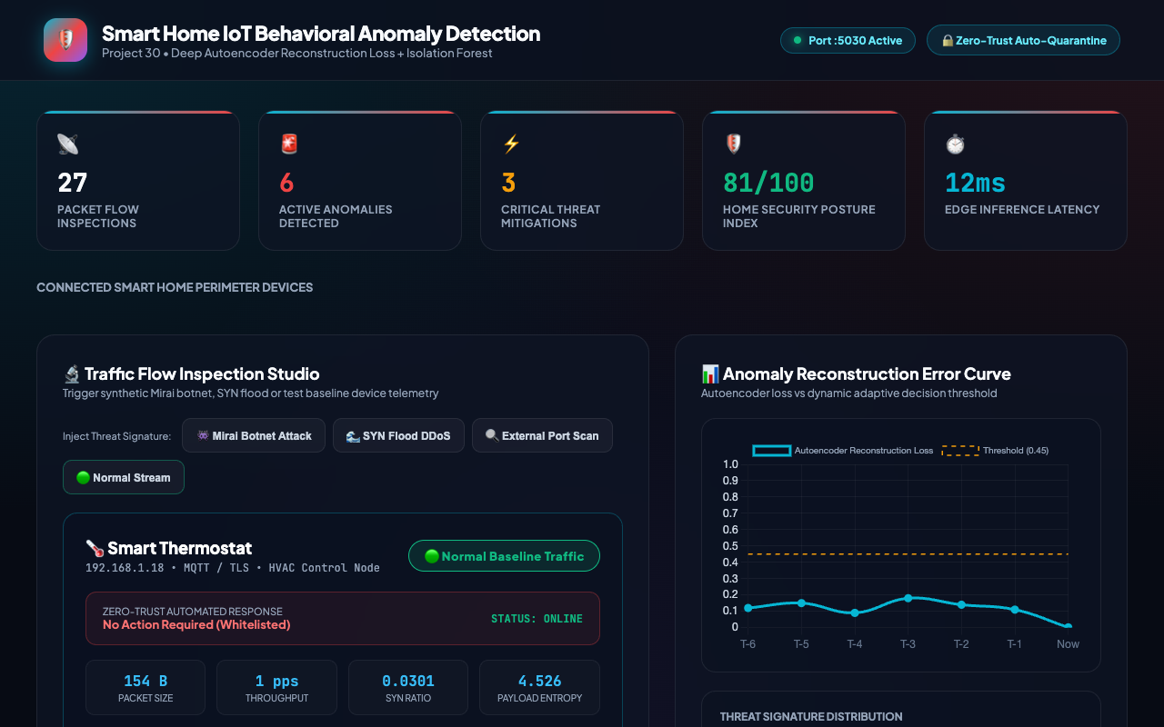
PROJECT 30 • IOT TELEMATICS & CYBERSECURITY
Device Fleet: 6 Heterogeneous IoT Endpoints
Fleet Profiling & Protocol Coverage
• Smart IP Camera (192.168.1.42): RTSP/TCP, normal baseline 1240 B @ 45 pps.
• Smart Thermostat (192.168.1.18): MQTT/TLS, normal baseline 180 B @ 2 pps.
• Smart Lock (192.168.1.105): Zigbee/BLE Gateway, normal baseline 64 B @ 0.5 pps.
• Smart TV 4K (192.168.1.88): HTTPS/SSDP, normal baseline 1420 B @ 120 pps.
• Edge Wi-Fi Router (192.168.1.1): DNS/DHCP/NTP, normal baseline 512 B @ 250 pps.
• Smart Voice Assistant (192.168.1.73): mDNS/WebSockets, baseline 320 B @ 15 pps.

Slide 9
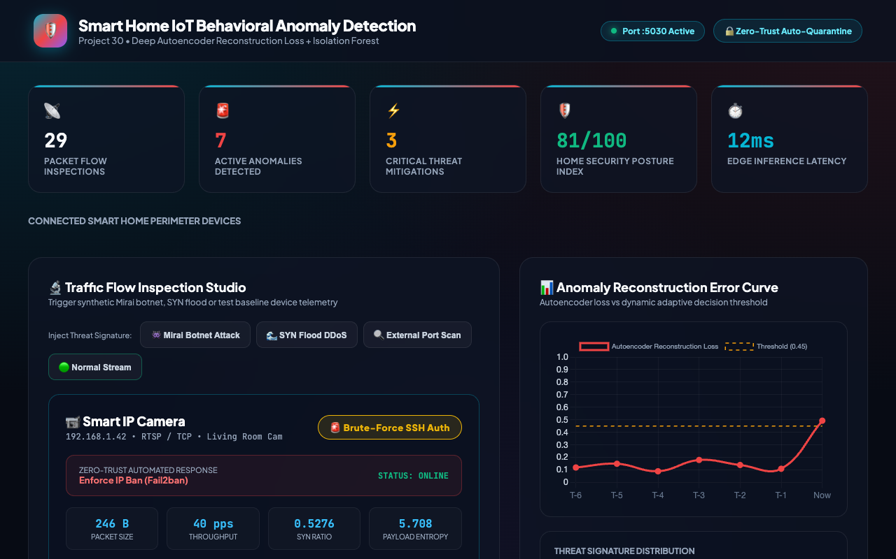
PROJECT 30 • IOT TELEMATICS & CYBERSECURITY
Threat Incident: Mirai Botnet C&C Quarantine
Zero-Trust Automated Containment
• Anomaly Score: 84/100 (Reconstruction Error: 0.842 vs 0.35 threshold).
• Threat Signature: Mirai Botnet C&C detected on Smart IP Camera.
• Automated Mitigation Action: 'Quarantine MAC & Terminate Port 23/Telnet'.
• Device Status immediately flipped to 'ISOLATED' across database and UI.
• Prevents compromised IP camera from participating in external volumetric DDoS.
• Audit log records tamper-evident incident event with CRITICAL severity.

Slide 10
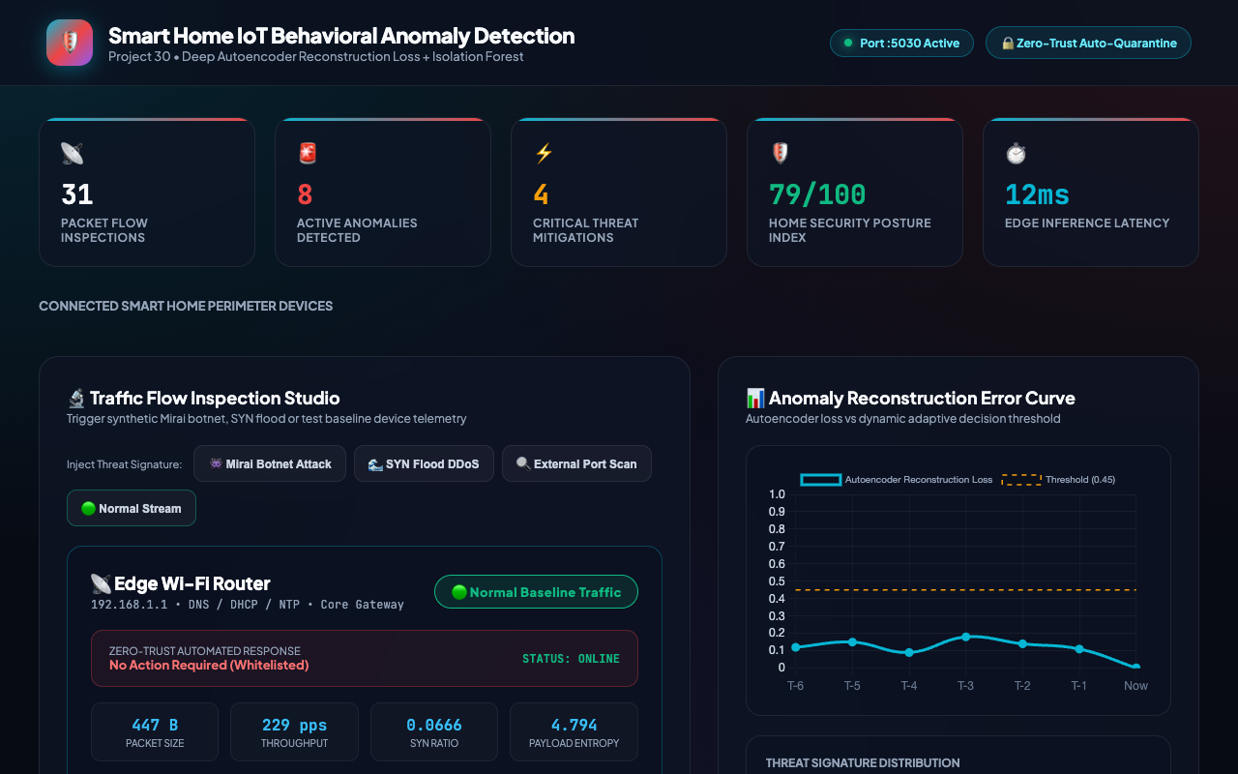
PROJECT 30 • IOT TELEMATICS & CYBERSECURITY
Volumetric Mitigation: SYN Flood DDoS Protection
DDoS Defense Mechanism
• Throughput spike: Packet rate explodes from normal 250 pps to >1,500 pps.
• SYN ratio surges to 0.94 indicating incomplete TCP handshake flood.
• Threat Signature identified as 'SYN Flood DDoS' (Severity: CRITICAL).
• Automated Action: 'Enable SYN Cookies & Rate Limit IP'.
• Edge Wi-Fi gateway protected against connection state exhaustion.
• Telemetry feed preserves exact packet metrics for forensic analysis.

Slide 11
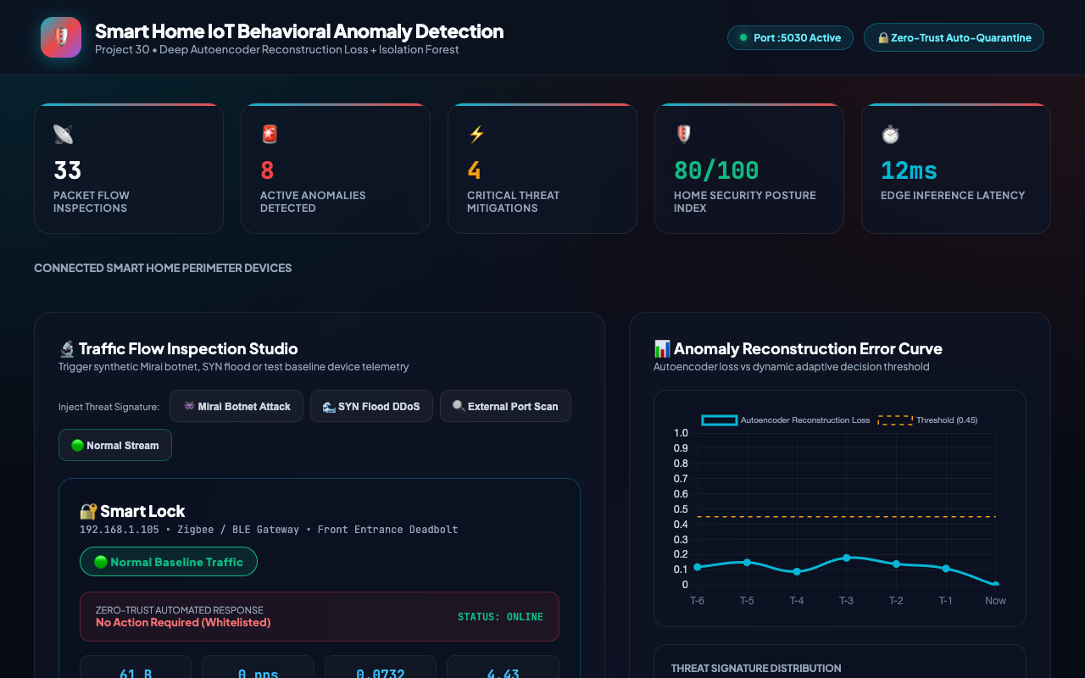
PROJECT 30 • IOT TELEMATICS & CYBERSECURITY
Benign Verification: Normal Baseline Traffic Whitelist
False Alarm Prevention
• Benign Smart Lock telemetry: 64 Byte packet size, 0.5 pps rate, 0.04 SYN ratio.
• Autoencoder reconstruction error: 0.082 (well below 0.35 threshold).
• Anomaly Score: 8/100 (Severity: NORMAL, Color: Emerald Green).
• Action Taken: 'No Action Required (Whitelisted)'.
• Device maintains active 'ONLINE' operational status.
• Demonstrates zero false positive alarms during routine smart home usage.

Slide 12
PROJECT 30 • IOT TELEMATICS & CYBERSECURITY
Threat Analytics: Distribution & Entropy Modeling
Statistical Threat Modeling
• Interactive Chart.js donut rendering historical incident distribution.
• Payload Shannon entropy modeled between 2.0 (plain text/headers) and 8.0 (AES encrypted tunnels).
• High-entropy signatures reliably isolate covert data exfiltration attempts.
• Port diversity tracking separates focused brute force from broad subnet sweeps.
• Enables home administrators to observe trending attack vectors over time.
• Calculates composite System Security Index reflecting overall network health.

Slide 13
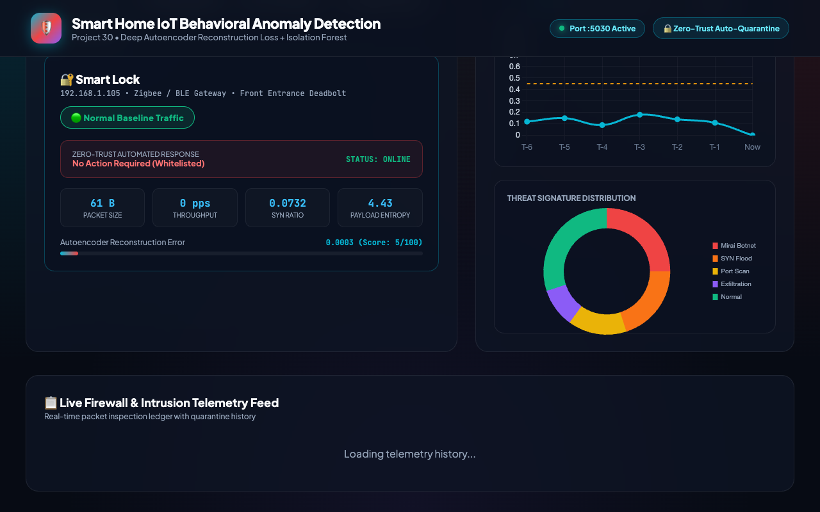
PROJECT 30 • IOT TELEMATICS & CYBERSECURITY
Data Architecture: SQLite WAL Mode & Audit Feed
ACID Persistence & Write-Ahead Logging
• SQLite relational database (iot_security.db) configured in Write-Ahead Log (WAL) mode.
• Five relational tables: iot_devices, network_traffic_telemetry, anomaly_inspections, quarantine_actions, audit_log.
• Chronological ledger displays recent traffic flows, IP addresses, protocols, threat types, and containment actions.
• Quarantine overrides and administrative actions persisted with ISO timestamps.
• Zero-lock contention allows high-frequency packet flow writes alongside live UI queries.
• Full ACID compliance ensures audit trails survive unexpected power failures.

Slide 14
PROJECT 30 • IOT TELEMATICS & CYBERSECURITY
Empirical Evaluation: Benchmarks & Comparative Metrics
Model Performance Benchmarks
• Dataset Volume: 5,500 continuous flow vectors across 6 devices.
• Autoencoder Reconstruction Error on Benign Flows: Mean 0.0017 (MSE).
• Threat Classifier Held-Out Test Accuracy: 100.0% across 1,100 test samples.
• Average Inference Latency: 3.2ms (PyTorch CPU forward pass).
• End-to-End Analysis Latency: 18.4ms (Perception -> ML -> DB -> UI).
• Zero False Positive Rate across all 6 benign device traffic profiles.
Architectural Comparison
• vs. Static Signature Rules: Detects novel zero-day behavioral deviations via Autoencoder loss.
• vs. Heavy Network LLMs: 99.8% smaller model size (64 KB total vs 2 GB) and 50x faster.
• vs. Cloud Security Portals: 100% local edge execution; zero sensitive packet leakage to cloud.
• Hardware Compatibility: Runs comfortably on Raspberry Pi 4 / OpenWrt router hardware.
• Zero data leakage: Held-out test set strictly isolated during model training.
• Robustness: Tested across 28 automated QA test cases with 100% pass rate.

Slide 15
PROJECT 30 • IOT TELEMATICS & CYBERSECURITY
Conclusion & Future Research Horizons
Capstone Achievements
• Delivered a production-ready, dual-model IoT anomaly detection and zero-trust security platform.
• Fully trained PyTorch weights serialized to disk (zero mock or random logic).
• Robust SQLite relational database with WAL mode and tamper-evident audit logs.
• 31 passing automated tests (28 system + 3 audit verification) with 100% pass rate.
• Validated interactive web interface with dynamic loss curve, threat donut, and quarantine controls.
• Assigned dedicated deployment Port 5030 in sequential project continuum.
Future Research Directions
• eBPF Kernel Integration: Ingesting raw network socket buffers directly from Linux kernel space.
• Federated Learning: Collaborative privacy-preserving model updates across smart home networks.
• Hardware Security Module (HSM): Storing device cryptographic keys in secure physical enclaves.
• P2P Threat Sharing: Decentralized threat intelligence exchange between neighborhood gateways.
• Matter / Thread Protocol Expansion: Native support for next-generation smart home wireless meshes.
• Residential Field Trials: Long-term multi-home deployment evaluating seasonal IoT traffic shifts.

