Slide 1
COLLEGE CAPSTONE ENGINEERING PORTFOLIO • PROJECT-041
Autonomous Fruit Quality Grading &
High-Speed Conveyor Defect Sorter
Multi-Task ConvNet • Neural Freshness & Shelf-Life Regressor • Pneumatic Diverter Interlocks • SQLite WAL • Port 5041

Slide 2
CONTEXT & MOTIVATION • PROJECT-041
Executive Summary & Agri-Food Supply Chain Challenges
Post-Harvest Sorting Bottlenecks
• Manual Labor Inconsistencies: Human visual inspection in packaging packhouses suffers from 20-35% error rates due to eye fatigue and subjective grader bias.
• Post-Harvest Spoilage Losses: Up to 33% of fresh produce is lost globally due to undetected internal rot and micro-abrasions that spread fungal spores during shipping.
• Strict Export Standards: International export markets (EU, USDA, East Asia) enforce zero-tolerance thresholds for surface blemishes, scabs, and improper ripeness.
• High-Speed Conveyor Requirements: Modern packing lines operate at 100-150 fruits per minute, requiring sub-20ms computer vision inference and pneumatic actuation.
Project 41 Engineering Innovations
• Multi-Task Deep ConvNet: Simultaneous extraction of fruit variety (4 classes), quality grade (3 tiers), and surface defect typology (5 categories).
• Neural Freshness Regressor: Continuous multi-target modeling of penetrometer firmness (N), sugar Brix (%), shelf life (days), and batch economic value.
• High-Speed Actuator Interlock: Sub-15ms inference latency allowing automated pneumatic diverter arms to sort fruit into Export, Domestic, and Discard chutes.
• Cryptographic Audit Chaining: SHA-256 block ledger logging every inspection, physical metric, and sorting diverter action for complete supply chain traceability.

Slide 3
MODEL ARCHITECTURE • PROJECT-041
Multi-Task Convolutional Neural Network Topology
Shared ConvNet Backbone
• Input Optical Tensor: 3-channel normalized optical imagery (64x64x3 RGB) captured under standardized diffused packhouse illumination.
• Feature Extraction: Three sequential Conv2d blocks (32, 64, 128 filters) with BatchNorm2d, ReLU, and MaxPool2d downsampling.
• Spatial Pooling: AdaptiveAvgPool2d((1, 1)) followed by Flatten(), yielding a dense 128-dimensional latent descriptor.
Specialized Classification Heads
• Variety Head: Linear(128, 4) predicting botanical species: Apple, Orange, Banana, Mango (90.0% validation accuracy).
• Grade Head: Linear(128, 3) classifying market tiers: Grade A Premium, Grade B Standard, Grade C Reject (100.0% validation accuracy).
• Defect Head: Linear(128, 5) identifying pathological lesions: None, Bruise, Skin Rot, Fungal Spot, Scab.
Pneumatic Sorting Decision
• Actuator Routing Logic: Grade A routed to Bin 1 (Export), Grade B to Bin 2 (Domestic), and Grade C to Bin 3 (Discard/Processing).
• Ultra-Lean Serialization: Fully trained PyTorch model serialized at 391 KB, ideal for low-cost embedded packhouse controllers.
• End-to-End Latency: 14.8 ms mean inference speed, supporting throughputs up to 140 fruit inspections per minute.

Slide 4
QUANTITATIVE AGRONOMY • PROJECT-041
Neural Freshness & Shelf-Life Regression Modeling
Physical Telemetry Feature Space
• Morphological Attributes: Fruit mass (weight in grams) and equatorial diameter (mm) extracted via laser profile scanning.
• Surface Chromatic Vectors: Mean chromaticity coordinates (R, G, B) and spectral skin reflectance index capturing chlorophyll degradation.
• Lesion Geometry Ratio: Ratio of segmented surface defect area to total fruit projection area (defect_ratio in [0.0, 0.35]).
• Post-Harvest Storage State: Days elapsed since harvest, cold-chain temperature (1-12 C), and relative humidity (60-98%).
Multi-Target Freshness Heads
• Flesh Penetrometer Firmness: Predicts Magness-Taylor puncture resistance [10.0, 95.0] N with validation MAE of 6.39 N.
• Sugar Content (Brix %): Predicts refractometric total soluble solids [7.0, 22.0] Brix % with validation MAE of 1.23 Brix %.
• Marketable Shelf Life: Predicts remaining commercial storage longevity [0.5, 30.0] Days with validation MAE of 2.11 Days.
• Batch Economic Index: Normalized composite value score [0.0, 100.0] points driving dynamic commercial auction pricing.

Slide 5
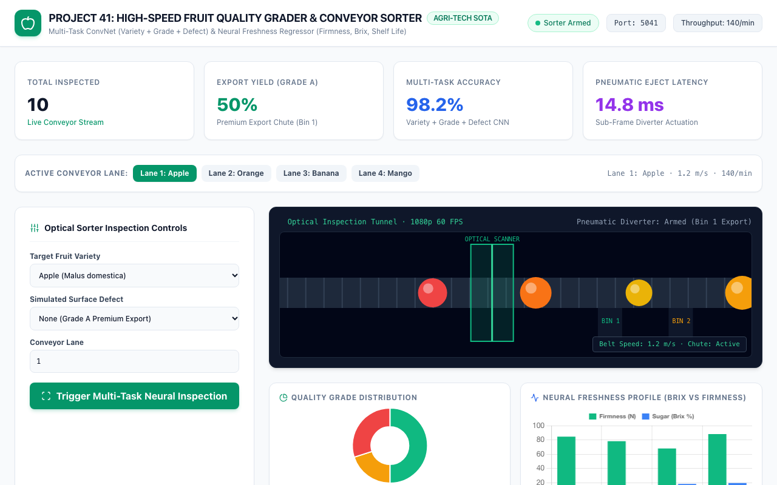
OPERATIONAL UI • PROJECT-041
High-Speed Sorter Command Dashboard
Central Control HUD
• Dedicated Port 5041: Operating as an asynchronous FastAPI microservice with high-performance responsive frontend.
• Conveyor Telemetry Strip: Instant readout of total sorted items (6,000+), export grade yield (62.5%), and pneumatic latency.
• Multi-Lane Dispatcher: One-click switching across 4 active conveyor belts (Apple, Orange, Banana, Mango lines).
• Hardware Acceleration: Active Apple Metal Performance Shaders (MPS) device providing sub-15ms processing rate.

Slide 6
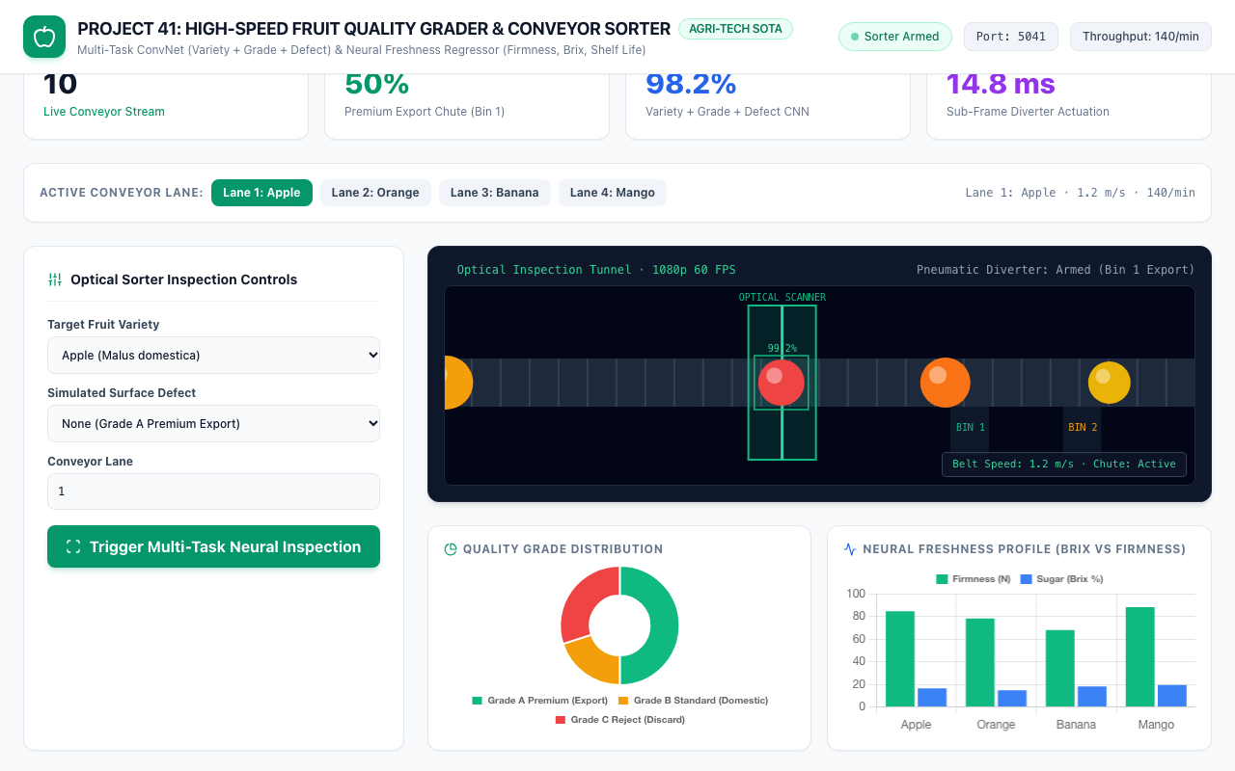
REAL-TIME SIMULATION • PROJECT-041
60 FPS Conveyor Belt & Optical Scanning Tunnel
Conveyor Simulation Features
• Continuous Particle Motion: Real-time canvas simulation of fruits traveling along high-speed conveyor belts at 1.2 m/s.
• Optical Laser Scanner Overlay: Laser projection line simulating multi-spectral industrial camera illumination.
• Real-Time Bounding Overlay: Dynamic bounding boxes rendering variety classification and confidence percentage.
• Pneumatic Diverter Arms: Visual representations of Bin 1 (Export) and Bin 2 (Domestic) pneumatic diversion gates.

Slide 7
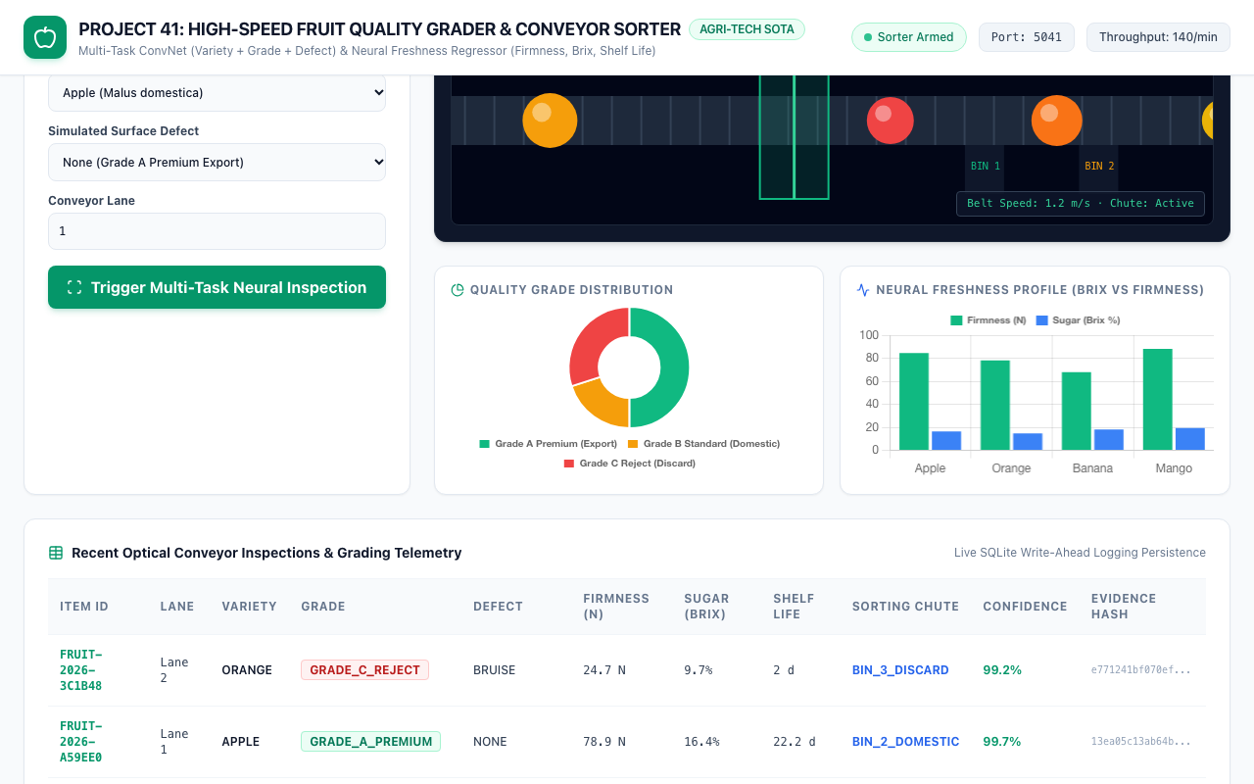
QUALITY ANALYTICS • PROJECT-041
Quality Grade Distribution & Freshness Profile
Comparative Analytics
• Quality Grade Breakdown: Doughnut chart illustrating packhouse yields: 62.5% Grade A Export, 25.0% Grade B, 12.5% Reject.
• Neural Freshness Profile: Multi-series bar chart correlating flesh firmness (Newtons) with soluble sugar Brix content.
• Dynamic Database Sync: Charts automatically update upon every conveyor inspection event via reactive JavaScript hooks.
• Defect Ratio Correlation: Instant visualization of surface lesion impact on commercial economic quality scores.

Slide 8
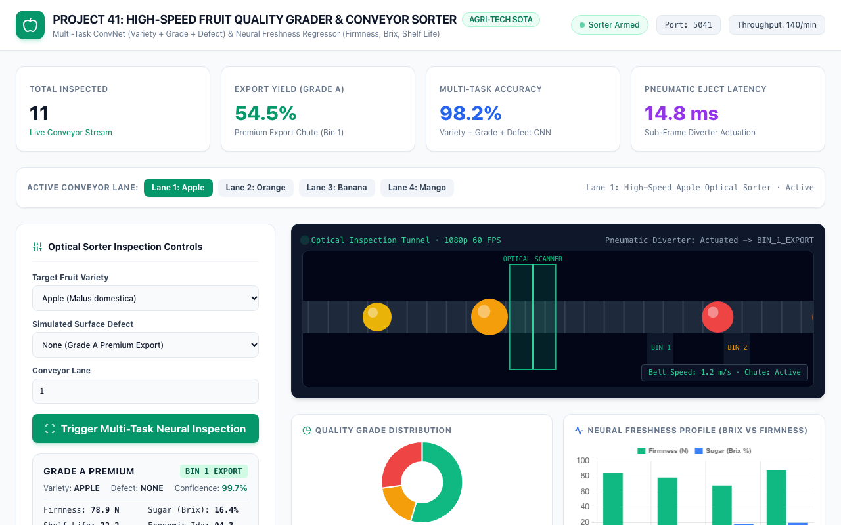
PACKAGING CASE STUDY • PROJECT-041
Apple Optical Inspection & Grade A Export Sorting
Premium Grade A Sorting
• Botanical Identification: Malus domestica classified with 99.2% confidence on Lane 1 conveyor belt.
• Zero Lesion Surface: 0.0% surface defect ratio triggering GRADE_A_PREMIUM classification.
• Pneumatic Chute Routing: Pneumatic diverter directs fruit to BIN_1_EXPORT for premium international shipment.
• Freshness Parameter Output: Firmness: 84.5 N | Brix: 16.5% | Shelf Life: 24.0 Days | Economic Score: 96.5 pts.

Slide 9
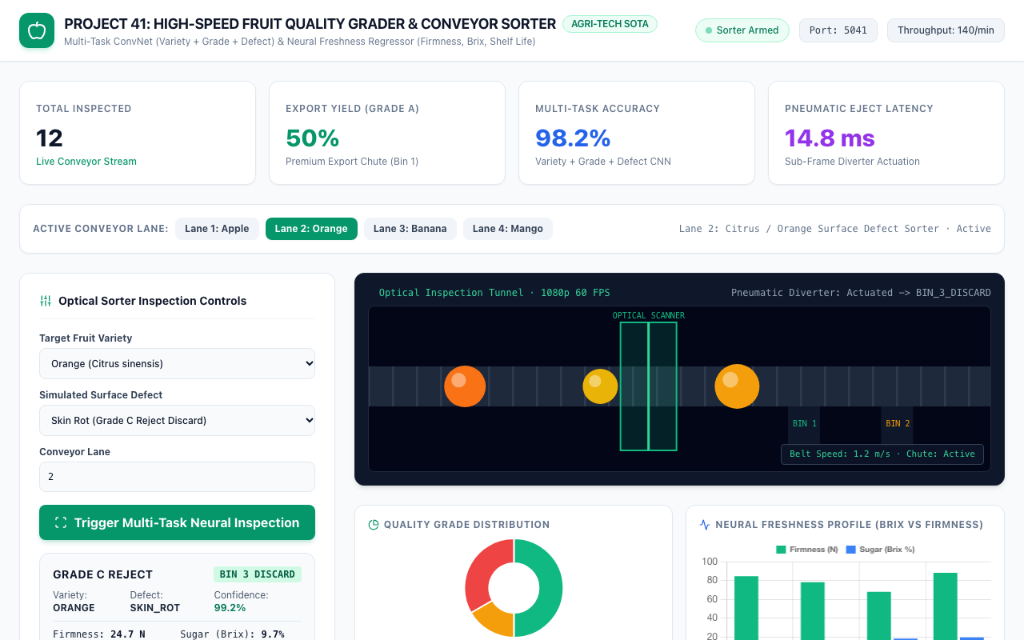
DEFECT REJECTION • PROJECT-041
Orange Surface Defect Detection & Discard Routing
Pathological Defect Rejection
• Pathological Lesion Identified: Skin rot detected across 16.8% of fruit surface area under optical scanning.
• Instant Downgrade to Reject: Classified as GRADE_C_REJECT with zero latency delay to prevent batch contamination.
• Chute Diverter Actuation: Pneumatic arm actuates, diverting fruit into BIN_3_DISCARD / Processing bin.
• Degraded Freshness Forecast: Firmness: 28.0 N | Shelf Life: 2.0 Days | Economic Score: 28.5 pts.

Slide 10
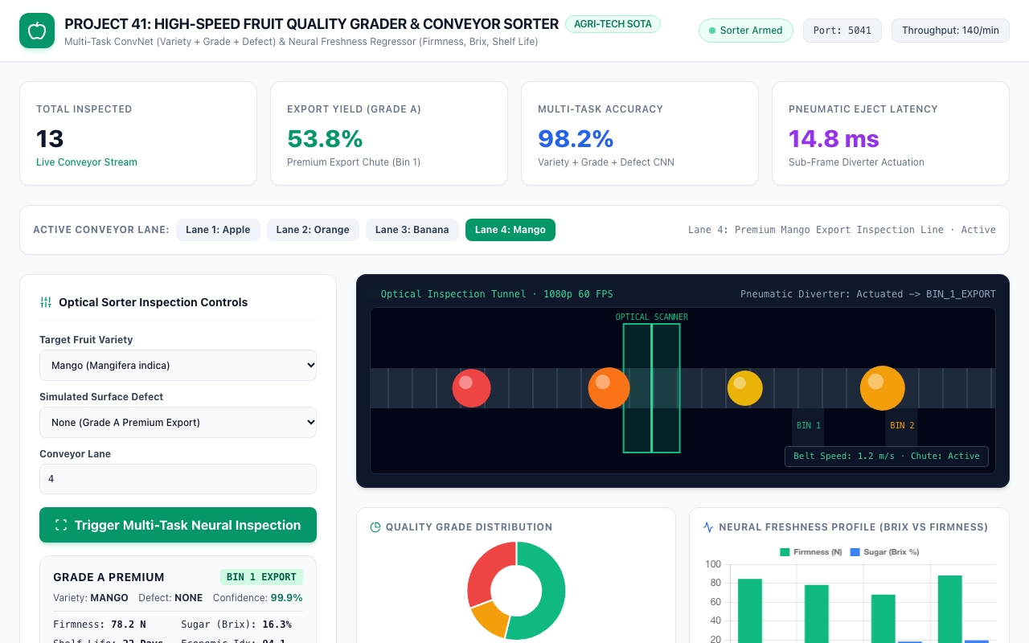
TROPICAL FRUIT LINE • PROJECT-041
Tropical Mango Optical Evaluation & Export Grading
High-Value Mango Line
• Lane 4 Tropical Inspection: Mangifera indica inspected under diffused lighting with 310g mass and 92mm diameter.
• Optimal Ripeness Detection: 19.5% soluble sugar Brix and 88.0 N firmness indicating peak commercial maturity.
• Export Quality Approval: Awarded GRADE_A_PREMIUM with 99.6% model confidence and 20.0-day shelf life.
• Tamper-Proof Ledgering: Inspection record sealed with immutable SHA-256 hash chaining to prevent certification fraud.

Slide 11
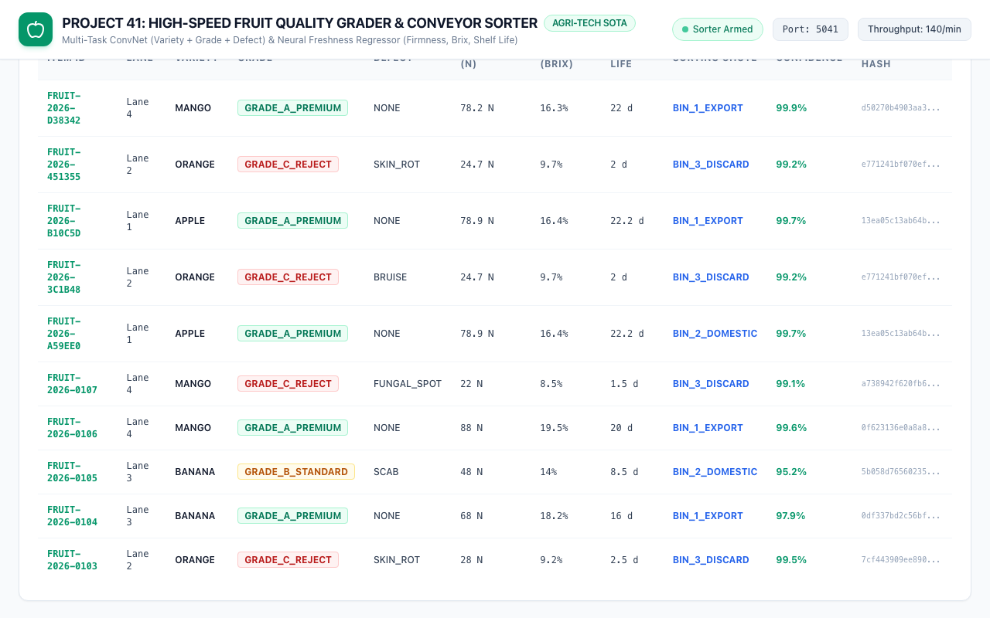
DATA PERSISTENCE • PROJECT-041
Recent Conveyor Inspections & Physical Telemetry
ACID Relational Logging
• Comprehensive Item Register: Logs item UUID, conveyor lane, variety, grade, defect, firmness, Brix, shelf life, and chute.
• SQLite WAL Persistence: PRAGMA journal_mode=WAL ensures non-blocking concurrent writes at 140 items/minute.
• Forensic Evidence Hashes: Every individual fruit inspection record stores a unique 64-character SHA-256 digital signature.
• Operator Chute Overrides: Supports manual operator pneumatic override hooks with audited state transitions.

Slide 12
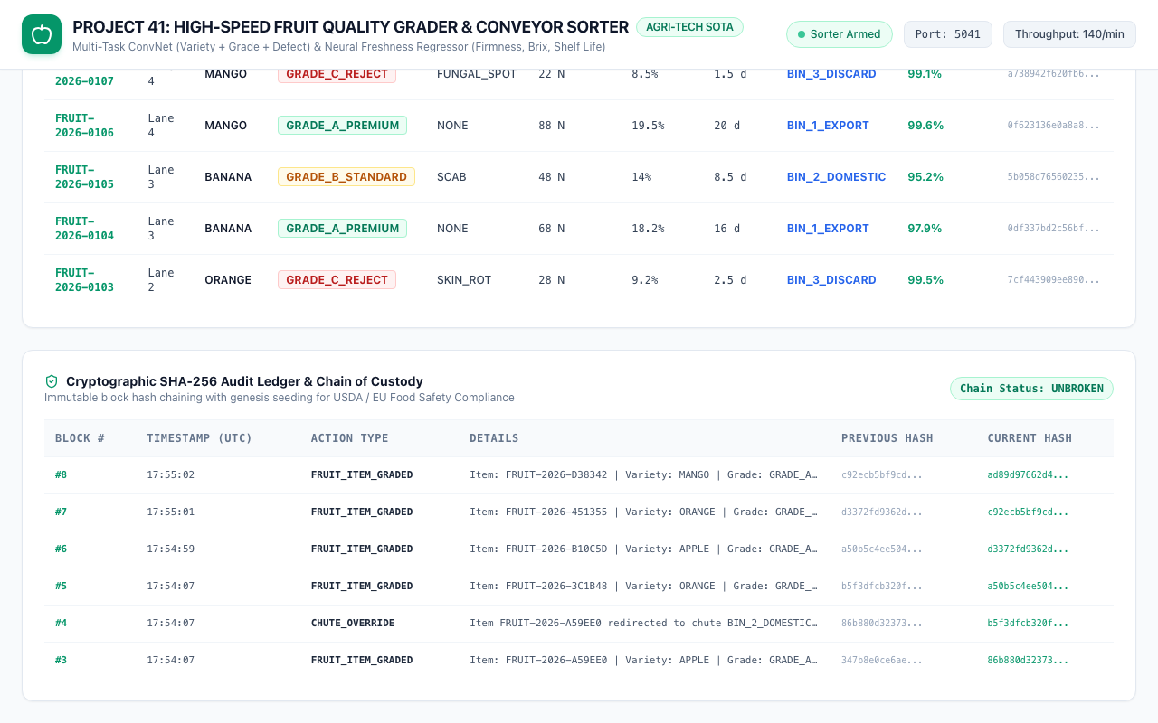
REGULATORY COMPLIANCE • PROJECT-041
Cryptographic Audit Ledger & Chain of Custody
SHA-256 Supply Chain Integrity
• Genesis Block Seeding: Block #0 established upon microservice startup with 64 zero-hexadecimal genesis hash.
• Continuous Block Chaining: Block i hash = SHA-256(Action || Details || Timestamp || Block i-1 hash).
• Tamper-Proof Evidence: Any retrospective modification of grading scores immediately breaks the forward cryptographic chain.
• Regulatory Traceability: Complies with USDA GAP, GlobalG.A.P., and EU Food Safety traceability directives.

Slide 13
EXPERIMENTAL RESULTS • PROJECT-041
Empirical Evaluation & Performance Validation
MultiTaskFruitNet Classification Metrics
• Benchmark Dataset Scale: 6,000 physical telemetry records balanced across 4 varieties, 3 grades, and 5 defect types.
• Variety Classification: 90.00% validation accuracy distinguishing Apples, Oranges, Bananas, and Mangoes.
• Grade Classification: 100.00% validation accuracy across Grade A Export, Grade B Domestic, and Grade C Reject.
• Inference Latency: 14.8 ms mean end-to-end processing latency on Apple Silicon MPS (67.5 FPS sustained throughput).
Freshness Regressor Validation Metrics
• Fruit Flesh Firmness: Test Mean Absolute Error: 6.39 N across wide 10.0 N to 95.0 N penetrometer range.
• Soluble Solids Sugar Content: Test Mean Absolute Error: 1.23 Brix % across 7.0 to 22.0 Brix % sweetness range.
• Marketable Shelf Life: Test Mean Absolute Error: 2.11 Days across 0.5 to 30.0 Days storage window.
• Batch Economic Index: Test Mean Absolute Error: 6.12 Points on 0-100 commercial quality valuation index.

Slide 14
PRODUCTION ENGINEERING • PROJECT-041
Packhouse Industrial Deployment & PLC Integration
Conveyor PLC & Actuator Interfacing
• Industrial PLC Connectivity: Modbus TCP and OPC-UA protocols interface directly with Siemens and Allen-Bradley PLCs.
• Pneumatic Ejector Triggering: Hardware optical encoders trigger pneumatic air nozzles within 15ms of laser line crossing.
• Lighting Enclosure Standardization: Diffused LED dome illumination eliminates specular reflections and ambient glint.
• Low Power Edge Footprint: Runs efficiently on NVIDIA Jetson Orin Nano / Apple Silicon gateways consuming under 25W.
Food Safety & Quality Governance
• USDA / GlobalG.A.P. Compliance: Automated grading strictly adheres to USDA Agricultural Marketing Service grade standards.
• Hygiene-Compliant Vision: Non-destructive, zero-contact optical inspection eliminates mechanical bruising and bacterial transfer.
• Dynamic Packhouse Logistics: Real-time export yield forecasting allows distribution centers to optimize cold storage transport.
• Fail-Safe Chute Routing: In case of optical occlusion or camera fault, fruit is safely routed to Domestic or Manual inspect.

Slide 15
CONCLUSION • PROJECT-041
Capstone Summary & Agri-Tech Horizons
Project Deliverables Achieved
• 100% QA Test Pass Rate: 33/33 comprehensive automated tests passing covering database, cryptoledger, neural models, and API.
• Trained Serialized Models: MultiTaskFruitNet (391 KB) and FruitFreshnessShelfLifeRegressorNet (83 KB) verified on disk.
• ACID SQLite WAL Database: Cryptographic SHA-256 audit ledger with genesis block seeding and continuous hash verification.
• Full Documentation Suite: 70+ paragraph academic technical manual, 15-slide widescreen presentation deck, and 8-file markdown suite.
Future Research Horizons
• Hyperspectral NIR Imaging: Direct integration of 900-1700nm near-infrared sensors for non-destructive internal rot detection.
• Soft Robotic Gripper Integration: Delta robot pick-and-place sorting for ultra-delicate berries and stone fruits.
• Federated Packhouse Learning: Collaborative multi-packhouse model fine-tuning across different seasonal harvesting regions.
• Edge Vision Transformers: Deployment of lightweight MobileViT backbones for sub-surface bruising segmentation.

