Slide 1

Investment Strategy (Finance & Risk Analytics)
Clients:
Mr. Patrick Jyengar
Mr. Peter Jyengar
Amara Wealth Management Pvt. Ltd.
Notes:
Hello Mr. Patrick & Mr. Peter,
Welcome to today’s presenstation wherein we’ll be discussing the investment strategy that’s been tailormade to meet your investment goals.

Slide 2

“Compound interest is the eighth wonder of the world. He who understands it, earns it. He who doesn’t, pays it.” – Albert Einstein
Notes:
Before I proceed, I’d like to thank you for giving us the opportunity to be your trusted financial advisor and we’re confident that we’ll be able to help you grow and compound your investments.

Slide 3

Agenda
Historical Overview of the Market
Financial Objectives & Investment Goals
Portfolio Recommendations
Notes:
Here’s a quick overview of the flow of today’s presentation

Slide 4
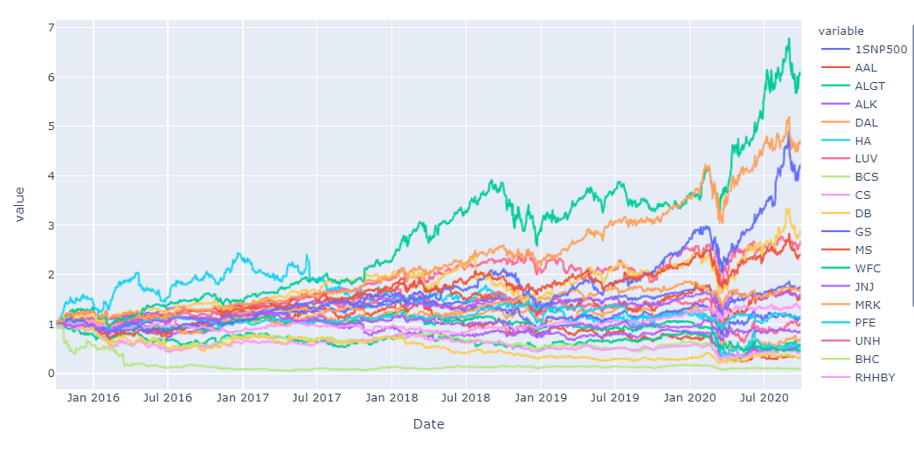
Historical Market Overview (5 years) - The overall market saw an uptrend from q4 2015 to q3 2018 - Primarily Due to US-China trade war, q4 2018 to q2 2019 had a slump - Market crashed from Feb 2020 due to pandemic induced economy slowdown
Notes:
Though overall the market has been in an upward trajectory, there have been some bumps on the way.

Slide 5
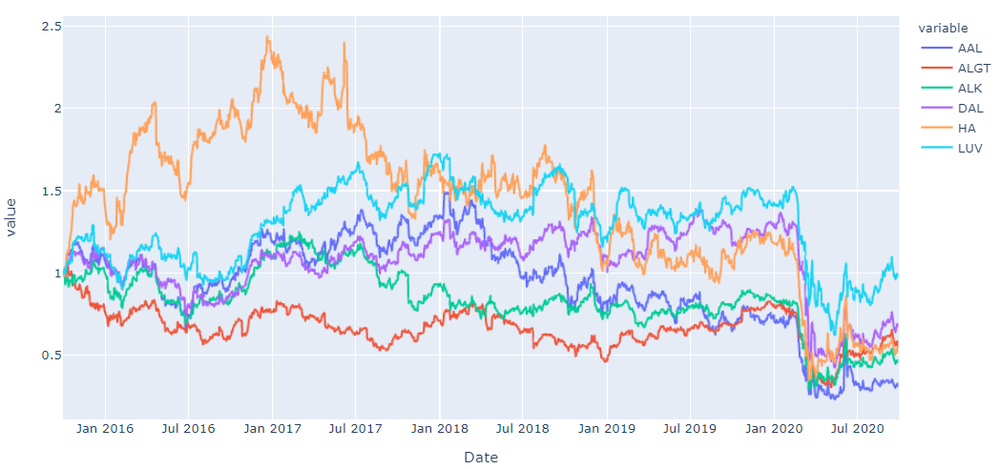
Aviation Sector Overview (Last 5 years) - Aviation sector has been under stress historically, however the pandemic related travel ban, and restrictions hit a real blow to the industry - If we look at the trends till Jan 2020 (pre-pandemic), all of the stocks were already under performing as compared to S&P500 - DAL and LUV still stood out compared to other in terms of good growth and returns as compared the other stocks in this sector.
Notes:
https://poweredtemplate.com/business-man-glad-about-corporate-profits-powerpoint-template-52570/

Slide 6
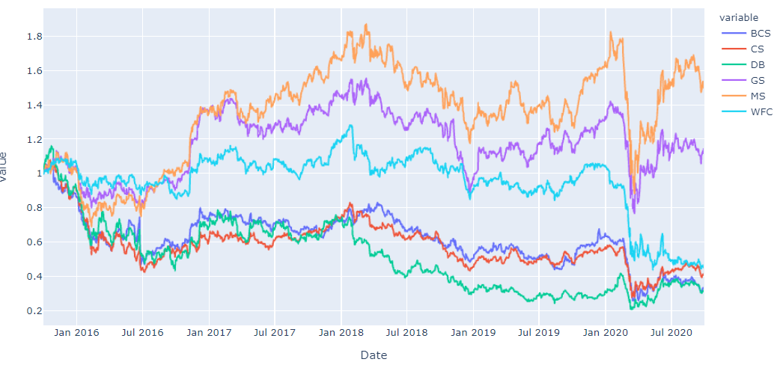
Finance Sector Overview (Last 5 years) - Finance sector has displayed neutral performance in the past 5 years - Though pandemic did cause a sharp decline, overall, it's now on its path to recovery - Morgan Stanley (MS) followed by Goldman Sachs (GS) continue to show strength and are the good picks from this sector
Notes:
https://poweredtemplate.com/business-man-glad-about-corporate-profits-powerpoint-template-52570/

Slide 7
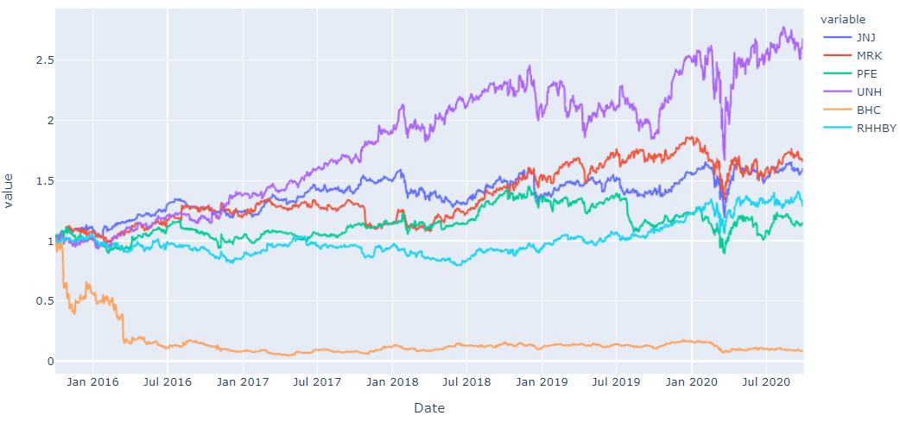
Pharma Sector Overview (Last 5 years) - For Pharma sector, we see a very strong performance and growth over the last 5 years - And during the pandemic, though there was a slight impact in Mar2020, it quickly bounced back and most of the stocks recovered to pre-pandemic prices - United Health Group (UNH) is the top performing stock from this sector, followed by Johnson & Johnson (JNJ), Merck (MRK) and Roche Holding (RHHBY).
Notes:
https://poweredtemplate.com/business-man-glad-about-corporate-profits-powerpoint-template-52570/

Slide 8
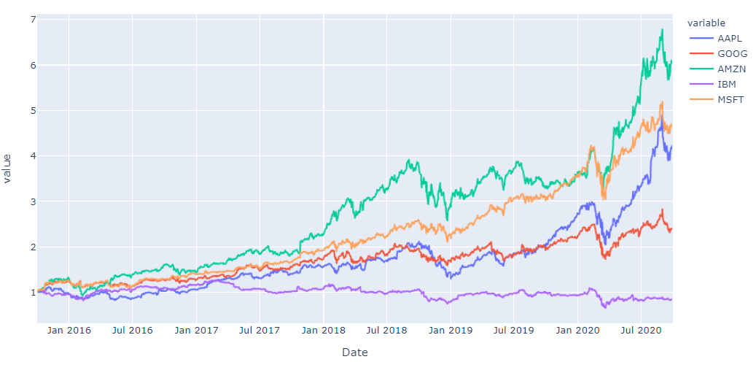
Technology Sector Overview (Last 5 years) - Tech sector overall has been the best sector in terms of exponential growth and performance with pandemic acting as a catalyst, wherein work from home made sure that Tech companies weren't as severely impacted and hence saw more investments compared to other sectors. - It's primarily due to Amazon (AMZN) which has given more than 6x returns, followed by Microsoft (MSFT) and Apple (AAPL) with more than 4x returns and finally Google (GOOG) with 2x returns. - IBM has not only underperformed but resulted in degrowth of -16% over the last 5 years.
Notes:
https://poweredtemplate.com/business-man-glad-about-corporate-profits-powerpoint-template-52570/

Slide 9
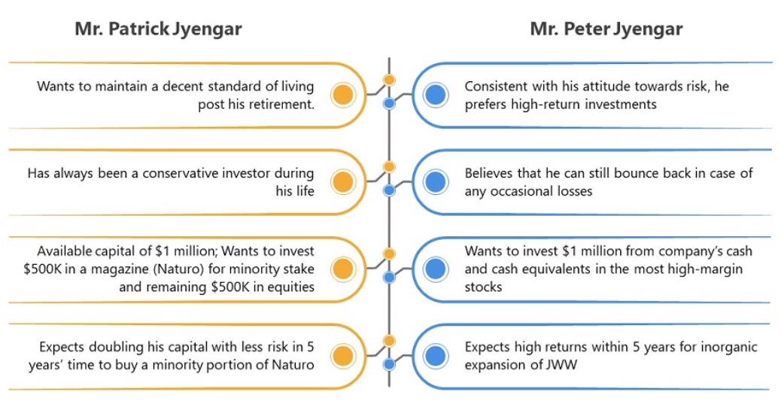
Investment goals

Slide 10
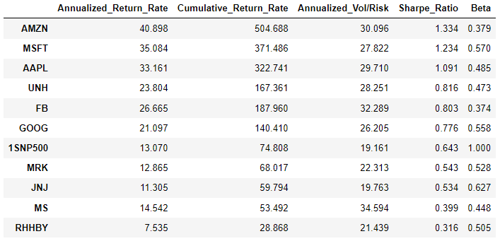
Portfolio Strategy & REcommendatiON
Top Stocks by Sharpe Ratio & Beta
On filtering the top 10 stocks based on the Sharpe Ratio and Beta, we see that all stocks from Aviation sector has been filtered out.
As we are still in the middle of the pandemic and the it may take years for the travel industry to regain the pre-pandemic level of growth and performance, we'll skip the Aviation sector stocks.
Next we’ll review the different combination of these stocks to create the right portfolio based on the specified goals and active investment strategy.

Slide 11
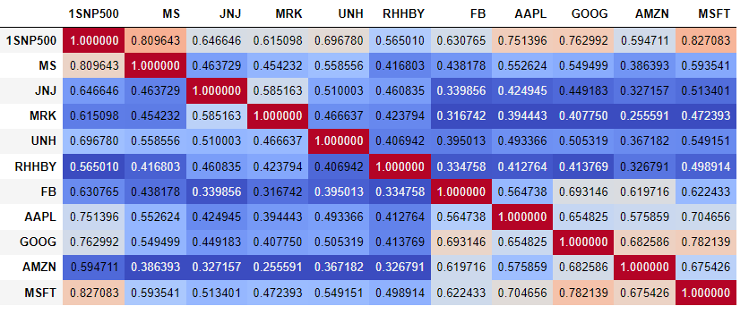
Correlation Matrix
Correlation Matrix suggests that though there is slightly high correlation between stocks of the same sector, overall, the correlation is low between the top 10 stocks.
Notes:
https://poweredtemplate.com/business-man-glad-about-corporate-profits-powerpoint-template-52570/

Slide 12
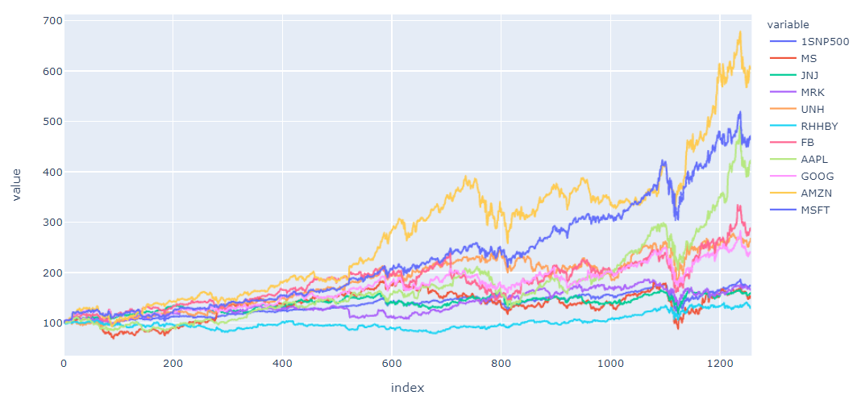
Plotting growth of 100 USD investment in top 10 stocks
100 USD in any of the top 10 stocks would have given a return of minimum 128 USD and maximum of 605 USD over the last 5 years

Slide 13
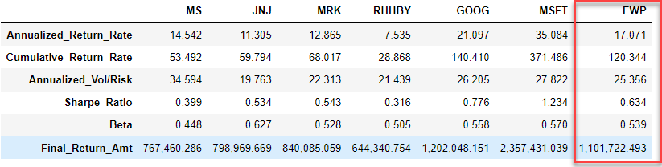
Thank you
a low-risk portfolio for
Mr. Patrick Jyengar
(includes stocks with lower annualized risk and Beta)
After reviewing 3 different combinations of low-risk stock portfolio, we'll choose the following stocks of equal weightage to meet Patrick's target of 2x return on his investment –
1. Merck & Co (MRK)
2. Johnson & Johnson (JNJ)
3. Roche Holding (RHHBY)
4. Microsoft (MSFT)
5. Google (GOOG)
6. Morgan Stanley (MS)

Slide 14
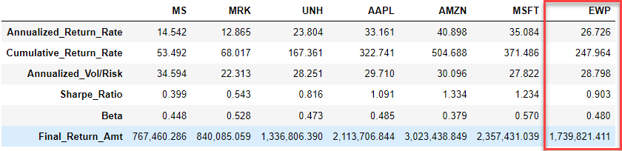
Thank you
a High-Returns portfolio for
Mr. Peter Jyengar
(includes stocks with high-margin returns)
After reviewing 3 different combinations of high return stock portfolio, we'll choose the following stocks of equal weightage to meet Patrick's target of high margin returns on his investment, while making sure the portfolio is well diversified –
1. Merck & Co (MRK)
2. United Health Group (UNH)
3. Apple (AAPL)
4. Microsoft (MSFT)
5. Amazon (AMZN
6. Morgan Stanley (MS)

Slide 15
Thank You!
Amara Wealth Management Pvt. Ltd.

