Slide 1
Student Name:Darshan Ashok Madnaik
College Name:D.K.T.E Society Textile And Engineering Institute Ichalkaranji
Final Project

Slide 2
Project Title: Netflix clone website

Slide 3
AGENDA
Problem statement
Project overview
Who are the end users
Your solution and its value proposition
The wow in your solution
Modelling
Results

Slide 4
PROBLEM STATEMENT:
In Netflix.com, user is not comfortable with dark theme
Solution:
Give the option to change the theme

Slide 5
Project Overview
This project is a simplified front end clone of Netflix.It was created with html and css. In my project “Netflix.com” I am giving this addition option for users to choose the light theme. That is now users can choose there suitable theme from Dark and light theme. I have done the project because Netflix clone is an online video entertainment website similar to Netflix, where you can watch unlimited movies & TV shows for one low monthly price. Netflix Clone broadcasts movies and TV shows over the Internet to new locations with large audiences.

Slide 6
WHO ARE THE END USERS
Student
Doctors
Engineers
Teacher
Worker
Scientist
Lawyer
Journalist

Slide 7
YOUR SOLUTION AND ITS VALUE PROPOSITION
Earlier there is no option for users to change the website theme. In my project “Netflix.com” I am giving this addition option for users to choose the light theme.
That is now users can choose there suitable theme from Dark and light theme.

Slide 8
THE WOW IN YOUR SOLUTION
In my project “Netflix.com” I am giving this addition option for users to choose the light theme. That is now users can choose there suitable theme from Dark and light theme.

Slide 9
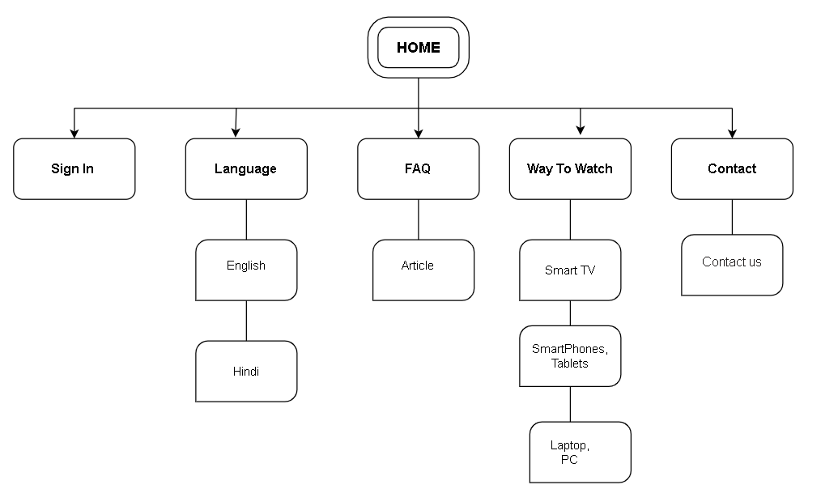
MODELLING

Slide 10
RESULTS
Github link: https://github.com/darshanmadnaik/Netflix_clone_website

