Slide 1


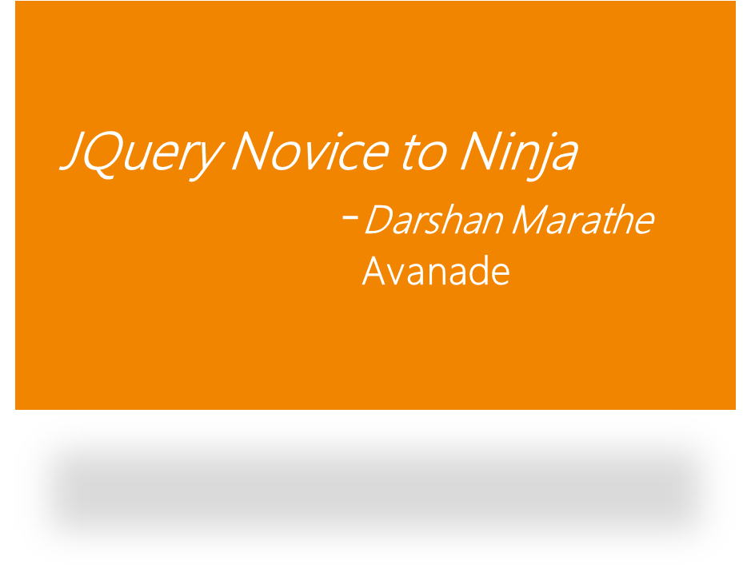



Notes:
© 2007 Microsoft Corporation. All rights reserved. Microsoft, Windows, Windows Vista and other product names are or may be registered trademarks and/or trademarks in the U.S. and/or other countries.
The information herein is for informational purposes only and represents the current view of Microsoft Corporation as of the date of this presentation. Because Microsoft must respond to changing market conditions, it should not be interpreted to be a commitment on the part of Microsoft, and Microsoft cannot guarantee the accuracy of any information provided after the date of this presentation.
MICROSOFT MAKES NO WARRANTIES, EXPRESS, IMPLIED OR STATUTORY, AS TO THE INFORMATION IN THIS PRESENTATION.

Slide 2
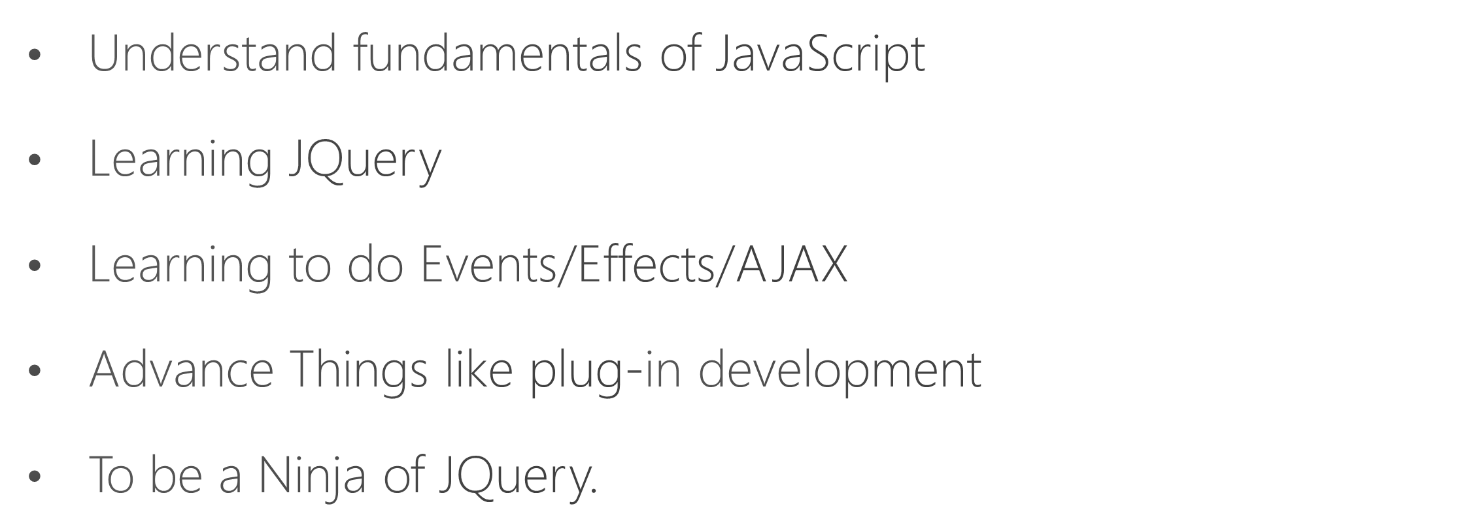

Slide 3

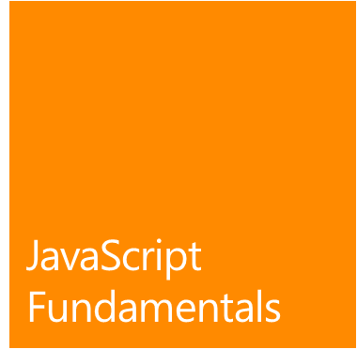
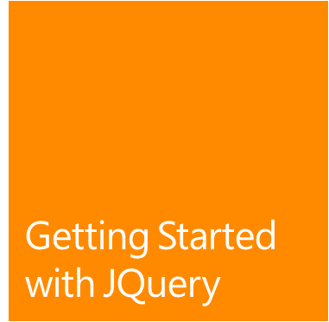



Agenda

Slide 4


Slide 5
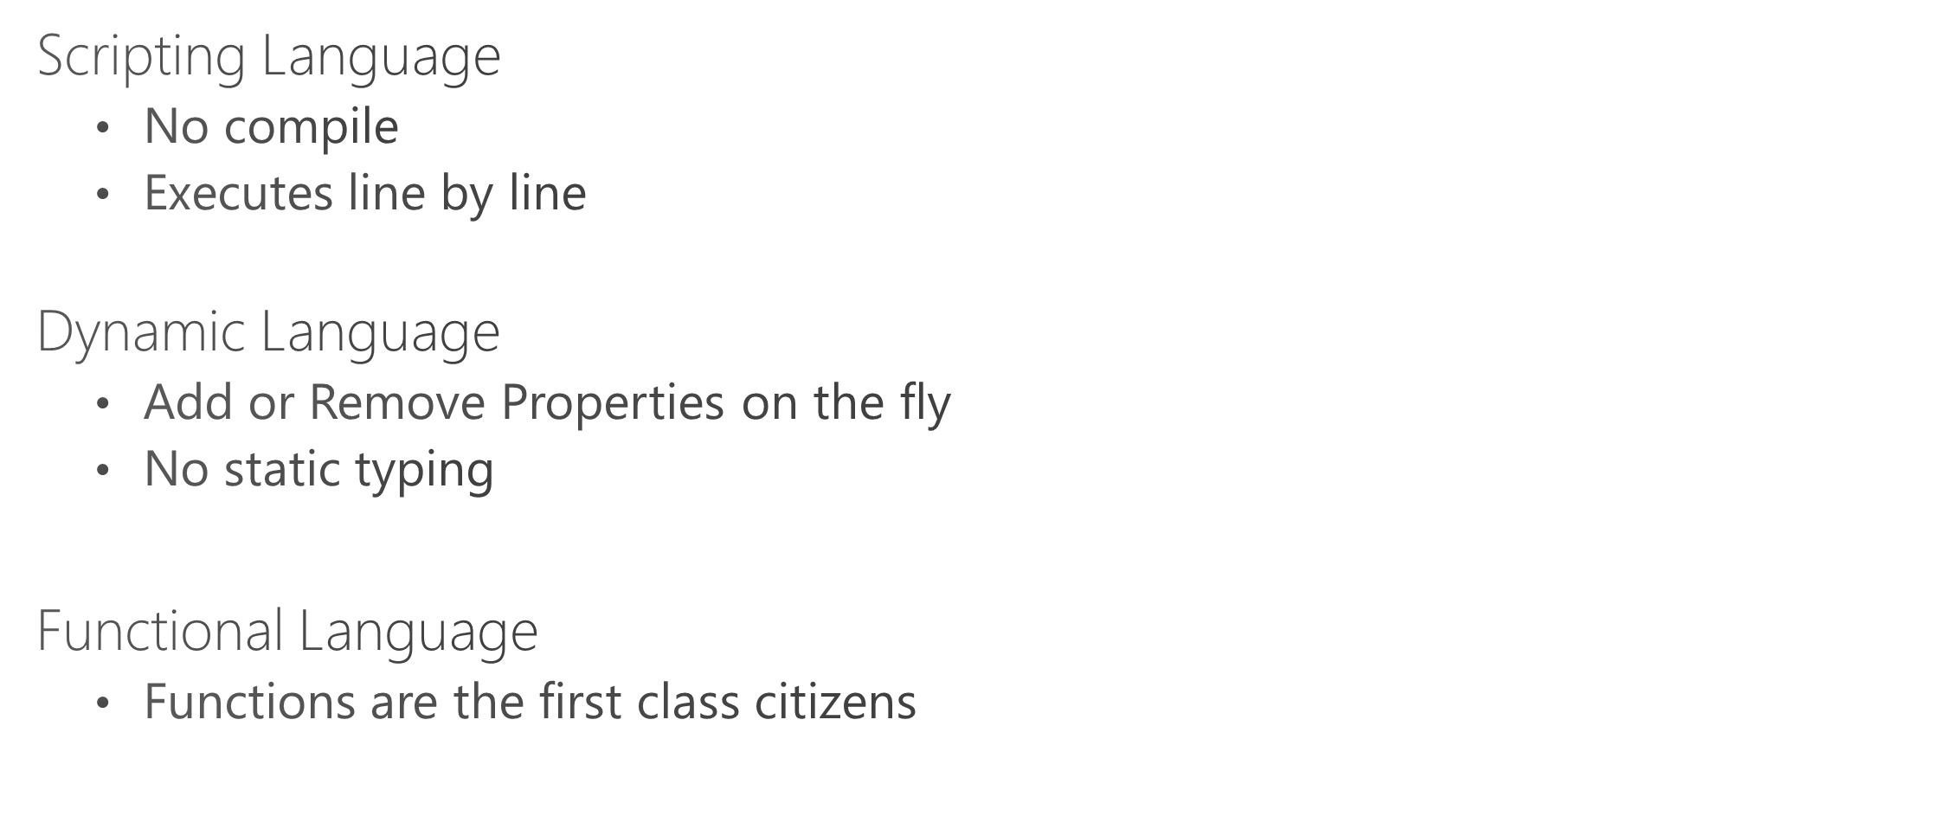

Slide 6
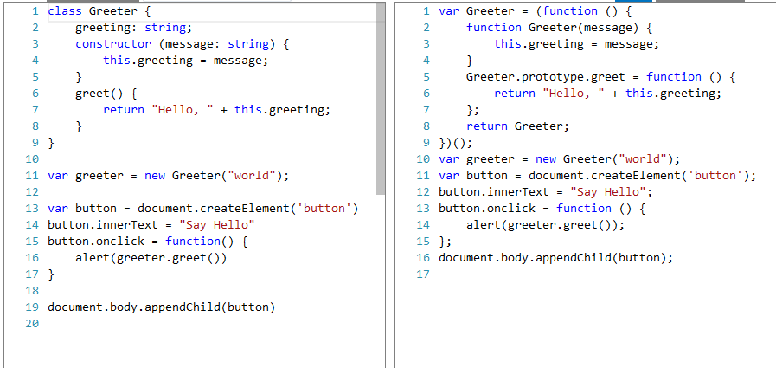

Slide 8
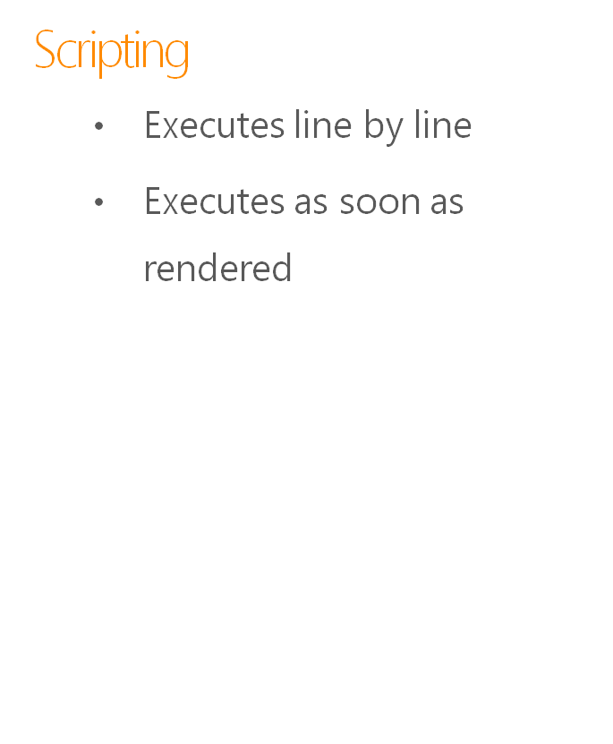
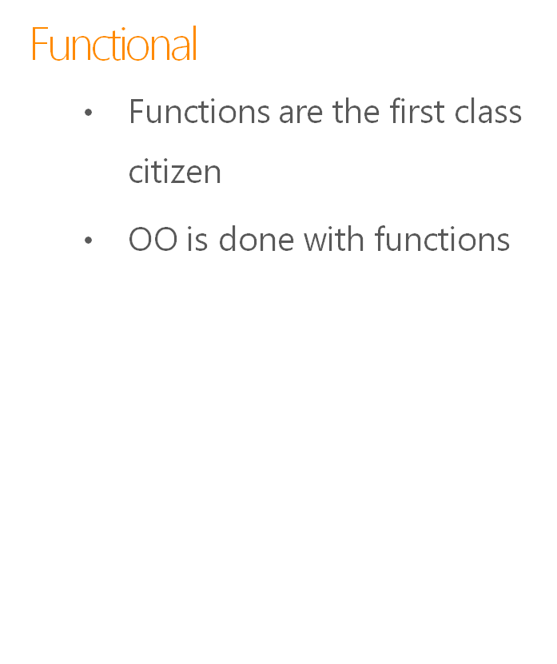
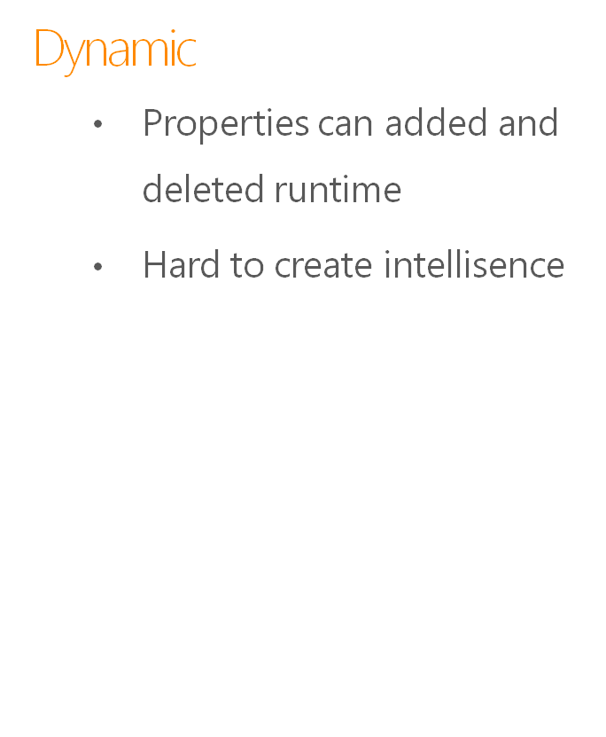
Key takeaways for JavaScript
Memory Management
Generally done by the engine which is running it for example V8 and chakra
Object oriented
OO is achieved with functional programming
Good and Bad
Being dynamic is really hard to refactor but can do some great stuff with like writing Jquery.

Slide 9
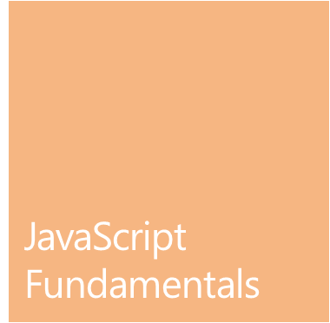

Slide 10


Slide 11




What is JQuery ?
  jQuery is a lib written in JavaScript
  It’s the Enterprise lib for JavaScript
  Geared for working on classic and modern browsers
  Used on 89% on of the websites
  JQuery / JQuery UI / JQuery Mobile / QUnit
What it can do ?
  Write less do more
  DOM Manipulation
  Helps you to go home on time. ☺

Slide 12




Slide 13



Supported by Microsoft
  Used in more than 89% of website
  Used in Major Web frameworks ASP. Net/RoR/PHP
  Works on PC/Mac/Mobile
  Abstracts the tuff part of JavaScript.

Slide 14
  Via CDN
  <script src="http://ajax.googleapis.com/ajax/libs
  /jquery/1/jquery.min.js"></script>
  <!– Pros(Speed , Always latest) Cons(Google is blocked, Always latest) />
  Manually
  Go to Jquery.com
  Download the file
  Refer it
  <script src=“~/Scripts/jquery.min.js"></script>

Slide 16
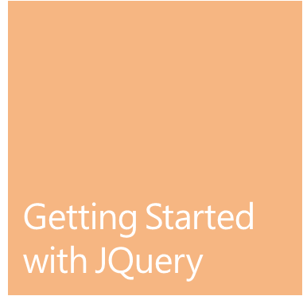

Slide 17


Slide 18
Events, Effects And AJAX
Events
  Easily Liston and capture events
  Take action on the with a fluent syntax
Effects
  Archive effects in a single line of code which might take 1000 lines to do it in JavaScript
  Control the speed
AJAX
  GET/POST/PUT/DELETE
  Works with JSON/XML

Slide 20
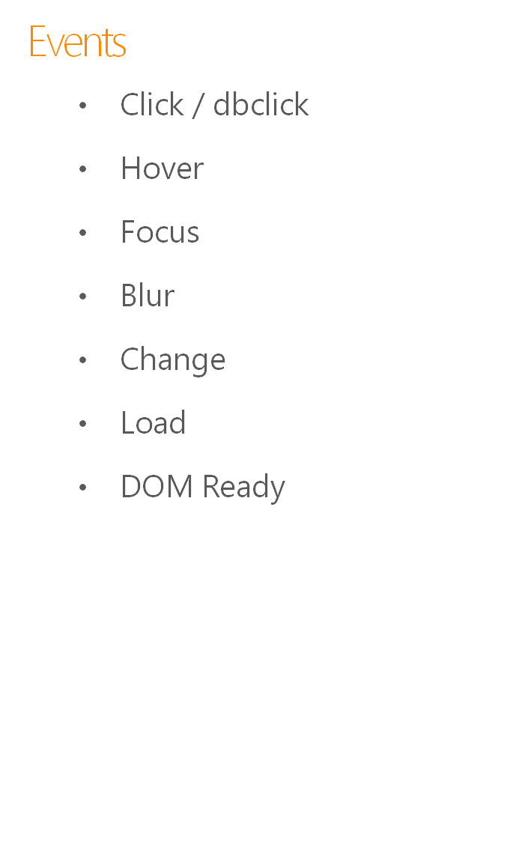
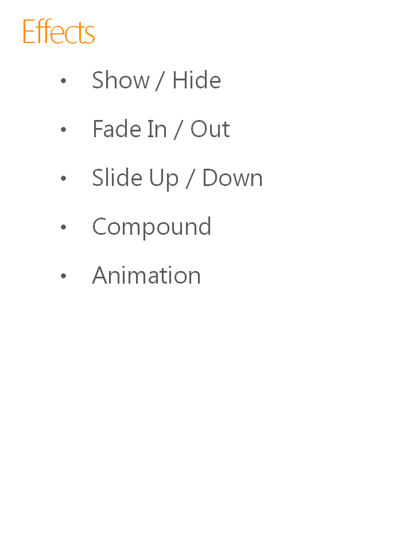
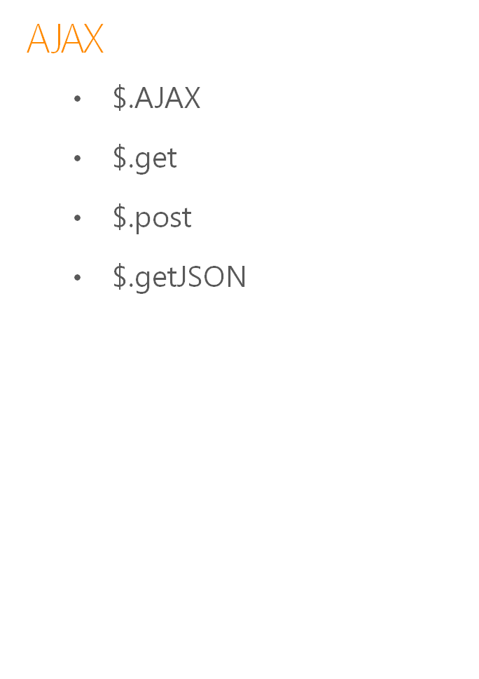
Easy Binding
Elements can bound to various Events and accessible through this keyword
Smooth effects
Smooth effects can be controlled with time and delay
Async Programing
Just define endppoint and with promises programming Async AJAX is easy

Slide 21

Agenda

Slide 22


Slide 23



Plug-In Development
Writing Selectors
  Creating your custom Selectors
  Other Selector tricks
Developing Plug-Ins
  Understanding JQuery plug-ins
  Using a plug-in
  Writing your first plug-in
  Defining default for you plug-in

Slide 24
  $.extend(
  $.expr[":"],
  {
  reallyhidden: function (a) {
  var obj = $(a);
  while ((obj.css(“visibility”) == “inherit” && obj.css(“display”) != “none”) && obj.parent()) {
  obj = obj.parent();
  }
  return (obj.css(“visibility”) == “hidden” || obj.css(‘display’) == ‘none’);
  }
  }
  );
  alert($(‘#something’).is(‘:reallyhidden’))

Slide 25
  (function($){
  $.fn.extend(
  {
  //plugin name here
  Hilight: function(options)
  {
  //Settings list and the default values
  var defaults =
  {
  defaultvar1: "value",
  defaultvar2: "value"
  };
  var options = $.extend(defaults, options);
  return this.each(function()
  {
  var o =options;
  var obj = $(this);
  //do stuff here
  });
  }
  });
  })(jQuery);

Slide 27

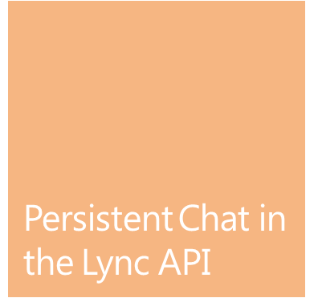
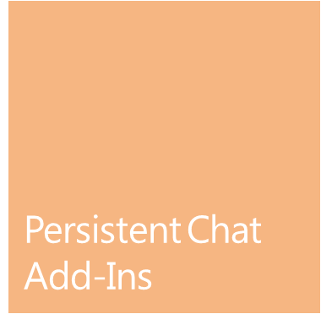
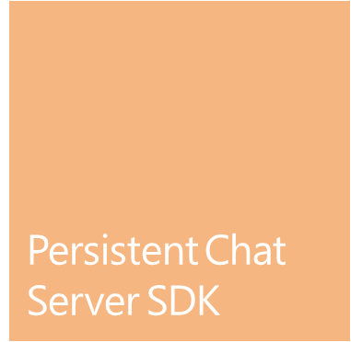
Agenda

Slide 28
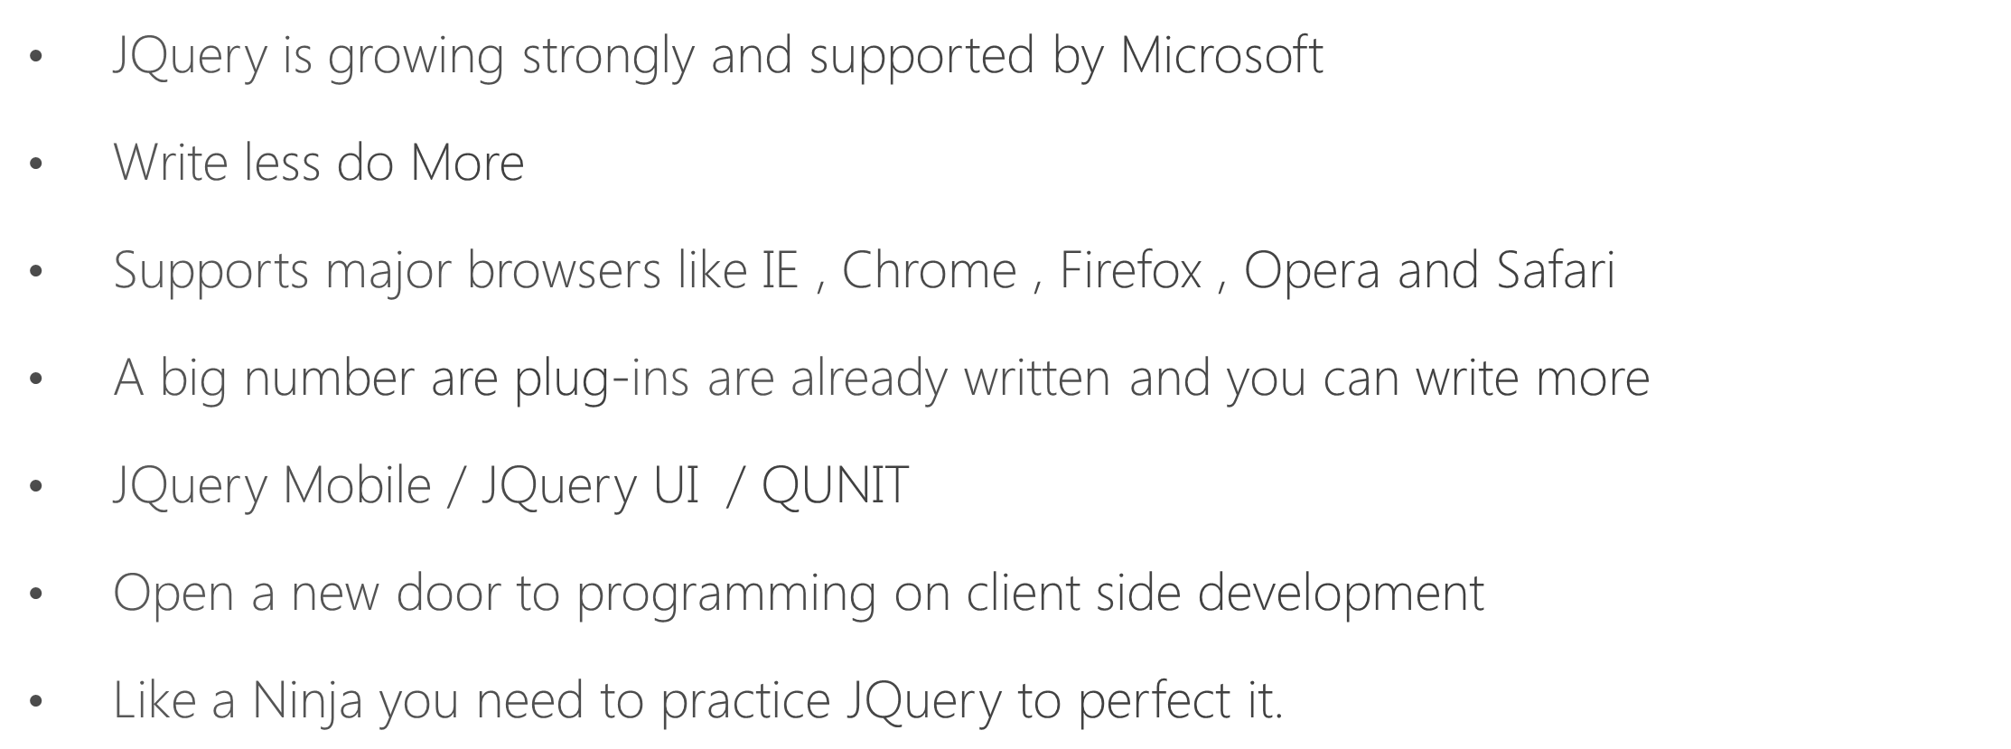

Slide 29
thank you

Slide 30


