Slide 1
Lending Club Predictive Model By Darshan Singh

Slide 2
About Task
Find the credit worthiness of the people
Past data is given for around 24K.
84% Credit worthiness and remaining non creditworthiness.

Slide 3
Why Predictive Modeling?
The random guess model will either give all the users as creditworthiness or un-creditworthiness.
This could cause severe business loss either due to frauds or with no customers.
Predictive model tries to balance between actual user with default and users with no defaults.
This will reduce the exposure to risk but at the same time will not lose the creditworthy users.

Slide 4
Exploratory Analysis
There was some missing data
There were no collinearity among the data
There was correlation between no of credit lines and Total number of credit lines.
Some of the factor columns has very few cases which could cause issue in splitting and modeling as well as could cause false patterns.

Slide 5
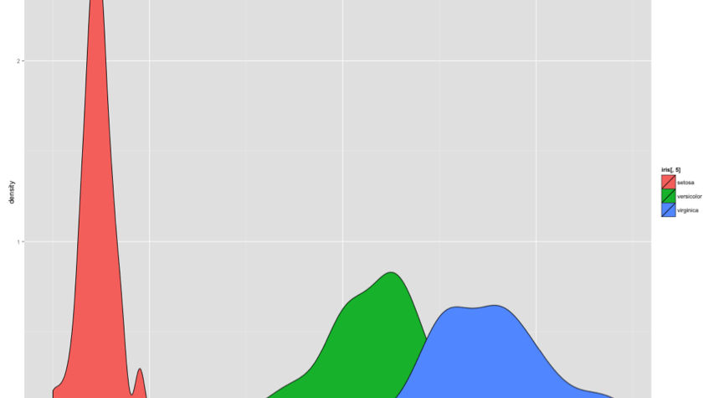
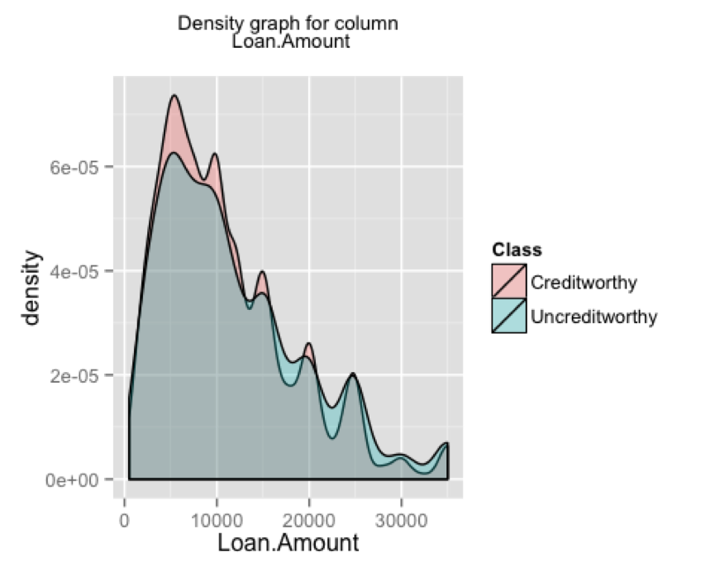
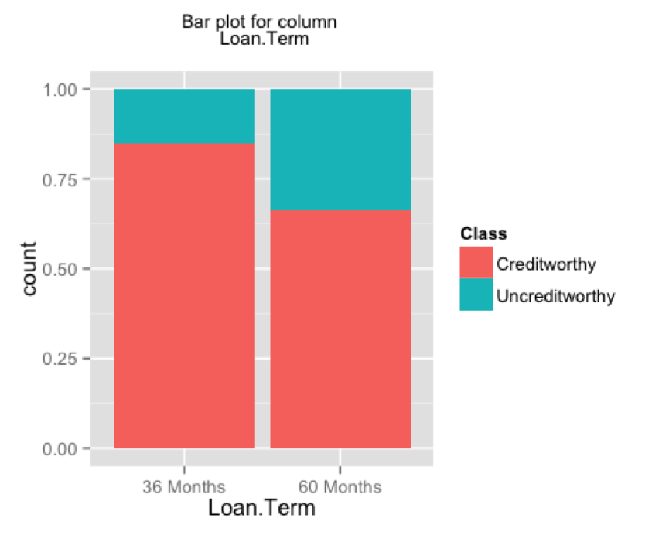
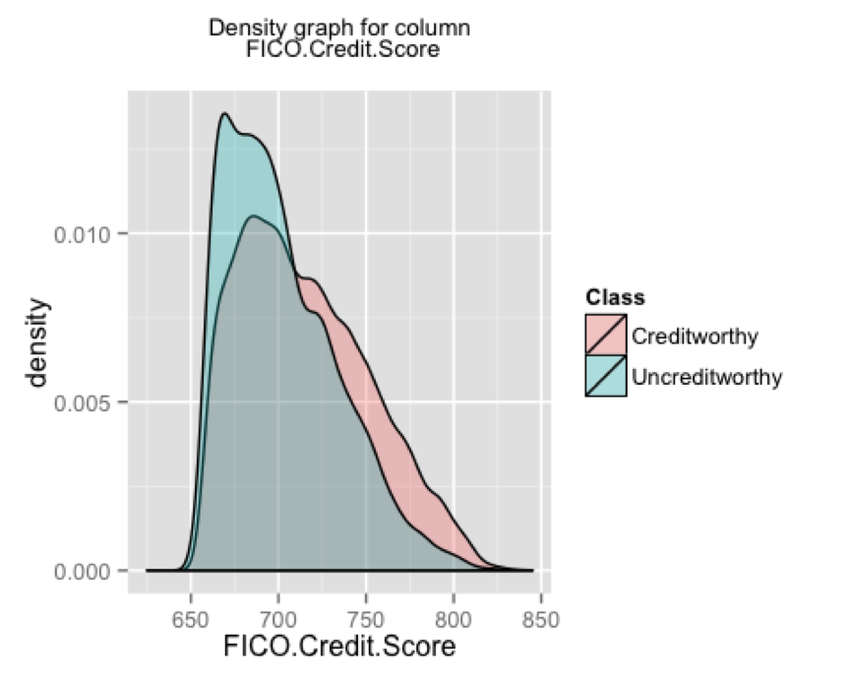
Real world data Graphs

Slide 6
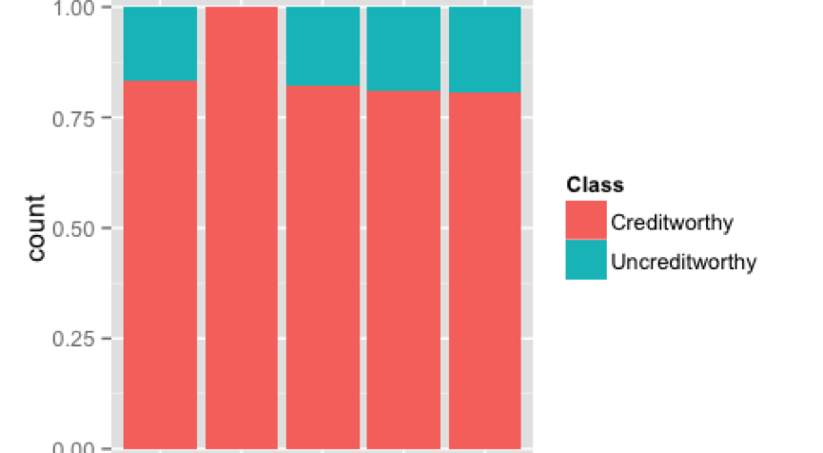
Graphs Can be deceiving

Slide 7
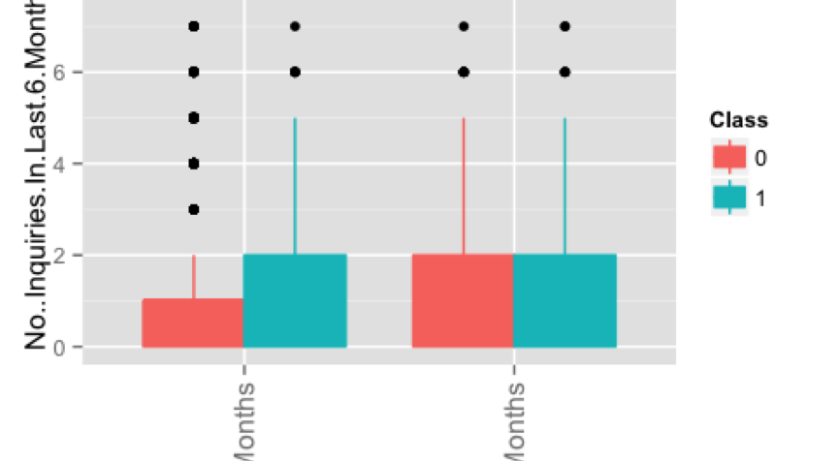
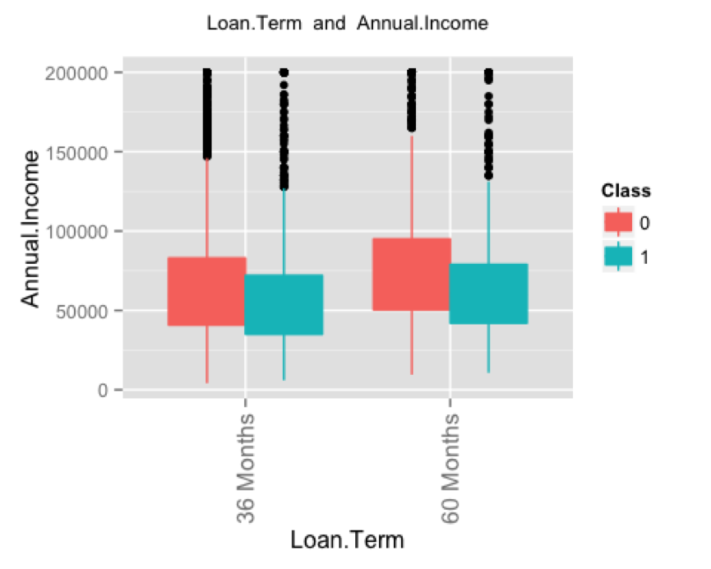
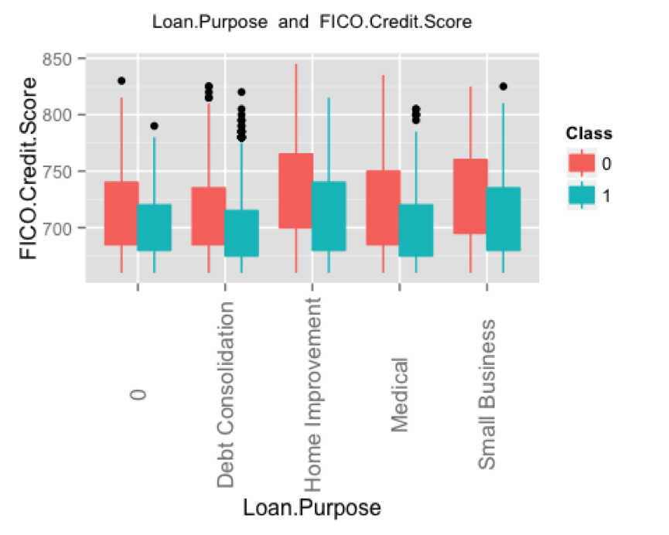
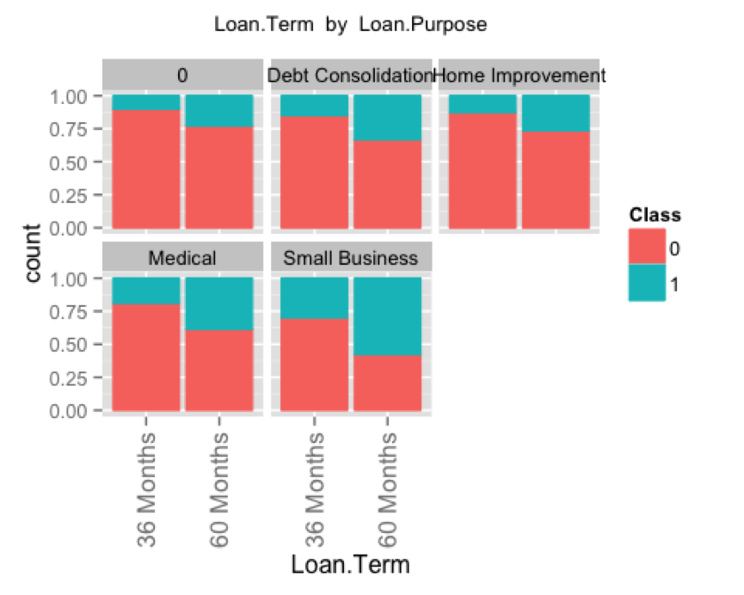
Interaction Terms

Slide 8
Exploratory Analysis Summary
Graphs did not show significant patterns.
The density graph for continuous data did not show any significant difference in 2 classes.
In some cases, the patterns were great but the number of cases were less than 10.
Usually the same pattern is shown by different features for same data.
There is class imbalance as the uncreditworthy has just around 15-16% data whereas creditworthy has rest of the data.

Slide 9
Feature Selection
Used Decision Tree algorithms to see the individual column importance as well as a pair of columns.
No columns were providing gain of even 0.01.
Random forest same results but ran on all the columns to see their significance rankings.
Used chi square test to see independence of columns w.r.t. Class column.
Used Logistic regression for importance of features for single as well as interaction terms.

Slide 10
Model Performance criteria
ROC Curve.
Use AUC.
Check the recall of the Creditworthy and Uncreditworthy classes.
Gini coefficient and KS scores.

Slide 11
Modeling
Used only Logistic regression on all the data after transforming some of the columns
Got an AUC around 0.70 -0.72 on validation set.
Got less AUC for test set.
RF provided the best AUC for both test and the validation set.
Recall and Accuracy were above 64% which is standard for this data.

Slide 12
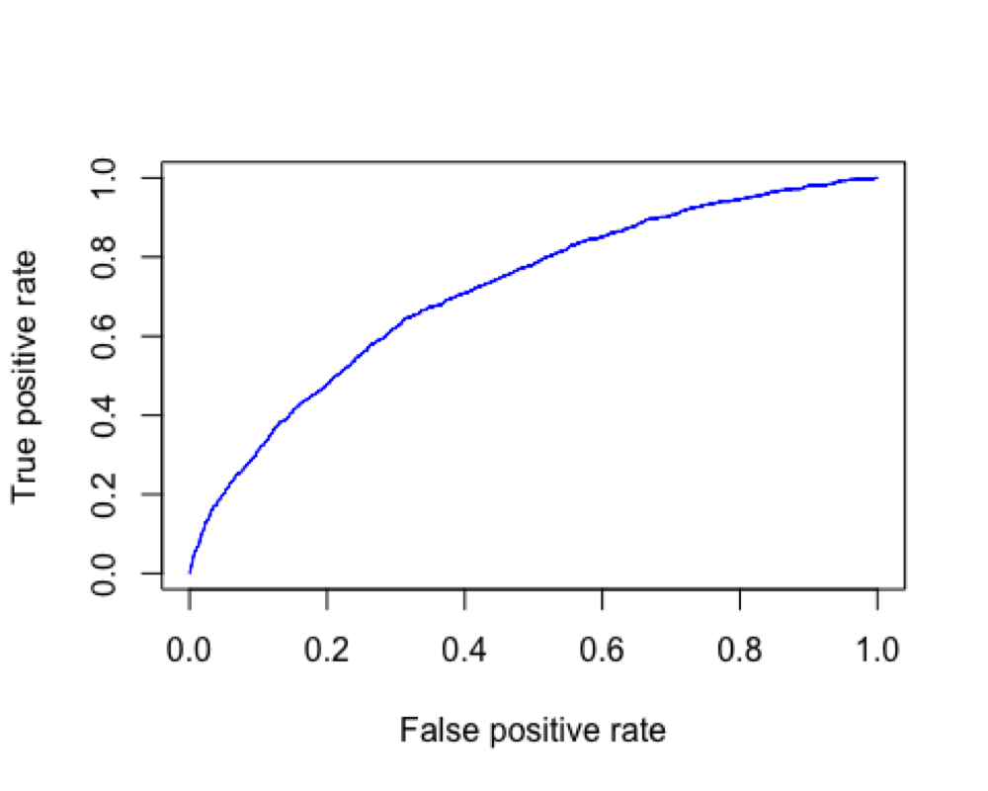
Modeling ROC Curve

Slide 13
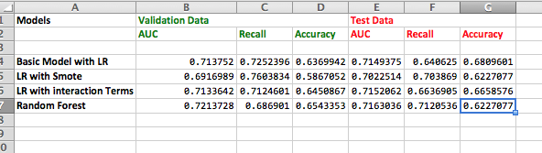
Model Summaries

Slide 14
Final comments
Data did not show any sort of patterns as RF and DT did not provide any info.
Graphs showed little pattern as well.
Need more analysis of data from business point of view to make sure that we are not missing any data which could be useful for patterns.
Need to play on adding some new fields based on the business knowledge.
Analyze the data especially where with similar data the row is marked as uncreditworthy and creditworthy.

Slide 15
Further Analysis
Use cost Matrix
Use other interaction terms.
Brute force method
Use say SVM , KNN etc.
Different method to tackle the class imbalance problem.
Add extra columns say summary statistics
Add extra columns using KNN
Play with parameters of LR and RF further. Use only validation set for this. Do not touch test data for this.

Slide 16
Q & A
Any Questions?
Thank you.

