Slide 1


Adventure Works Sales Insights with Power BI

Slide 2

Overview of Adventure Works sales data
the Adventure Works project aimed to provide a comprehensive view of the company's performance over the years, including revenue growth, outlier detection, and insights into factors affecting sales. This data-driven approach supports informed decision-making and enhances business performance by leveraging the power of business intelligence tools like Power BI.

Slide 3
Data preparation and loading
Data Collection
Data Cleaning
Data Modeling
Gathering relevant sales data from multiple sources while ensuring accuracy and completeness is a foundational step in any data-driven business intelligence or analysis project
Data cleaning and transformation are essential steps in the data preparation process, ensuring that the data used for analysis is accurate and free from inconsistencies. This involves addressing missing values through imputation or deletion, removing duplicate records, standardizing data formats for consistency, handling outliers appropriately, and converting data types as needed.
A robust data model serves as the foundation for effective reporting and analysis by organizing data, ensuring data integrity, optimizing data retrieval, and providing a structured framework that supports the changing needs of the organization. It enhances data quality, consistency, and security while empowering users to derive meaningful insights and make informed decisions based on trustworthy data.

Slide 4
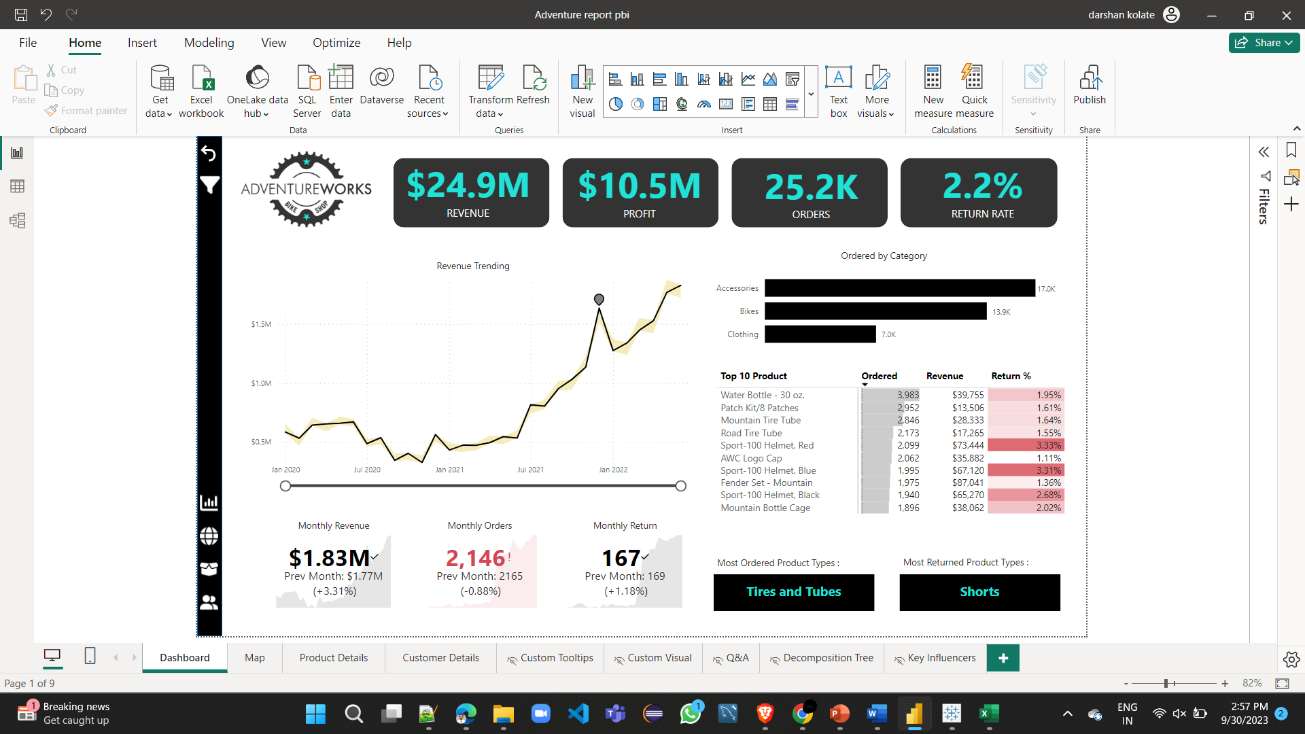
Creating visualizations and reports

Slide 5
Insights and analysis
1
Seasonal Sales Patterns
Leveraging seasonal fluctuations, you can optimize inventory management, reduce carrying costs, maximize sales during peak periods, and create targeted marketing campaigns that resonate with your audience's seasonal preferences.
Revenue Spikes
2
Identified revenue spikes, such as the $1,635,309 total on 12/1/2021, which exceeded the expected range, and pinpointed influential factors like high revenue in the United States within the Mountain Bikes subcategory."
3
Cross-Selling Opportunities
Identify cross-selling opportunities by recommending complementary products when customers add items to their cart or during the checkout process.

Slide 6
Conclusion and next steps
Maximize Profits
Continuous Improvement
Advanced Visualizations
Advanced visualizations such as tree-maps reveal hierarchical data structures, while scatter plots expose correlations and outliers, enabling more profound insights.
Implement data-driven insights to optimize pricing, marketing, and operations for increased revenue and profitability.
To analyze sales metrics, customer trends, and market insights, enabling continuous optimization of sales strategies and resources.

