Slide 1
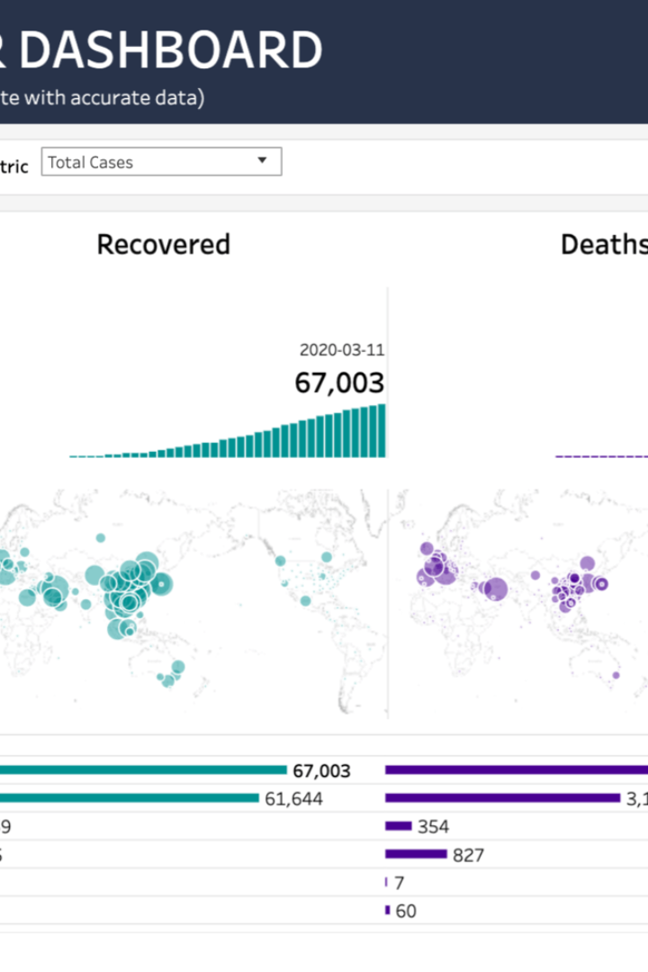
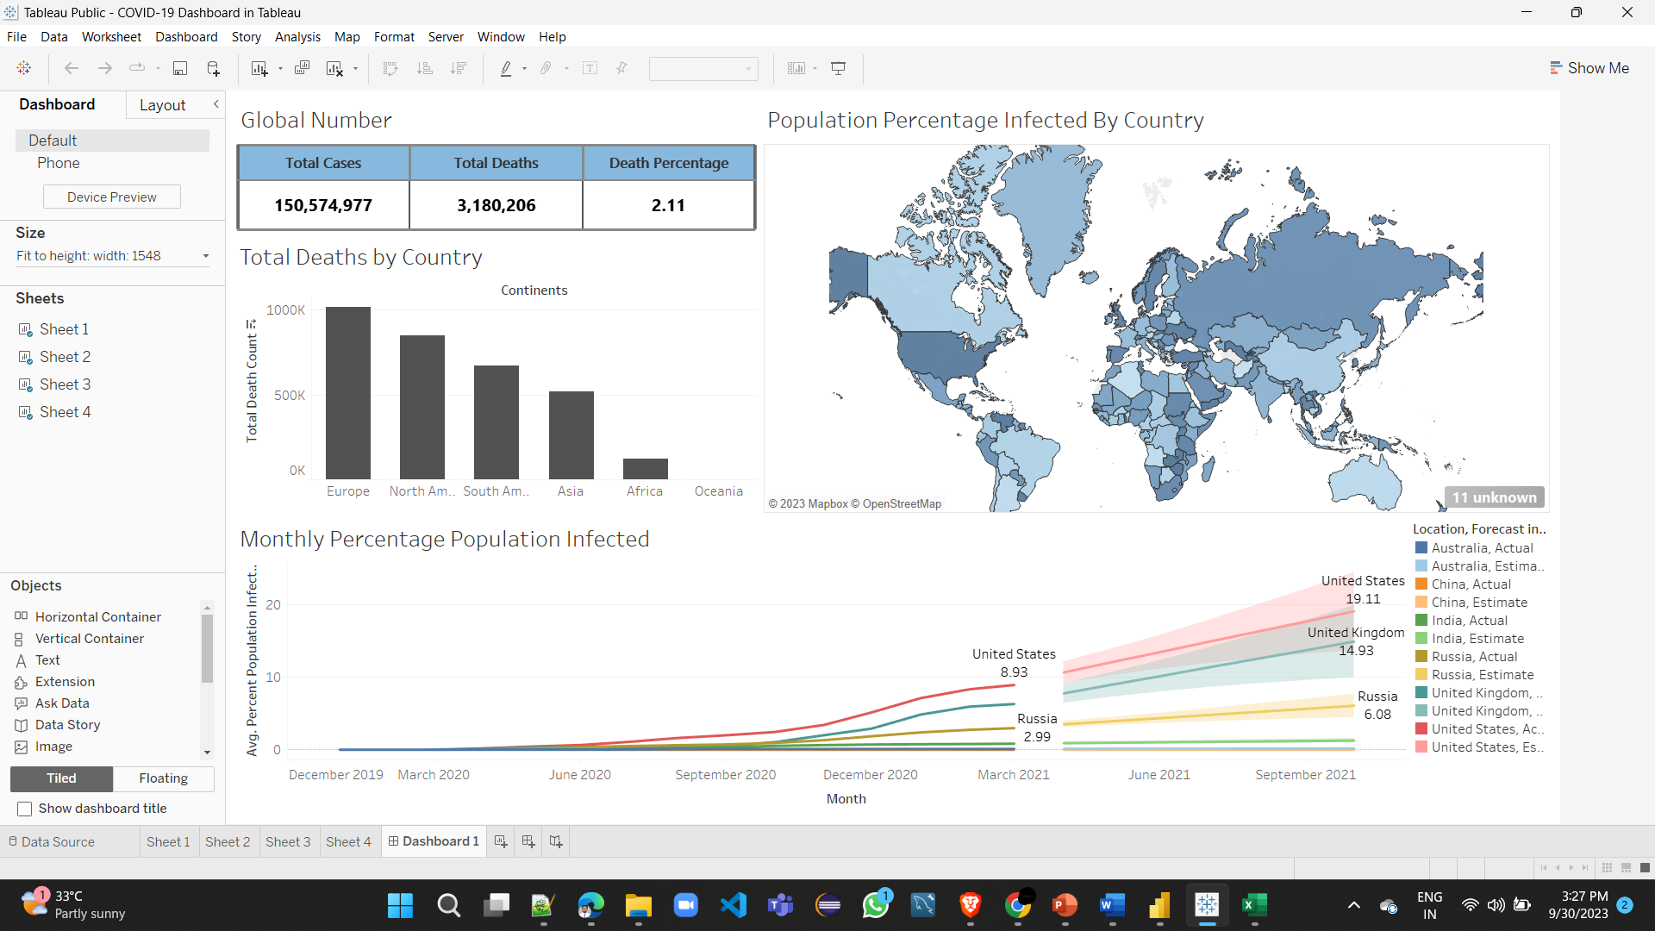
COVID-19 Data Exploration and Visualization with SQL and Tableau

Slide 2

Introduction
1
Overview
Exploring and visualizing COVID-19 data is essential for tracking the pandemic's course, identifying regional disparities, and informing data-driven decisions, ultimately saving lives and managing resources effectively.
2
SQL & Tableau
SQL is essential for efficiently querying and processing data, while Tableau provides powerful visualization tools to translate complex datasets into easily understandable visuals, making them vital for comprehensive data analysis and effective communication of insights.

Slide 3

COVID-19 Data Sources
1
Obtaining Data
2
Available Datasets
Our World in Data: Their COVID-19 dataset provides comprehensive global statistics, including cases, deaths, testing, and vaccination data.
World Health Organization (WHO): Global data with an API.
COVID Data API: Aggregated data from various sources.
Kaggle: Various COVID-19 datasets.
Google Mobility Reports: Community mobility trends data.

Slide 4

Data Exploration with SQL
1
Data Manipulation
Harness SQL to efficiently manipulate and query COVID-19 data by leveraging its capabilities for data filtering, aggregation, and joins. You can extract valuable insights, such as regional trends, testing rates, and vaccination coverage, to aid in pandemic analysis and decision-making.
2
Querying Techniques
To extract valuable insights from COVID-19 data using SQL:
Use joins to combine multiple datasets, such as cases and testing data.
Employ aggregate functions like SUM and COUNT for statistics like total cases or testing rates.
Utilize window functions for time-series analysis, calculating moving averages or identifying trends over time.

Slide 5

Data Visualization with Tableau

Slide 6

Case Study: Analyzing COVID-19 Trends
1
Applying SQL and Tableau
2
Visualizing Insights
By integrating SQL and Tableau, you can seamlessly transition from data extraction and transformation in SQL to visualization and exploration in Tableau, providing a comprehensive approach to understanding COVID-19 trends.
Created interactive pandemic dashboards and geospatial visualizations, aiding in real-time hotspot identification and vaccination rate monitoring for effective pandemic response.

Slide 7

Conclusion
1
Benefits of SQL & Tableau
Using SQL and Tableau for COVID-19 data exploration offers advantages such as efficient data querying, manipulation, and aggregation using SQL, enabling in-depth analysis. Tableau provides dynamic, interactive visualizations that simplify complex data, aiding in clear and actionable insights communication. Together, they facilitate comprehensive data-driven decision-making in the ongoing pandemic response.
2
Further Exploration
Empower individuals to embrace SQL and Tableau by highlighting their versatility in analyzing diverse datasets, fostering a culture of data-driven decision-making, and showcasing the potential for discovering deeper insights through continuous experimentation and exploration

