Slide 1

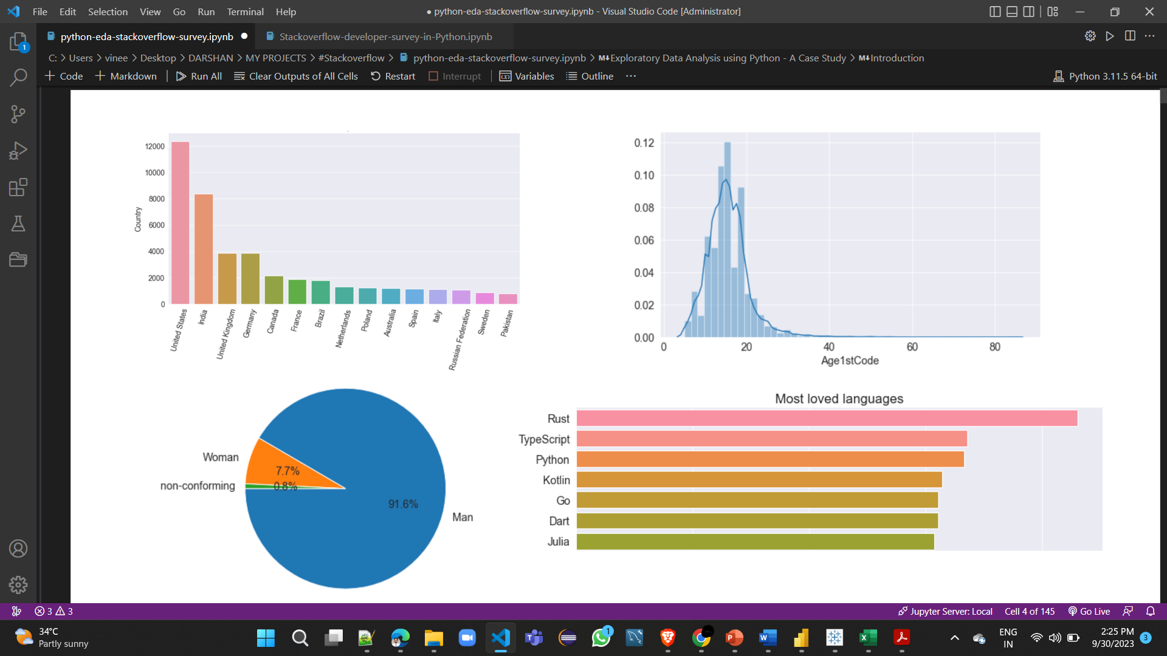
Unveiling the Insights of Stack Overflow Developer Survey with Python

Slide 2

Introduction
1
Background of Stack Overflow Developer Survey
The Stack Overflow Developer Survey is an annual survey conducted by Stack Overflow, one of the most popular online platforms for programmers and software developers. The survey is designed to gather insights into the global developer community, providing a comprehensive view of the tools, technologies, trends, and opinions prevalent among software developers around the world.
2
Importance of Exploratory Data Analysis (EDA)
Exploratory Data Analysis (EDA) is critically important in data analysis as it serves as the initial phase where data is comprehensively explored, cleaned, visualized, and understood. EDA not only helps in detecting data quality issues and outliers but also facilitates pattern recognition, hypothesis generation, and the formulation of informed research questions. Moreover, it plays a vital role in feature selection, assumption checking for statistical tests, and ultimately in reducing the risk of erroneous conclusions, ensuring that subsequent data-driven decisions and analyses are based on a solid and reliable foundation of insights and understanding of the data.

Slide 3

Data Collection and Preparation
1
Overview of the survey data
2
Data cleaning and preprocessing steps
Understand the structure and scale of the data collected in the Stack Overflow Developer Survey.
Use a helper library, (https://github.com/JovianML/opendatasets), which contains a collection of curated datasets and provides a helper function for direct download.
Explore the techniques used to clean and prepare the survey data for analysis.

Slide 4

Exploratory Data Analysis
1
Overview of Python libraries used for EDA
2
Analysis of developer demographics
3
Analysis of programming languages and technologies used
Powerful Python employed for insightful data exploration and visualization - Pandas, NumPy, Seaborn, Matplotlib.
A significant percentage of programmers either work part-time or as freelancers, which can be a great way to break into the field, especially when you're just getting started.
Java script & HTML/CSS are the most used programming languages in 2020, closely followed by SQL & Python.
Python is the language most people are interested in learning, since it is an easy-to-learn general-purpose programming language well suited for various domains.

Slide 5

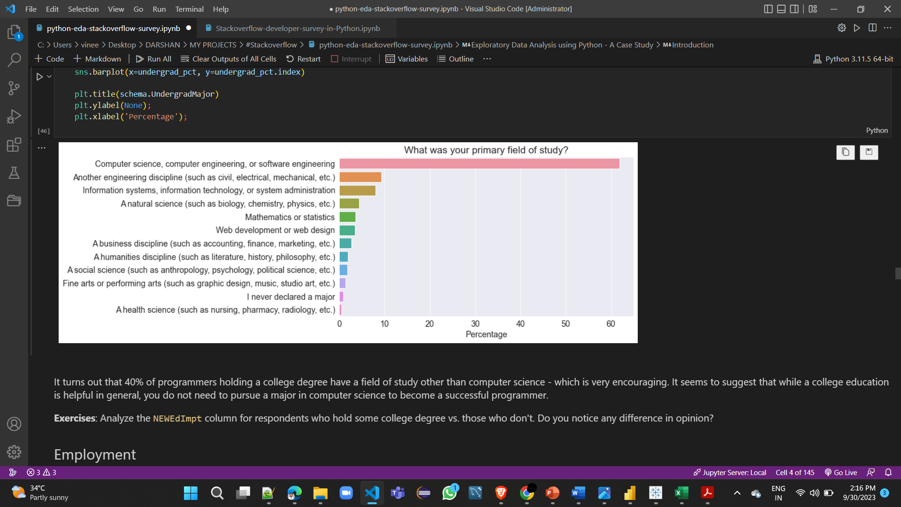
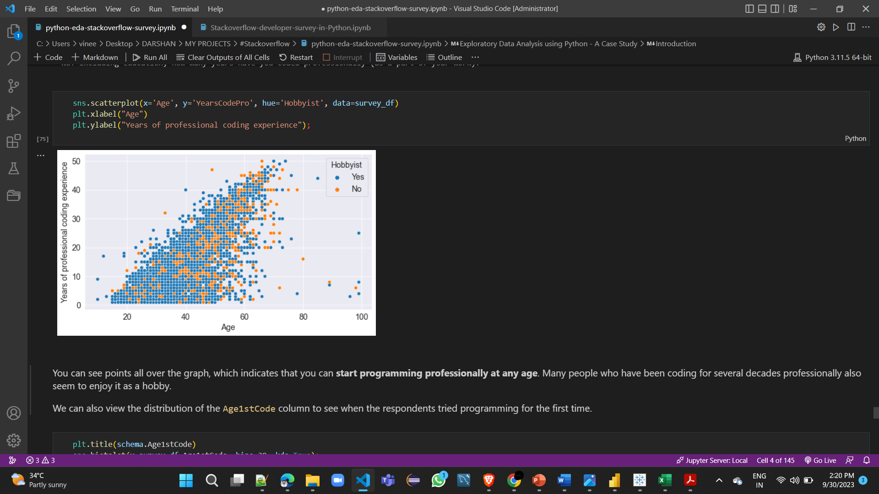
Findings and Insights
1
Key findings from the EDA
Although most programmers hold a college degree, a reasonably large percentage did not have computer science as their college major. Hence, a computer science degree isn't compulsory for learning to code or building a career in programming.
Insights about the developer community and industry trends
2
Programmers worldwide seem to be working for around 40 hours a week on average, with slight variations by country.
You can learn and start programming professionally at any age. You're likely to have a long and fulfilling career if you also enjoy programming as a hobby.

Slide 6

Conclusion
1
Summary of the presentation
Summarized the key findings and insights uncovered from the Stack Overflow Developer Survey data.
Emphasized the importance of understanding these insights for developers, companies, and the tech industry as a whole.
2
Importance of EDA for making data-driven decisions
Exploratory Data Analysis (EDA) is vital for data-driven decision-making because it helps understand, clean, and derive insights from data, identifies trends and patterns, validates assumptions, reduces risks, supports hypothesis generation, and facilitates clear communication, ultimately leading to more informed and effective decisions.

