Slide 1
EE-542 Lab-3
Team:
Darshan Patil (patild@usc.edu)
Vishal Guruprasad (vgurupra@usc.edu)

Slide 2
Given Task
Develop a file transfer program that uses your custom protocol that performs better than any other program available.
The link speed between the sender and receiver must be 1000Mbps and the test file size must be at least 1GBytes. You should test your system under various different conditions. However two settings that you must expose your system for the assignment are:
The Delay (RTT) of 10ms with the Loss rate of 1%
The Delay (RTT) of 200ms with the Loss rate of 20%
You also will need to prove the reliability of your system by running MD5 on both the original file and the received file
Steps
Client(Sender)
Use ‘netem’ on one of the computer to artificially inject a delay and Packet Loss. For example, if your ethernet link is named ‘eth0’ , command: sudo tc qdisc add dev enp9s0 root netem delay 200ms loss 20%
Create a UDP Socket to transfer packets
Map the entire file in the virtual address space using the mmap() - determine the file size using lseek operation
Create the MD5 Checksum of the file.
Create a TCP Socket and Send File info such as filesize and MD5 CheckSum to the server(receiver)- as this carries info regarding the filesize which is very important and used in number of packets calculation
In the main thread we would be sending the data by adding the data to the packet payload till sequenceNumber == num_packets-1 which means all the data is sent.
Create a thread which keeps monitoring if all the packets are received by the receiver(using NACKS), if the receiver asks for a particular packet resend it(UDP)
Unmap the file from virtual address space and close the file pointer and Sockets.

Slide 3
Server(Reciever)
Use ‘netem’ on one of the computer to artificially inject a delay and Packet Loss. For example, if your ethernet link is named ‘eth0’ , command: sudo tc qdisc add dev enp9s0 root netem delay 200ms loss 20%
Create a UDP Socket to Receive packets
Bind the UDP socket to the port number
Create a TCP Socket and Recieve the file information such as filesize and MD5 checksum by using the socket system calls{bind,listen,accept,read}
Create a new file in w+ mode and determine the number of packets required to obtain the entire file
In the main thread, call the recieve packet(), he will be recieving from the sender we continuously stay in the loop untill all the packets are recieved
Create another thread to handle packet loss, if an ACK_Check is initiated; it basically checks if all the packets are received, if not get the Sequence number of packets which are not received and ask the sender to resend.
Close the File Pointer and Socket.
Calculate the MD5 CheckSum of the Received file, and compare it with the SHA sent by the client through TCP and Validate the File Integrity.

Slide 4
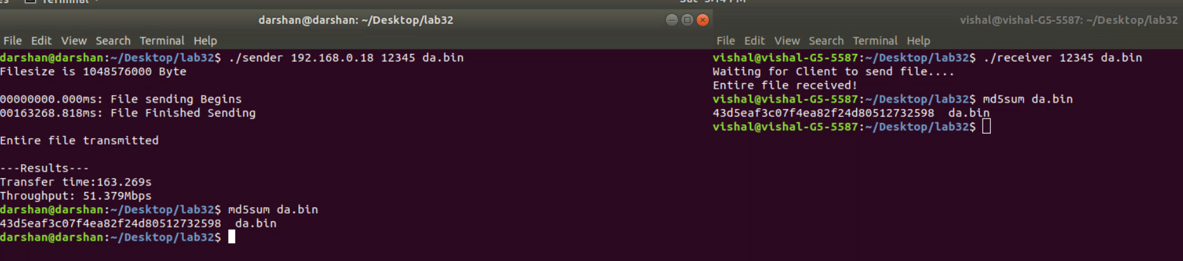
Results
Delay (ms) | Packet Loss (%) | Bandwidth(Mbits/sec) | File Size (Mbytes)
0 | 0 | 51.379 | 1000
10 | 1 | 47.967 | 1000
200 | 20 | 35.435 | 1000

Slide 5
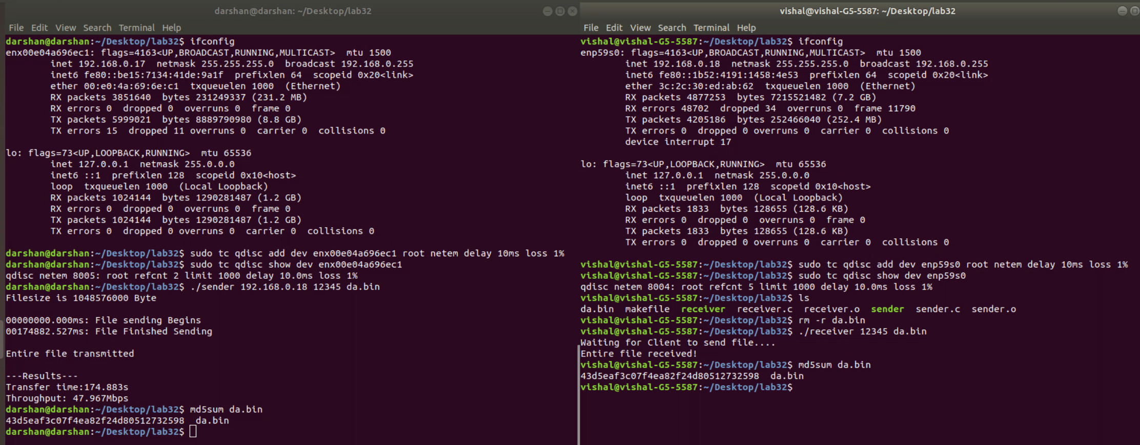

Slide 6
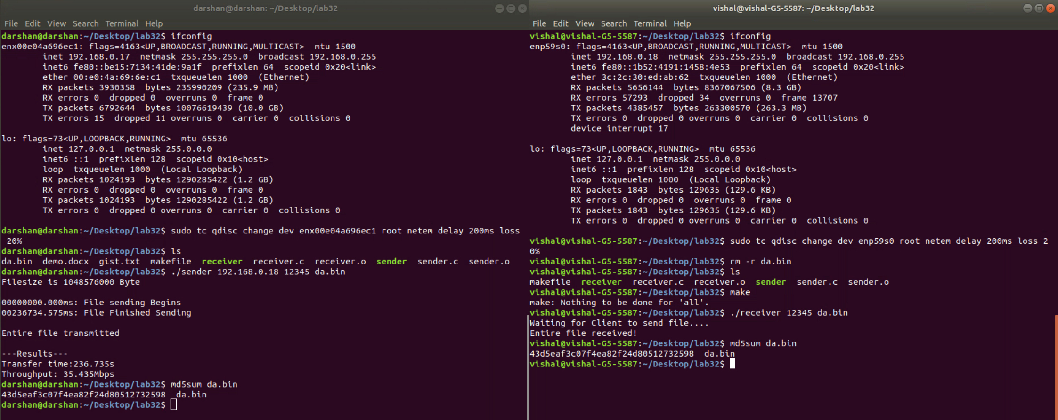

Slide 7
Reference
http://www.ee.surrey.ac.uk/Teaching/Unix/
https://www.garron.me/en/linux/visudo-command-sudoers-file-sudo-default-editor.html
https://openmaniak.com/iperf.php https://netbeez.net/blog/how-to-use-the-linux-traffic-control/
https://www.poftut.com/linux-ethtool-tutorial-usage-examples/ 1.1. Band

