Slide 1
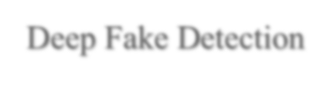


Deep Fake Detection
Ashmit Kinariwala
60003230272
Atharv Kulkarni
60003230214
Darshan Purohit
60003230012
Aaryan Kamdar
60003230007
Under the guidance of
Dr. Ram Mangrulkar
Project Guide
Department of Information Technology
DJSCE
Mumbai University
2024-25

Slide 2


Overview
Deep Fake Detection
Problem Definition
Abstract
Proposed System
Implementation
References/Learning resources

Slide 3

Problem Definition
Deep Fake Detection
The rapid advancement of Generative Adversarial Networks (GANs) has enabled the creation of highly realistic deepfake videos.
These deepfakes pose significant threats to security, misinformation, privacy, and digital trust.
Existing detection methods struggle with real-time processing, generalizability, and adversarial attacks.
Our goal is to develop an efficient, scalable, and accurate deepfake detection model.

Slide 4

Abstract
Deep Fake Detection
Deepfake technology is widely used in media, entertainment, and cybersecurity.
However, it can be misused for misinformation, identity theft, and forgery.
Our project combines CNNs and MiniGNNs for deepfake detection.
The system processes facial landmarks, builds graphs, and detects manipulations using Tensor Fusion Networks (TFN), MTCNN, Pyramid ResNet, and KNN.
We achieve higher accuracy and better generalizability compared to traditional CNN-based models.

Slide 5
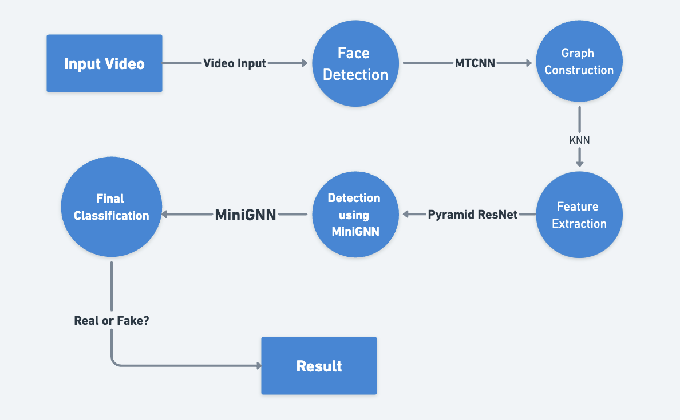

Proposed System
Deep Fake Detection
The system detects and analyzes facial regions using Mini Graph Neural Networks (MiniGNN).
It enhances deepfake detection by capturing both spatial and temporal inconsistencies.

Slide 6

Algorithms & Techniques Used
Deep Fake Detection
MTCNN (Multi-task Cascaded CNN) → Detects facial features.
Pyramid ResNet → Extracts hierarchical features.
K-Nearest Neighbors (KNN) → Creates graph edges between similar patches.
MiniGNN (Graph Neural Networks) → Detects inconsistencies in facial patches.
Tensor Fusion Networks (TFN) → Combines CNN & GNN outputs for better classification.

Slide 7

Datasets & Evaluation
Deep Fake Detection
Key Datasets Used:
FaceForensics++ (1,000 real & manipulated YouTube videos)
DFDC (5,000 real and GAN-generated deepfake videos)
DeepForensics-1.0 (48,000+ manipulated videos)
Celeb-DF (5,639 fake celebrity videos)
Performance Metrics:
Accuracy, Precision & Recall, F1-Score
Comparison:
CNN-based Models: 85.3% Accuracy
MiniGNN Model: 91.7% Accuracy
TFN-based Model: 94.2% Accuracy
References & Learning Resources:
FaceForensics++ Dataset
DeepForensics-1.0 GitHub
PRRNet: Pixel-Region Relation Network

Slide 8

Implementation
Deep Fake Detection
Preprocessing: Convert videos into frames, detect faces using MTCNN
Feature Extraction: ResNet extracts feature maps, MiniGNN builds a graph-based representation
Training & Testing:
◇ Train model on DeepForensics-1.0 dataset
◇Validate using cross-dataset testing (FaceForensics++, DFDC)
◇Fine-tune parameters using Tensor Fusion Networks
Results: Improved accuracy over traditional CNN-based models

Slide 9

References & Learning Resources
Deep Fake Detection
Research papers:
"PRRNet: Pixel-Region Relation Network for Face Forgery Detection"
"ResNet-Swish-Dense54: Deep Learning Approach for Deepfake Detection"
Datasets: FaceForensics++, DFDC, DeepForensics, DeeperForensics-1.0
GitHub resources:
◇DeepFaceLab (Face Swapping)
◇Awesome Deepfake Detection (Collection of Resources)
◇DeeperForensics-1.0
◇DeepFaceLab

Slide 10

Research Papers
Deep Fake Detection
Xuan Hau Nguyen, Thai Son Tran, Van Thinh Le, Kim Duy Nguyen, Dinh-Tu Truong, Learning Spatio-temporal features to detect manipulated facial videos created by the Deepfake techniques https://doi.org/10.1016/j.fsidi.2021.301108.
Zhihua Shang, Hongtao Xie, Zhengjun Zha, Lingyun Yu, Yan Li, Yongdong Zhang, PRRNet: Pixel-Region relation network for face forgery detection,Pattern Recognition https://doi.org/10.1016/j.patcog.2021.107950.
Tianyi Wang, Ming Liu, Wei Cao, Kam Pui Chow, Deepfake noise investigation and detection,Forensic Science International: Digital Investigation, https://doi.org/10.1016/j.fsidi.2022.301395.
Saima Waseem , Syed Abdul Rahman Syed Abu-Bakar, Zaid Omar, Bilal Ashfaq Ahmed, Saba Baloch and Adel Hafeezallah Deepfake detection based on remote photoplethysmography https://doi.org/10.1007/s11042-023-14744-z
Jiachen Yang, Shuai Xiao, Aiyun Li, Guipeng Lan, Huihui Wang, Detecting fake images by identifying potential texture difference,Future Generation Computer Systems, https://doi.org/10.1016/j.future.2021.06.043.
Gaojian Wanga Qian Jianga Xin Jina Xiaohui Cuic FFR_FD: Effective and fast detection of DeepFakes via feature pointdefects https://doi.org/10.1016/j.ins.2022.03.026
Marriam Nawaz Ali Javed · Aun Irtaza ResNet-Swish-Dense54: a deep learning approach for deepfakes detection https://doi.org/10.1007/s00371-022-02732-7

Slide 11

Thank You!!!
Deep Fake Detection

