Slide 1

Firewall Policy Complexity: From Simple ACLs to Least Privilege Network Access
Team Ping of 5 · BACSE203 Computer Networks · Fall 2026 · Case Study (Topic 17)
Ramsrivathsan R
25BCE2111
S Darshan
25BCE2883
M B Adavan
25BCE0063
Naveen V S
25BCE0059
Himaneesh S
25BAI0007
PERMIT
DENY
School of Computer Science and Engineering, VIT Vellore
Notes:
Introduce the team and the topic: how firewall/ACL policy changes as we move from simple, broad rules to least-privilege rules, and what that costs in complexity.

Slide 2
Agenda
1
Part A
Review paper
Problem, five literature themes, research gaps
2
Part B
Design
Requirements, network, three policies, test method
3
Part B
Results
Stage-by-stage evidence, metrics, key findings
4
Part C
Alignment
Comparison with the literature, limitations, future work
Notes:
Walk through the structure: the assignment has a review paper (Part A), a Packet Tracer case study (Part B) and an alignment note (Part C).

Slide 3


The problem we studied
Research question
Broad rules are easy, but open
How does refining network access policy from broad, to department-level, to service-level least privilege change (a) the unnecessary flows the policy allows and (b) the policy's size, specificity and dependence on rule order, and how do these results compare with the literature?
Most small networks let every department reach every server. One router ACL can close those paths.
Strict rules are safe, but costly
Each step towards least privilege adds rules, conditions and rule-order dependence, which the literature links to errors.
SECURITY
COST
measured together, on one network
Notes:
The gap: studies rarely measure the security gained and the management cost on the same policy as it is refined. We do that on a small simulated enterprise.

Slide 4






Objectives
Build
Specify
A multi-department network in Packet Tracer; confirm every test flow works with no ACLs
Write the required and forbidden flows before writing any rule
Implement
Measure
Three policy stages at the same seven enforcement points
Unnecessary access left, and policy size, specificity and rule-order dependence
Stress
Compare
Design two typical policy mistakes (shadowed rule, missing DNS rule)
Relate the results to the literature reviewed in Part A
Notes:
Objective 5 (the misconfiguration experiments) was designed but not run in the time available; we say so on the limitations slide.

Slide 5





What the literature says (Part A)
Perimeter filtering
Policy anomalies
Growth & misconfiguration
Default deny at the boundary; inside often trusted
First-match order causes shadowing and redundancy
Real rule sets are often wrong; complexity tracks risk
[3], [6], [7]
[9]–[12]
[1], [2], [13]
Least privilege & Zero Trust
Management tools
No trust from location; segment to limit lateral movement
Detect or prevent anomalies; usability rarely tested
[4], [5], [14]–[16]
[10]–[13], [17]
Notes:
Five themes from 18 sources (10 peer-reviewed). They agree misconfiguration is common, rule order hides conflicts and location-based trust is weak. They disagree on whether finer policy lowers net risk once complexity is counted.

Slide 6
Gaps we found, and our response
1
Empirical data on misconfiguration are dated and from few sources
Our response to gap 3
Write required and forbidden flows first.
Apply three policies of increasing precision to one network.
Measure leakage and policy size at every stage.
2
Unnecessary access is rarely measured against written requirements
3
Security gain and management cost are seldom measured on the same policy
4
Management tools are seldom evaluated with real users
Notes:
Gap 3 is the one our case study addresses on a small scale.

Slide 7
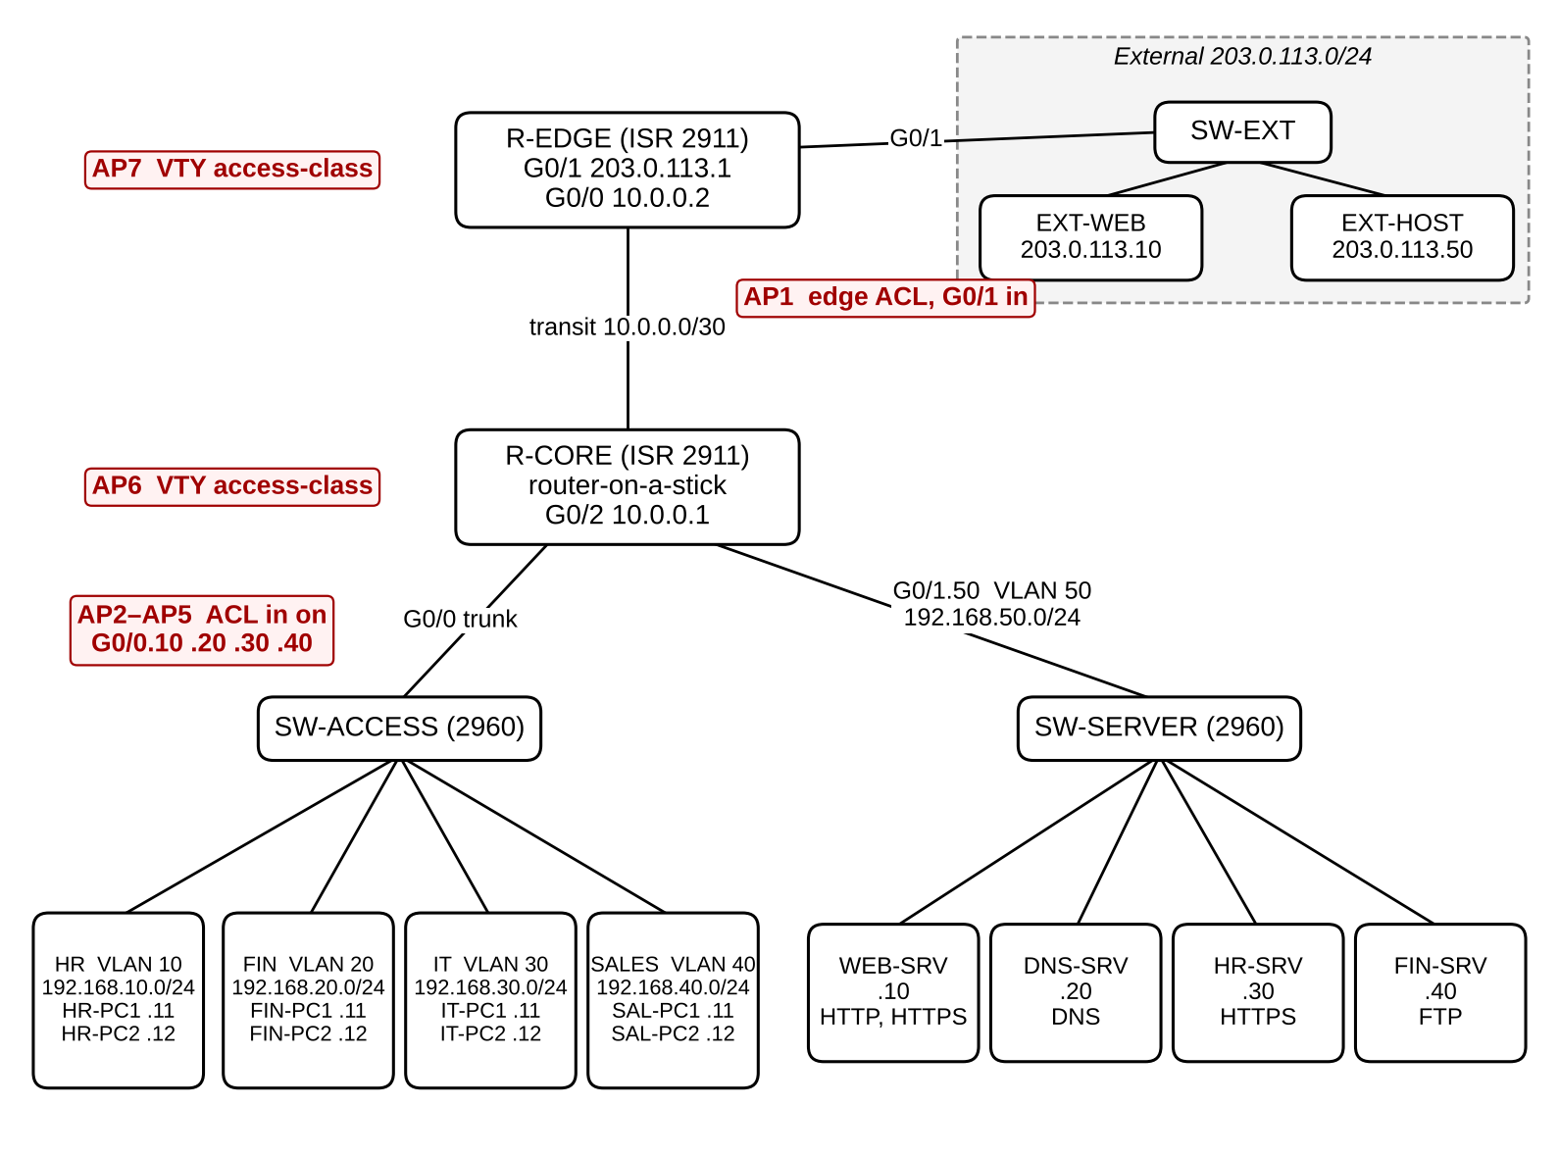
Network design: 19 devices, 7 enforcement points
4 departments
HR, Finance, IT, Sales: VLANs 10–40
4 servers
Web, DNS, HR records (HTTPS), Finance (FTP)
Simulated Internet
203.0.113.0/24 (RFC 5737)
7 enforcement points
Edge ACL, 4 department ACLs, 2 router logins
Notes:
Router-on-a-stick core router holds all internal ACLs; edge router holds the Internet filter. Same seven enforcement points in every stage, only the rules change.

Slide 8
Requirements written before any rule
REQUIRED
FORBIDDEN
R1 | All departments → DNS server (UDP 53)
R2 | All departments → web portal (HTTP/HTTPS)
R3 | HR → HR records server (HTTPS)
R4 | Finance → finance server (FTP)
R5 | IT → both routers (SSH)
R6 | IT → servers (ping)
R7 | All departments → Internet web
R8 | Internet → public web portal
X1 | Department → other department
X2 | Non-HR → HR records server
X3 | Non-Finance → finance server
X4 | Non-IT → router management
X5 | Anyone → routers by Telnet
X6 | Non-IT → servers by ping / unused ports
X7 | Internet → anything except the portal
U1: PC-to-PC traffic inside one VLAN cannot be filtered by a router ACL. "Unnecessary access" = any X flow the policy still allows.
Notes:
Every Stage 2 and Stage 3 rule traces back to one of these requirements. FTP stands in for a database because Packet Tracer servers have no database service.

Slide 9
Three policies of increasing precision
Stage 1
Stage 2
Stage 3
Broad
Department-level
Least privilege
Any internal source → any destination; only the Internet edge filtered
Own department → whole server zone and Internet; other departments denied
Each department → exact host, protocol and port it needs; SSH only for IT
10 rules
25 rules
40 rules
Stage 0 (no ACLs) is the positive control: every test must work before any rule is applied.
Notes:
Each stage is applied on top of the previous one in the same Packet Tracer network. Rule counts are as configured (one Stage 1 edge line was rejected by Packet Tracer).

Slide 10
What a least-privilege ACL looks like
ip access-list extended ACL-HR-IN
permit udp HR host DNS-SRV eq domain
permit tcp HR host WEB-SRV eq www
permit tcp HR host WEB-SRV eq 443
permit tcp HR host HR-SRV eq 443
deny ip HR 192.168.0.0/16
permit tcp HR any eq www
permit tcp HR any eq 443
deny ip any any
R1
R2
R2
R3
X1–X6
R7
R7
Host + protocol + port
Each permit names exactly what one requirement needs
Order matters
The internal deny must stay above the Internet permits, or HR can reach any internal host on 80/443
24 such pairs
In Stage 3, 24 rule pairs would change behaviour if swapped
Notes:
Simplified names: HR = 192.168.10.0/24. The full ACLs are in Appendix B of the report.

Slide 11

Test method
1
2
3
4
5
Write flows
Build Stage 0
Apply stage
Run same 17 tests
Record evidence
8 required, 7 forbidden, 1 uncontrollable
All 17 tests must work
Paste ACLs on both routers
Same PCs, same order
Screenshots and ACL counters
Metrics fixed before any result
Leakage = forbidden tests that succeeded ÷ forbidden tests evidenced
Required success = required tests that succeeded ÷ required tests evidenced
Policy size, rule specificity and order-dependent rule pairs, from the configurations
Notes:
A test with no screenshot is marked not evidenced and left out of every count; we never assume an outcome.

Slide 12
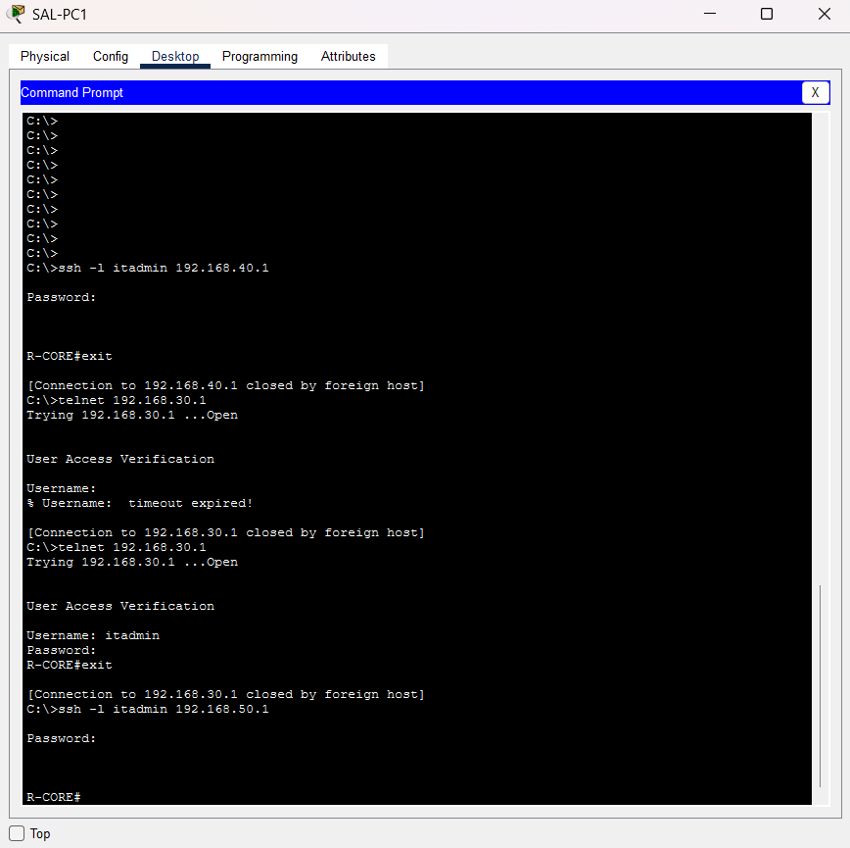
Stage 0: the network works with no rules
Positive control: 17 of 17 reachable
Every test, even the forbidden ones, worked with no ACLs. So any later block is caused by the policy, not by a broken cable or a stopped service.
Faults found and fixed during the build
R-CORE G0/1 had R-EDGE's address 203.0.113.1, which blocked external traffic
DNS-SRV and EXT-WEB first had wrong IP addresses
Two tests ran from a different PC than planned (T05, T12)
Notes:
The screenshot shows a Sales PC logging in to the core router by SSH and Telnet: forbidden later, allowed here because no rules exist yet.

Slide 13
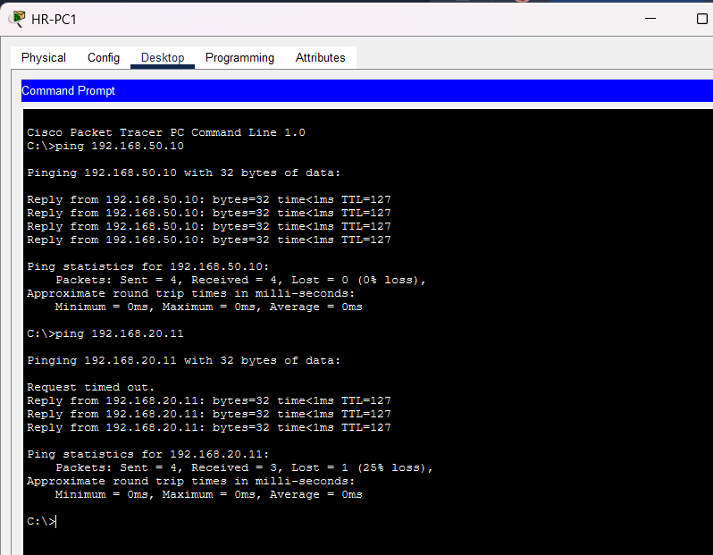
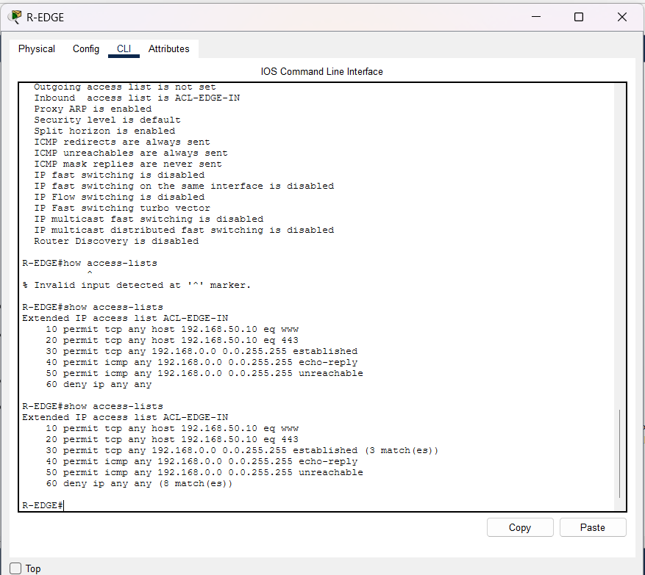
Stage 1 (broad): the inside stays open
PERMIT
HR pings a server (T13) and a Finance PC (T07): both forbidden, both work
COUNTERS
Edge ACL: return traffic matched 3×, deny matched 8×
Notes:
The broad policy only filters the Internet edge. One edge line (time-exceeded) was rejected by Packet Tracer, so Stage 1 has 10 rules instead of the planned 11.

Slide 14
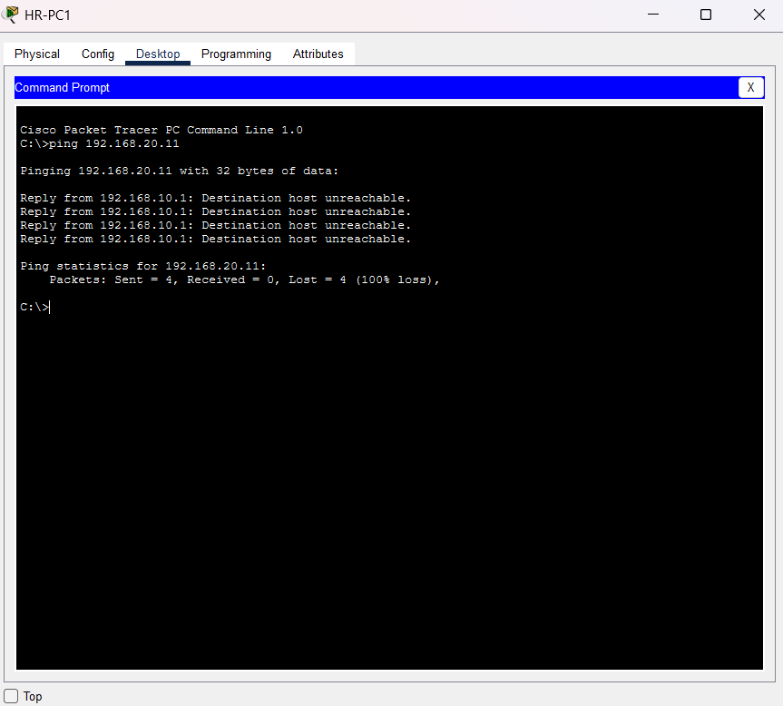
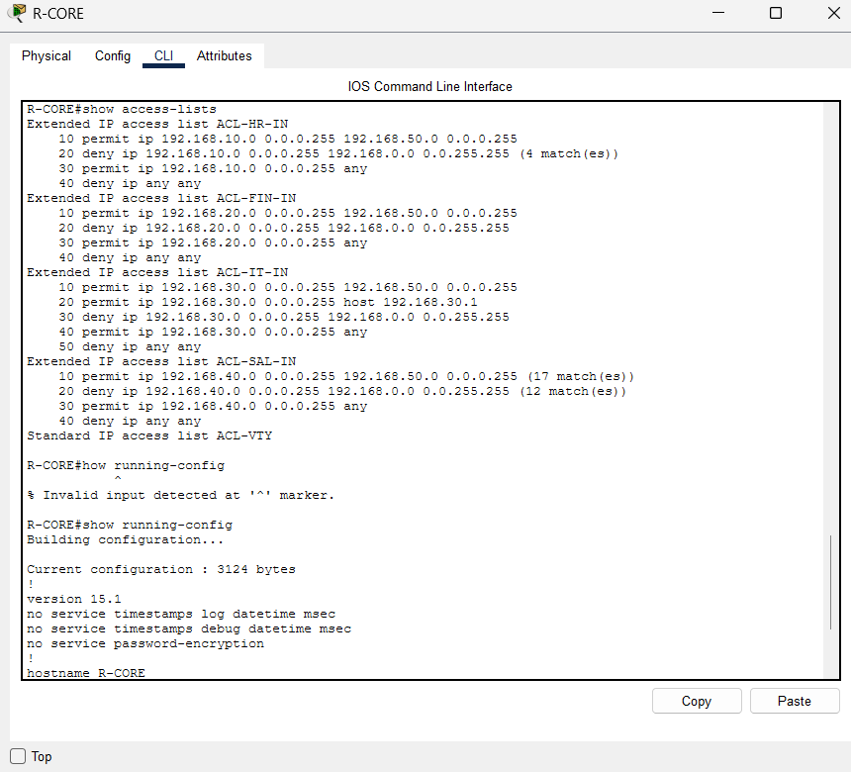
Stage 2 (department-level): departments separated
DENY
HR → Finance PC now blocked (T07)
COUNTERS
One ACL per department; deny entries count hits
Notes:
Stage 2 blocks department-to-department traffic, but each department can still reach the whole server zone, so 4 of 8 forbidden flows still work.

Slide 15
All observed results
Test | Flow | Type | S0 | S1 | S2 | S3
T01 | HR → web portal | Req | A | A | A | A
T03 | HR → DNS | Req | A | n/e | A | n/e
T04 | Finance → FTP | Req | P | n/e | n/e | P
T05 | HR → HR records | Req | A | n/e | n/e | A
T06 | IT → router SSH | Req | A | n/e | n/e | A
T14 | IT → ping server | Req | A | n/e | A | n/e
T15 | Internet → portal | Req | A | n/e | A | n/e
T17 | HR → Internet web | Req | A | A | A | n/e
T07 | HR → Finance PC | Forb | A | A | D | D
Test | Flow | Type | S0 | S1 | S2 | S3
T08 | Sales → FTP | Forb | A | n/e | A | D
T10 | Sales → HR records | Forb | A | n/e | A | D
T11 | Sales → router SSH | Forb | A | n/e | D | D
T12 | Telnet → router | Forb | A | n/e | A | n/e
T13 | HR → ping server | Forb | A | A | A | n/e
T16 | Internet → FTP | Forb | A | n/e | D | n/e
T19 | Sales → router SSH (2) | Forb | A | n/e | D | n/e
T18 | Same-VLAN ping | Ctrl | A | n/e | A | n/e
Green = policy goal met · Red = forbidden flow worked or required flow failed · Amber P = partial (FTP login only) · n/e = no screenshot, excluded from counts · S0 has no rules, so every flow should work
Notes:
This is Table 7 of the report in colour. Read across a row to see a flow being closed as the policy is refined, for example T07 and T10.

Slide 16
Results: access fell as rules grew
Stage 1
2 of 2
forbidden flows worked
Stage 2
4 of 8
forbidden flows worked
Stage 3
0 of 4
forbidden flows worked
Counts cover only tests with screenshot evidence, so they are not compared as percentages.
Notes:
Security improved stage by stage while the rule count quadrupled and order-dependent pairs went from 0 to 24. Required flows: 2 of 2, 5 of 5, 3 of 4.

Slide 17
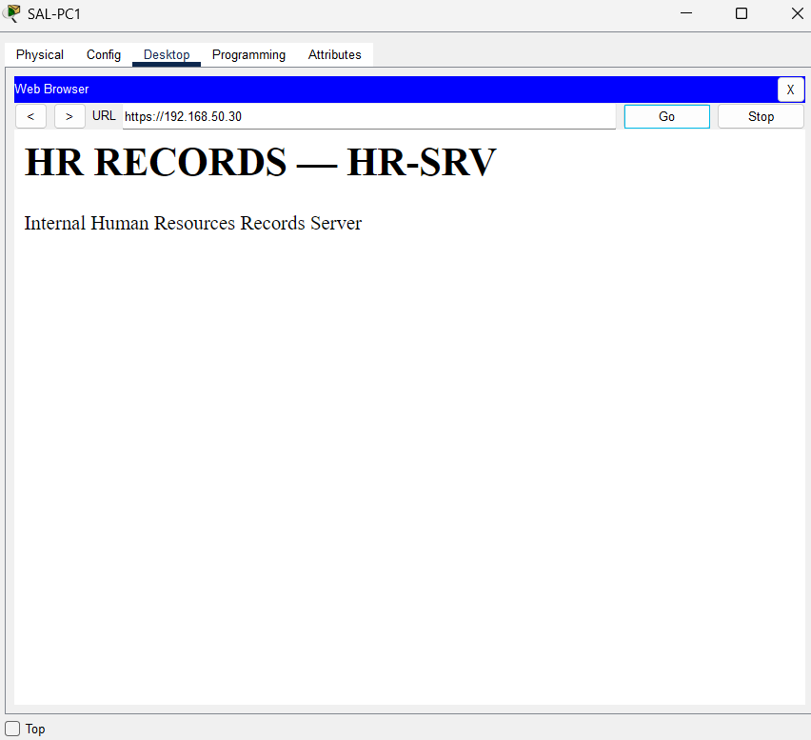
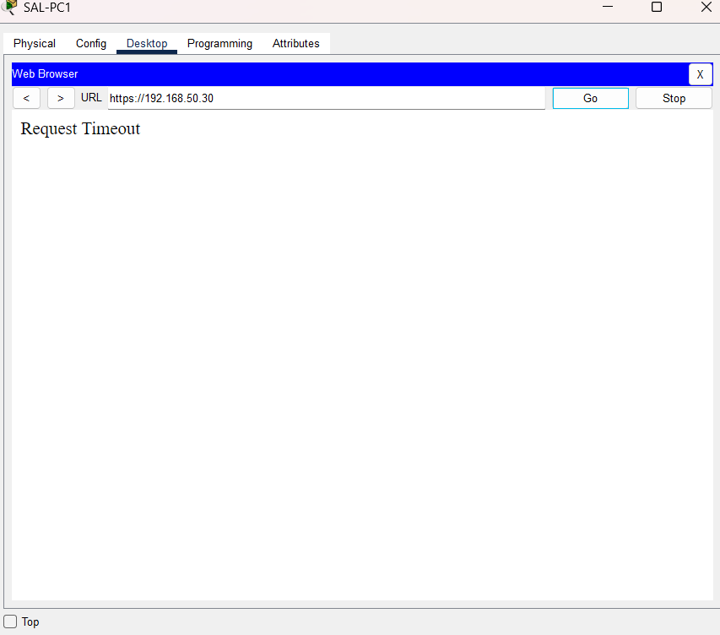
Same test, two policies: Sales → HR records (T10)
PERMIT
Stage 2: department rule opens the whole server zone
DENY
Stage 3: only HR may reach HR-SRV on port 443
Notes:
Under the department-level policy any Sales PC could still open the confidential HR site, simply because it is inside the network. Least privilege closes it.

Slide 18
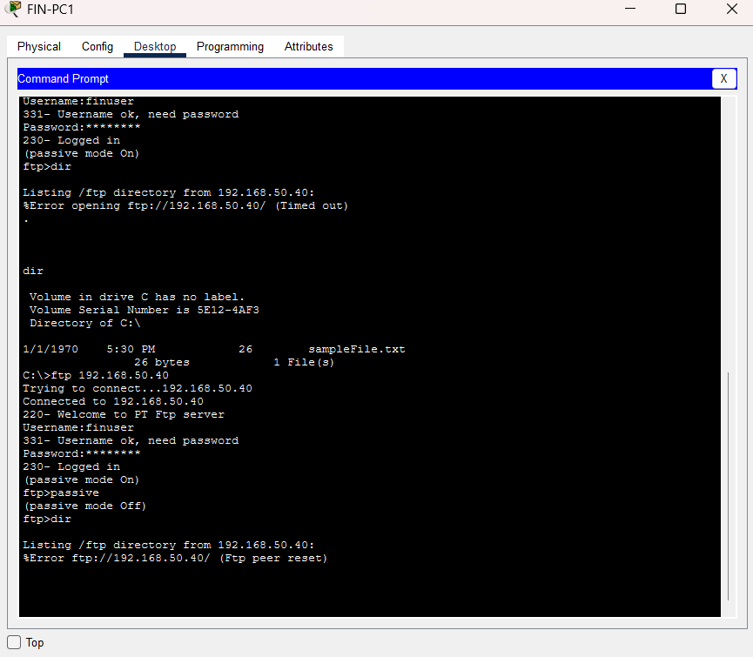
Key finding: least privilege broke a required service
What happened
Finance could log in to its FTP server, but listing files failed: "Timed out" (passive) and "Ftp peer reset" (active).
Why
The Stage 3 rule permits only the FTP control port (21). FTP's separate data connection hits the "deny internal" rule.
So what
Least privilege costs more than rules: multi-connection services need extra, carefully ordered entries.
Notes:
Our design predicted this. It is the clearest example of the usability cost of a strict port-based policy.

Slide 19



Other observations
Two locks, two symptoms
Rule count can mislead
In Stage 2, Sales SSH to 192.168.40.1 timed out (interface ACL) while SSH to 192.168.50.1 was refused (router login rule): one goal, enforced in two places.
The Stage 3 edge ACL is the strictest but has the fewest entries (6 → 6 → 5).
Same-VLAN traffic
Build issues fixed
HR-PC1 always reached HR-PC2: traffic inside a VLAN never passes the router, so no router ACL can filter it.
A duplicate IP on R-CORE and wrong server addresses were found in Stage 0 and corrected before testing.
Notes:
The timeout versus refusal shows overlapping enforcement points, which makes policies harder to reason about.

Slide 20
How our results compare with the literature (Part C)
Observation | Literature | Relation
Forbidden flows: 2 of 2 → 4 of 8 → 0 of 4 | [3], [5] | Agrees
Rules 10 → 25 → 40; order pairs 0 → 9 → 24 | [2] | Agrees in direction
Strictest edge ACL has fewest entries | [9], [10] | Agrees: count misleads
Department rules still let Sales reach HR data | [4], [15] | Agrees: zone trust too coarse
Stage 3 broke FTP file listing | [13] | Partly: adds a concrete usability cost
Same-VLAN traffic never filtered | [15], [16] | Agrees: limit of router ACLs
We measured reachability and policy structure, not administrator error, so [2] is matched in direction, not proven.
Notes:
Our results support default-deny and need-based access, and show concretely that location-based trust is too coarse.

Slide 21






Limitations
Small scale
Evidence gaps
Not Zero Trust
19 devices and 40 rules, versus large real rule sets
Screenshots for 17 tests in Stage 0, 4 in Stage 1, 14 in Stage 2, 7 in Stage 3
ACLs see addresses and ports, never user or device identity
Simulator models
Not run
Stateless filter
FTP stands in for a database; no NAT, logging or attack traffic
Misconfiguration experiments M1 and M2; zero-hit and line-change metrics
established accepts any TCP segment with ACK or RST set
Notes:
Be upfront: counts describe only the tests with screenshot evidence.

Slide 22


Future work
Fix the FTP gap
Run the mistake experiments
Add one minimal, correctly ordered data-channel rule, or move the finance service to HTTPS/SFTP, and re-test
M1 (shadowed rule) and M2 (missing DNS rule) on copies of Stages 2 and 3
Complete the evidence
Stateful and identity-aware
Capture every test and ACL counter in every stage; save running configs to measure lines changed
Compare with a stateful firewall and with identity-based microsegmentation (Zero Trust)
Notes:
Each item addresses a limitation from the previous slide.

Slide 23


Conclusion
Security improved
Cost rose
Usability suffered
Forbidden access fell from broad to least privilege; all forbidden flows we captured were blocked in Stage 3
Rules grew 4× and order-dependent pairs from 0 to 24
Least privilege broke FTP file listing until the policy is extended
Write the required flows first, then refine — the trade-off is real, and it can be measured.
Thank you · Questions?
Notes:
Summarise the three findings and invite questions.

Slide 24
References (1 of 3)
[1] A. Wool, "A quantitative study of firewall configuration errors," Computer, 37(6), 2004.
https://ieeexplore.ieee.org/document/1306389
[2] A. Wool, "Trends in firewall configuration errors," IEEE Internet Computing, 14(4), 2010 (extended version).
https://arxiv.org/abs/0911.1240
[3] K. Scarfone, P. Hoffman, "Guidelines on firewalls and firewall policy," NIST SP 800-41 Rev. 1, 2009.
https://doi.org/10.6028/NIST.SP.800-41r1
[4] S. Rose et al., "Zero trust architecture," NIST SP 800-207, 2020.
https://doi.org/10.6028/NIST.SP.800-207
[5] J. H. Saltzer, M. D. Schroeder, "The protection of information in computer systems," Proc. IEEE, 1975 (full text).
https://www.cs.virginia.edu/~evans/cs551/saltzer/
[6] N. Freed, "Behavior of and requirements for Internet firewalls," RFC 2979, 2000.
https://www.rfc-editor.org/rfc/rfc2979
Notes:
Links are clickable in slideshow mode.

Slide 25
References (2 of 3)
[7] P. Ferguson, D. Senie, "Network ingress filtering," BCP 38 / RFC 2827, 2000.
https://doi.org/10.17487/RFC2827
[8] R. Ward, B. Beyer, "BeyondCorp: A new approach to enterprise security," ;login:, 39(6), 2014.
https://www.usenix.org/publications/login/dec14/ward
[9] E. Al-Shaer, H. Hamed, "Discovery of policy anomalies in distributed firewalls," IEEE INFOCOM, 2004.
https://pure.kfupm.edu.sa/en/publications/discovery-of-policy-anomalies-in-distributed-firewalls/
[10] E. Al-Shaer et al., "Conflict classification and analysis of distributed firewall policies," IEEE JSAC, 2005.
https://doi.org/10.1109/JSAC.2005.854119
[11] L. Yuan et al., "FIREMAN: A toolkit for firewall modeling and analysis," IEEE S&P, 2006.
https://doi.org/10.1109/SP.2006.16
[12] M. G. Gouda, A. X. Liu, "Structured firewall design," Computer Networks, 51(4), 2007.
https://ftp.math.utah.edu/pub/tex/bib/idx/compnetamsterdam2000/51/4/1106_1120.html
Notes:
Links are clickable in slideshow mode.

Slide 26
References (3 of 3)
[13] A. Voronkov et al., "Systematic literature review on usability of firewall configuration," ACM CSUR, 2017.
https://doi.org/10.1145/3130876
[14] N. Syed et al., "Zero trust architecture (ZTA): A comprehensive survey," IEEE Access, 2022.
https://ieeexplore.ieee.org/document/9773102
[15] R. Chandramouli, "Guide to a secure enterprise network landscape," NIST SP 800-215, 2022.
https://doi.org/10.6028/NIST.SP.800-215
[16] CISA, "Microsegmentation in zero trust, part one: Introduction and planning," 2025.
https://www.cisa.gov/resources-tools/resources/microsegmentation-zero-trust-part-one-introduction-and-planning
[17] Y. Bartal et al., "Firmato: A novel firewall management toolkit," ACM TOCS, 2004.
https://doi.org/10.1145/1035582.1035583
[18] J. Arkko et al., "IPv4 address blocks reserved for documentation," RFC 5737, 2010.
https://www.rfc-editor.org/rfc/rfc5737
All 18 references, as in the report (IEEE style). Links: DOI where available, otherwise publisher, repository or full-text page.
Notes:
Links are clickable in slideshow mode.

