Slide 1
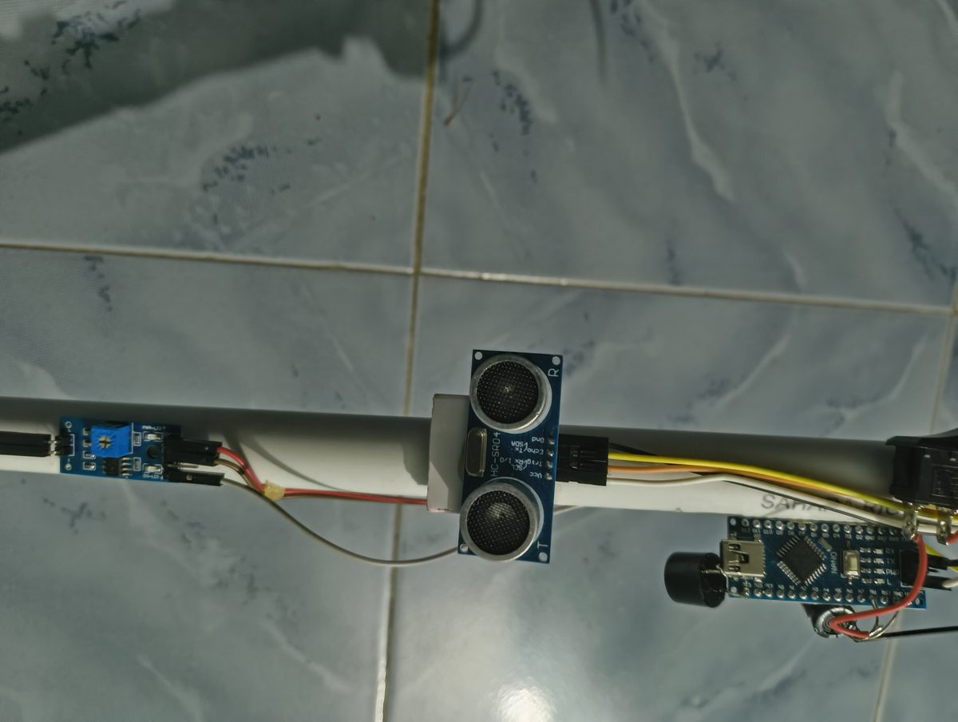
VisionGuard
COURSE PROJECT
Smart cane for visually impaired people: obstacle and wet-surface warning with an Arduino Nano
Darshan S
BACSE324 Embedded Systems Architecture | Course Project
Notes:
Good morning. Our project is VisionGuard, a smart cane for visually impaired people. It warns the user about obstacles in front and about water or wet ground at the tip, using an Arduino Nano, an ultrasonic sensor and a moisture probe.

Slide 2
What this presentation covers
01
02
03
Problem
Objectives
System design
Why a normal cane is not enough
What the cane must achieve
Block diagram, hardware, circuit
04
05
06
Software
Results
Way forward
Algorithm, DFG, state diagram, code
Prototype, tests and cost
Limitations and future scope
Notes:
This is the flow of the talk: the problem, our objectives, the system design, the software, the results, and finally the limitations and future scope.

Slide 3



The problem with a white cane
Contact-only detection
2.2 billion
Obstacles are found only when the cane hits them, about 1 m ahead
No water warning
people worldwide live with a near or distance vision impairment
Puddles, open drains and wet mud go unnoticed until stepped in
No distance information
The user cannot tell how close an obstacle is
Source: WHO, World Report on Vision, 2019
Notes:
Millions of people depend on the white cane. Its limits: it detects an obstacle only on contact, it cannot warn about water or open drains, and it gives no idea of distance.

Slide 4



Existing solutions and their limits
White cane
Guide dog
Commercial smart canes
+ Cheap and simple
+ Excellent navigation
+ Electronic early warning
− Contact-only, no water or distance warning
− Expensive, long training, not widely available
− High cost, imported, hard to repair locally
The gap: a low-cost cane that warns early about obstacles and about water underfoot
Notes:
A white cane is cheap but contact-only. Guide dogs are excellent but expensive and scarce. Commercial smart canes are costly and imported. Our project targets the gap: a low-cost cane that warns about both obstacles and water.

Slide 5
Objectives
50 cm
50–400 ms
Detect obstacles ahead with an ultrasonic sensor and warn before contact
Encode distance in the beep gap: closer obstacle, faster beeps
< 500
₹876
ADC reading below this means water: continuous tone, top priority
Low-cost, portable cane running on one 18650 cell with a switch
Notes:
Four measurable objectives: detect obstacles within 50 cm; show distance through the beep gap, from 50 ms when very close to 400 ms at 50 cm; detect water when the moisture reading drops below 500 out of 1023, with priority; and keep the cane cheap and portable, about 876 rupees of hardware on one battery.

Slide 6



Proposed solution: VisionGuard
Ultrasonic “eyes”
HC-SR04 measures distance to obstacles ahead
Moisture-sensing tip
Probe at the bottom detects water and wet mud
Prioritised buzzer alerts
Continuous tone for water; faster beeps as obstacles get closer
Notes:
Our solution adds three things to a PVC cane: an ultrasonic sensor as its eyes, a moisture probe at the tip, and a buzzer that gives prioritised alerts. An Arduino Nano runs it all from a single 18650 battery.

Slide 7
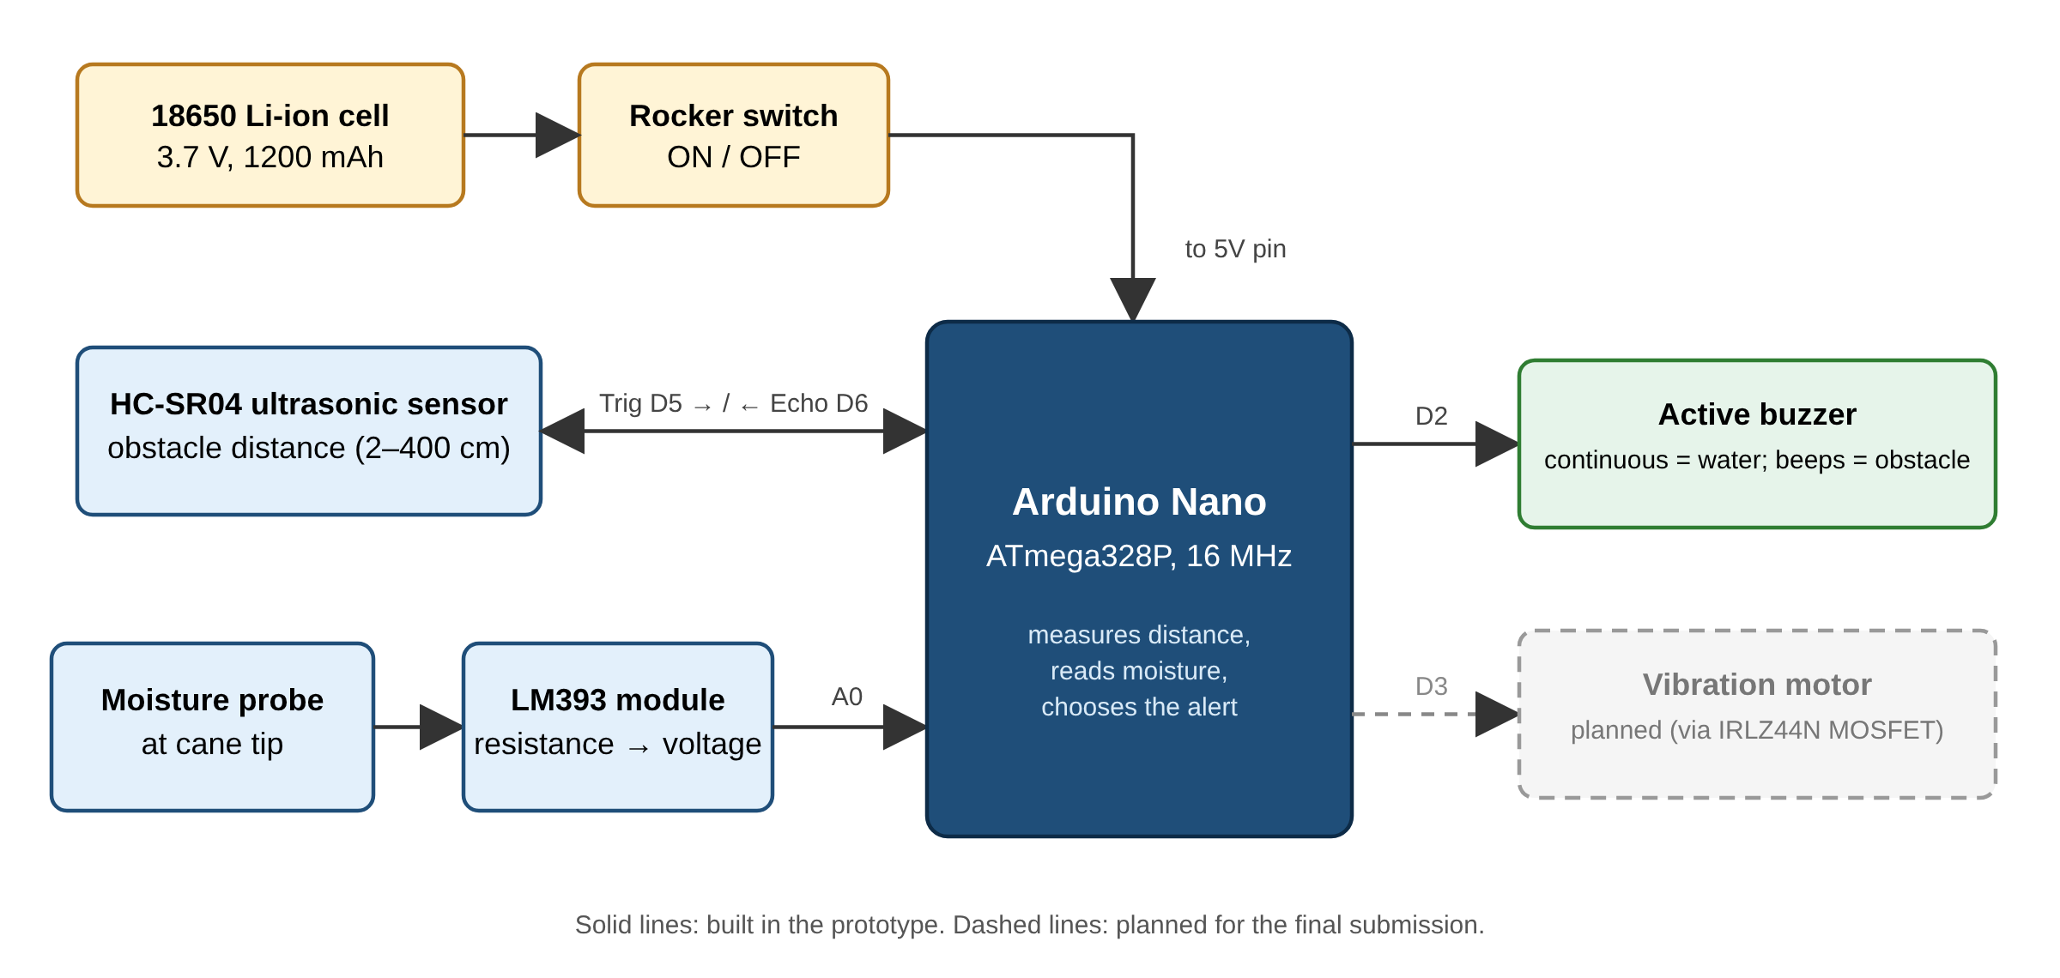
Block diagram
Notes:
Inputs on the left: the ultrasonic sensor on D5 and D6, and the moisture probe through the LM393 module on A0. The Nano in the middle decides. The output is the buzzer on D2. Power comes from the battery through the switch to the 5V pin. The dashed vibration motor is planned, not built yet.

Slide 8





Hardware components
Arduino Nano
HC-SR04
Moisture probe
LM393 module
ATmega328P controller
Ultrasonic distance sensor
Water sensing at the tip
Probe resistance → voltage
Active buzzer
18650 Li-ion
Rocker switch
Capacitor
Audio alert on D2
3.7 V, 1200 mAh
Power ON / OFF
220–470 µF supply filter
Notes:
These are the eight electronic parts. The Nano is the brain, the HC-SR04 measures distance, the probe and LM393 module sense water, the buzzer alerts, and the battery, switch and capacitor make up the power system.

Slide 9
Why the Arduino Nano
Small and light enough to mount on the cane shaft
Low cost (about ₹250) and easy to replace
5 V logic matches the HC-SR04 and the moisture module
Built-in ADC reads the moisture voltage directly
Programmed over USB with the free Arduino IDE
16 MHz
32 KB
ATmega328P clock
Flash memory
10-bit
18×45 mm
ADC, 8 analog inputs
Fits on a cane
Notes:
We chose the Arduino Nano because it is small enough for a cane, cheap, uses 5 volt logic like our sensors, has a built-in 10-bit ADC for the moisture probe, and is easy to program over USB. A Raspberry Pi would be overkill in cost, power and size.

Slide 10
How the ultrasonic sensor measures distance
1
Trigger
d = v × t / 2
Nano holds Trig HIGH for 10 µs
2
Burst
v ≈ 343 m/s = 0.034 cm/µs
÷ 2 because sound travels there and back
Example: t = 1000 µs → d = 0.034 × 1000 / 2 = 17 cm
Range 2–400 cm · beam ≈ 15°
Sensor sends eight 40 kHz sound pulses
3
Echo
Echo stays HIGH for the round-trip time t
Notes:
The Nano sends a 10 microsecond pulse on Trig. The sensor emits eight 40 kHz pulses and holds Echo high until the echo returns. Distance equals speed of sound times time, divided by two because the sound goes there and back. For example, 1000 microseconds gives 17 centimetres.

Slide 11
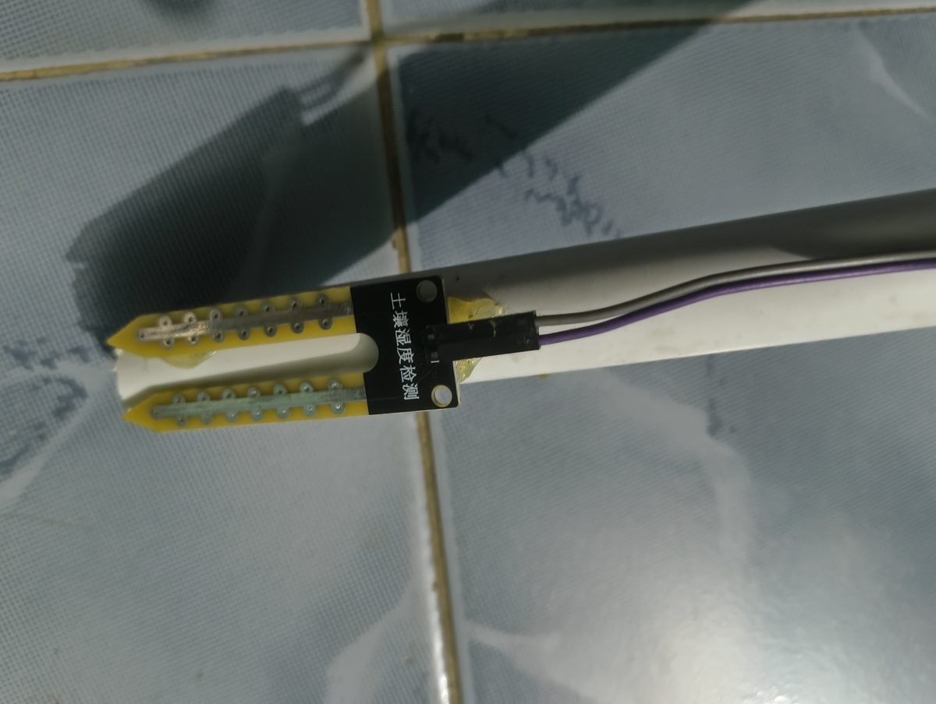
How the tip detects water
Water conducts electricity, so the resistance Rp between the copper tracks drops. The LM393 module turns this into a voltage:
V_A0 = Vcc × Rp / (Rp + Rf)
≈ 1023
< 500
Dry: Rp very high
Wet: water alert
Moisture probe glued at the cane tip
The reading is ratiometric (independent of battery voltage). The D0 output is unused; the threshold is set in code.
Notes:
The probe has two copper tracks. Dry air does not conduct, so the reading is near 1023. Water conducts, the resistance drops, and the voltage on A0 falls. Below 500 we treat it as water. Because the ADC reference and the divider use the same supply, the reading does not depend on the battery voltage.

Slide 12
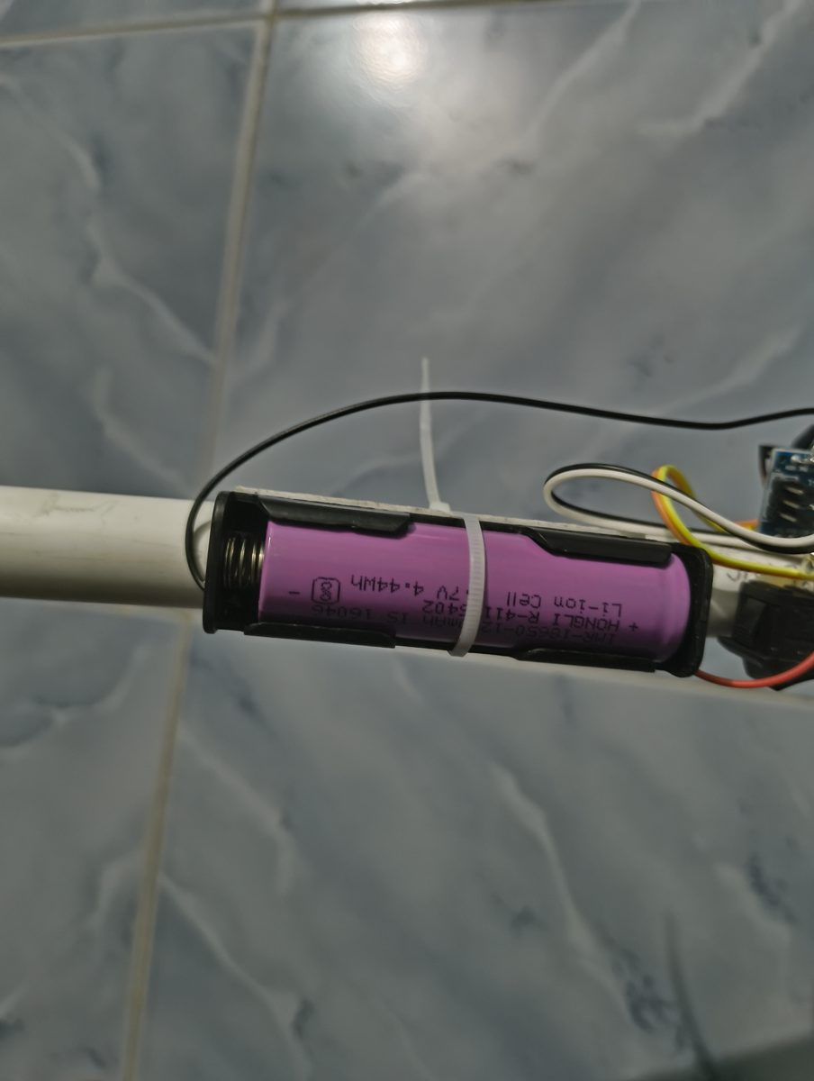
Power system
18650 cell
Rocker switch
5V pin
3.7 V, 1200 mAh
ON / OFF
Nano + both sensors
~40 mA
≈ 30 h
total current draw
theoretical runtime
Safety: switch OFF before plugging in USB. The battery feeds the 5V rail directly.
Notes:
One 18650 lithium-ion cell powers everything through a rocker switch connected to the Nano's 5V pin. Total draw is about 40 mA, so the 1200 mAh cell lasts roughly 30 hours in theory. A capacitor smooths the supply. Important: switch off before connecting USB, because the battery is wired directly to the 5V rail.

Slide 13
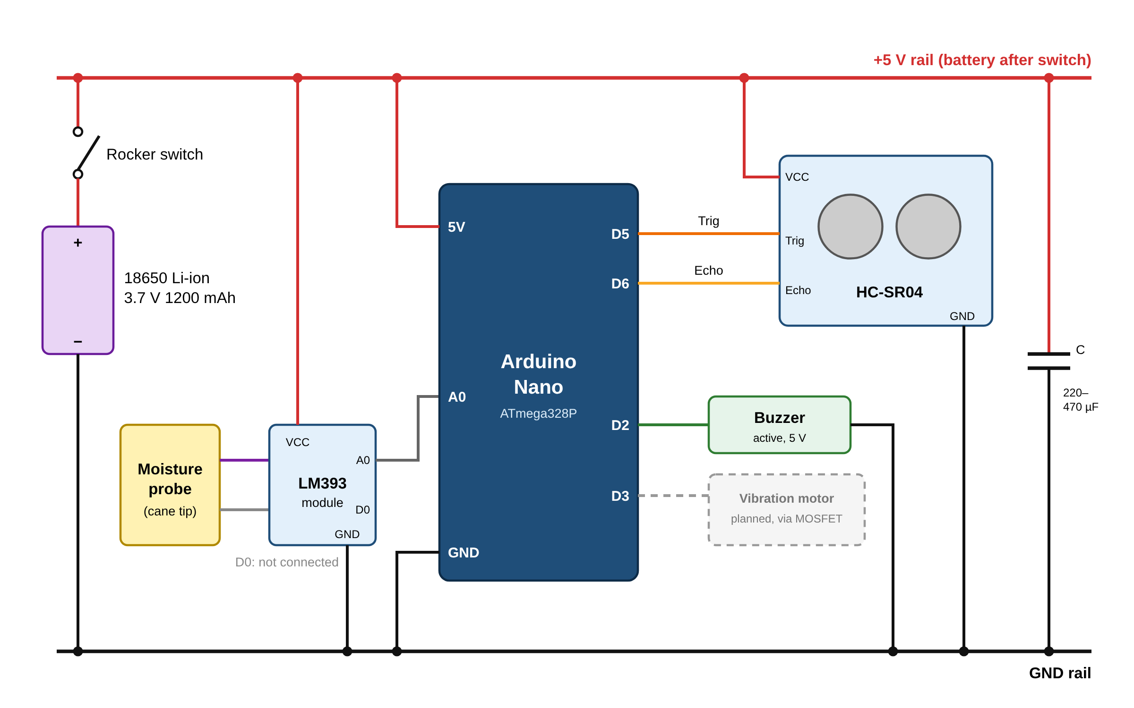
Circuit diagram
Shared +5 V and GND rails
Trig → D5, Echo → D6
Moisture A0 → A0
Buzzer → D2
Capacitor across 5V and GND
D3 reserved for a vibration motor
Notes:
All modules share the 5 volt and ground rails. Trig goes to D5, Echo to D6, the moisture output to A0 and the buzzer to D2. D3 is reserved for a vibration motor in the next version.

Slide 14
Pin connections
Device pin | Nano pin | Purpose
Battery + (via switch) | 5V | Power, 3.0–4.2 V
Battery − | GND | Common ground
HC-SR04 Trig | D5 | 10 µs trigger pulse (output)
HC-SR04 Echo | D6 | Echo pulse width (input)
LM393 A0 | A0 | Moisture value 0–1023
LM393 D0 | — | Not used
Buzzer + | D2 | HIGH = sound
Sensor VCC / GND | 5V / GND | Module power
Notes:
This table shows every connection. Note that the moisture module's digital output D0 is not used; we read the analog value so we can set the threshold in software.

Slide 15
Algorithm
1
Initialise
2
Measure distance
3
Read moisture
Set pin modes, start Serial at 9600
Trigger, pulseIn() with 30 ms timeout, d = t × 0.034 / 2
m = analogRead(A0), 0–1023
4
Water?
5
Obstacle?
6
Clear
If m < 500, buzzer ON continuously
Else if 0 < d < 50, beep 50 ms, wait map(d) = 50–400 ms
Else buzzer OFF; wait 30 ms and repeat
Notes:
The loop: initialise once, then measure distance, read moisture, and decide. Water has first priority with a continuous tone. Otherwise, if an obstacle is within 50 cm, it beeps with a gap from 50 to 400 ms depending on distance. Otherwise it is silent. Then it waits 30 ms and repeats.

Slide 16
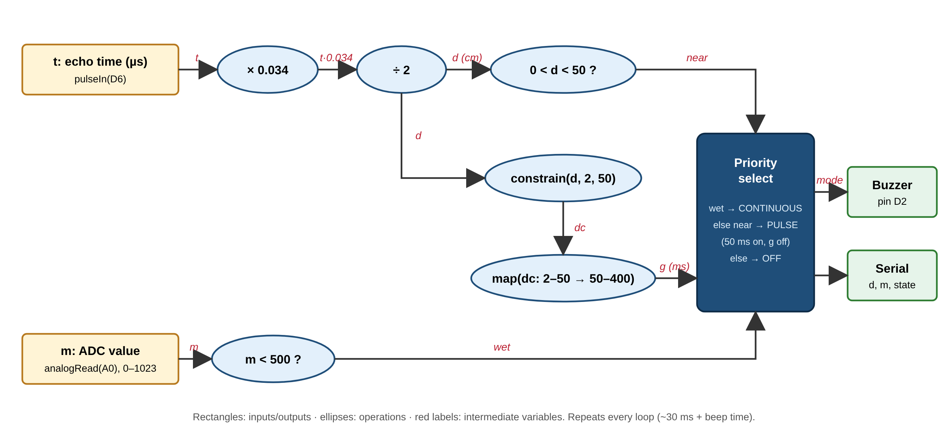
Data flow graph
Echo time t becomes distance d, which feeds two branches (near, and beep gap g); moisture m becomes wet. The priority select drives the buzzer.
Notes:
The data flow graph shows the computation: the echo time is multiplied by 0.034 and divided by 2 to get distance. Distance goes to a comparison for 'near' and to constrain and map to get the beep gap. The moisture value is compared with 500 to get 'wet'. The priority select combines them to drive the buzzer.

Slide 17
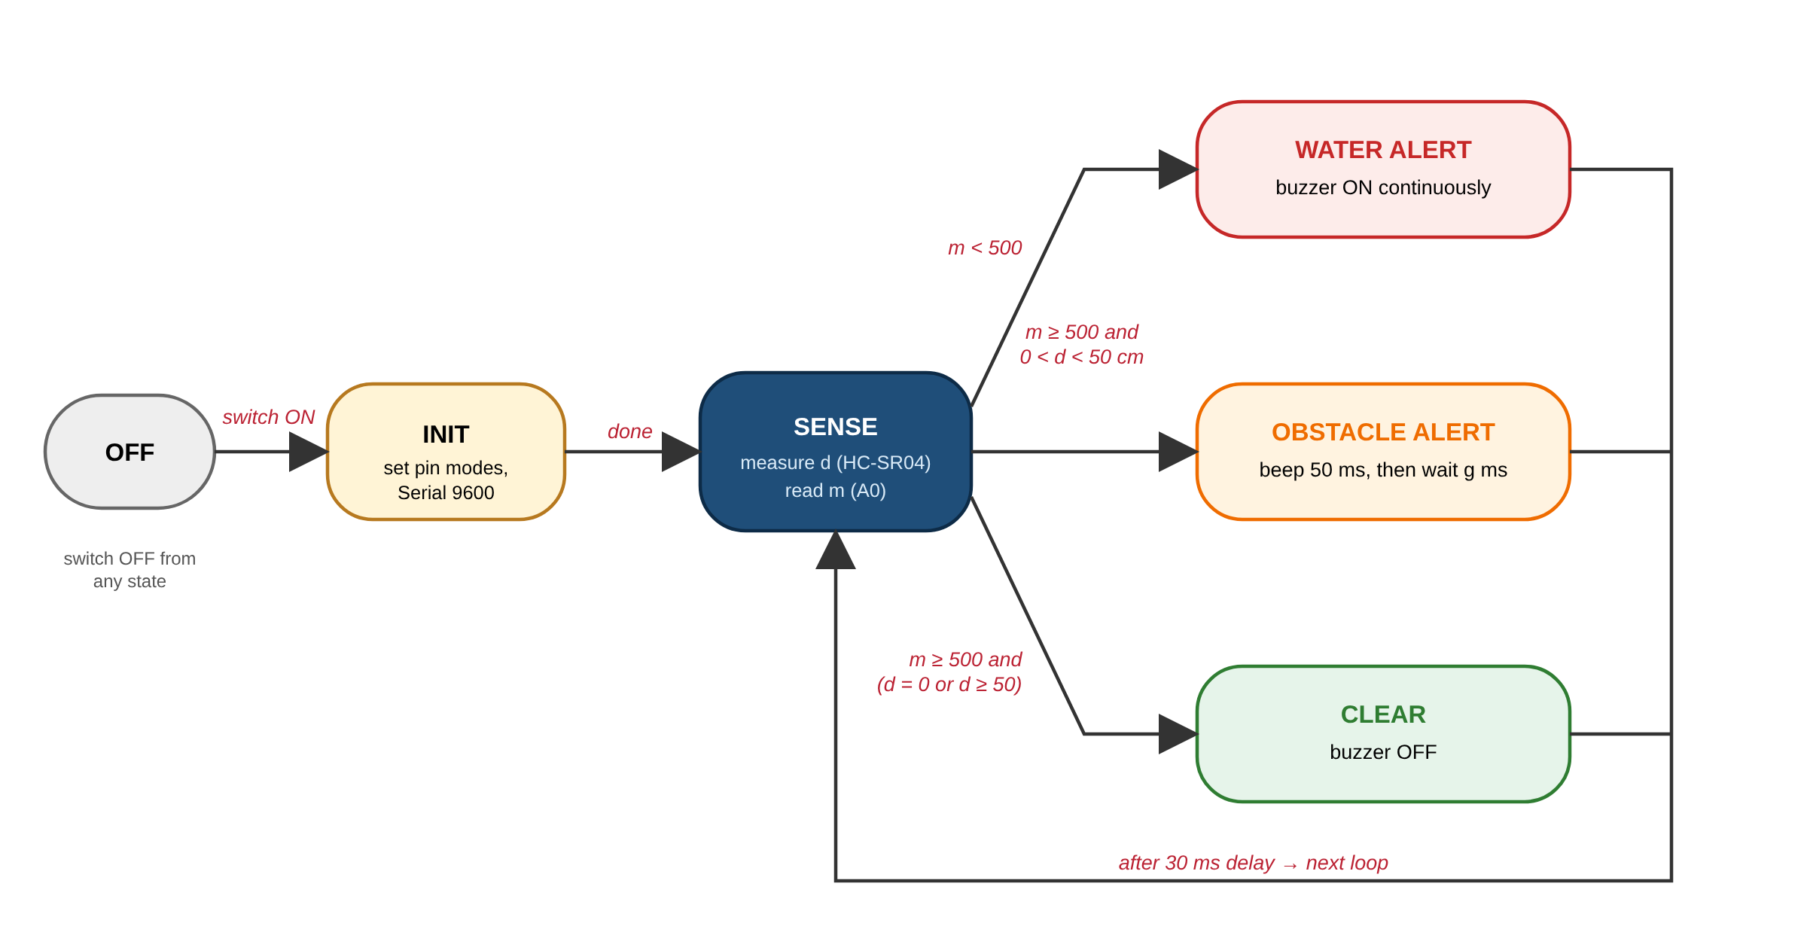
State diagram
Every loop the system senses, then enters exactly one state: WATER, OBSTACLE or CLEAR. Water always wins.
Notes:
After switch-on, the system initialises and then senses. From SENSE it goes into exactly one state: water alert, obstacle alert or clear. Each returns to SENSE after 30 milliseconds. Switching off returns it to OFF from any state.

Slide 18
Key code logic
int readDistanceCm() {
digitalWrite(TRIG_PIN, HIGH);
delayMicroseconds(10);
digitalWrite(TRIG_PIN, LOW);
unsigned long t =
pulseIn(ECHO_PIN, HIGH, 30000);
return t * 0.034 / 2;
}
if (soil < 500) // water
buzzer ON (continuous);
else if (d > 0 && d < 50)
beep, gap = map(d,2,50,50,400);
else buzzer OFF; // clear
pulseIn() timeout
30 ms, so a missed echo cannot freeze the loop
0.034 / 2
Speed of sound in cm/µs, halved for the round trip
map()
Turns 2–50 cm into a 50–400 ms beep gap
Notes:
This is the core code, simplified. readDistanceCm sends the trigger pulse and measures the echo with a 30 ms timeout. Then the if-else chain implements the priority: water first, then obstacle with map() giving the beep gap, otherwise off.

Slide 19
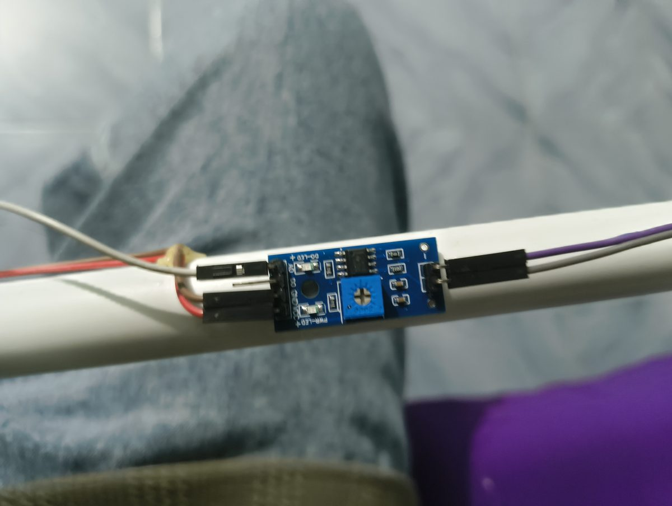
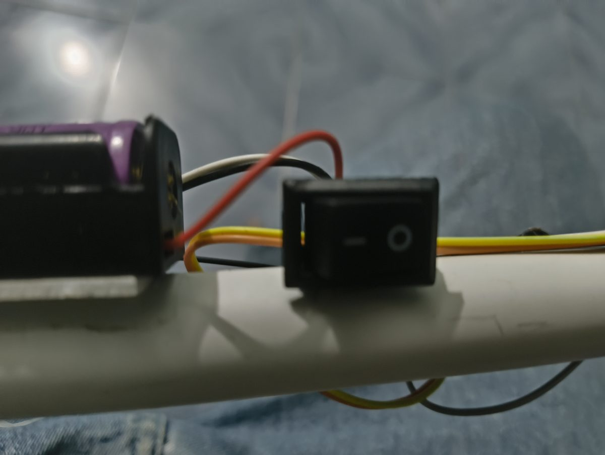
The prototype
Sensors, Nano, buzzer and power are mounted along a PVC pipe; the probe sits at the tip
Notes:
This is the built prototype. From the tip: the moisture probe, the LM393 module, the ultrasonic sensor facing forward, then the Nano with the buzzer, the switch and the battery near the handle, which keeps it easy to swing.

Slide 20
Testing and results
Test | Method | Expected | Result
Power on battery | Switch ON, no USB | Nano LED on, system runs | Verified
Obstacle alert | Move a notebook from 60 to 5 cm | Beeps under 50 cm, faster when closer | Verified
Path clear | Point at open space | Silent | To confirm
Water alert | Dip probe tip in water | Continuous tone | Calibrating
Priority | Water + obstacle together | Continuous tone (water wins) | To confirm
Update the Result column after the Serial Monitor tests (dry and wet readings).
Notes:
Testing so far: the cane runs on battery and the obstacle alert works, with beeps getting faster as the obstacle approaches. The water alert is implemented and we are calibrating the threshold from the dry and wet readings on the Serial Monitor.

Slide 21
Cost of the cane hardware
₹876
total cane hardware
₹1,805 including tools (₹660) and parts for planned upgrades (₹269). Prices from the supplier invoice; buzzer and PVC body estimated.
Notes:
The cane hardware costs about 876 rupees. The full project spend was 1,805 rupees, but that includes the soldering iron and other tools, and parts kept for the next version such as the MOSFET and fuse. That is far cheaper than commercial smart canes.

Slide 22


Advantages and limitations
Advantages
Limitations
Warns before contact; distance shown by beep rate
Detects water and wet mud, unlike most basic smart canes
Low cost, local parts, easy to repair
Rechargeable battery, simple on/off use
Narrow ~15° beam misses head-level and thin obstacles
Water detected only when the tip touches it
Resistive probe corrodes over time
Unregulated 3.7 V supply, no low-battery warning
Buzzer hard to hear in heavy traffic
Notes:
Advantages: early warning with distance information, water detection, low cost and easy repair. Limitations: the narrow beam misses head-level obstacles, water is detected only on contact, the probe corrodes, the supply is unregulated, and a buzzer can be hard to hear in traffic.

Slide 23






Future scope
Vibration motor
Regulated power
More sensors
Silent haptic alerts via the IRLZ44N MOSFET
5 V boost converter, TP4056 charger, 1 A fuse
Angled up for heads, down for steps and potholes
Capacitive probe
GPS + SOS
PCB + enclosure
No exposed metal, so no corrosion
Send location to family via GSM or Bluetooth
Waterproof, robust, ready for field trials
Notes:
For the final version we plan a vibration motor for silent alerts, regulated power with charging and a fuse, extra sensors for head-level obstacles and steps, a capacitive moisture sensor, GPS with an SOS message, and a PCB in a waterproof enclosure.

Slide 24
References
[1] Elecfreaks, “Ultrasonic Ranging Module HC-SR04,” datasheet, 2011.
[2] Microchip Technology, “ATmega328P megaAVR Data Sheet,” DS40002061, 2020.
[3] Arduino, “Arduino Nano,” docs.arduino.cc/hardware/nano
[4] Arduino, “Language Reference: pulseIn(), analogRead(), map(),” arduino.cc/reference
[5] Texas Instruments, “LM393 Dual Comparator,” datasheet, ti.com/product/LM393
[6] World Health Organization, “World Report on Vision,” Geneva, 2019.
Notes:
These are the datasheets and documentation we used.

Slide 25
Thank you
Conclusion
A plain cane becomes a low-cost electronic travel aid
Warns about obstacles before contact, with distance in the beep rate
Gives priority warnings for water underfoot
Runs from one rechargeable cell for about ₹876
Questions?
Notes:
To conclude: VisionGuard turns a plain cane into a low-cost electronic travel aid that warns about obstacles before contact, shows distance through the beep rate, and gives priority warnings for water, all for under 900 rupees. Thank you. We are happy to take questions.

