Slide 1
EXAM TIME TABLE
TEAM NAME – D3VA
MEMBERS : R.DARSHAN
V. A. BALAJI
D. ASWANTH RAM

Slide 2
PROBLEM STATEMENT
Exam time tabling problems is defined as assigning a set of exams E = e1, e2, ... ee into a limited number of ordered timeslots (time periods) T = t1, t2, ... tt and rooms of certain capacity in each timeslot C = C1, C2, ...Ct, subject to a set of constraints
The timetable creation is a tedious process, since so many constraints to be considered before make it. There is a need for an automatic system. To create an exam schedule for University examination for an academic institution by considering possible constraints.

Slide 3
INPUT / OUTPUT
START DATE
LIST OF HOLIDAYS
LIST OF HALLS
LIST OF INVIGILATORS
COURSE DETAILS
DEPARTMENT DETAILS

Slide 4
CONSTRAINTS
HARD CONSTRAINTS
Minimum of 2 – 3 days of gap between every exam.
Exams should not be scheduled on the input holidays
Consecutive days should not be scheduled for exams.
Exam dates of one semester must not overlap with other semester exam dates.

Slide 5
CONSTRAINTS
SOFT CONSTRAINTS
Availability of invigilator is checked before assigning them to the respective exam halls.
Availability of exam halls is checked by comparing the total number of students with sum of capacity of all exam halls.
If there are insufficient number of exam halls , requirement of extra exam halls is needed to assign for all students.
If the number of halls exceeds the number of invigilators, there are insufficient number of invigilators. Requirements of additional invigilators is mandatory here.

Slide 6
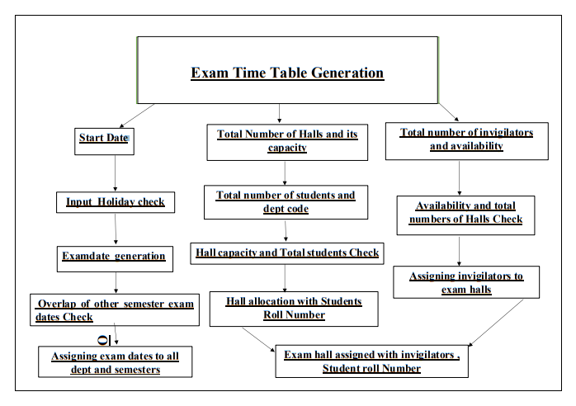
ARCHITECTURE DIAGRAM

