Slide 1
👨‍👦‍👦 Team details
Team Name: DUALITY
Team Members
Name | Email ID | Number no
X S Minisha Alias Lincy | minishalincy123@gmail.com | 9901288026
Darshan Ramesh | darshanramesh2004@gmail.com | 9900581945

Slide 2
📝 Theme – Lack of on-the-go, need-based support to teachers
📌 Theme Overview
Teachers across diverse classrooms face real-time instructional and classroom-management challenges that cannot be addressed through periodic training or delayed mentoring, as existing systems provide largely generic feedback. As a result, teachers struggle to apply new strategies in live classrooms and revert to traditional methods. This highlights the need for just-in-time, personalized coaching during moments of practice. At the same time, CRPs, ARPs, and BRPs lack real-time visibility into classroom realities, limiting their ability to provide timely, data-driven support through periodic visits.

Slide 3
📌 Solution Overview​
Our solution is to develop a web-based application with Low Network Capabilities that includes a multilingual AI classroom assistant and offline support, enabling teachers to seek guidance during real-time classroom challenges. Teachers can use text, voice, or images to receive personalized support through short activities and learning resources. At the same time, CRPs, ARPs, and BRPs gain real-time visibility into teachers’ classroom data through dashboards, allowing timely academic and mentoring support. The platform also supports peer solution sharing and alert-based assistance to strengthen everyday classroom support.

Slide 4
  Real-Time Support Gap: Teachers face classroom problems in the moment, but current support arrives weeks later through CRP/ARP visits. This delay causes teachers to abandon innovative methods and return to rote teaching, reducing learning quality.
  Need for Personalized, On-Demand Coaching: Every classroom is different, and teachers need immediate, context-specific guidance when challenges occur, which traditional workshops and delayed feedback cannot provide.
  Limited Visibility for CRP, ARP, and BRP: Resource persons currently lack real-time insight into classroom struggles, making it difficult for them to give targeted, data-driven academic and mentoring support.
📌 Reasons for selecting this theme

Slide 5
📌 App Features
1. AI Classroom Assistant: Teachers can ask classroom doubts using text, voice, or images and receive personalized, context-aware solutions with feedback on whether they worked.
2. Low Network Capabilities: Works smoothly in low network conditions, allowing teachers to access tips, past queries, and resources with minimal connectivity.
3. Short Educational Videos: Teachers get quick, bite-sized teaching tips and strategy videos that can be watched anytime, even offline, during free or extra class time.
4. Multilingual Language Support: The entire app works in multiple languages, allowing teachers to use the platform in their preferred local language.
5. Planning & Reminders: Teachers can plan daily tasks and classroom goals using an in-app calendar and notes, with automatic reminders and notifications to support timely follow-through.

Slide 6
📌 Frameworks/Technologies stacks
Frontend ->
Next.js (Web UI for teachers, CRP, ARP, BRP Dashboards),
PWA (Offline access, caching, notifications),
i18n (Next-i18next) → Multilingual UI (labels, buttons, screens)
Backend ->
Python (Core backend logic and processing)
FastAPI (APIs, AI orchestration, data flow)
Database ->
MongoDB (NoSQL database that efficiently stores large volumes of data)
AI & Language Layer (Mixed) :
Hugging Face Models (Classroom issue classification, intent detection)
Gemini (Personalized teaching advice and coaching responses)
IndicTrans2 (AI4Bharat) (Indian language translation for input/output)

Slide 7
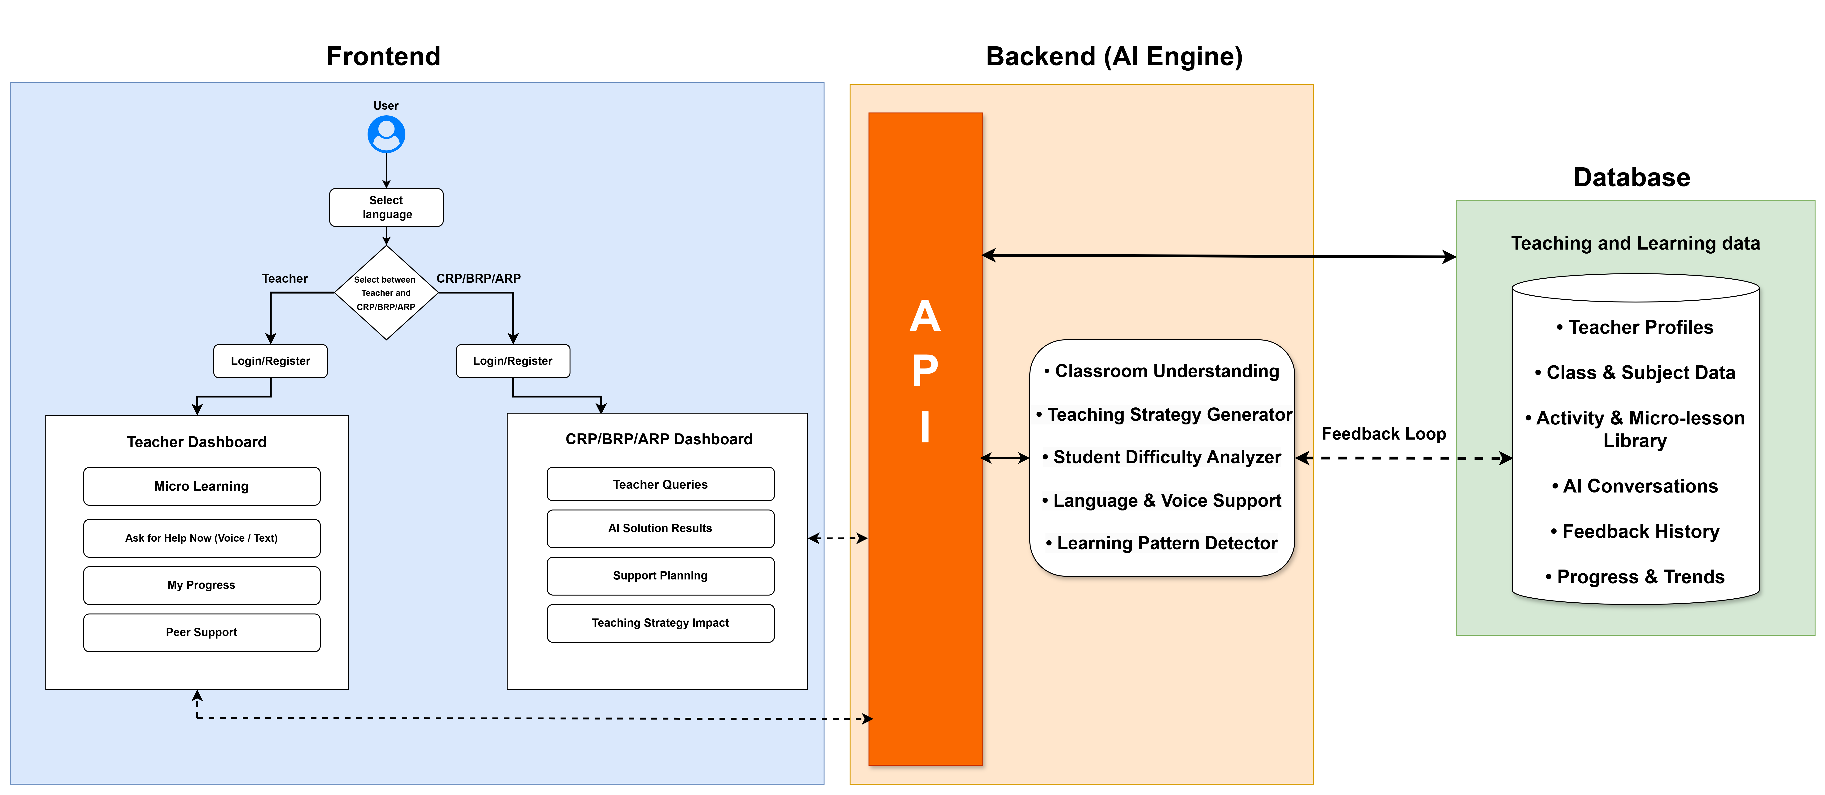
📊 Architecture diagram

Slide 8
THANK YOU

