Slide 1
A Hybrid MPI-CUDA Framework for High-Performance Large-Scale Log Analysis
Project Presentation
Serial CPU • MPI • CUDA • Hybrid MPI-CUDA
Large-scale synthetic log analysis and performance evaluation

Slide 2
1. Problem Statement
Large applications generate huge volumes of log data.
Sequential analysis can become time-consuming as data size increases.
This project investigates parallel approaches for faster log analysis.
The program counts ERROR, WARN, INFO and DEBUG records.

Slide 3
2. Objectives
Develop a Serial CPU baseline.
Develop an MPI-based parallel CPU implementation.
Develop a CUDA-based GPU implementation.
Develop a Hybrid MPI-CUDA implementation.
Compare execution time, speedup and efficiency.
Evaluate behavior across large synthetic log datasets.

Slide 4
3. Synthetic Log Data
generate_logs.py creates application-style synthetic logs.
Each record contains a timestamp, log level and message.
Levels: ERROR, WARN, INFO and DEBUG.
Synthetic data gives controlled, repeatable dataset sizes.
Tested approximately 100 MB, 500 MB, 1 GB and 2 GB.

Slide 5
4. Overall Architecture
Input log file → Serial / MPI / CUDA / Hybrid
Serial: one CPU process scans the complete file.
MPI: file is divided into chunks for CPU processes.
CUDA: one CPU process launches many GPU threads.
Hybrid: MPI divides the file and processes invoke CUDA.
Output: log-level counts and execution time.

Slide 6
5. Implementation and Source Files
Component | Main file | Purpose
Serial | src/serial_main.c | Sequential CPU baseline
CPU analysis | src/cpu_analyze.c | Log-level detection/counting
MPI | src/mpi_only_main.c | Divide work among CPU processes
CUDA | src/kernel.cu | GPU kernel and analysis
Hybrid | src/main.c | MPI + CUDA integration
Generator | generate_logs.py | Synthetic logs
Benchmark | benchmark.sh | Performance tests
Analysis | analyze_results.py | Speedup/efficiency + graphs

Slide 7
6. Serial CPU Implementation
Uses one CPU process.
Reads and analyzes the complete log file sequentially.
Acts as the performance baseline.

Slide 8
7. MPI Implementation
MPI divides the file into byte ranges.
Boundaries are adjusted to newline boundaries.
Each process analyzes its own chunk.
MPI_Reduce combines local counts.
Tested with 1, 2, 4 and 8 processes.

Slide 9
8. CUDA Implementation
One CPU process controls the NVIDIA GPU.
Many CUDA threads perform the actual analysis.
The kernel identifies log records and counts log levels.
CUDA error checking is included.
CPU process count and CUDA thread count are different concepts.

Slide 10
9. Hybrid MPI-CUDA Implementation
MPI partitions the input file among processes.
Each process reads its assigned chunk.
Each chunk is passed to analyzeChunkGPU().
CUDA performs the analysis on the GPU.
MPI_Reduce combines results.

Slide 11
10. Correctness Verification
Log level | Count
ERROR | 75,056
WARN | 224,933
INFO | 900,082
DEBUG | 299,929
The same input datasets were used for comparison.
Validated implementations produced matching ERROR/WARN/INFO/DEBUG counts.
Example ~100 MB counts: ERROR 75,056; WARN 224,933; INFO 900,082; DEBUG 299,929.

Slide 12
11. Performance Results — ~100 MB
Variant | Processes | Time (s)
Serial | 1 | 0.1343
CUDA-only | 1 | 2.3638
MPI-only | 1 | 0.3747
MPI-only | 2 | 0.1775
MPI-only | 4 | 0.1367
Hybrid | 1 | 1.1586
Hybrid | 2 | 1.0894
Hybrid | 4 | 1.1572

Slide 13
12. Performance Results — ~500 MB
Variant | Processes | Time (s)
Serial | 1 | 0.6575
CUDA-only | 1 | 1.9245
MPI-only | 1 | 0.5478
MPI-only | 2 | 0.2672
MPI-only | 4 | 0.1725
MPI-only | 8 | 0.1277
Hybrid | 1 | 1.2206
Hybrid | 2 | 1.0853
Hybrid | 4 | 1.1537
Hybrid | 8 | 1.3553

Slide 14
13. Performance Results — ~1 GB
Variant | Processes | Time (s)
Serial | 1 | 1.4727
CUDA-only | 1 | 2.3270
MPI-only | 1 | 1.0356
MPI-only | 2 | 0.5215
MPI-only | 4 | 0.3440
MPI-only | 8 | 0.2424
Hybrid | 1 | 1.5784
Hybrid | 2 | 1.4683
Hybrid | 4 | 1.4095
Hybrid | 8 | 1.5036

Slide 15
14. Performance Results — ~2 GB
Variant | Processes | Time (s)
Serial | 1 | 0.2725
CUDA-only | 1 | 2.8062
MPI-only | 1 | 0.2193
MPI-only | 2 | 0.1176
MPI-only | 4 | 0.0797
MPI-only | 8 | 0.0560
Hybrid | 1 | 1.0573
Hybrid | 2 | 1.0832
Hybrid | 4 | 1.0846
Hybrid | 8 | 0.6759

Slide 16
15. Performance Analysis and Graphs
benchmark.sh collects execution times.
analyze_results.py calculates speedup and efficiency.
Outputs: analysis_summary.csv, speedup_report.png, execution_time_report.png.
Graphs compare implementations and process counts across datasets.

Slide 17
16. Why 4 MPI Processes Can Sometimes Beat 8
More processes do not automatically mean better performance.
MPI communication and synchronization add overhead.
Processes compete for CPU resources.
Multiple processes reading the same storage can create I/O contention.
After a point, work per process becomes small relative to overhead.

Slide 18
17. Key Findings
MPI provided the strongest performance among the tested approaches for several larger workloads.
CUDA-only was not always faster because GPU transfer and kernel overhead matter.
The current Hybrid implementation did not consistently outperform MPI.
Correctness was verified by matching log-level counts.
Performance depends on workload size, hardware, I/O and communication overhead.

Slide 19
18. Limitations and Future Improvements
Experiments used one system with RTX 3050 4 GB GPU and 12 CPU cores.
GPU transfer and coordination overhead affects Hybrid.
Single timings can be affected by caching and system load.
Future: reduce transfers, improve GPU utilization, use asynchronous operations and test more computationally intensive workloads.
Repeat runs and statistical summaries would strengthen benchmarking.

Slide 20
19. Conclusion
cd ~/hybrid_mpi_cuda_log_analysis
python3 generate_logs.py 10000 test.log
make clean && make
./log_analyzer_serial test.log
./log_analyzer_cuda test.log
mpirun --oversubscribe -np 4 ./log_analyzer_mpi test.log
mpirun --oversubscribe -np 4 ./log_analyzer_hybrid test.log
python3 analyze_results.py
A complete Serial, MPI, CUDA and Hybrid MPI-CUDA framework was implemented.
Large synthetic datasets were generated for repeatable testing.
Correctness was verified through matching counts.
Performance was evaluated using execution time, speedup and efficiency.
The experiments show that more parallelism is not automatically better.

Slide 21
20. Live Demonstration Commands

Slide 22
21. Likely Viva Questions
Why synthetic logs? → Controlled, repeatable and scalable datasets.
Why Serial = 1 process? → Sequential baseline.
Why CUDA = 1 process? → One CPU process controls many GPU threads.
Why can 4 MPI processes beat 8? → Communication, synchronization and I/O/resource contention.
Why was Hybrid not always fastest? → MPI-CUDA coordination and data-transfer overhead.
Speedup? → Serial time ÷ selected implementation time.
Efficiency? → Speedup ÷ number of processes.

Slide 23
Thank You
Questions?

Slide 24
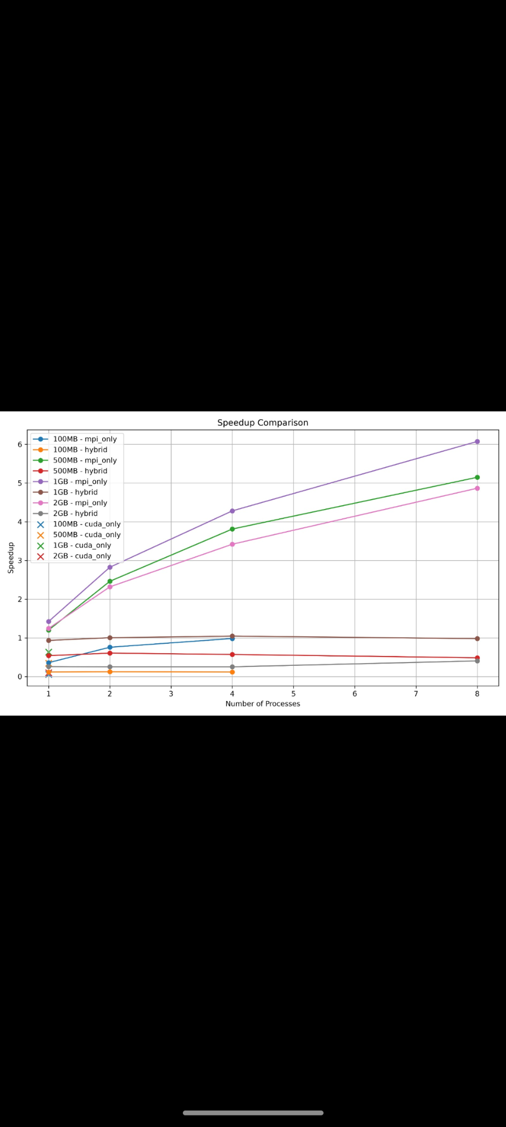
Performance Graph 1 — Speedup Comparison

Slide 25
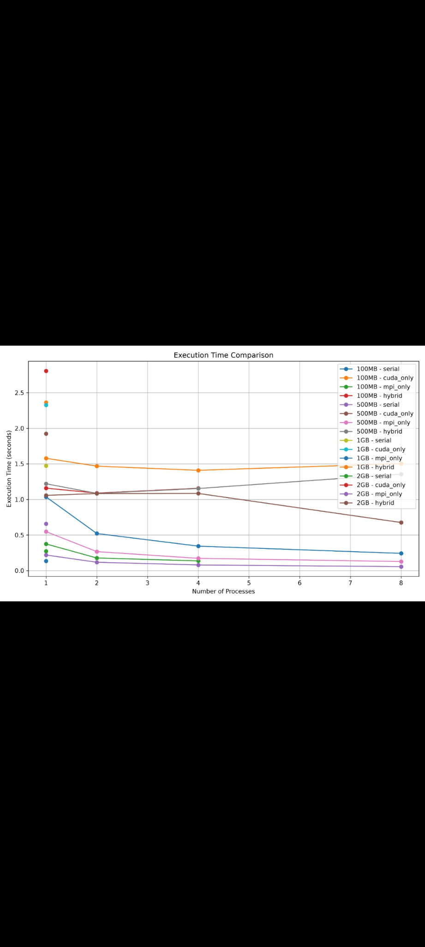
Performance Graph 2 — Execution Time Comparison

