Slide 1
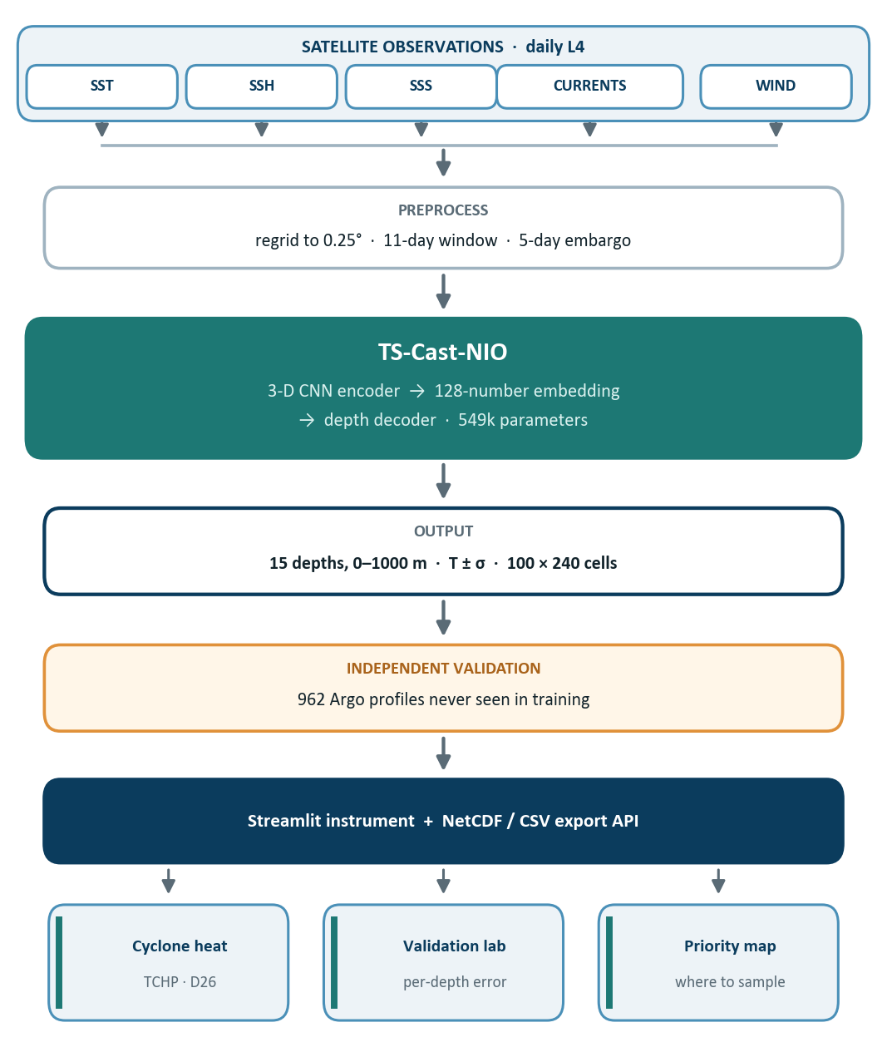
TEAM
NAME
OceanEmbed
PASTE OFFICIAL
SIH 2026 LOGO
❖ Proposed Solution
➤ Comprehensive OceanEmbed Subsurface Platform: A web dashboard and reproducible pipeline that reconstructs daily ocean temperature at 15 depths from 0 to 1000 m across the North Indian Ocean, using surface observations alone.
➤ Satellite-Only Input: Runs on OSTIA sea-surface temperature, DUACS altimetry, SMOS-blended salinity, GLOBCURRENT surface currents and observational winds — no in-situ float is needed at prediction time, which is what makes it operational every single day.
➤ TS-Cast-NIO Model: A 3-D CNN compresses an 11-day window of 7 surface maps into a 128-number ocean embedding, and a decoder expands it into a full temperature profile — 549k parameters, kept deliberately small for the data available.
➤ Uncertainty on Every Value: The model predicts a spread alongside each temperature, so the product states where it should not be trusted, instead of showing one confident number everywhere.
➤ Independent Validation: Scored against 963 Argo float profiles never seen in training — 0.91 °C RMSE over 12,727 comparisons, 24% better than climatology, and better at 14 of the 15 depths.
➤ Derived Ocean Products: Mixed-layer depth, thermocline depth, cyclone heat potential (TCHP / D26), eddy and upwelling detection, and anomaly maps — all computed from the reconstructed profile, never assumed.
➤ Observation-Priority Map: The uncertainty field ranks where the ocean is least known, turning a gap in knowledge into a concrete answer to where the next Argo float should be deployed.

Slide 2
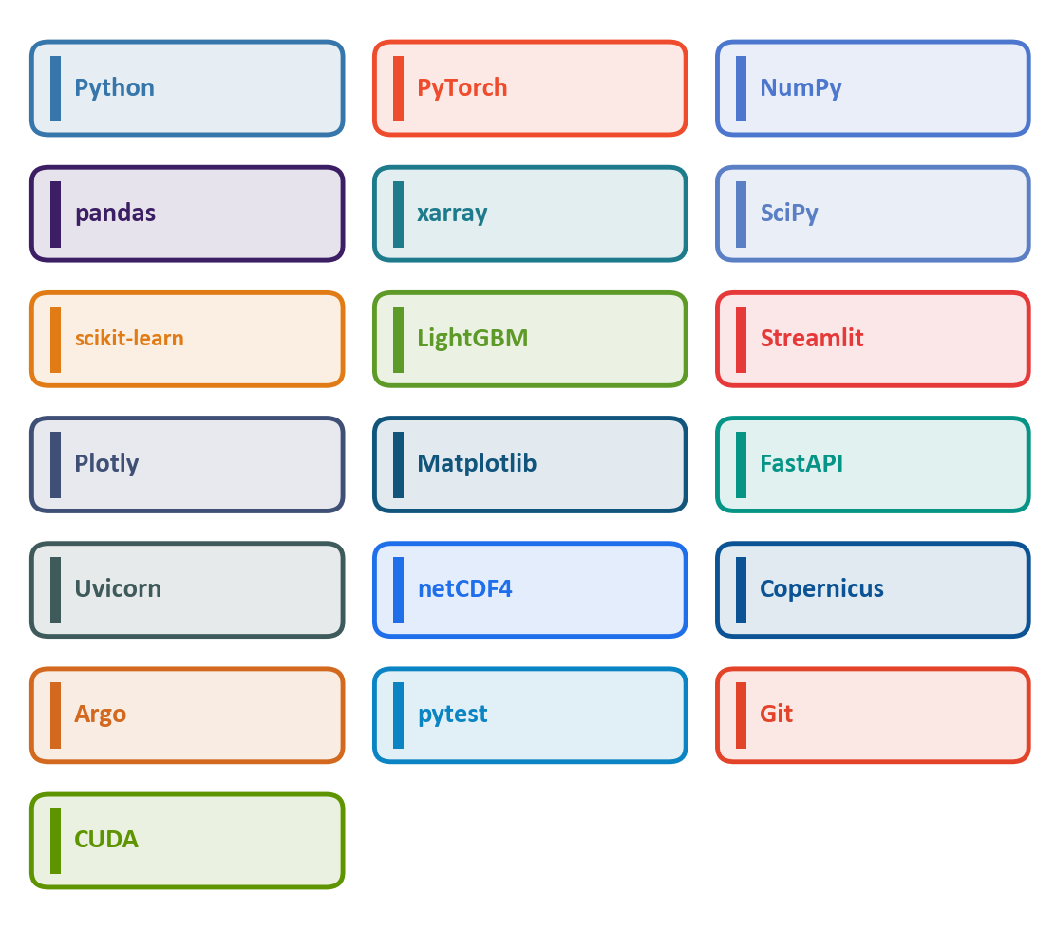
TEAM
NAME
TECHNICAL APPROACH
PASTE OFFICIAL
SIH 2026 LOGO
❖ Technology Stack
Languages & Core: Python 3.12, NumPy, pandas, PyArrow, PyYAML.
Ocean Data: xarray, netCDF4, SciPy, copernicusmarine (CMEMS), argopy, erddapy.
AI / ML: PyTorch — 3-D CNN encoder + depth decoder, 549k parameters; scikit-learn; LightGBM baseline and quantile uncertainty; CUDA.
Frontend & Visualisation: Streamlit — 15 feature modules behind one lazy registry; Plotly; Matplotlib.
API & Export: FastAPI, Uvicorn, and NetCDF / CSV / Parquet export.
Reproducibility & Testing: pytest — 1,032 tests covering the code and the claims; Git; ruff; seeded configs; and a SHA-256-verified frozen checkpoint manifest.
METHODOLOGY AND PROCESS FOR IMPLEMENTATION

Slide 3
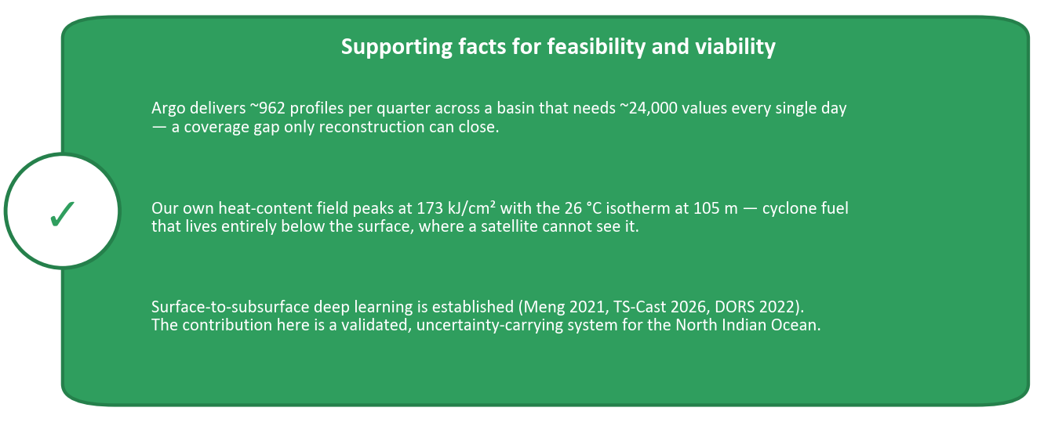
TEAM
NAME
FEASIBILITY AND VIABILITY
PASTE OFFICIAL
SIH 2026 LOGO
■ Feasibility
1. Technical: Already built end-to-end — 388 gap-free days of satellite input, a trained model, and a running instrument. Not a proposal.
2. Economic: Every input is free and open. CMEMS and Argo cost nothing, training takes about 9 minutes on one GPU, and inference runs on a laptop.
3. Operational: The satellite L4 products are published daily and operationally, so the pipeline runs forward in near-real-time with no in-situ input.
■ Viability
4. Scales beyond the pilot: The architecture is region-agnostic — retargeting to another basin is a data-bundle change, not a redesign.
5. Reproducible and auditable: Seed, config and a SHA-256-verified checkpoint are frozen in a manifest, with 1,032 tests that guard the claims as well as the code.
■ Challenges
6. The thermocline is the hard layer: Error runs 1.06–1.24 °C through 50–150 m, peaking at 100 m where temperature falls fastest with depth.
7. Uncertainty is improved, not calibrated: Coverage runs below nominal in the mixed layer. We report the shortfall rather than widening the band to hide it.
8. Epoch selection was not independent: The shipped epoch was chosen on the test period; a leak-free protocol costs +0.07 °C over three seeds, and we say so.
9. INCOIS gridded Argo is unreachable: Their data layer is down, so validation uses individual argopy floats instead.
■ Use Cases
10. Cyclone intensity: upper-100 m heat content, the fuel term a surface map cannot see.
11. Monsoon & fisheries: Bay of Bengal stratification and Arabian Sea upwelling, both subsurface.
12. Next-float targeting & assimilation: an uncertainty-ranked map of where the ocean is least known.
■ Deployment Potential
1. Hand-off to INCOIS / IMD: Output is a daily NetCDF field on a standard grid — directly ingestible by existing forecast and assimilation chains.
2. Zero licence cost: Open Copernicus and Argo data on an open-source stack. Nothing proprietary to renew.
3. Fisheries & naval advisories: The same profile drives potential-fishing-zone and sonar-range products Indian agencies already issue.
4. Research platform: Frozen seeds, checkpoints and an export API make it a base others extend, not a one-off demo.
■ Solutions
5. Robust data & protocol: 388 gap-free days, a 5-day embargo between train and test, scored on 963 floats never seen in training.
6. Modular integration: 15 lazily-loaded feature modules behind one registry — a broken feature contains itself instead of downing the instrument.
7. Refusal over invention: Below the seafloor the model returns nothing rather than a number, and the scorer declines those depths too.

Slide 4
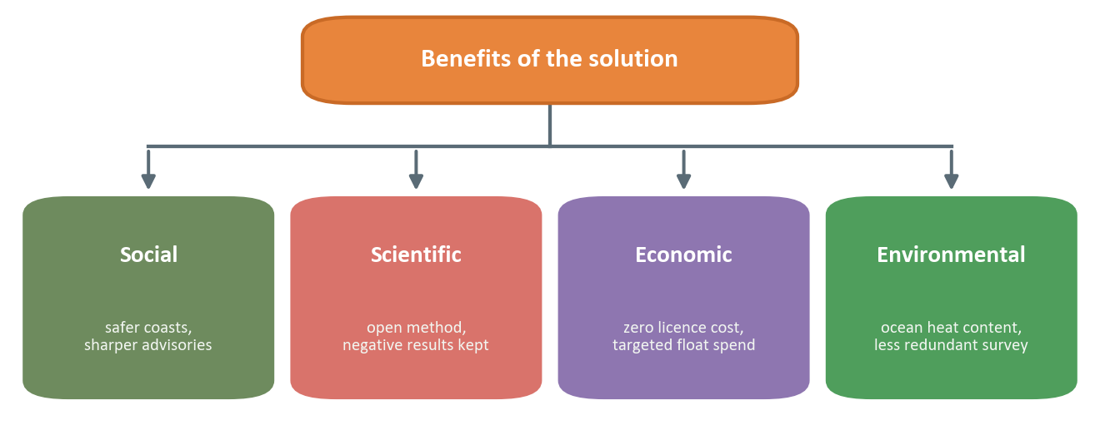
TEAM
NAME
IMPACT AND BENEFITS
PASTE OFFICIAL
SIH 2026 LOGO
❖ Benefits of the solution
Social:
• Better cyclone-intensity input for the most densely populated cyclone basin.
• Sharper fishing-zone advisories for small-scale fishers who cannot afford a wasted trip.
• Uncertainty shown on screen, so an advisory can state its own confidence instead of implying certainty.
Scientific / Technological:
• Targets the North Indian Ocean, where most published work targets the Pacific.
• An uncertainty head trained jointly with temperature, not bolted on afterwards.
• Negative results published beside positive ones — the FiLM decoder and the density loss were both measured harmful and dropped.
Economic:
• Zero data-licensing cost: Copernicus and Argo are open, and so is the stack.
• About 9 minutes of GPU training and laptop-class inference — no cluster required.
• Targets Argo deployment, the most expensive part of ocean observation, at the cells where information is scarcest.
Environmental:
• Monitors ocean heat content, the dominant store of excess planetary heat.
• Sees subsurface heat and upwelling structure that surface-only monitoring is blind to.
• Reduces redundant ship survey by targeting where observation actually adds information.
❖ Potential impact on the target audience:
• INCOIS & IMD: A daily subsurface field with an uncertainty band — an input their cyclone and ocean-state forecasts currently lack at this cadence.
• Fisheries & coastal communities: Thermocline and mixed-layer depth drive fishing zones; a daily profile sharpens advisories that today rest on surface temperature alone.
• Indian Navy & shipping: Sound-speed structure follows the temperature profile, feeding sonar-range and routing decisions directly.
• Ocean researchers & the Argo programme: A quantitative, defensible answer to where the next float is worth deploying.
• Disaster management agencies: Upper-ocean heat is the fuel term in rapid cyclone intensification — the failure mode that costs the most lives on this coast.

Slide 5
TEAM
NAME
RESEARCH AND REFERENCES
PASTE OFFICIAL
SIH 2026 LOGO
❖ Key literature
❖ Data and problem statement
▸ Meng et al., 2021. Reconstruction of Three-Dimensional Temperature and Salinity Fields From Satellite Observations. JGR: Oceans. doi:10.1029/2021JC017605
▸ TS-Cast, 2026. Deep Learning for Subsurface Ocean Reconstruction from Satellite Observations in the Northwestern Pacific. Ocean Science 22, 2161.
▸ DORS, 2022. Subsurface Temperature Reconstruction for the Global Ocean from 1993 to 2020 Using Satellite Observations and Deep Learning. Remote Sensing 14(13), 3198. doi:10.3390/rs14133198
▸ FFPG-net, 2025. Feature fusion with physical guidance for subsurface thermal structure reconstruction.
▸ NeSPReSO, 2025. PCA + neural network subsurface prediction, Gulf of Mexico.
▸ Surface inputs (Copernicus Marine): OSTIA sea-surface temperature; DUACS L4 altimetry (cmems_obs-sl_glo_phy-ssh); SMOS-blended salinity (cmems_obs-mob_glo_phy-sss); GLOBCURRENT total currents (cmems_obs-mob_glo_phy-cur); L4 wind (cmems_obs-wind_glo_phy).
▸ Training target: GLORYS12V1 reanalysis, cmems_mod_glo_phy_my_0.083deg_P1D.
▸ Independent validation: Argo float profiles via argopy — 963 profiles, 12,727 depth comparisons, never seen in training.
▸ Problem statement: SIH26066, Ministry of Earth Sciences — subsurface temperature from daily surface observations, North Indian Ocean, 0.25°.
Citation discipline: the five papers above are reviewed at abstract level (docs/LITERATURE_MATRIX.md). They are cited here for existence and general approach only. No numerical comparison against their published results appears anywhere in this deck.

