Slide 1
HackerEarth
Prototype Submission Template For Participants

Slide 2
TEAM NAME and MEMBER DETAILS
THEME:
Darshan S M Pooja
EY Badges

Slide 3
PROBLEM STATEMENT
1)Detection of the clusters of triangles formed by the network of ranks and the domain a user can get, based on a clustering coefficient
2) The analysis of follwer to followee, to the shortest path, follow back etc, metrics are considered to explain the relationship of the processes exists in our environment
3) Jaccard distance 4) Cosine distance 5) Page rank 6) Shortest path
7) Weakly connected component 8) Adar index 9) Follow back
10) Katz centrality 11) Hits(Hyper-link Induced Topic Search)

Slide 4
SOLUTION
Recommendation engine is cool, everyone builds them, to try to build it with the help of graph theory and analytics, using multiple graph metrics
3) Jaccard distance 4) Cosine distance 5) Page rank 6) Shortest path
7) Weakly connected component 8) Adar index 9) Follow back
10) Katz centrality 11) Hits(Hyper-link Induced Topic Search)

Slide 5
CHECKLIST
List of features incorporated from the problem statement
Jaccard distance
Cosine distance
Page rank
Shortest path
Weakly connected component
Adar index
Follow back
Katz centrality
Hits(Hyper-link Induced Topic Search)

Slide 6
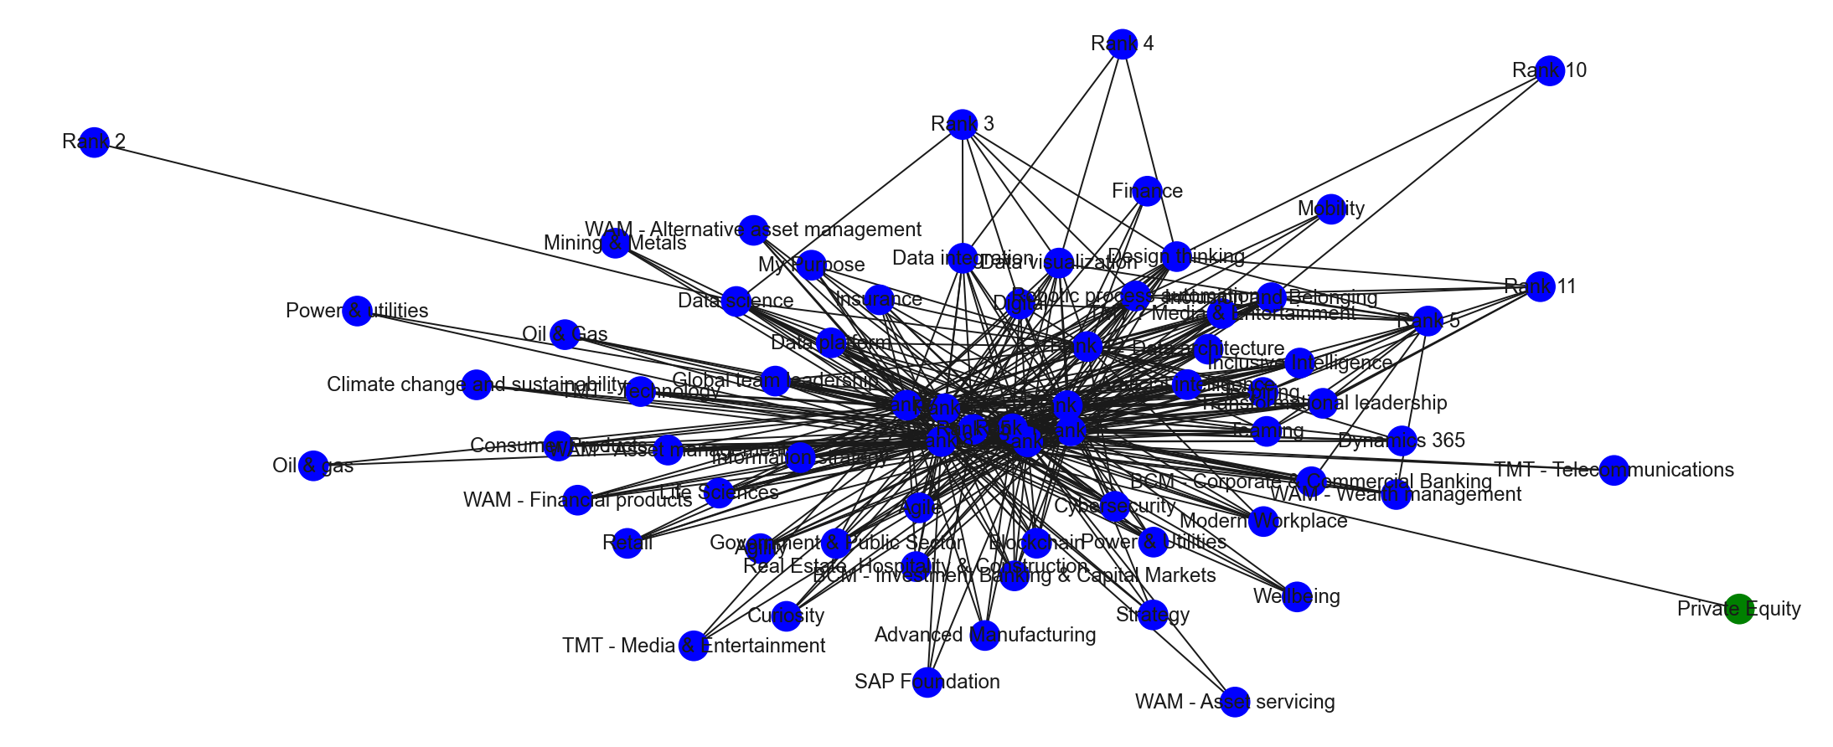
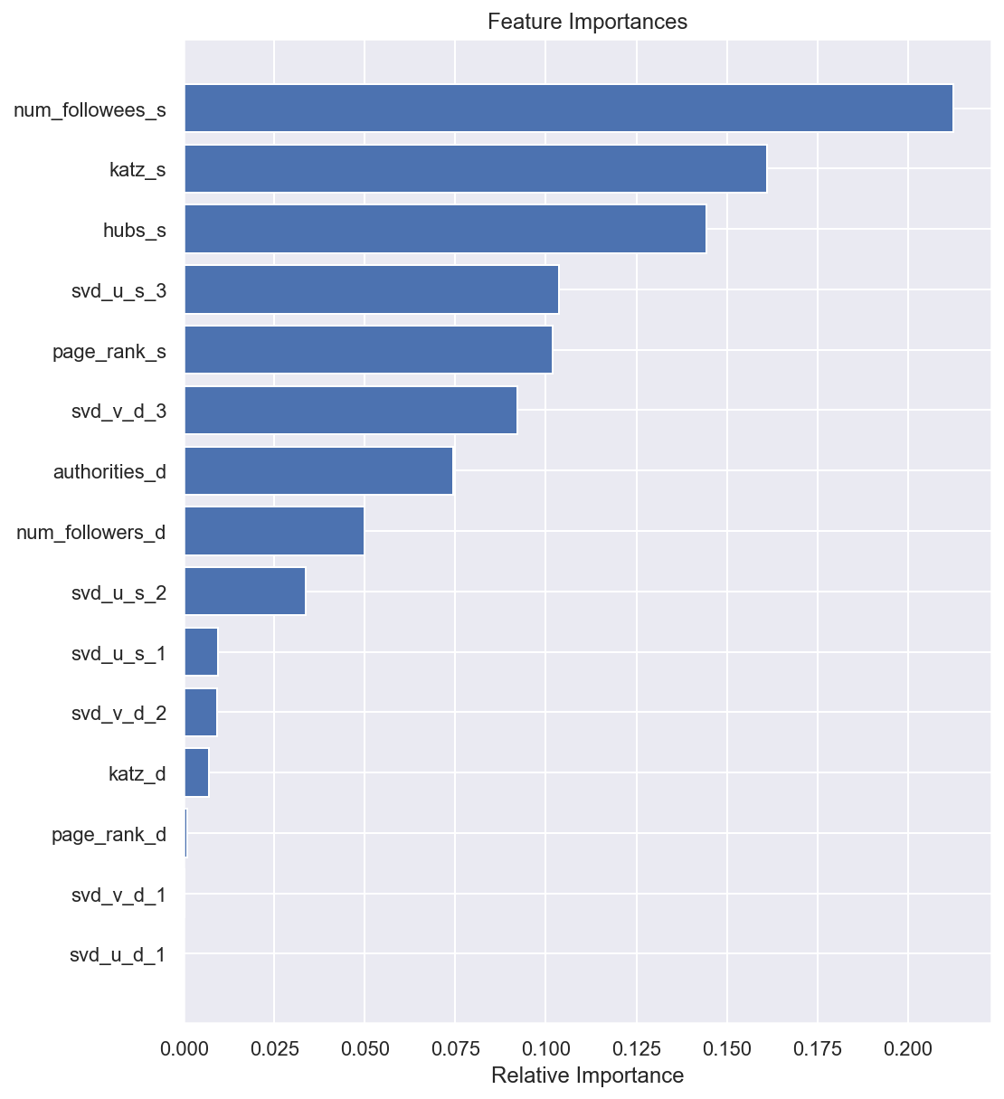
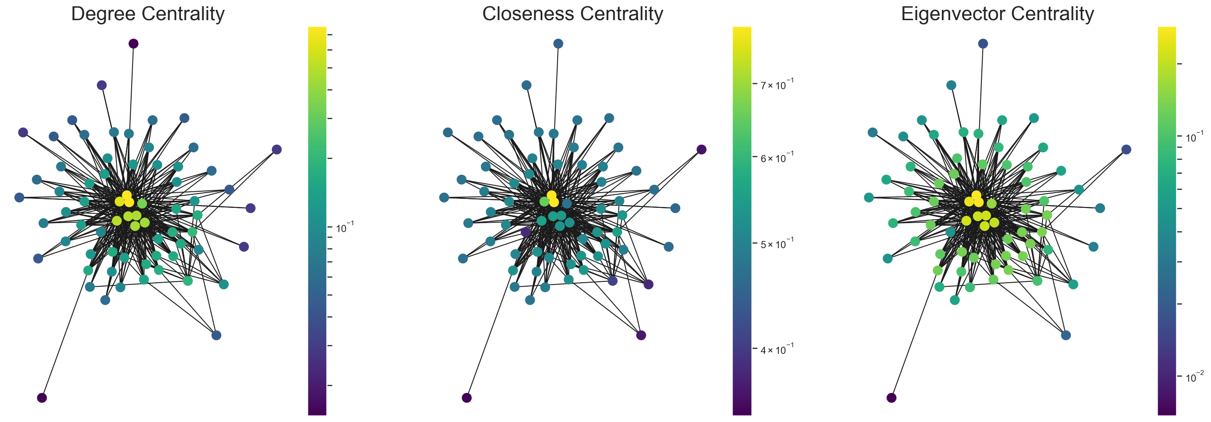
METHODOLOGY

Slide 7
THANK YOU

