Slide 1
SolSecure Iteration 1
TEAM 2
Aishwarya Kalmangi - 1001988076
Darshan Shanthveer Patil - 1001719406
Diganth Prakash - 1001965135
FNU Nikitha Padmanabha - 1001968063
Vinay Kumar Shiva Kumar - 1001959006

Slide 2
Project Plan
Features Plan:
Recognize the functionality of the Manticore and Mythril.
Should have both tools compiled and running
Use smart contracts as input for both tools

Slide 3
Project Plan
Top 5 risks
Risk 1: Not enough documentation for both Manticore m and Mythril
Risk 2: Finding smart contracts to use as inputs
Risk 3: Devices with Linux OS are not accessible.
Risk 4: Problems with team member scheduling.
Risk 5: Dependencies identified in incremental steps.

Slide 4
Project Plan
Future Features:
Manticore Features | Mythril Features
Integer Underflow | Integer Overflow
Crytic Test Balance | Reentrancy
Crytic_test_max_invariant | Uninitialised Storage Pointer
The above features from each of the tools will be combined and implemented in SolSecure.
CLI and GUI support for SolSecure will be provided.

Slide 5
Specification and Design
Setting up the environment by isolating the dependencies for each tool independently.
We did exploratory analysis for the methods that we have planned on using.
There were some challenges that were hard to tackle with each tool having a different .sol and test case file.

Slide 6
Features Implemented
Installed both Manticore and Mythril
Installed Mythril locally and verified integer arithmetic bugs like integer underflow or overflow using umd_example.sol
Installed Manticore and verified running analysis.
Implemented python script for SolSecure, integrated it with manticore API and verified token.sol [1][2][3]

Slide 7
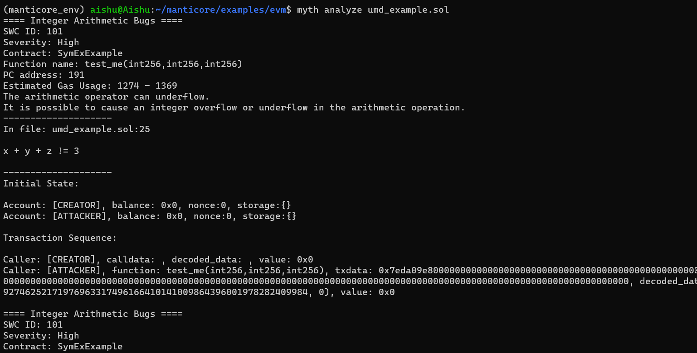
Mythril Installation and Validation

Slide 8
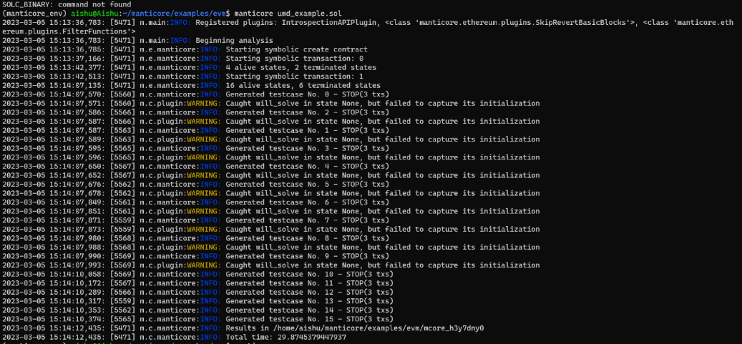
Manticore Installation and Validation

Slide 9
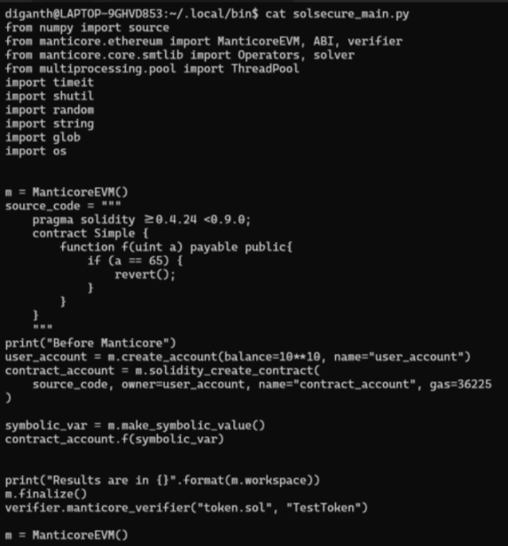
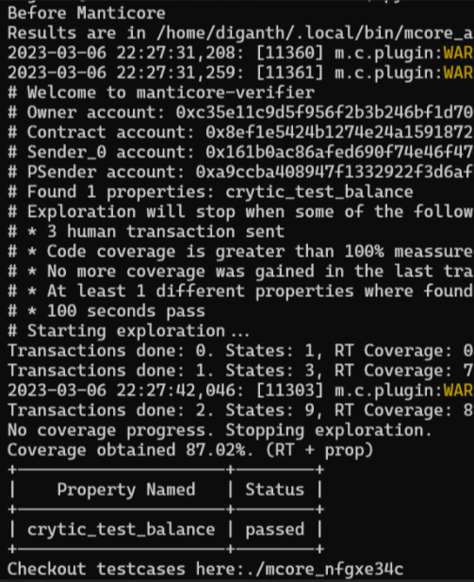
Code and Tests
INPUT
OUTPUT

Slide 10
Customers and Users
Customers: ​
Dr. Christopher Csallner​ - Provide Team Assistance and Project Feedback (Written Deliverables & Project Repo).​
GTA Mohammed Rifat - Provide Team Assistance and Project Feedback (Written Deliverables & Project Repo).​
Shovon Niverd Pereira​ - Team Collaborator for Ethereum Smart Contracts.​
Review Team 2 Members​ - Provide Project Feedback per Iteration (Written Deliverables & Code Review)
Users: ​
Class of CSE 6324-004​ - Team’s Target Audience and Possible Future Users of the Tool.​

Slide 11
References
[1] https://github.com/trailofbits/manticore
[2] https://github.com/ConsenSys/mythril
[3] https://readthedocs.org/projects/mythril-classic/downloads/pdf/latest/
[4]https://packaging.python.org/en/latest/guides/installing-using-pip-and-virtual-environments/#installing-virtualenv
[5] https://raz0r.name/writeups/polyswarm-smart-contract-hacking-challenge-writeup/
Github Repository - https://github.com/darshanspatil07/SolSecure

Slide 12
THANK YOU!
QUESTIONS?

