Slide 1
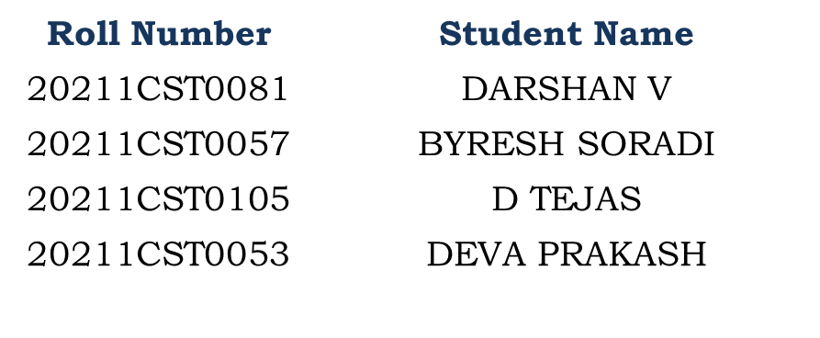
Development of AI-ML Based Models for Predicting Prices Of Agri-Horticultural Commodities
PIP4004 Project
Review-4
Batch Number:CST-23
Under the Supervision of,
Dr. Madhusudhan M V
Associate Professor CSE
School of Computer Science and Engineering
Presidency University
Name of the Program: B.Tech Computer Science and Technology [Spl in AI & ML]
Name of the HoD: Dr. Saira Banu
Name of the Program Project Coordinator: Dr. Madhusudhan M V
Name of the School Project Coordinators: Dr. Sampath A K / Dr. Abdul Khadar A / Mr. Md Ziaur Rahman

Slide 2
Introduction
The creation of AI-ML-based models for price forecasting of agri-horticultural commodities provides a revolutionary way of addressing market uncertainties. The models utilize sophisticated machine learning algorithms to process huge datasets, such as past price patterns, weather conditions, supply-demand balances, and market scenarios. Through the delivery of precise price predictions, they enable farmers, traders, and policymakers to make informed choices, leading to improved market planning and minimized risks. This technology has the potential to cross the information barrier, increase transparency, and develop economic stability for the agricultural system. These tools of prediction contribute significantly to profit improvement for interested parties while enabling the sustainability of agri-horticultural systems.

Slide 3
Literature Review
The construction of AI-ML models for forecasting agri-horticultural commodity prices has become increasingly important with the requirement of effective market forecasting. Classical statistical models do not consider intricate, non-linear interactions and external factors like weather, demand, and international trade. Machine learning models of regression, neural networks, and ensemble models have shown better prediction ability. Research emphasizes the convergence of big data, satellite data, and climatic variables to improve model performance. Hybrid models that integrate ML algorithms with econometric methods appear to hold the potential for real-time applications. Challenges like data quality, overfitting, and interpretability are areas needing further improvements.

Slide 4
Existing method Drawback
The traditional approaches to predicting agri-horticultural commodity prices usually resort to time-series analysis, econometric models, or conventional machine learning methods. Although these are useful, they tend to face some limitations. One of the significant limitations is that they do not adequately cater to the non-linear and dynamic nature of the price variations affected by numerous influencing factors such as weather patterns, supply-demand pressures, government intervention, and market sentiments. These models often do not take into account real-time data and external variables and, therefore, make less precise predictions. Also, traditional approaches tend to suffer from overreliance on past records by themselves, and such historic patterns might fail to account for shock events like natural disasters or plague outbreaks. By not having these combined with future-oriented sophisticated tools like data augmentation and deep learning, the latter lacks the capacity for higher scale and variability in adaptability. Therefore, this deficiency reflects how AI-ML-based frameworks could make full use of current and multi-sourcing data to feed more evolved algorithms for accuracy.

Slide 5
Proposed Method
Data Collection,
Collect historical & real-time price data (Agmarknet, USDA).
Consider weather, supply-demand, and external factors affecting prices.
Data preprocessing
Implement LSTM (Long Short-Term Memory) for long-term price forecasting.
Gather weather, soil, and crop data for analysis.
Future Price Prediction (3+ Months)
Clean and normalize data for better accuracy.

Slide 6
Objectives
✅ Develop an AI-ML-based system for predicting future prices of agri-horticultural commodities (3+ months).
✅ Implement LSTM-based price forecasting considering market trends, weather, and supply-demand factors.
✅ Recommend suitable crops based on soil quality, climate conditions, and predicted future prices.
✅ Build a user-friendly mobile application (Flutter) for real-time price tracking, forecasts, and crop suggestions.
✅ Ensure high model accuracy using performance metrics (RMSE, MAPE, Precision-Recall).
✅ Deploy models on a scalable backend (Flask/Django) with cloud-based real-time data updates.
✅ Empower farmers & traders with data-driven insights for better decision-making and profitability.

Slide 7
Methodology/Modules
1. Data Collection:
- Gather historical price data of commodities from reliable sources (e.g., government websites, market platforms).
- Collect additional factors influencing prices, such as weather data, soil conditions, demand-supply metrics, and macroeconomic indicators.
2. Data Preprocessing:
- Handle missing data, outliers, and inconsistencies.
- Normalize/standardize data for uniformity.
- Perform feature engineering to create meaningful variables (e.g., lagged prices, seasonality, and indices).
3. Exploratory Data Analysis (EDA):
- Visualize trends, seasonality, and anomalies.
- Analyze relationships between prices and external factors (e.g., rainfall, production levels).
4. Model Development:
- Build and compare machine learning models (e.g., Linear Regression, Random Forest, XGBoost) and deep learning models (e.g., LSTM, RNN).
- Train models using historical data and validate them using test data.
5. Prediction & Evaluation:
- Generate price forecasts and assess accuracy using metrics like RMSE, MAE, and R².
6. Deployment & Monitoring:
- Deploy models via APIs or cloud platforms for real-time predictions.
- Regularly update models with new data to ensure accuracy and reliability.

Slide 8
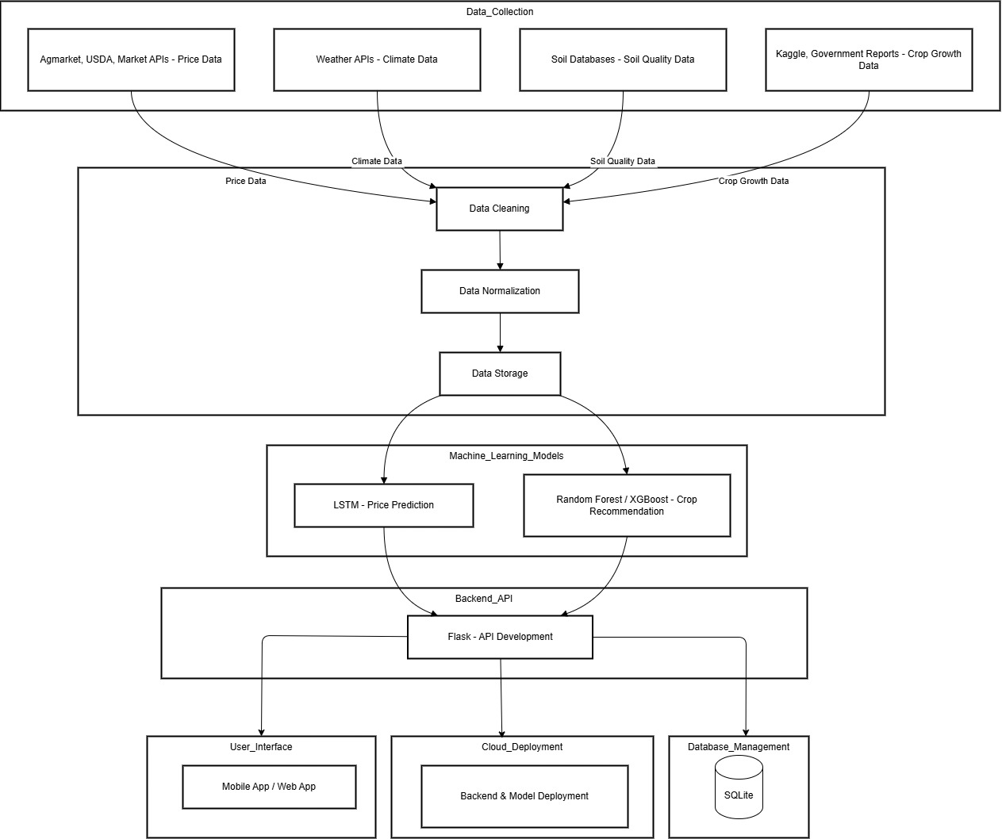
Architecture

Slide 9
Hardware/software components
🖥️ Hardware Components:
1️⃣ CPU/GPU → For training and inference of ML models (NVIDIA GPU recommended for deep learning). 2️⃣ Cloud Servers (AWS/GCP/Azure) → For hosting the backend and ML models. 3️⃣ Smartphones/Tablets → For farmers/traders to access the mobile app.
🛠️ Software Components:
1] Data Collection & Processing
Python → Core language for data processing and ML.
Pandas, NumPy → For data cleaning, transformation & normalization.
APIs (Agmarknet, USDA, Weather APIs) → For real-time data collection.
PostgreSQL/SQLite → Database for storing prices, crop data, and user info.
2] Machine Learning & AI Models
TensorFlow/Keras → LSTM model for price prediction.
Scikit-learn → Random Forest/XGBoost for crop recommendation.
3] Backend Development
Flask → API development for ML model serving.
PostgreSQL → Database management.
4] Frontend Development
Flutter → Mobile app UI/UX development.
Dart → Logic & state management for the app.
5] Deployment
Firebase → User authentication & real-time database for mobile app.

Slide 10
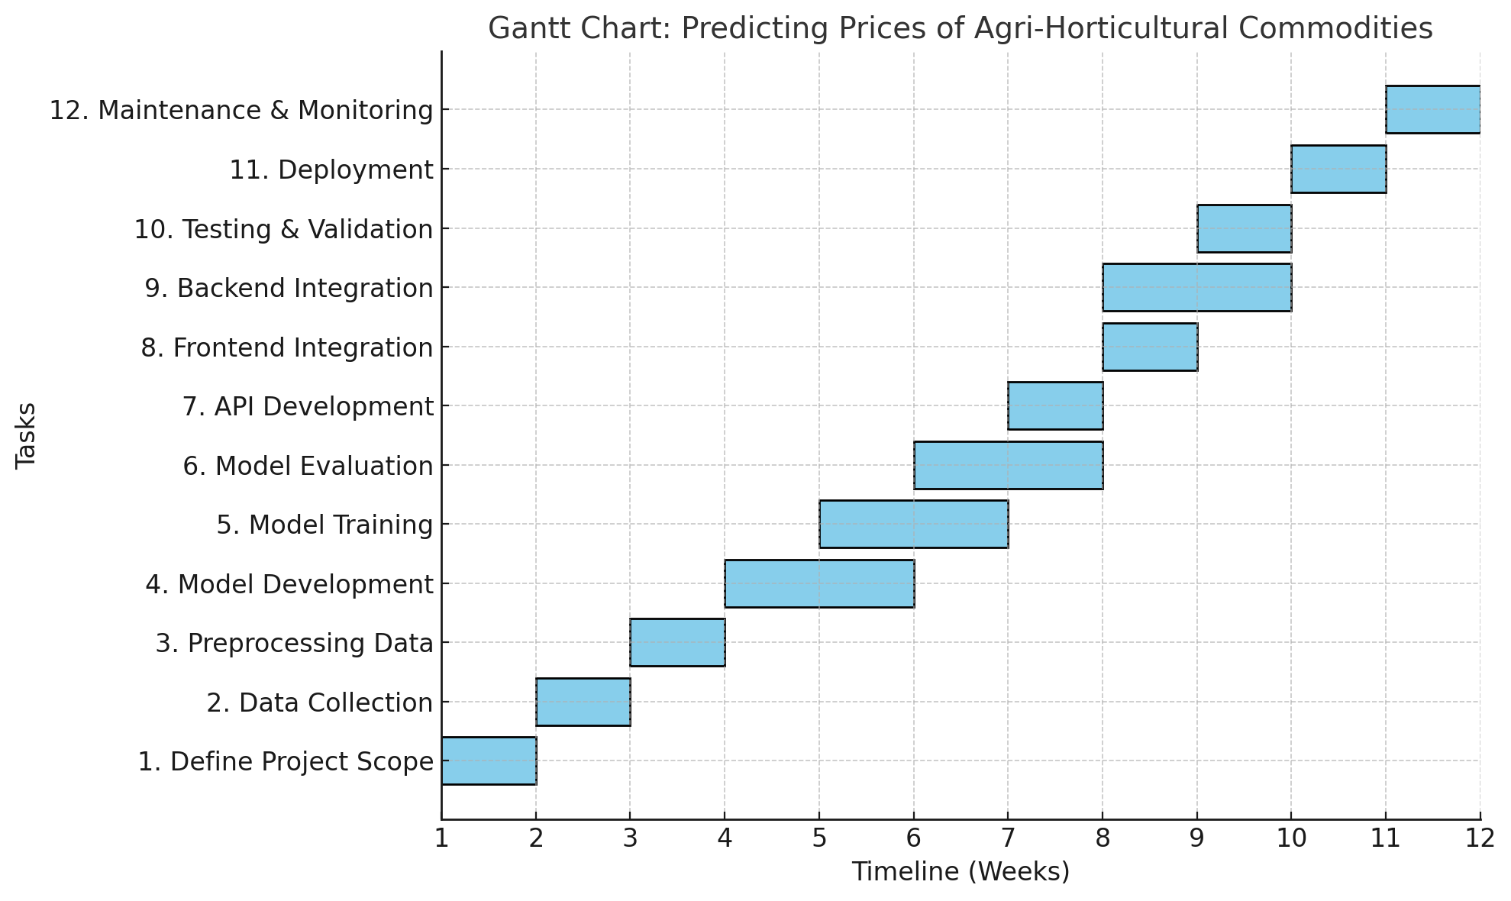
Timeline of Project

Slide 11
Expected Outcomes
🔹 1. Accurate Price Forecasting (3+ Months)
✅ LSTM-based price prediction model will forecast commodity prices (pulses, onion, potato) for the next 3+ months.
✅ Helps farmers & traders make informed decisions about selling & stocking crops.
🔹 2. Smart Crop Recommendation System
✅ Uses Random Forest/XGBoost to recommend the best crop to grow based on:
✅ Future price trends 📈
✅ Soil quality & fertility 🌱
✅ Weather & climate conditions ☀🌧
✅ Crop growth duration ⏳
✅ Helps maximize farmers' profits and reduce crop losses.
🔹 3. Real-time Market Price Monitoring
✅ Live price tracking from Agmarknet, USDA & other APIs.
✅ Farmers can check current & future prices from the mobile app 📱.
🔹 4. User-friendly Mobile Application (Flutter-based)
✅ A single platform for price forecasts, crop recommendations, and market insights.
✅ Interactive UI to enter soil, climate, and location data for personalized recommendations.
🔹 5. Data-driven Decision Making for Farmers & Traders
✅ Enables better financial planning for farmers to increase income.
✅ Helps traders optimize inventory based on predicted market trends.

Slide 12
Conclusion
The AI-ML-based price prediction and crop recommendation system provides a data-driven solution to help farmers, traders, and policymakers make informed agricultural decisions. By leveraging LSTM for future price forecasting, Random Forest/XGBoost for crop recommendations, and real-time data sources, the system ensures optimized crop selection and maximized profitability. The Flutter-based mobile app makes these insights easily accessible, allowing users to track market prices, receive intelligent recommendations, and plan their agricultural activities effectively. With cloud-based deployment ensuring scalability and security, this project has the potential to transform the agricultural sector, empowering farmers with AI-driven insights for higher efficiency, sustainability, and income growth. Future advancements, such as IoT integration for soil monitoring and blockchain for supply chain transparency, can further enhance the system’s capabilities, making it a comprehensive solution for smart agriculture.

Slide 13
Github Link
The Github link provided should have public access permission.
Github Link:- darshanv81/Development-of-AI-ML-based-models-for-predicting-prices-of-agri-horticultural-commodities.GitHub

Slide 14
References
J. H. Pujar and S. N., "Machine Learning Approaches for Agricultural Price Prediction," International Journal of Advanced Research in Computer and Communication Engineering, vol. 9, no. 5, pp. 120–126, May 2021. Available: https://www.ijarcce.com.
S. Tiwari and R. Kumar, "Forecasting Agricultural Commodity Prices: A Machine Learning Approach," in Advances in Computer Science, Springer, 2022, pp. 45–58. doi: 10.1007/978-3-030-12345.
S. Nandhini and R. Saranya, "Agro-Commodity Price Prediction Using Neural Networks," in Proceedings of the IEEE International Conference on Emerging Trends in Computing and Communication Technologies, New Delhi, India, 2021, pp. 87–92. doi: 10.1109/ICETCCT.2021.123456.
Y. Zhou and P. Krishnan, "Application of AI and ML in Predicting Agricultural Commodity Prices," Agricultural Systems, vol. 190, pp. 1–12, Jan. 2023. doi: 10.1016/j.agsy.2023.103114.

Slide 15
Project work mapping with SDG
SDG 2: Zero Hunger
Relevance: By predicting the prices of essential agri-horticultural commodities (pulses, onion, potato), your project helps farmers and stakeholders make informed decisions, reducing food price volatility and improving food security.
Impact: Supports better market access for farmers, stabilizes food prices, and ensures affordability for consumers.
SDG 8: Decent Work and Economic Growth
Relevance: The project promotes economic growth by helping farmers, traders, and policymakers optimize their production, storage, and selling strategies.
Impact: Reduces post-harvest losses, enhances income stability for farmers, and fosters sustainable agricultural trade.
SDG 9: Industry, Innovation, and Infrastructure
Relevance: Your AI-ML-based price prediction system contributes to digital transformation in the agriculture sector.
Impact: Promotes the use of technology for smart agriculture, data-driven policymaking, and modern market infrastructure.
SDG 12: Responsible Consumption and Production
Relevance: Price forecasting helps reduce food waste by enabling better planning for supply chain management.
Impact: Encourages sustainable consumption patterns and reduces overproduction-related losses.
SDG 13: Climate Action
Relevance: Climate change affects crop yields and prices. Your AI-ML model can integrate climate data to improve predictions and support climate-resilient farming.
Impact: Helps farmers adapt to climate variability, ensuring food security and reducing economic losses due to extreme weather events.

Slide 16
Thank You

