Slide 1


PHOENIX WARRIORS

Slide 2
Team Members
Rayansh Singh
Aryan Nale
Darsh Askand
Ishan Kodre
Varad Kodre
Rishit Singh
Atharva Kawade

Slide 3
Our Values
Team
Work
Self Belief
Self Confidence
Collaboration
Trust
Ethics
Creativity

Slide 4

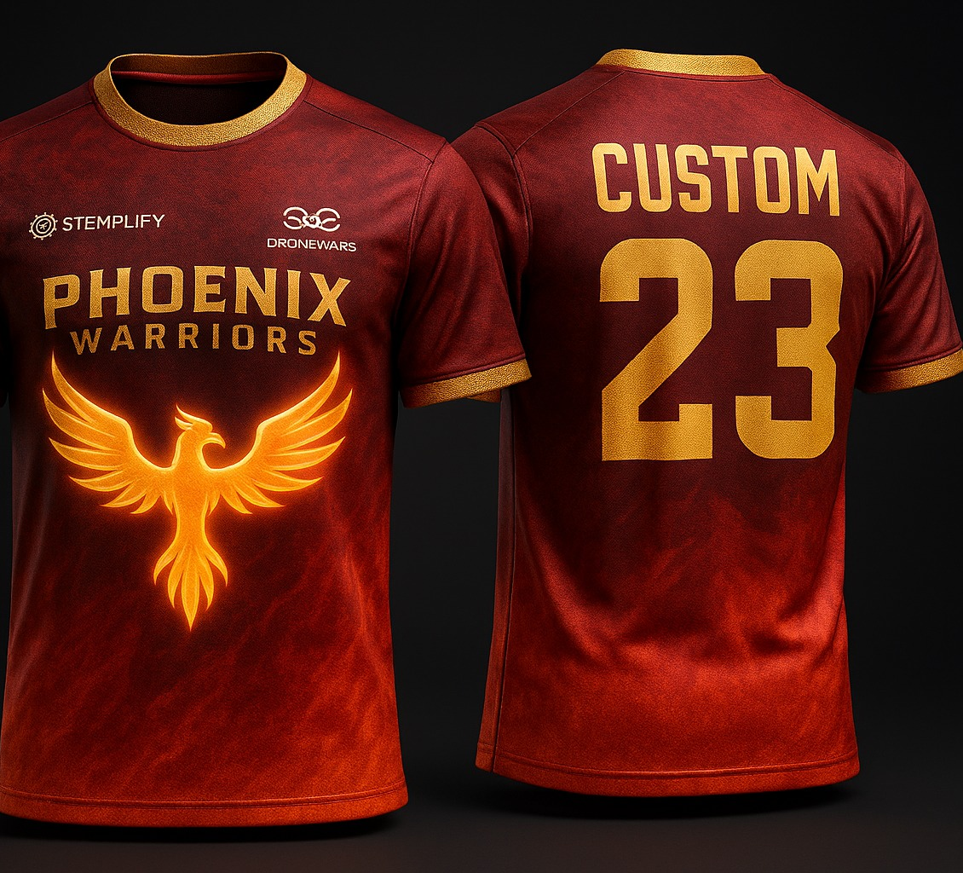
Our Logo and Jersey
Our logo is inspired by a mythical bird known as the phoenix. It is a mythological immortal bird associated with the sun, known for rising from its own ashes after dying in a fiery self-immolation, symbolizing rebirth, immortality, and resilience.
Our jersey showcases our sponsors on the chest with our team's name and logo. Whereas on back we have team member name with lucky number.

Slide 5


About Our Sponsors
STEMplify offers age-appropriate globally recognized engaging STEM programs curated in Kits, Learn & Compete patterns. The programs are delivered through a combination of in-school trainers & online platforms.
A hands-on STEM program centered on designing, learning the concepts, assembling, and flying drones. It fosters skills in STEM, igniting curiosity and exploration in the world of drones.

Slide 6

What Is Aerodynamics?
Aerodynamics is the way objects move through air. The rules of aerodynamics explain how an airplane is able to fly.
Anything that moves through air is affected by aerodynamics, from a rocket blasting off, to a kite flying.
Since they are surrounded by air, even cars are affected by aerodynamics.

Slide 7
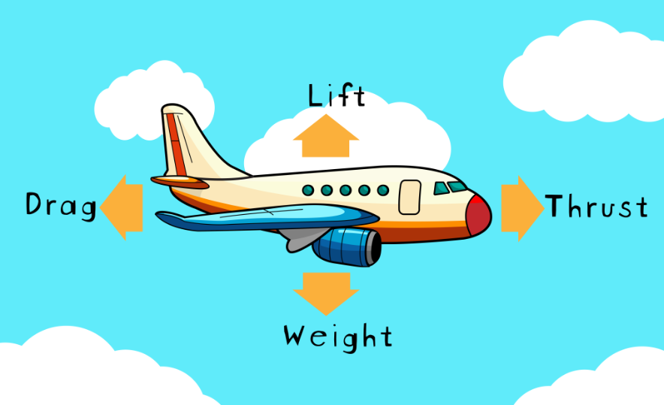
What Are the Four Forces of Flight?
The four forces of flight are lift, weight, thrust and drag.
These forces make an object move up and down, and faster or slower.
The amount of each force compared to its opposing force determines how an object moves through the air.

Slide 8

Thank You!

