Slide 1
Name: Darsh Dake
Roll no.: ML-A-009
Enrollment no.: 200103062012

Slide 2
Rekognition

Slide 3
It is cloud based computer vision service offered by AWS which can be used to perform various image and video analysis tasks such as object and scene detection, face detection, face comparison, facial analysis, PPE detection etc.
It uses deep learning to analyze images and videos to detect scene, faces and objects and provides high degree of accuracy.
It can detect and analyze faces from image and video, including facial recognition, emotion detection, gender detection, landmarks of ones face, image quality, even estimates age range, etc.
Also features like celebrity recognition, text detection from printed and even hand written text, face search for collection of faces, video analysis for frame-by-frame object, face or scene detection, trace them across multiple frames.
It can be useful for developers and businesses to analyze images and videos at minimal pricing and leverage the advances in computer vision without heavy investments on infrastructure or machine learning expertise.

Slide 4
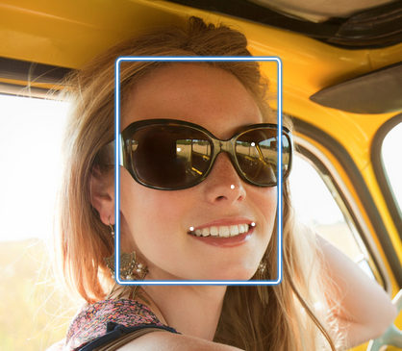
Detect Faces
When we use detect_faces() then it will give response containing location of face with bounding box, age range, smile, eyeglasses, sunglasses, gender, beard, mustache, eyesopen, mouthopen, emotions, landmarks, pose, quality and confidence.
We need not to train any cnn model for it just upload image and call in function and we get our response in json format which can be easily handled by any programming language.

Slide 5
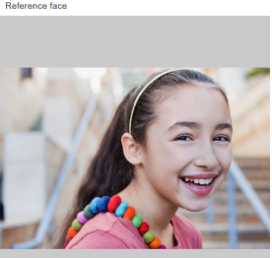
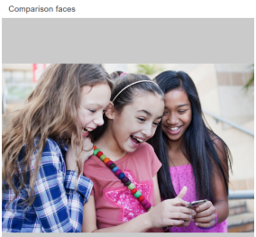
Compare Faces
compare_faces() used for it, which requires source and target image. We need to specify similarityThresold to specify that only consider similar if certain percentage of similarity is achieved.
It will respond with json response containing face data with boundingbox, confidence, pose, landmarks, quality, and its similarity. Same data for unmatched face except similarity and sourceimagedata like boundingbox and confidence.

Slide 6
Why use Rekognition
It can detect, analyze and compare faces for use cases like public safety, user verification, counting number of people, etc.
Quick, simple, easy to use without any advanced knowledge of machine learning and deep learning algorithms.
It can be easily integrated with various other services like Lambda, to request to process image data and save response to other services like RDS, S3 etc.
It has best accuracy as compared to other cloud services and far better than open source libraries as AWS keeps on training on images that we use to perform some operation using rekognition service.
With its APIs, we can integrate these capabilities to our software to automate some repeating processes like security surveillance, presence of person, etc.
It is based on pay-as-you-go. We only need to pay for number of images processed.

Slide 7
Advantages of Rekognition over open-source libs
Easy Integration: It provides APIs to integrate it into our application without using those open-source libraries in our application which would not even give accuracy as rekognition.
Scalable: As it is cloud based, so it can handle any number of images.
Accuracy: Trained on all types of images so we not need to train model just give the images it will process them and gives better accuracy then those libraries.
Secure: It is more secured than open-source libs.
Custom models: Allows user to create custom model with specific needs, which is hard to do using open-source libraries.

Slide 8
Thank You

