Slide 1
Name: Darsh Dake
Roll no.: ML-A-009
Enrollment no.: 200103062012

Slide 2
Textract

Slide 3
It is cloud based OCR(Optical Character Recognition) service provided by AWS.
It helps to extracts text data from scanned documents, PDF and images. It can even extract text from hand-written document and has support to numerous languages world wide.
It can also identify key-value pair and table data and output them in structured format like CSV, JSON or XML.
It always learns from new data and Amazon is continually adding new features to the service.
It is based on deep learning technology and is highly scalable and easy to use.
It is a strong tool for automating document processing tasks like scanning documents, extracting data from forms, invoices, receipts etc., and enabling text search on scanned documents.

Slide 4
Textract Working
Once we upload file and call textract function then it preprocesses image by removing unwanted artifacts that might affect quality of OCR.
It identifies page boundaries and separates input document into single pages.
It applies machine learning algorithms to detect and recognise text data and uses OCR to convert it to machine readable form.
It recognise text data and extracts structured data like tables, forms, key-value pairs from document.
Atlast it provides with JSON format response which can be easily integrated with any application.

Slide 5
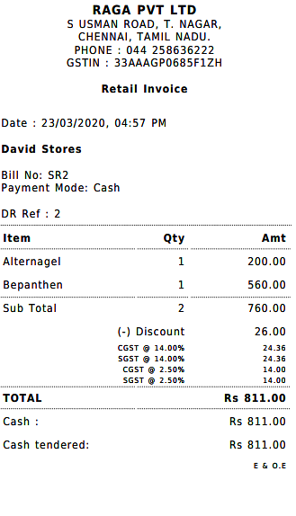
Suppose we have a image of bill then amazon textract will recognise each and every letter, word, line from this image and will provide us with json response.
We can extract amount printed on this bill and can analyze texts like vendor name, date, number, from this type of common occurring images. Hence we can automate such process. Also can monitor spendings, spending patterns
We use detect_document_text() to extract text data from this bill which will respond with textmetadata, blocks, blocktype which may have addition attribute like text, confidence, geometry and relationships.

Slide 6
Why use Textract
It is so well trained that is OCR is beat in the world and it can even extract text data from low quality images.
We can extract text data from images, PDFs, and also scanned documents including from tables and forms using it.
It can be easily integrated with other AWS services like S3 and lambda. Also with other applications.
It is specially trained to handle different data of different types like receipts, books, printed bills, documentations, so it acts accordingly.
It extracts data in key-value pair so its structured well so it can be easily handled by any programming language to perform operation on the response.

Slide 7
Advantages over open-source libraries
Scalability: It can handle any amount of documents while open-source libraries would require particular infrastructure to process that amount of documents.
Pay-as-you-go: Large cost saving as we only need to pay for documents processed while open-source libraries will require additional hardware devices and its capex and opex cost would increase.
Automatic classification: It has ability to classify documents which helps developers to develop faster while using open-source libraries would take to time and effort.
Accuracy: As said earlier, it is one of the world’s best OCR algorithm so it has very high accuracy and can extract data from low quality images.

Slide 8
Thank You

