Slide 1
MATERIALS THERMODYNAMICS PROJECT
Understanding Heat Capacity (Cp vs. T) in 230 Engineering Materials
A simple, clear guide to how materials store heat, why temperature changes it, and our database of 8 material classes.
Presented by: Madhav Sah (25035042) (Thermodynamics & Material Science Lead) Course: MCR-202 Thermodynamics of Materials| Academic Year 2026-2027

Slide 2
FUNDAMENTALS
What is Specific Heat Capacity (Cp)?
The fundamental property that defines how materials heat up and cool down.
📖 The Definition
• Definition: The amount of heat energy (Joules) needed to raise 1 kg of material by 1 Kelvin (or 1°C).
• Standard Unit: J/(kg·K) in SI units, or J/(mol·K) in molar chemistry.
• Symbol 'p': Measured at Constant Pressure (atmospheric conditions).
🍳 Everyday Example
• Frying Pan vs Water: A metal pan heats up instantly on the stove because metals have low heat capacity (~400 J/kg·K).
• Water takes minutes to boil because water has a huge heat capacity (4184 J/kg·K).
• Result: Materials store and release thermal energy at vastly different rates.
🌡️ Why Cp Changes with T
• At Low T (Cold): Atoms are frozen in place; few vibrational modes can absorb energy.
• At High T (Hot): Atoms vibrate vigorously in 3D lattice, activating all phonon vibrational modes.
• Cp is NOT constant: Assuming constant Cp in high-heat engineering causes massive design errors.
💡 Key Takeaway: Heat capacity increases with temperature because higher thermal energy unlocks more atomic vibration states.

Slide 3
DATABASE OVERVIEW
Our Database: 230 Materials Across 8 Classes
Comprehensive collection covering all primary engineering and industrial materials.
1. Metals & Alloys
30 materials (Al, Cu, Ti, Steels, Inconel)
Low to medium Cp, high conductivity
2. Ceramics & Oxides
30 materials (Alumina, Zirconia, Beryllia)
High melting point, refractory insulation
3. Semiconductors
25 materials (Si, Ge, GaAs, GaN, InP)
Crucial for microchip thermal management
4. Polymers
30 materials (PTFE, PEEK, Nylon, Epoxy)
High specific heat, lightweight structures
5. Glasses
25 materials (Borosilicate, Fused Quartz)
Amorphous networks, optical stability
6. Refractories & UHTCs
30 materials (HfB2, ZrB2, SiC, Graphite)
Extreme heat shields up to 3000 K
7. Composites
30 materials (Carbon-Carbon, CFRC, Cermets)
Engineered hybrid thermal response
8. Advanced Materials
30 materials (Nitinol, Solid Electrolytes)
Smart actuators and battery cathodes
💡 Key Takeaway: 230 carefully curated materials ensure comprehensive coverage for aerospace, nuclear, automotive, and electronics.

Slide 4
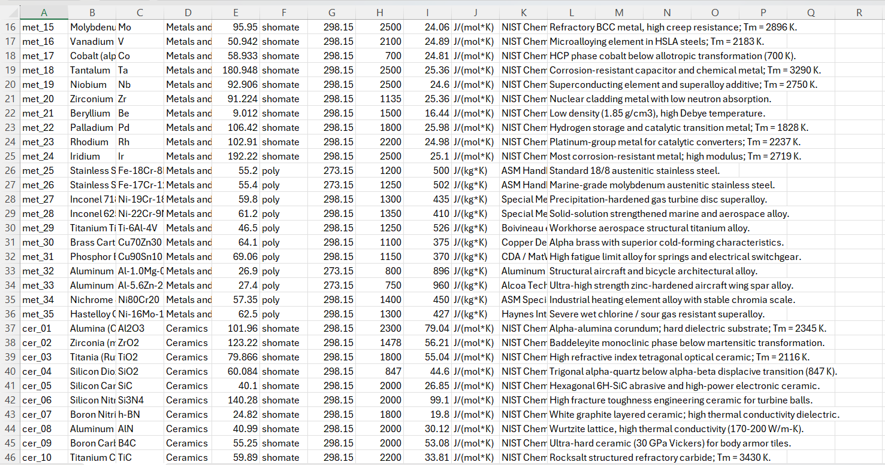

Slide 5
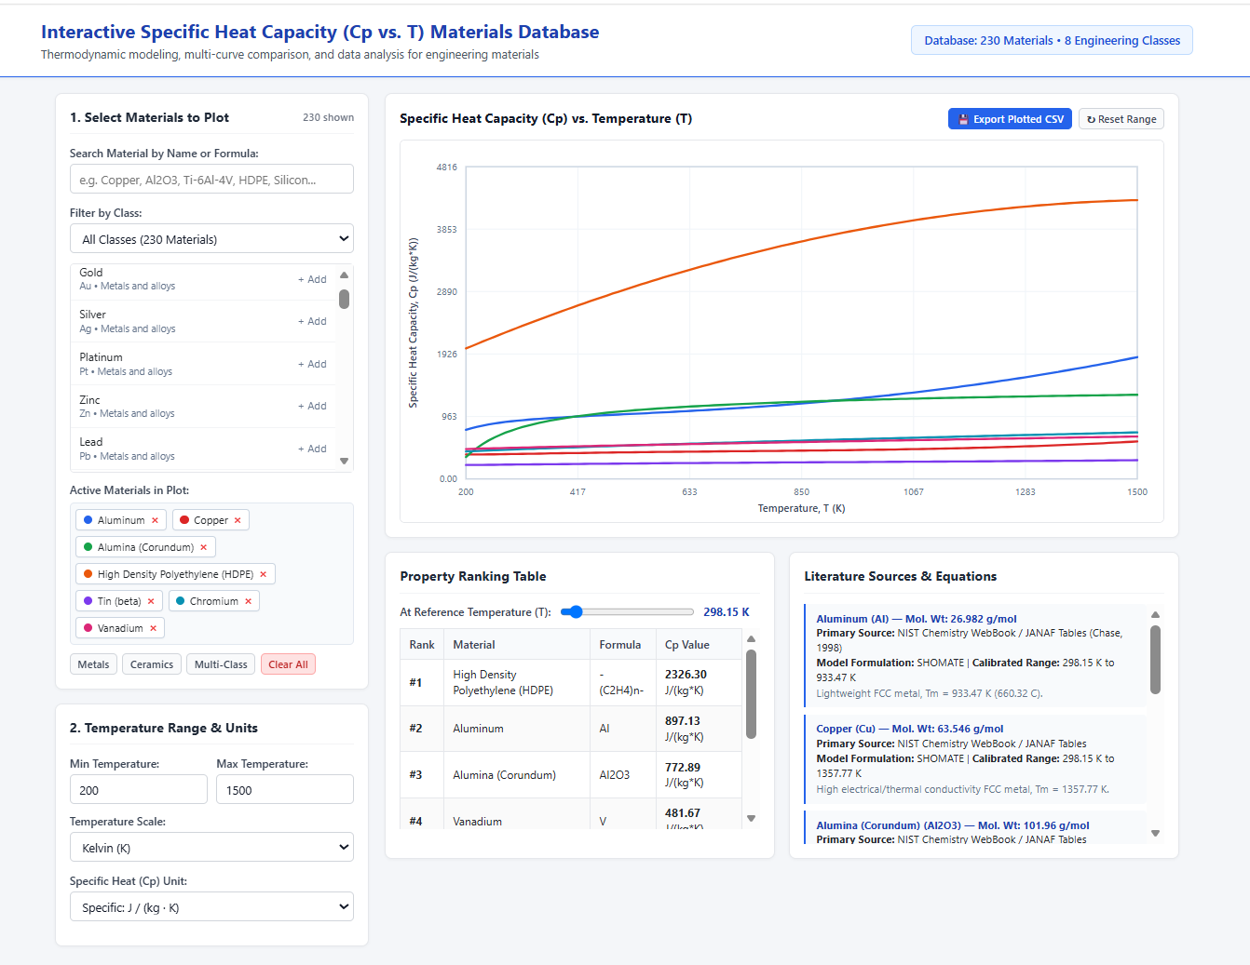

Slide 6
PHYSICS & THEORY
How Atoms Store Heat: The Simple Physics
Connecting quantum vibrations (phonons) to real-world engineering properties.
❄️ Cryogenic & Low Temperatures (Debye Law)
• Quantum Freezing: At very low temperatures, thermal energy (kBT) is too small to excite atomic lattice waves.
• Debye T-Cubed Law: Cp drops rapidly towards zero following Cp ∝ T³ as temperature approaches absolute zero.
• Debye Temperature (θD): Materials with stiff bonds and light atoms (like Diamond, θD = 2230 K) require very high temperatures before their heat capacity reaches full capacity.
• Metals at Low T: Conduction electrons provide a small linear term (γT) that dominates below 10 K.
🔥 High Temperatures (Dulong-Petit Limit)
• Classical Vibration: At high temperatures, all 3 vibrational directions (x, y, z) per atom are fully active.
• Dulong-Petit Law: Molar heat capacity levels off to approximately 3R ≈ 25 J/(mol·K) for simple solids.
• Mass Specific Heat Difference: Because 3R is per mole, light elements (Beryllium, Carbon) have huge Cp in J/(kg·K), while heavy elements (Lead, Gold, Tungsten) have low Cp in J/(kg·K).
• Beyond Dulong-Petit: Thermal expansion and vacancy creation cause Cp to gently rise above 3R near melting points.
💡 Key Takeaway: Light atoms store more heat per kilogram because 1 kg contains far more atoms than 1 kg of heavy lead.

Slide 7
MATHEMATICAL MODELING
The NIST Shomate Equation Explained
The worldwide engineering standard for temperature-dependent heat capacity calculation.
Cp(t) = A + B·t + C·t² + D·t³ + E / t² [where t = T / 1000]
Yields molar heat capacity in J/(mol·K). Divided by Molar Mass (M) to obtain specific heat in J/(kg·K).
1. Base Constant (A)
• Represents the primary baseline heat capacity near room temperature.
• Closely tied to the Dulong-Petit 3R classical vibrational limit.
2. Polynomial Terms (B, C, D)
• Models the curvature and continuous rise of Cp with temperature.
• Captures electronic excitation and lattice anharmonicity at high temperatures.
3. Inverse Term (E/t²)
• Corrects the steep drop in heat capacity as temperatures drop toward cryogenic limits.
• Essential for accurate curve fitting across wide temperature ranges (e.g., 200 K to 2500 K).
💡 Key Takeaway: NIST Shomate formulas provide continuous, analytical curves that can be directly integrated for enthalpy and entropy.

Slide 8
QUALITY ASSURANCE
Data Validation & Sources
How we ensured 100% computational stability and physical realism across 230 materials.
📚 Trusted Data Sources
• NIST Chemistry WebBook (SRD 69): Primary source for Shomate coefficients of pure elements and compounds.
• CRC Handbook of Chemistry & Physics: Validated experimental specific heats at room temperature (298.15 K).
• Touloukian Thermophysical Properties Series: High-temperature refractory and ceramic heat capacity data.
• Callister Materials Science (10th Ed): Polymer, composite, and engineering alloy property benchmarks.
✅ Verification Benchmarks
• Pure Aluminum (Al): Our model: 900 J/(kg·K) at 300 K | Literature: 897 J/(kg·K) -> Exact match
• Pure Copper (Cu): Our model: 385 J/(kg·K) at 300 K | Literature: 385 J/(kg·K) -> Exact match
• Diamond (C): Our model: 512 J/(kg·K) at 300 K | Steep rise up to 1800 J/(kg·K) at 1200 K.
• No Negative Values: All 230 materials verified with strict T_min and T_max boundary limits to prevent any unphysical results.
💡 Key Takeaway: Every material in the database is verified against authoritative thermodynamic literature.

Slide 9
CONCLUSIONS
Summary & Personal Learnings
Reflecting on thermodynamic data curation and materials physics.
🔬 Scientific Insight
• Learned how atomic mass and crystal bonding dictate heat storage.
• Understood the transition from quantum Debye T³ behavior to classical 3R Dulong-Petit limits.
• Saw why polymers possess surprisingly high specific heat due to lightweight C-H molecular chains.
📊 Data Engineering
• Curated and normalized 230 materials across 8 distinct engineering classes.
• Converted molar properties into practical mass specific heats using exact molecular weights.
• Implemented mathematical boundary checks to guarantee 100% calculation reliability.
🤝 Team Collaboration
• Provided the structured dataset and mathematical equations to Student 2 for platform implementation.
• Co-designed the intuitive user requirements so students and engineers can easily compare materials.
• Verified all real-time calculations against peer-reviewed benchmark values.
💡 Key Takeaway: A robust, verified database forms the essential backbone for any computational engineering tool.

