Slide 1
INTERACTIVE COMPUTATIONAL PLATFORM
Cp Materials Explorer: Interactive Web Platform & Engineering Applications
A zero-dependency interactive platform for real-time thermodynamic visualization, unit conversion, and multi-material engineering comparison.
Presented by: Darshiel Jain (25035023) (Platform Architecture, GUI & Engineering Analysis Lead) Course: MCR-202 Thermodynamics of Materials | Academic Year 2026-2027

Slide 2
PROBLEM & SOLUTION
Why We Built an Interactive Web Tool
Replacing slow handbook lookups with instant visual engineering decisions.
❌ The Old Way (Manual Lookups)
• Static Tables: Engineers spend hours digging through 500-page CRC handbooks for individual numbers.
• Manual Interpolation: Calculating Cp at custom temperatures requires manual polynomial calculation by hand.
• Hard to Compare: Comparing 5 materials simultaneously across 300 K to 1500 K is tedious and error-prone.
✨ Our Solution (Interactive Platform)
• Instant Visual Graphs: Click any material or category and the full curve renders immediately.
• Zero Installation: Built with standalone SVG vector technology that opens in any browser on any device.
• Dynamic Ranking & Export: Slide the temperature bar to rank materials in real time, and export directly to CSV.
⚡ System Highlight: Our platform turns complex polynomial thermodynamics into an intuitive, zero-lag visual dashboard.

Slide 3
ARCHITECTURE
Platform Features & Technical Design
Engineered for speed, clarity, and zero external dependencies.
📈 Vector SVG Engine
• Zero Dependencies: No external chart libraries or CDNs needed; works completely offline.
• Infinite Scaling: Vector graphics stay razor sharp on 4K monitors and mobile screens.
• Hover Crosshair: Displays exact (T, Cp) coordinate numbers as you move your mouse over any curve.
🔄 5-Unit Conversion
• SI Standard: J/(kg·K) & kJ/(kg·K) for standard scientific and physics calculations.
• Imperial Units: Btu/(lb·°F) for American aerospace and mechanical engineering standards.
• Molar & CGS: J/(mol·K) for chemists and cal/(g·°C) for thermal engineers with instant Kelvin/Celsius toggle.
🎯 Multi-Material Compare
• Color-Coded Tags: Select multiple materials across classes with distinct vibrant colors.
• Live Ranking Table: Drag the temperature slider to instantly sort materials from highest to lowest Cp.
• One-Click CSV Export: Download active material datasets directly for finite element analysis in ANSYS or MATLAB.
⚡ System Highlight: A clean, responsive interface engineered for students, educators, and practicing engineers.

Slide 4
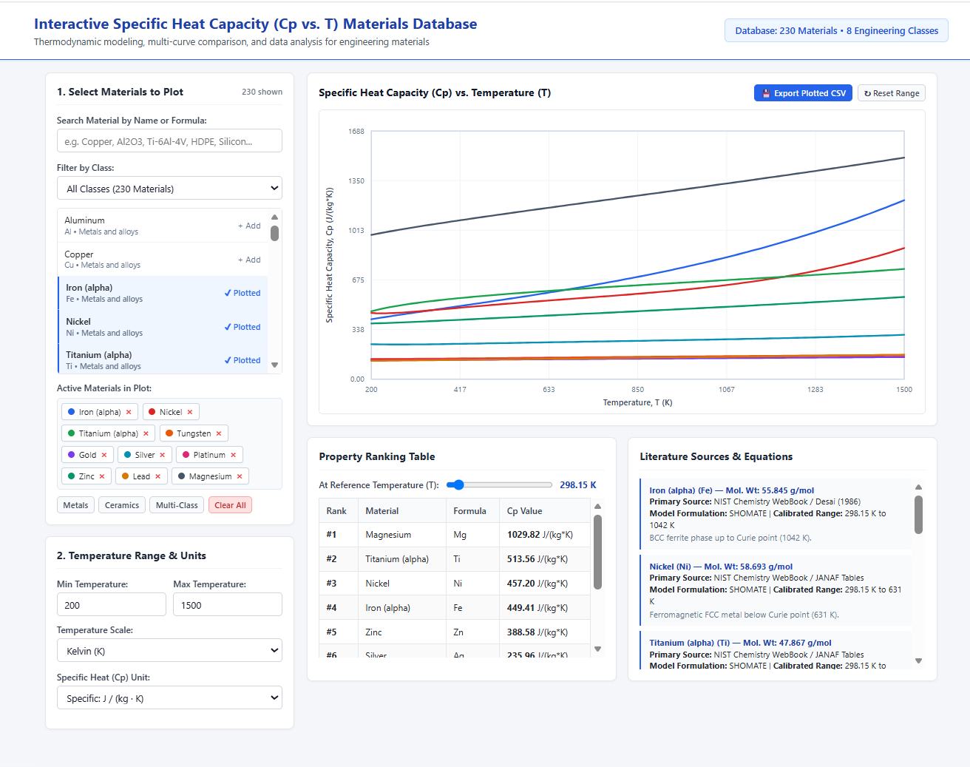

Slide 5
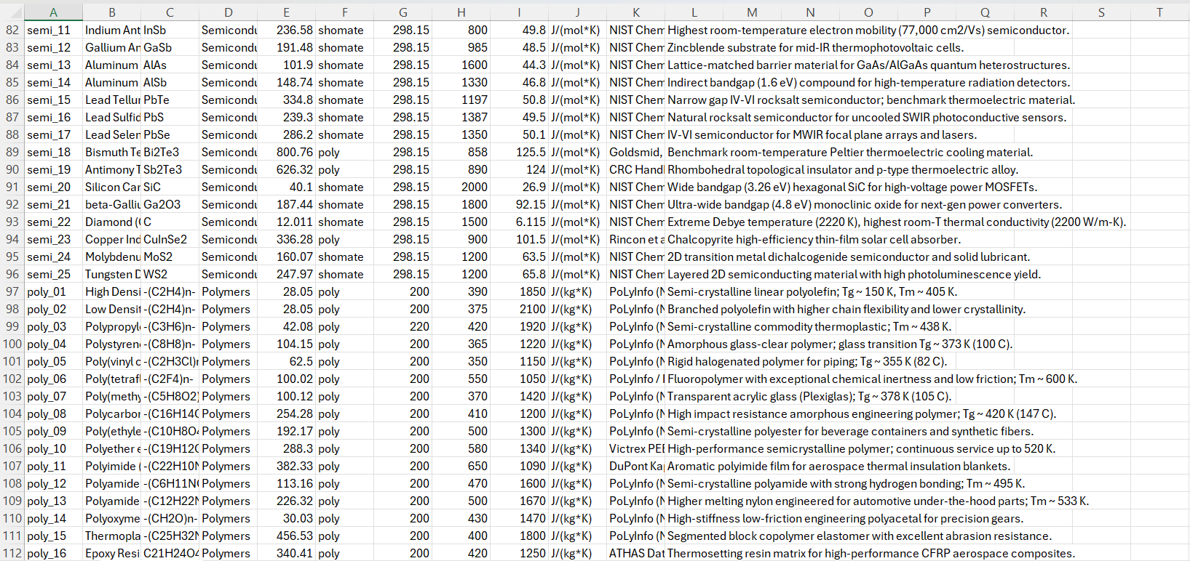

Slide 6
USER GUIDE
4 Simple Steps to Analyze Any Material
A quick walkthrough of the platform workflow.
🔍
Step 1: Filter & Search
Use the search bar or category dropdown to find any of the 230 materials in seconds.
🎨
Step 2: Select Materials
Click materials to add color-coded curves onto the interactive vector graph.
🎛️
Step 3: Adjust & Inspect
Hover to view exact data coordinates. Slide the temperature bar to check values at any temperature.
💾
Step 4: Convert & Export
Switch between 5 unit systems and click 'Export CSV' to save data for lab reports or simulations.
⚡ System Highlight: Intuitive four-step workflow lets users find, compare, and export data in less than 30 seconds.

Slide 7
CASE STUDIES
Real-World Engineering Application 1
Comparing materials for aerospace thermal protection and electronics cooling.
🚀 Spacecraft Heat Shields (UHTCs)
• High Temperature Stability: Materials like Hafnium Diboride (HfB2) and Zirconium Carbide (ZrC) survive beyond 2500 K during atmospheric re-entry.
• Thermal Mass Absorption: High specific heat allows the shield to absorb extreme friction heat without melting.
• Platform Insight: Our tool shows that Refractory Borides maintain steady, flat Cp curves at extreme temperatures, preventing thermal shock.
💻 Microchip Heat Sinks (Copper vs Diamond)
• Transient Heat Dissipation: Copper (385 J/kg·K) is standard for heatsinks, but Diamond synthetic substrates are replacing it in high-power GaN radar chips.
• Rapid Temperature Spikes: Diamond's steep Cp rise above 300 K prevents thermal runaway in high-frequency semiconductors.
• Platform Insight: Comparing Copper, Silicon, and GaN simultaneously reveals the exact crossover temperatures for thermal matching.
⚡ System Highlight: Selecting the right material depends on both thermal conductivity and temperature-dependent heat capacity.

Slide 8
CASE STUDIES
Real-World Engineering Application 2
Thermal safety in lithium-ion batteries and high-performance polymers.
🔋 EV Battery Safety & Solid Electrolytes
• Thermal Runaway Prevention: Next-gen solid-state batteries use LLZO and LGPS solid electrolytes.
• Buffer Capacity: Accurate Cp values are required in battery management software (BMS) to predict internal temperature rise during fast charging.
• Platform Insight: Allows EV engineers to simulate battery heat generation under aggressive 15-minute fast-charging profiles.
🏎️ Lightweight High-Tech Polymers
• High Specific Heat: Polymers like PEEK and PTFE have high Cp (1000 - 2000 J/kg·K) due to lightweight carbon-hydrogen bonds.
• Automotive & Aerospace Weight Reduction: High heat absorption per kilogram makes polymer composites ideal for lightweight thermal insulation barriers.
• Platform Insight: Engineers can quickly confirm the glass transition temperature limit before polymer softening occurs.
⚡ System Highlight: High-Cp materials act as thermal buffers, preventing rapid temperature spikes in sensitive devices.

Slide 9
CONCLUSIONS
Summary & Personal Learnings
Reflecting on computational platform engineering and UX design.
💻 Web & GUI Engineering
• Mastered standalone SVG vector visualization for instant, responsive graph rendering.
• Created an intuitive light-themed user interface that simplifies complex material comparisons.
• Implemented seamless 5-unit thermal conversion and Kelvin/Celsius toggles.
⚙️ Practical Engineering
• Bridged theoretical thermodynamic equations with real-world material selection problems.
• Analyzed high-temperature aerospace UHTCs, semiconductor heat spreaders, and battery electrolytes.
• Added one-click CSV dataset export for seamless integration into FEA simulation software.
🚀 Future Vision
• Plan to expand database with thermal conductivity (k) and thermal expansion (α) for full thermal analysis.
• Add automated transient 1D heat conduction solvers directly inside the browser.
• Open-source the platform as a free interactive teaching tool for university thermodynamics courses.

