Slide 1
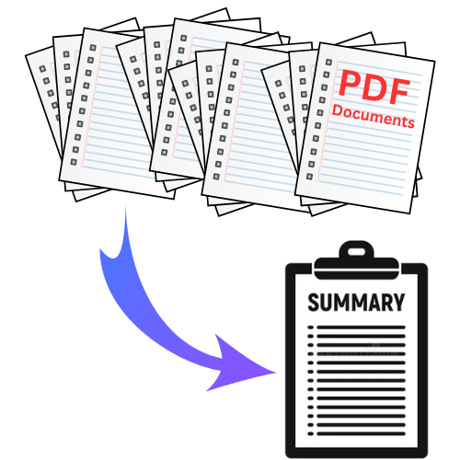
Project Report: Interactive PDF Explorer
Student Name – Darshika Verma
CISC 520-90- O-2024/Fall
Data Engineering and Mining

Slide 2
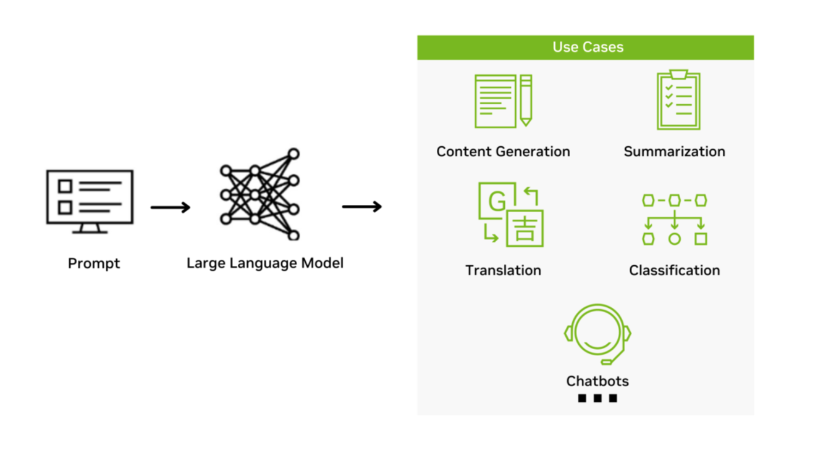
LLM Model
An LLM (Large Language Model) is an AI model trained on massive text datasets using deep learning (transformer architectures) to understand and generate human-like language, enabling it to handle complex language tasks with high accuracy.
Workflow:
Prompt: User inputs a query.
Processing: LLM processes it using neural networks.
Output: Generates a tailored response.
Use Cases:
1. Content Generation
2. Summarization
3. Translation
4. Classification
5. Chatbots

Slide 3
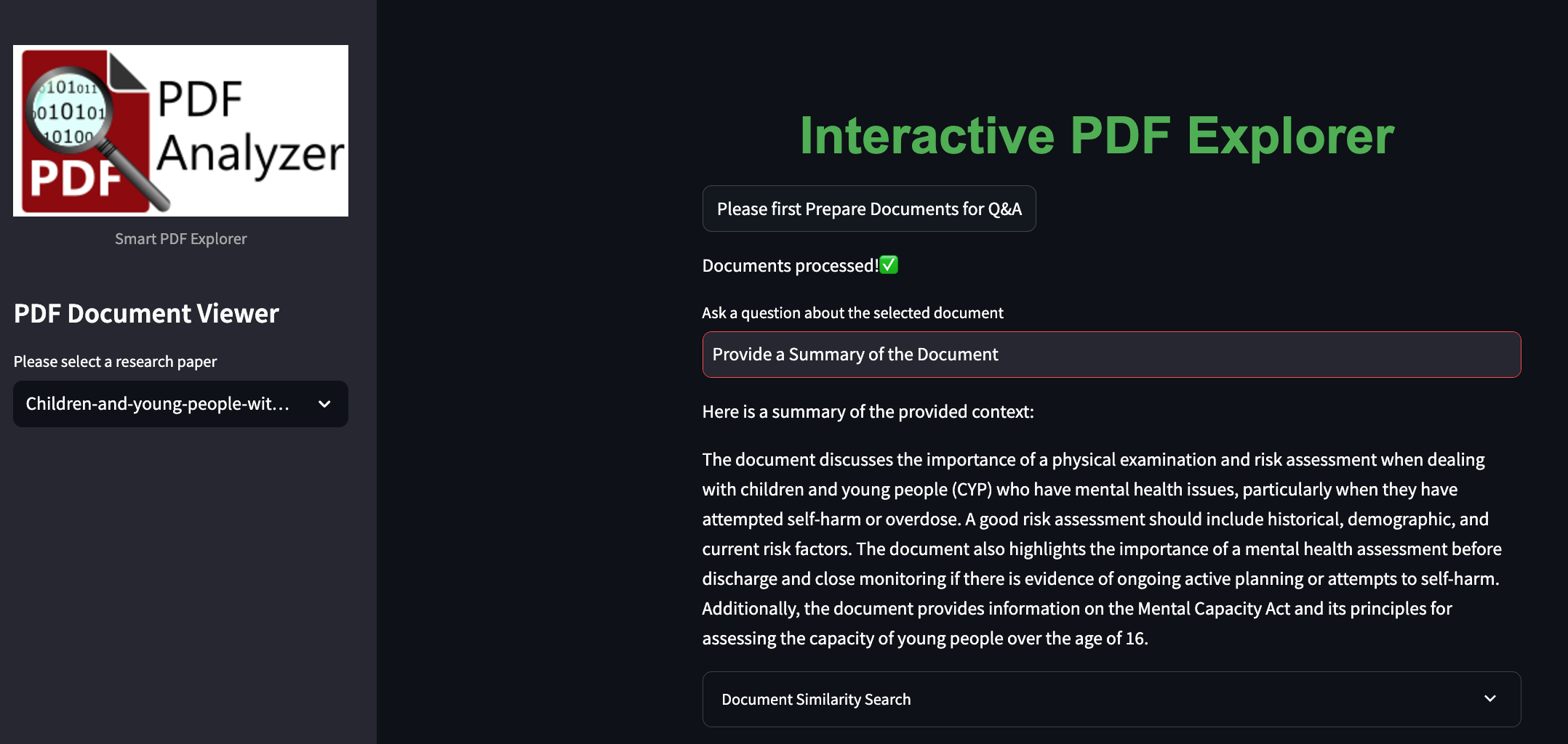
Introduction
The application utilizes Groq AI's inferencing engine, powered by advanced LLMs like Llama 3 and Mistral, for precise and efficient answer generation. Groq's unique LPU technology ensures faster inference, lower latency, and energy efficiency compared to GPUs.
The project aims to develop a robust, AI-powered application capable of extracting meaningful insights from PDF documents using natural language queries.
It is designed to simplify and enhance research and document exploration, catering to users from various fields like academia, business, healthcare, and more.
By leveraging advanced NLP and AI models, the application provides precise, context-aware answers to user queries, saving time and effort spent navigating complex, lengthy documents.
The tool empowers users to analyze docs. such as research papers, technical manuals, and reports with ease, enabling efficient information retrieval and knowledge generation.
Model | Developed By | Known For
Llama 3 | Meta | Contextual accuracy and language understanding.
Mistral | Mistral AI | Speed and efficiency in generating responses.

Slide 4
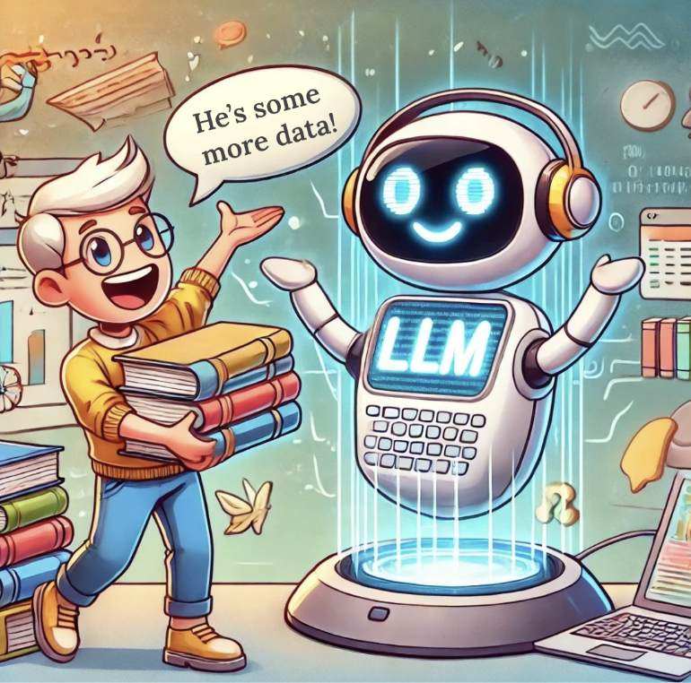
Uses of Interactive PDF Explorer
Academic Research: Quickly extract key insights from research papers, theses, and articles.
Business Analysis: Analyze reports, contracts, and financial documents efficiently.
Legal Sector: Search for clauses or precedents in legal documents.
Content Summarization: Generate summaries and key points from large texts.
Customer Support: Provide instant answers from product manuals or FAQs.
Healthcare: Extract critical data from clinical trials or medical guidelines.

Slide 5
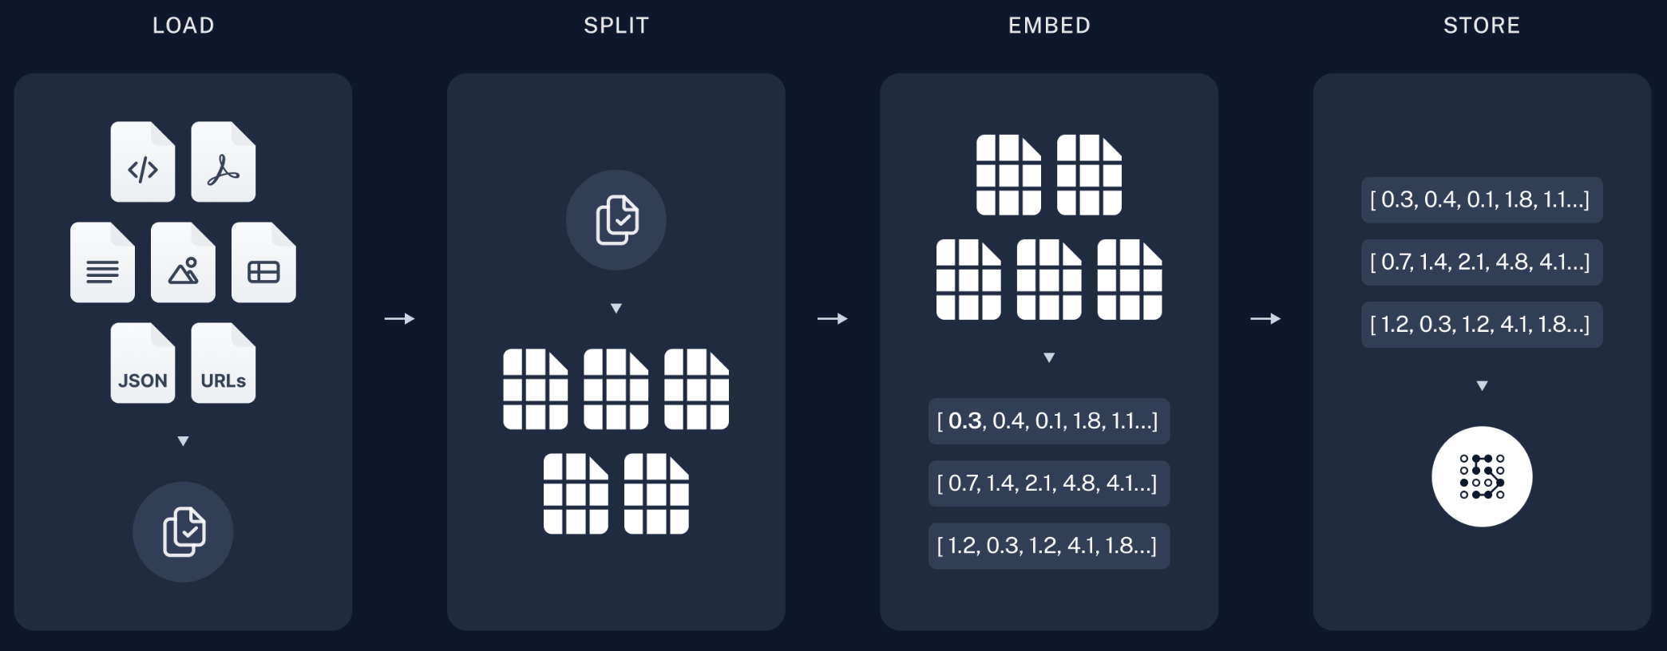
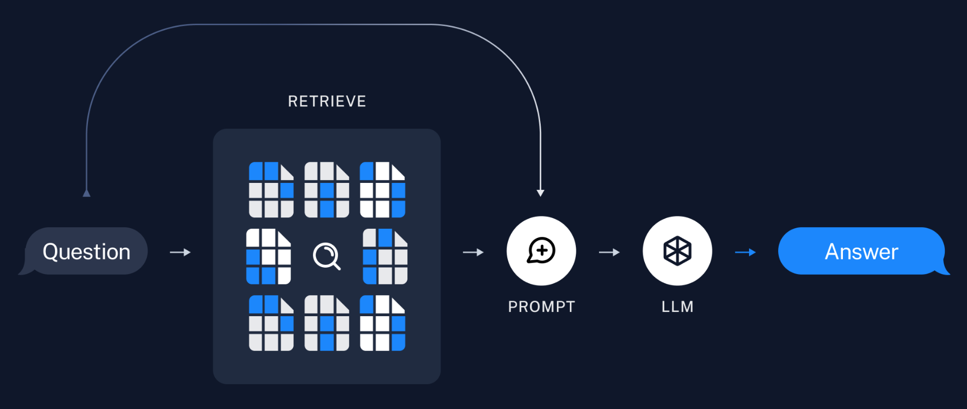
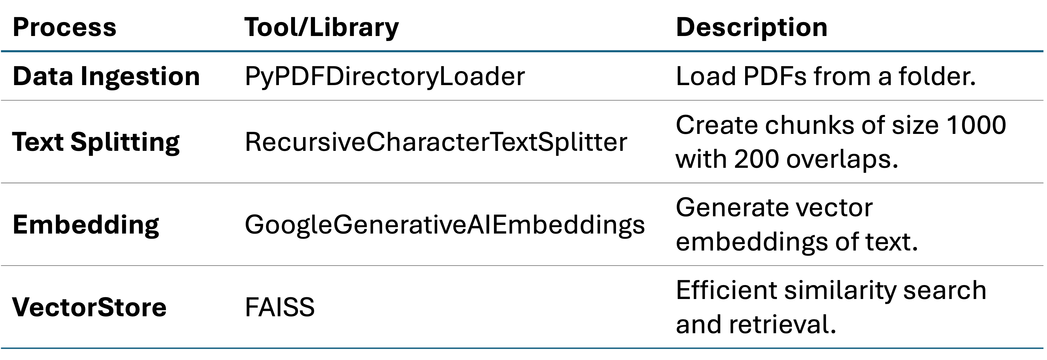
Architecture Overview & Technology Used (RAG)
RAG – Retrieval Augmented Generation & LangChain Retrieval Chain
Load
Data Ingestion: Load PDF documents.
Splitting
Text Splitting: Divide content into manageable chunks (done to handle context size issue).
Embedding
Embedding: Represent text as numerical vectors (enables similarity search).
Store
Vector Store: Store embeddings required for efficient similarity-based retrieval.
Retrieve and analyze
Q&A: Retrieve and analyze relevant chunks based on user input.
** Note - RAG (Retrieval-Augmented Generation): A type of application where a Generative AI app interacts with a large data source (e.g., PDFs) to retrieve relevant information and respond to user queries.

Slide 6
Workflow
Document Selection:
User uploads or selects mental health research papers from ScienceDirect.
Data Ingestion:
PDFs are loaded into the app using PyPDFDirectoryLoader.
Text Splitting:
Documents are divided into smaller chunks (1,000 characters with 200 overlaps) using RecursiveCharacterTextSplitter.
Embedding Generation:
Each chunk is converted into vector embeddings using GoogleGenerativeAIEmbeddings.
Vector Storage:
Embeddings are stored and indexed in a FAISS Vector Database for efficient similarity search.
Document Similarity Search:
The app compares the user’s query with the stored embeddings to retrieve similar document chunks.
This ensures that the most relevant context is provided in response to the query.
User Query:
User inputs a question related to the selected document.
Retrieval & Analysis:
The app retrieves relevant chunks using the FAISS database and analyzes them using the LangChain retrieval chain.
The context-aware response is generated.
Answer Display:
The app displays an accurate response along with similar document excerpts for reference (Streamlit used for frontend).

Slide 7
Challenges and Next Steps
Challenges:
Handling Large PDFs:
Efficiently processing and extracting insights from extremely large PDFs while maintaining performance and speed.
Improving Embedding Accuracy:
Enhancing the accuracy and relevance of vector embeddings to ensure high-quality, context-aware answers.
Future Improvements:
Support for Additional Document Formats:
Expand the tool to support other document formats like Word, PowerPoint, and HTML for broader use cases.
Integration of Advanced Models:
Incorporate advanced AI models such as GPT or domain-specific models to provide more sophisticated and nuanced answers to complex queries.

Slide 8

Thank you

