Slide 1


R. N. G. Patel Institute of Technology (RNGPIT)
Computer Science and Engineering Dept.
Semester : 8th
Subject : Internship/Project (3183101)
Presentation - 2
Backend developer intern
Prepared By:: | Faculty Mentor:: | Industry Mentor::
Pansuriya Darshil J. 180840131033 | Mr. Nikunj Y. Kansara Assistant Professor CSE, RNGPIT | Ms. Priyanka Rajani Team Leader Infozium Solution PVT LTD

Slide 2
Outline
Overview of Company
Introduction of the Internship Work (Purpose, Objective, Scope, Technologies, Literature review)
Timeline Chart for 12 weeks Internship
Abstract of Project
Description of modules on which you have worked
Implementation Work
Test Cases
Problem Encountered by you and Possible Solutions
Summary of Internship
Conclusion
Limitation and Future Enhancement
References

Slide 3
Overview of Company
Infozium Solution PVT LTD which is Software Solution Base Company which is Located In Surat.
Goal of the Company is that to provide the good and reliable solution to Client. Working on Many Trending Technologies Like React Native ,Flutter, ReactJS, Node JS, PHP etc…
Company have many teams which have experts in that fields of technology and create a multiple solution with their expertise and provide it to client.
Infozium Group has become one of the most dependable technology partners for a variety of industries, particularly in their digitization efforts.

Slide 4
Introduction of the Internship Work
Main Purpose of an Internship that I want to learn new technologies which are use by the companies Nowadays.
To gain real work experience and provide meaningful assistance to the company.
During internship I learned the nodejs framework which is used to develop the backend.
Worked on the Warehouse management project which is related to delivery services.

Slide 5
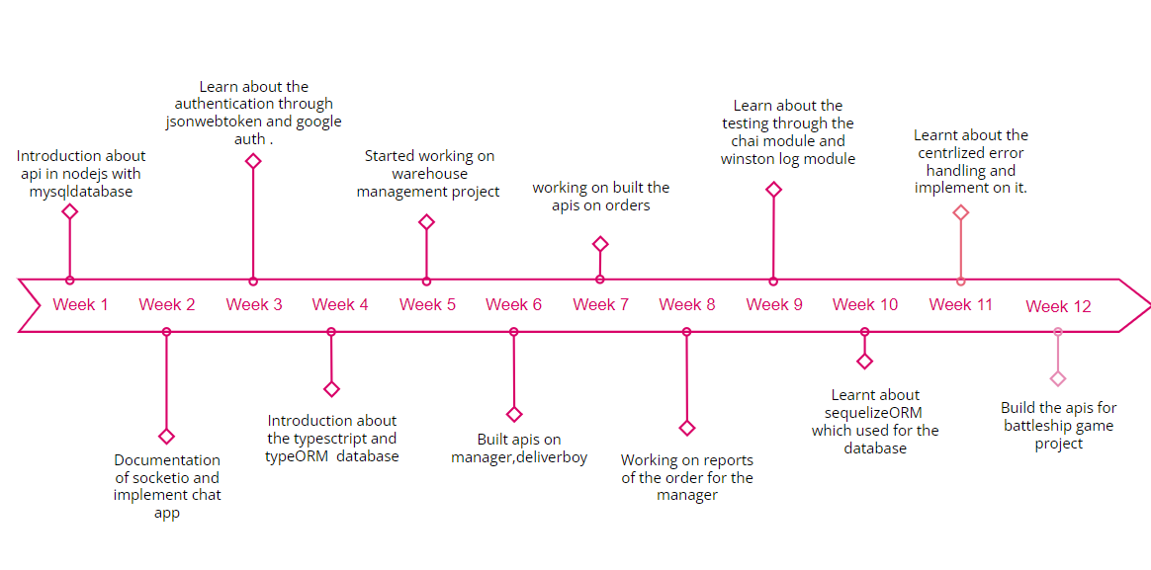
Timeline Chart for 12 weeks Internship

Slide 6
Abstract of Project
Warehouse management
Warehouse Management is based upon delivery services.It has mainly three Roles are Admin, Warehouse Manager and Delivery Boy In which admin and warehouse manager uses the web app and delivery boy uses the mobile app.
Admin can add/edit/delete Warehouse Manager and Delivery Boy as well apart from that admin can view/ edit delivery boy and Warehouse Manager. Admin can Manage, view, Assign Orders to Managers and Delivery Boys.
Warehouse Manager assign order to Delivery Boy and Download status of order and Payment Collection report.
Delivery Boy view all orders and Delivered the order and update the status of order and collect the payment.

Slide 7
Description of modules on which you have worked
Built the api for admin, manager, delivery boy.
Admin can create, block, edit manager and delivery boy and also create the warehouse and assign the warehouse manager to the warehouse.
Warehouse manager can upload the excel file which contains the unique number which gives by the admin, warehouse manager can view all orders and assign to the delivery boy.
Delivery boy can view all its order and deliver the order whether its for pickup or delivery. Collect the payment if the payment type is cash on delivery. Update the status of order either delivered or cancelled. He can view the history of orders and collected payment.
Manager can view the payment collection report of particular delivery boy.

Slide 8
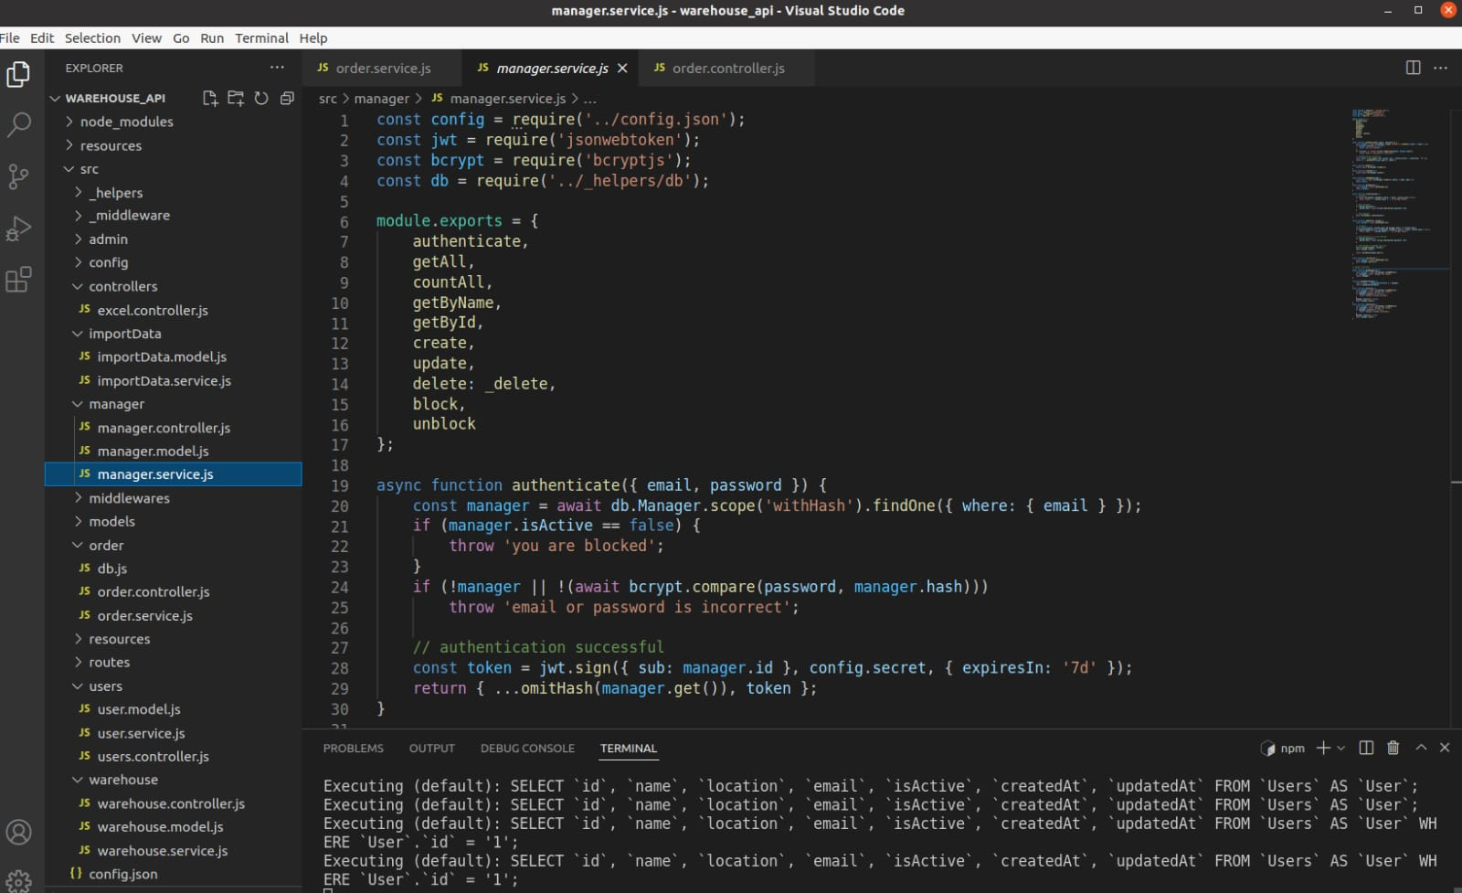
Implementation work

Slide 9
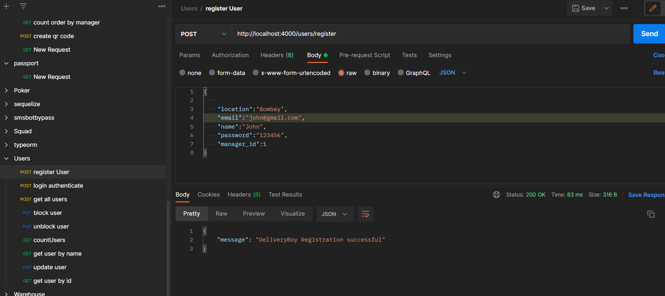
Implementation work

Slide 10
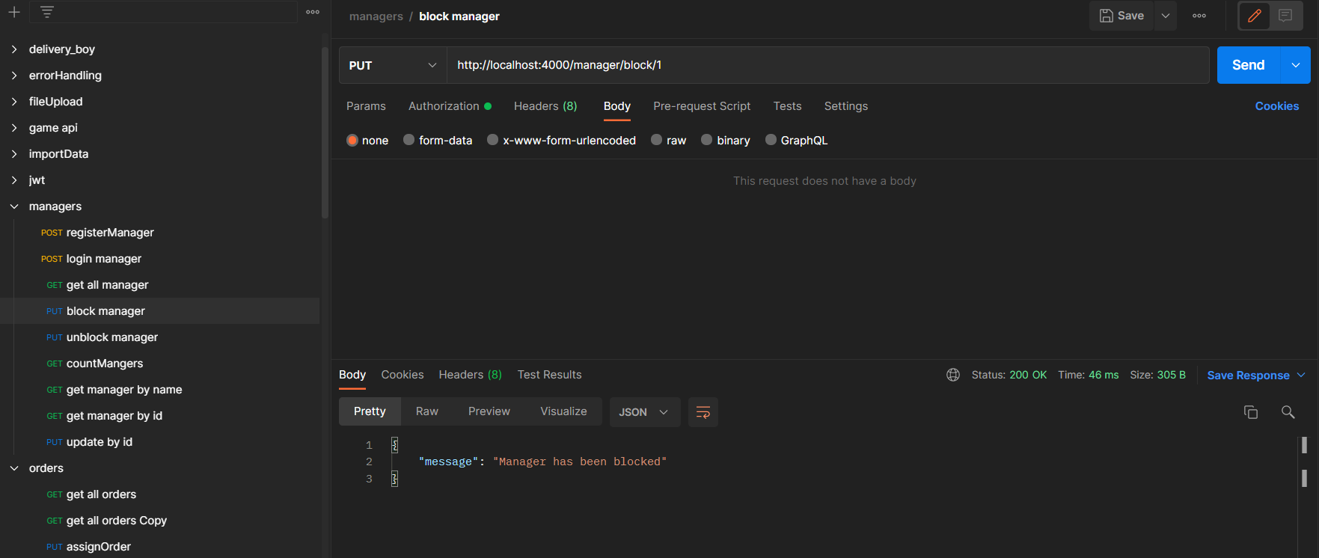
Implementation work

Slide 11
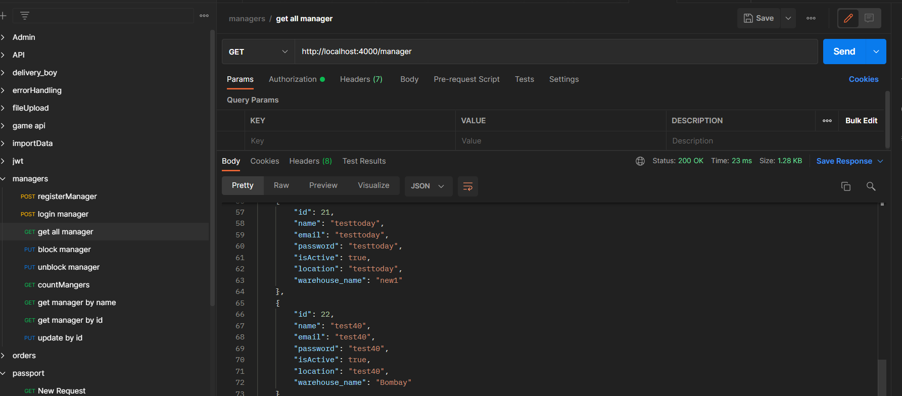
Implementation work

Slide 12
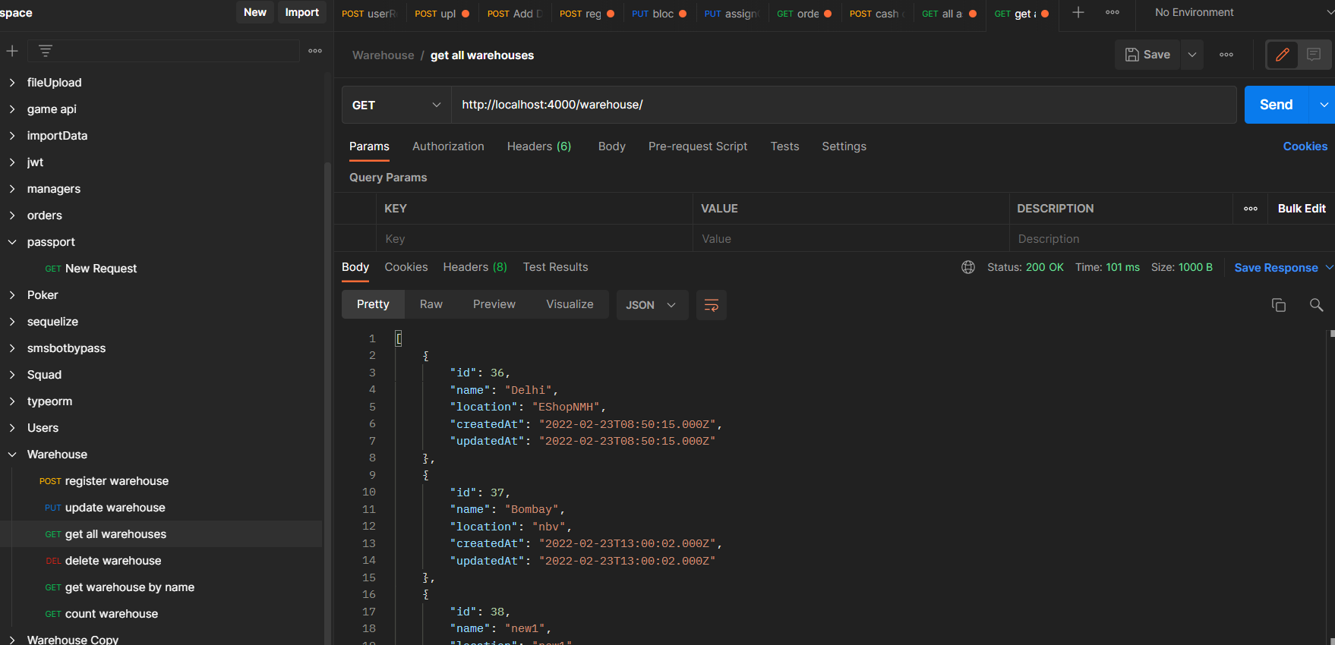
Implementation work

Slide 13
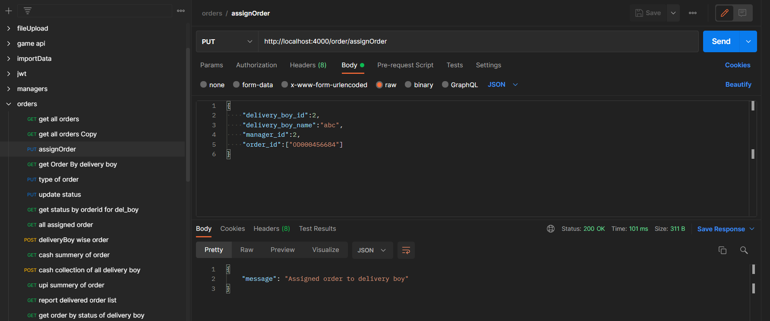
Implementation work

Slide 14
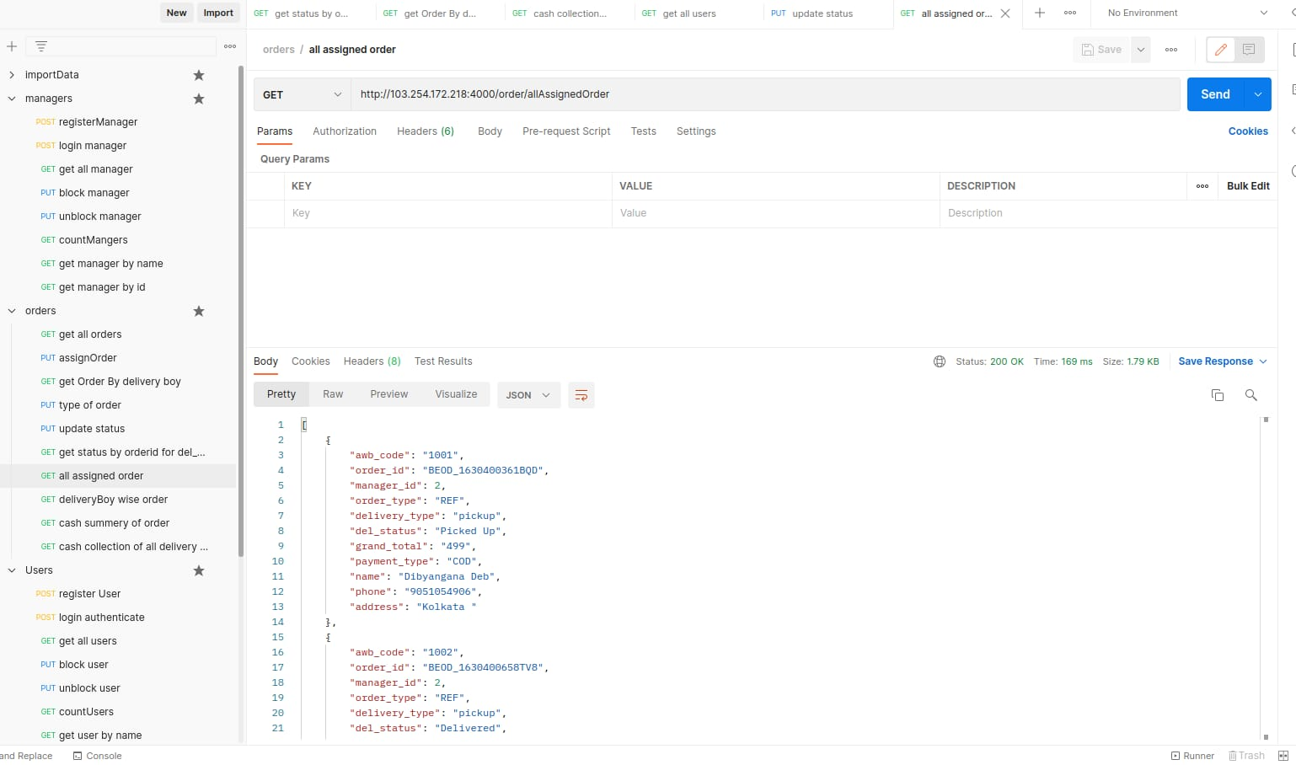
Implementation work

Slide 15
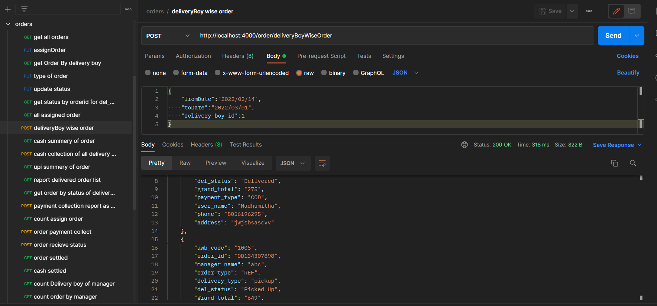
Implementation work

Slide 16
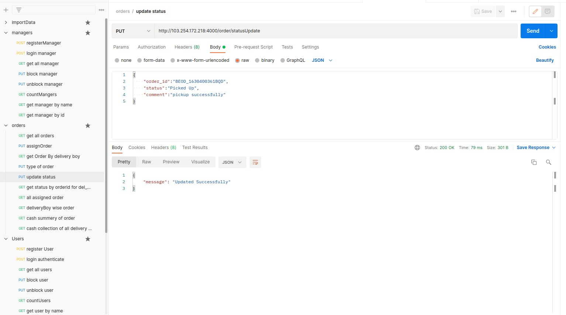
Implementation work

Slide 17
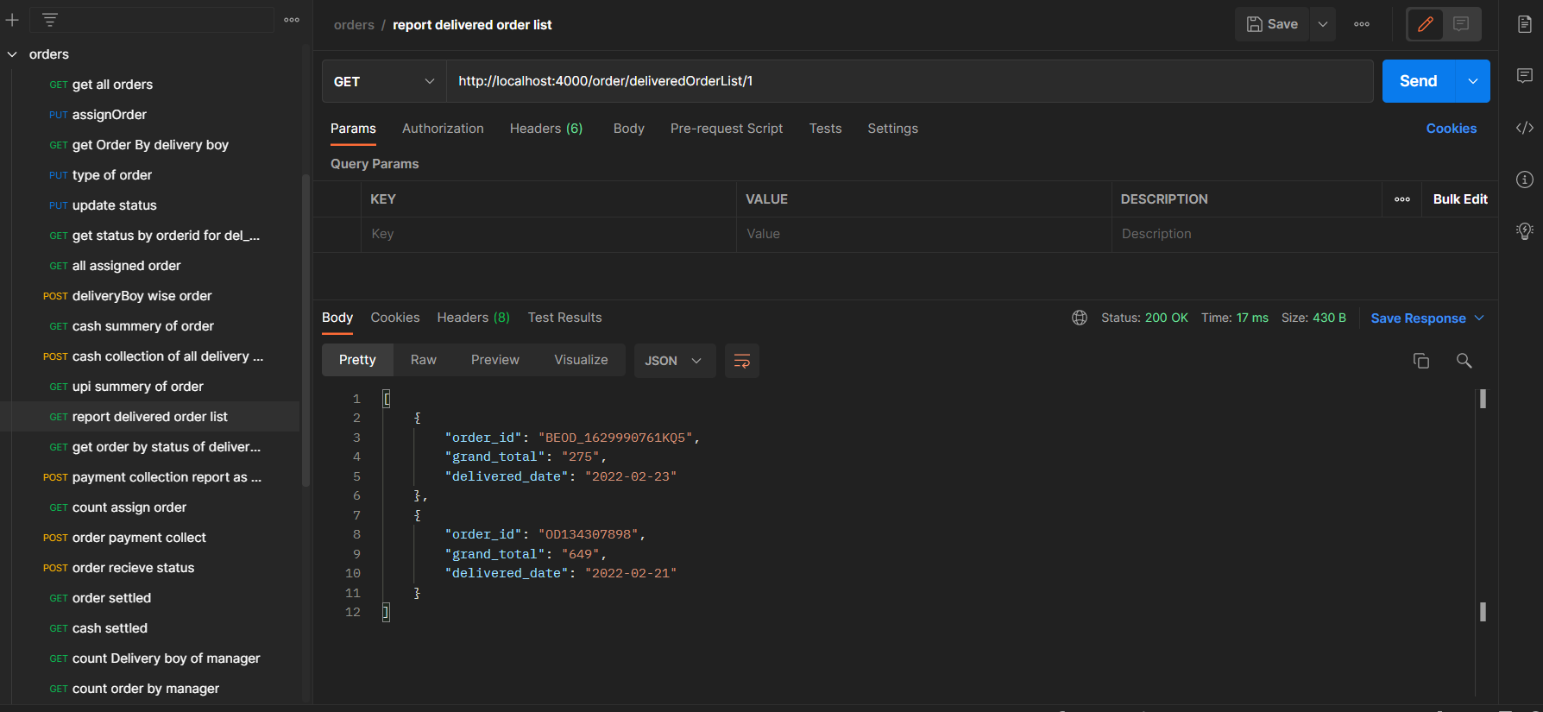
Implementation work

Slide 18
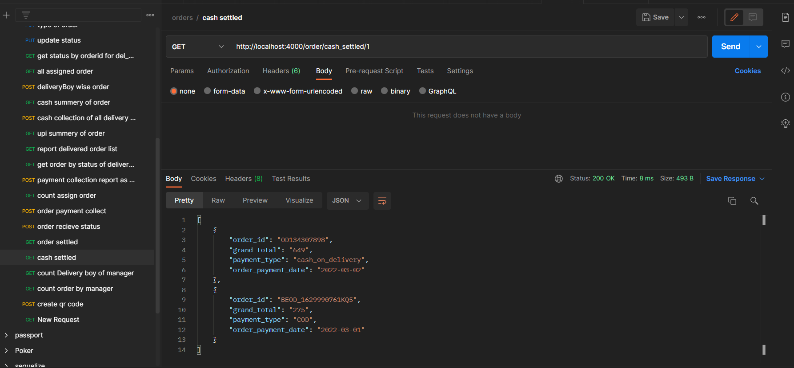
Implementation work

Slide 19
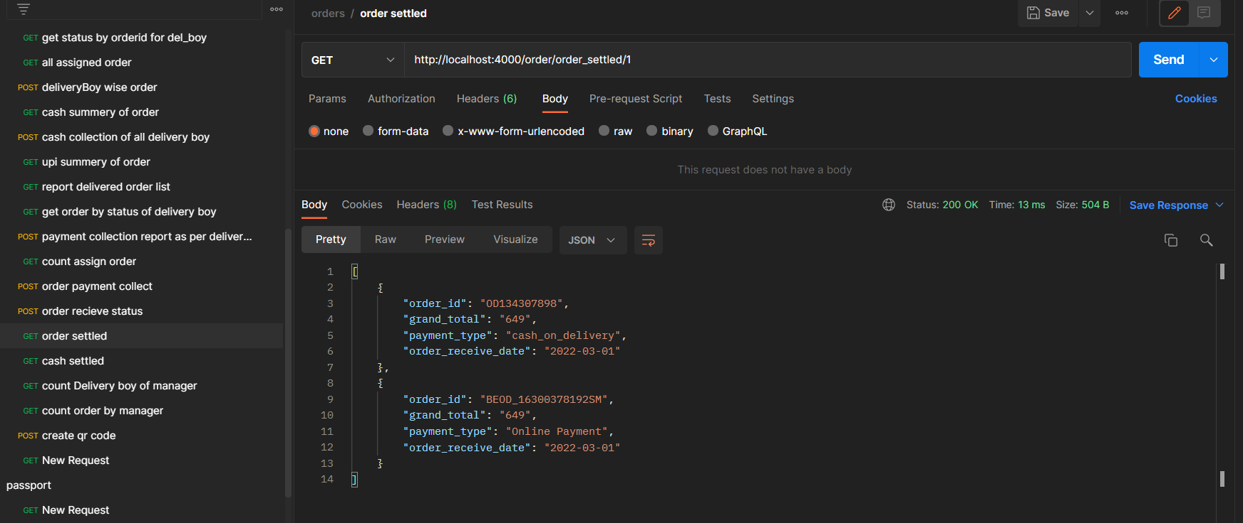
Implementation work

Slide 20
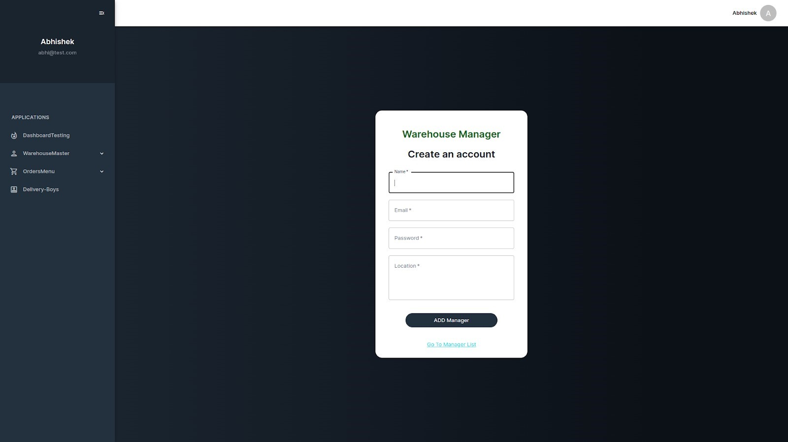
Implementation work

Slide 21
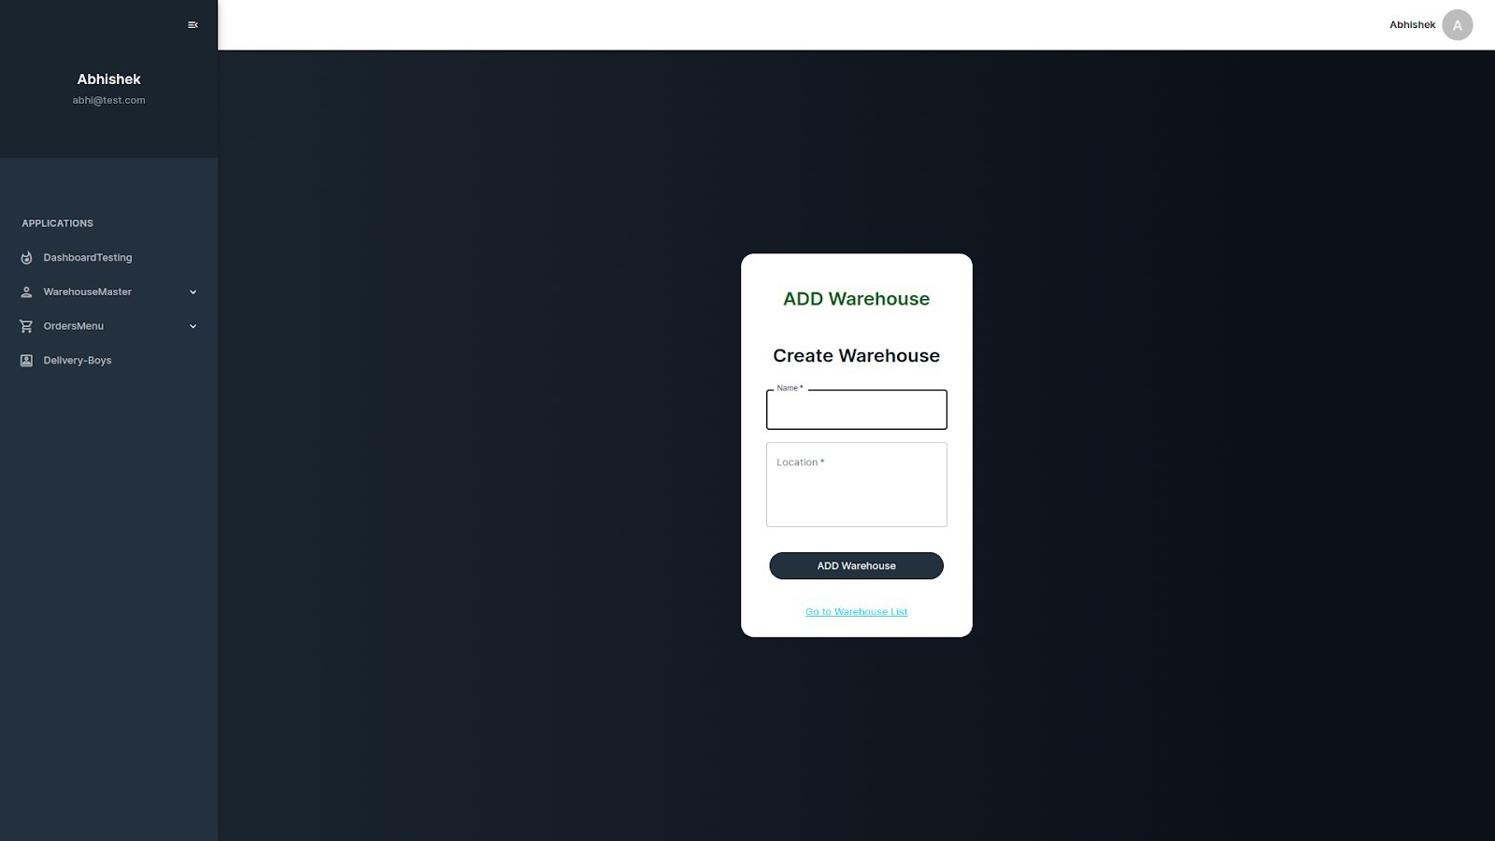
Implementation work

Slide 22
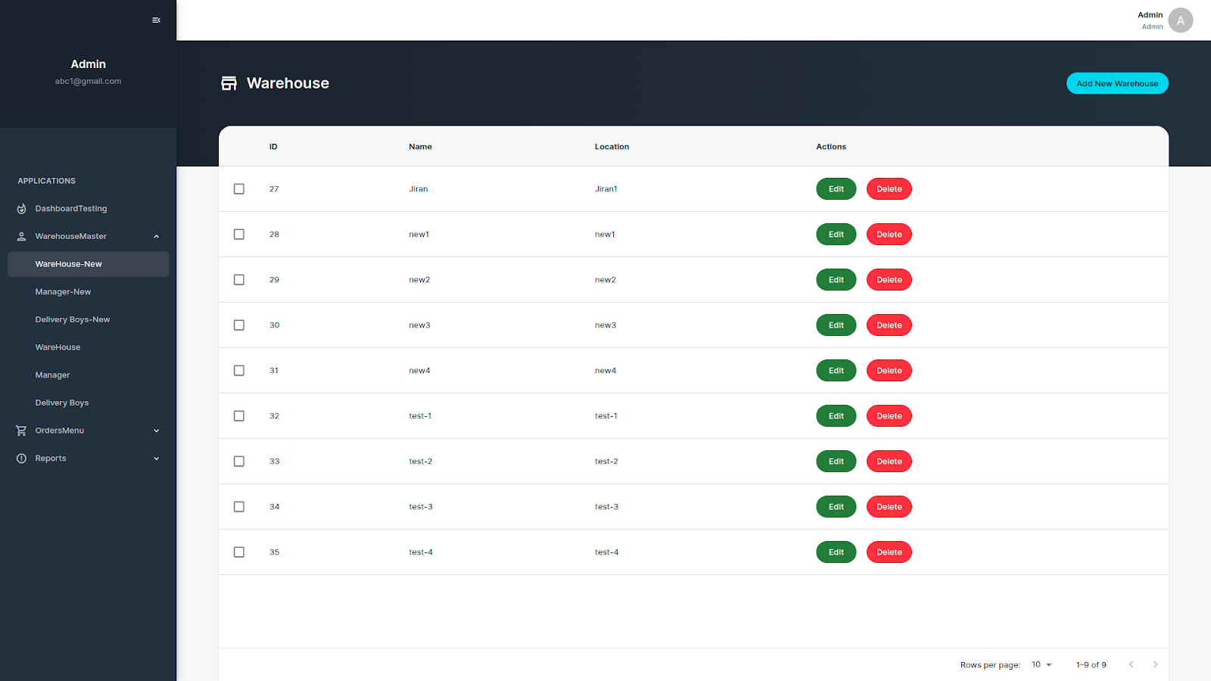
Implementation work

Slide 23
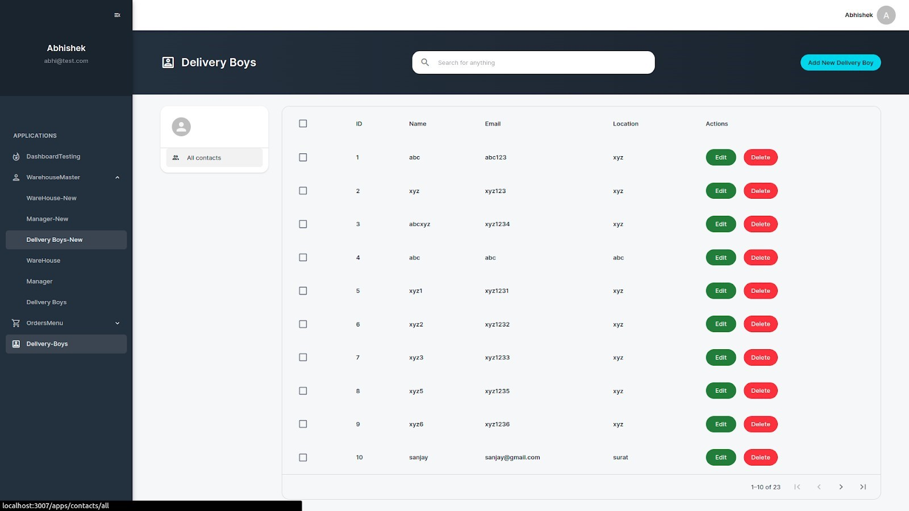
Implementation work

Slide 24
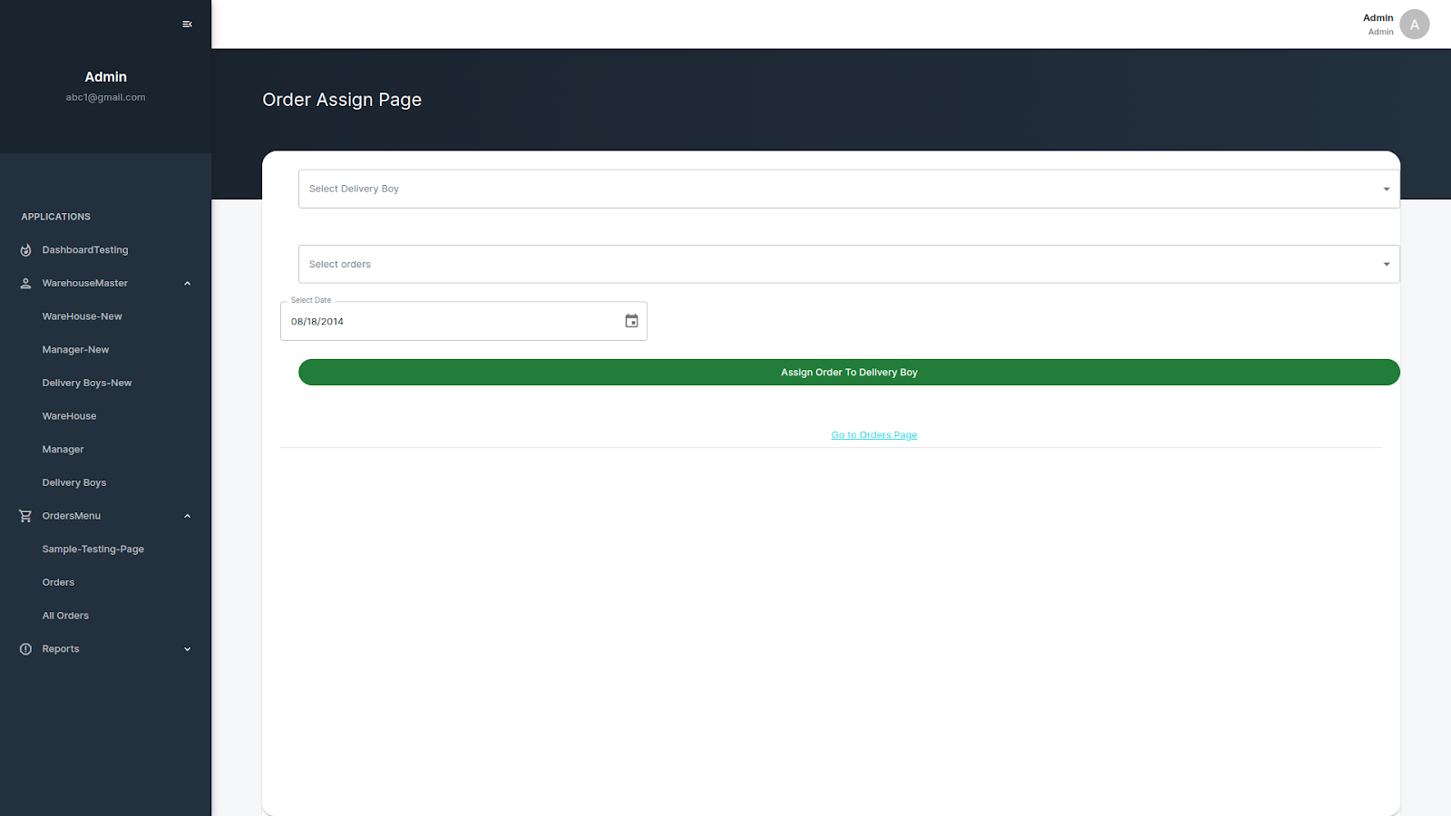
Implementation work

Slide 25
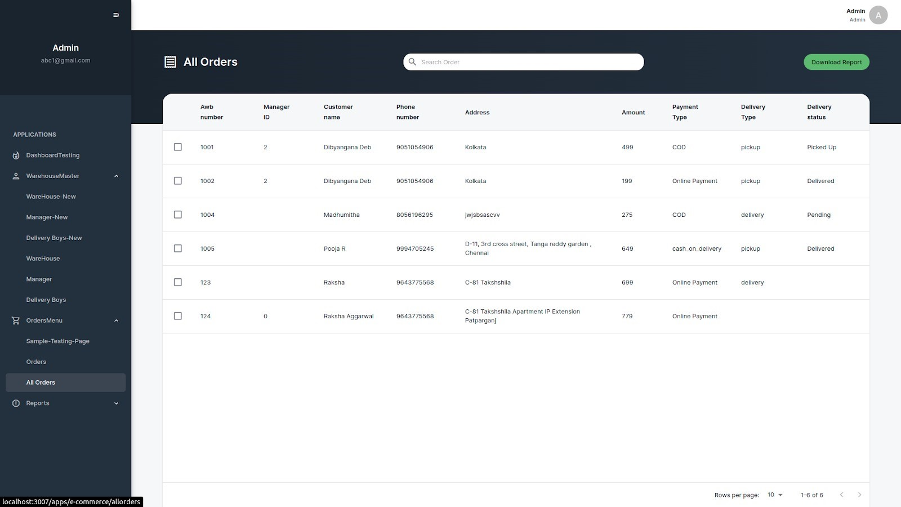
Implementation work

Slide 26
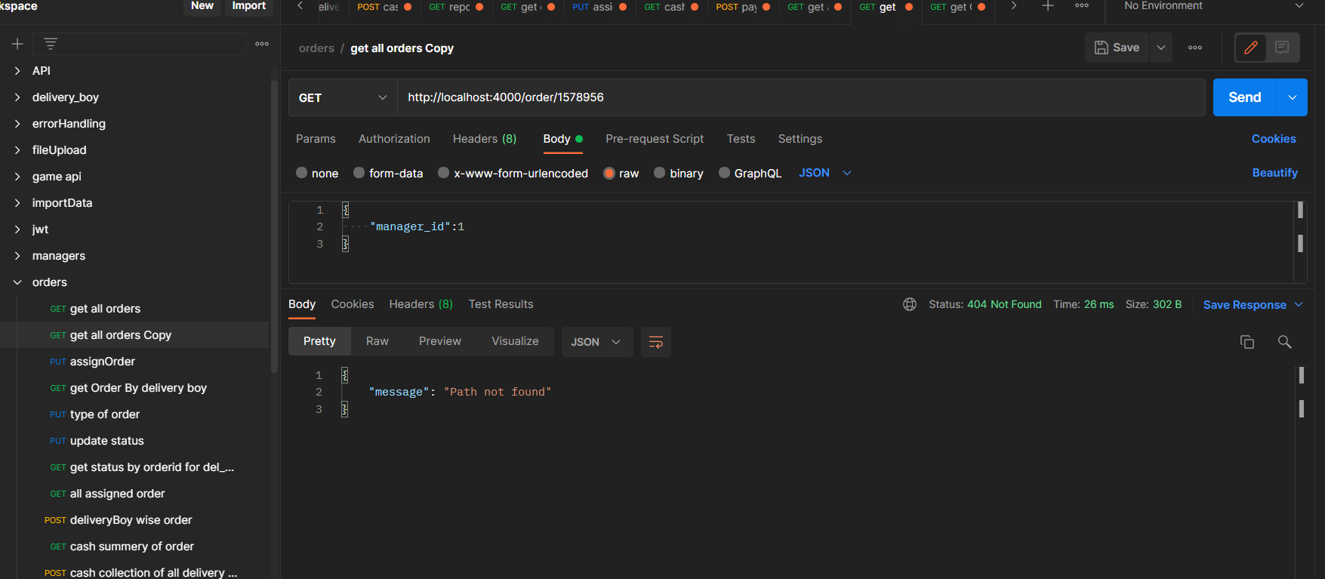
Test cases
If the user entered wrong url then it will sends the message.

Slide 27
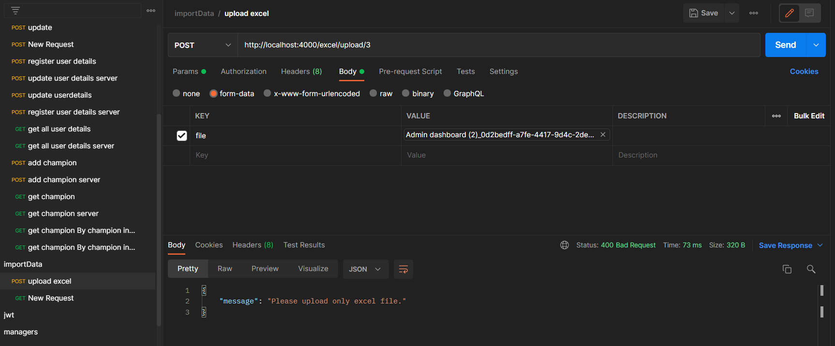
Test cases
If manager upload the other file except excel file than sends the message upload excel file.

Slide 28
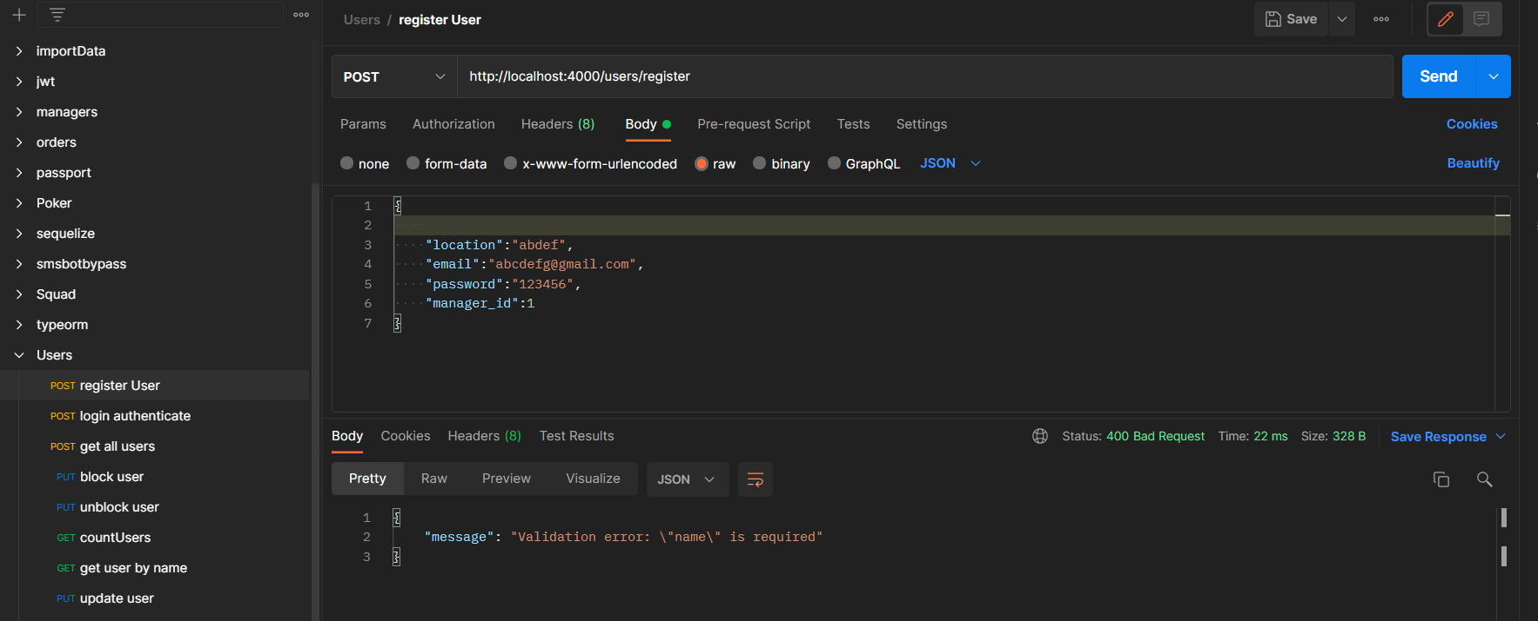
Test cases
While creating manager, delivery boy some fields are missing than returns field are required.

Slide 29
Problem Encountered by you and Possible Solutions
Encountered several problems during the development of projects. some of those problems are mentioned below:
Faced difficulties while uploading the excel file and downloading excel file which contains the data.
For that problem found the exceljs and read-excel-file/node module and use of them.

Slide 30
Summery of internship
During internship I learnt the different different module which are used into the projects.
Through Project gained the practical skills.

Slide 31
Conclusion
Learnt about the new technologies and gain the practical skills on it.

Slide 32
Limitation and Future Enhancement
In future added the QR code payment for customer while receiving the Order.

Slide 33
References
[1] https://www.udemy.com/course/the-complete-nodejs-developer-course- 2/learn/lecture/13729518#overview
[2] https://www.udemy.com/course/the-complete-nodejs-developer-course- 2/learn/lecture/13729538#overview

