Slide 1


R. N. G. Patel Institute of Technology (RNGPIT)
Computer Science and Engineering Dept.
Semester : 8th
Subject : Internship/Project (3183101)
Backend developer intern
Prepared By:: | Faculty Mentor:: | Industry Mentor::
Pansuriya Darshil J. 180840131033 | Mr. Nikunj Y. Kansara Assistant Professor CSE, RNGPIT | Ms. Priyanka Rajani Team Leader Infozium Solution PVT LTD

Slide 2
R. N. G. Patel Institute of Technology (RNGPIT)
Computer Science and Engineering Dept.
Semester : 8th
Subject : Internship/Project (3183101)
Presentation - 2
<<Title of Training>>
Prepared By:: | Faculty Mentor:: | Industry Mentor::
<<Student Name>> <<Enrolment No.>> | Mr. Nikunj Y. Kansara Assistant Professor CSE, RNGPIT | Mr. XYZ <<Designation>> <<Company Name>>

Slide 3
Outline
Purpose of my Internship
Introduction of the Organization
Timeline Chart for 12 weeks Internship
Training Work
Project Work
Future Work
References

Slide 4
Purpose of my Internship
Main Purpose of an Internship that I want to learn new technologies which are use by the companies Nowadays.
To gain real work experience and provide meaningful assistance to the company.
To gain experience and skills in a particular field.
To develop professional contacts.

Slide 5
Introduction of the Organization
Infozium Solution PVT LTD which is Software Solution Base Company which is Located In Surat.
Goal of the Company is that to provide the good and reliable solution to Client. Working on Many Trending Technologies Like React Native ,Flutter, ReactJS, Node JS, PHP etc…
Company have many teams which have experts in that fields of technology and create a multiple solution with their expertise and provide it to client.
Infozium Group has become one of the most dependable technology partners for a variety of industries, particularly in their digitization efforts.

Slide 6
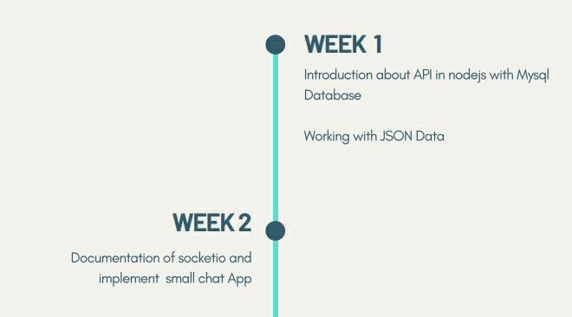
Timeline Chart for 12 weeks Internship

Slide 7
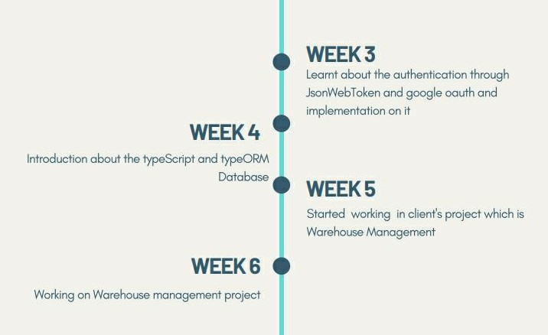
Timeline Chart for 12 weeks Internship

Slide 8
Purpose of my Internship
Main Purpose of an Internship that I want to learn new technologies which are use by the companies Nowadays.
To gain real work experience and provide meaningful assistance to the company.
To gain experience and skills in a particular field.
To develop professional contacts.
To gain exposure to upper management.

Slide 9
Training Work
Week 1
Learnt about the Javascript’s several object methods such as assign , create , freeze and more.
Later on, Gain the knowledge of HTTP requests like GET, POST, PUT, DELETE and how the REST API Works in Nodejs.[1]
Started working on the practical implementation of rest api in nodejs and intergrating api with the mysql database.
Fetch the data from json file and insert into mysql database and create api on those data.

Slide 10
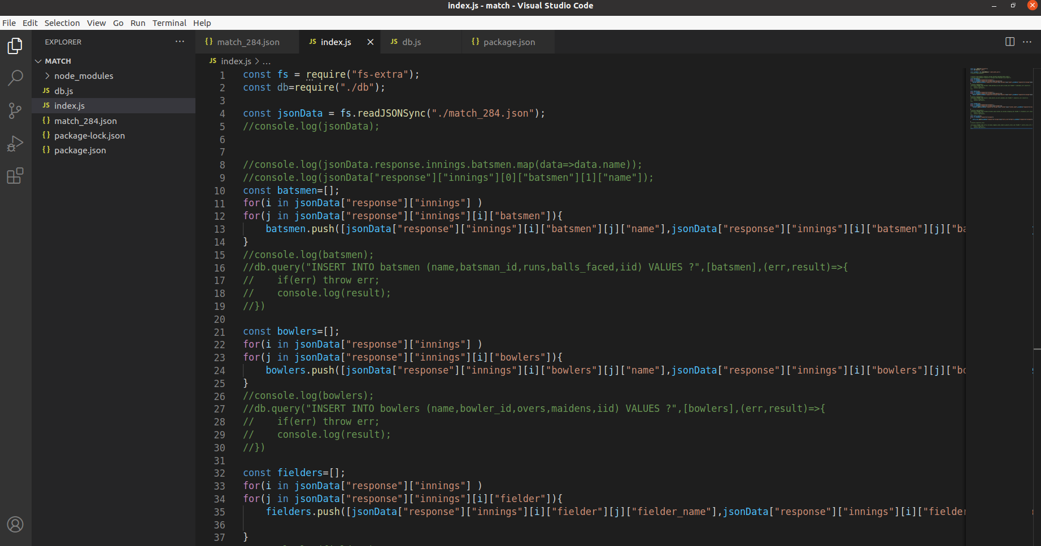
Training Work
Week 1

Slide 11
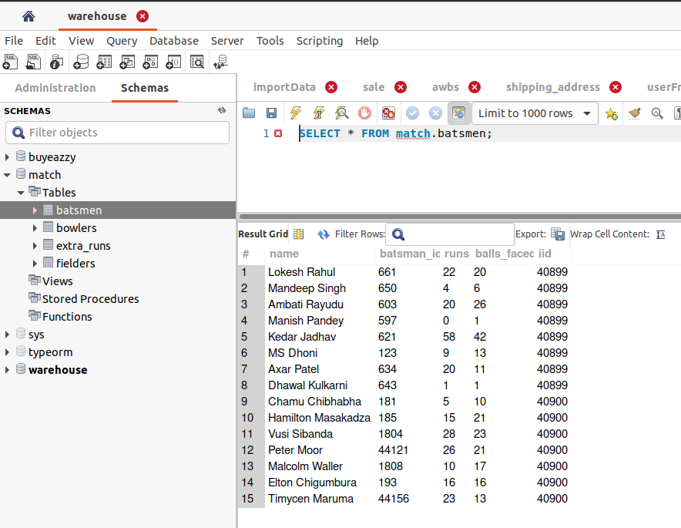
Training Work
Week 1

Slide 12
Training Work
Week 2
Working on the file module and validate the file uploadation in nodejs.
Learnt documentation about the socketio which is bi-directional communication between web clients and servers. It has two parts: a client-side library that runs in the browser, and a server-side library for Nodejs.[2]
Build the simple chat app using the socketio in which users enter into rooms and chatting with each other.

Slide 13
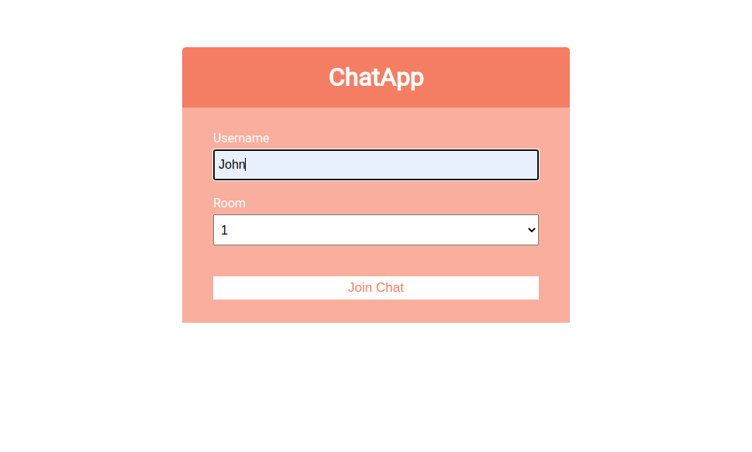
Training Work
Week 2

Slide 14
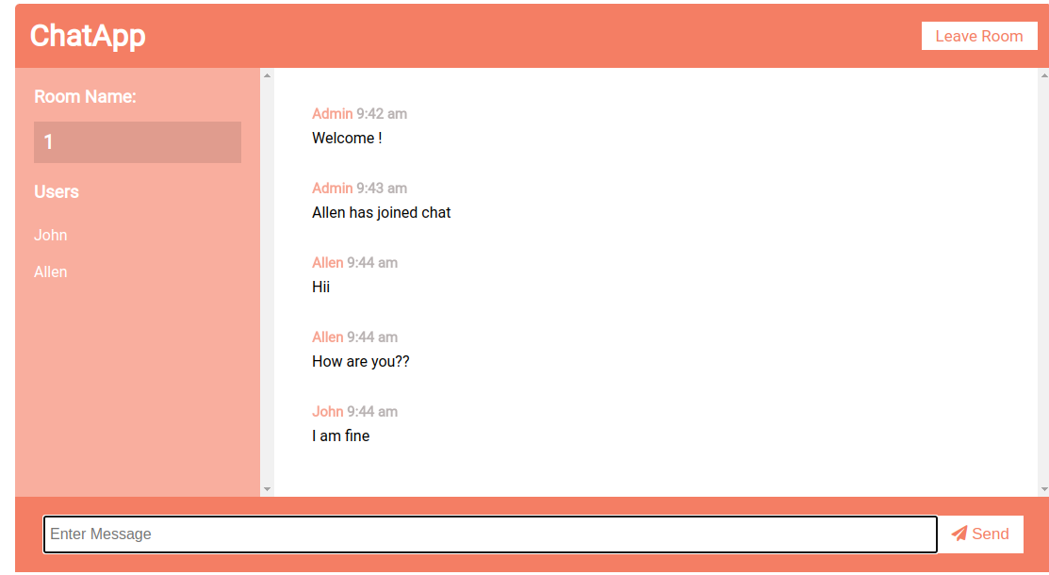
Training Work
Week 2

Slide 15
Training Work
Week 3
Learnt about the JsonWebToken which used for the authentication a user.
Implementation of jsonwebtoken with the accesstoken and the refreshtoken.
Implement passport-local-stratergy which is used for the authentication.
Google based authentication and facebook based authentication implement using the passport stratergy.

Slide 16
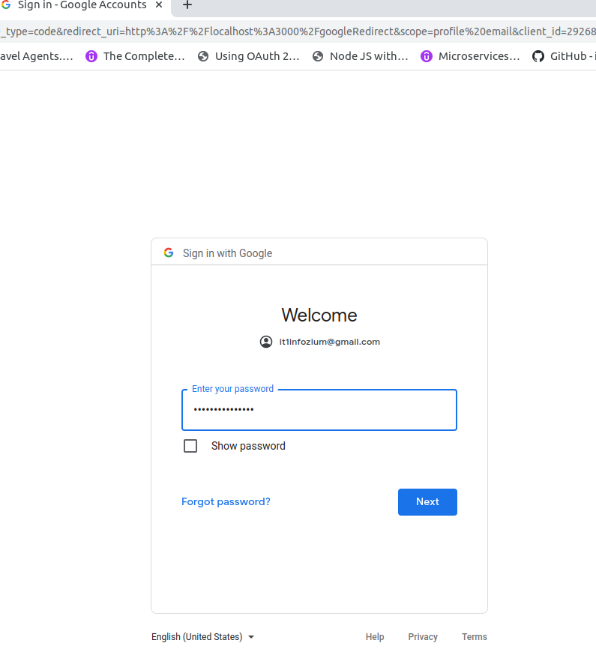
Training Work
Week 3

Slide 17
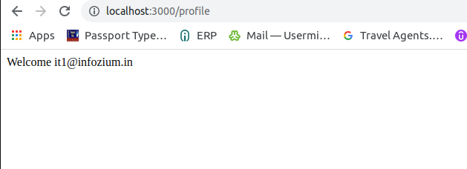
Training Work
Week 3

Slide 18
Training Work
Week 4
Overview of typescript, basic syntax of typescript, type annotations and inference.[3]
Learnt about the typeORM which is Object Relational library.
In typeORM entities, embeded entities, relations one to one , many to one, one to many.
Learnt the Select , insert, update, delete Query builder which is used for the CRUD operation.[4]
Implementation of the CRUD operation and relations between the entities.

Slide 19
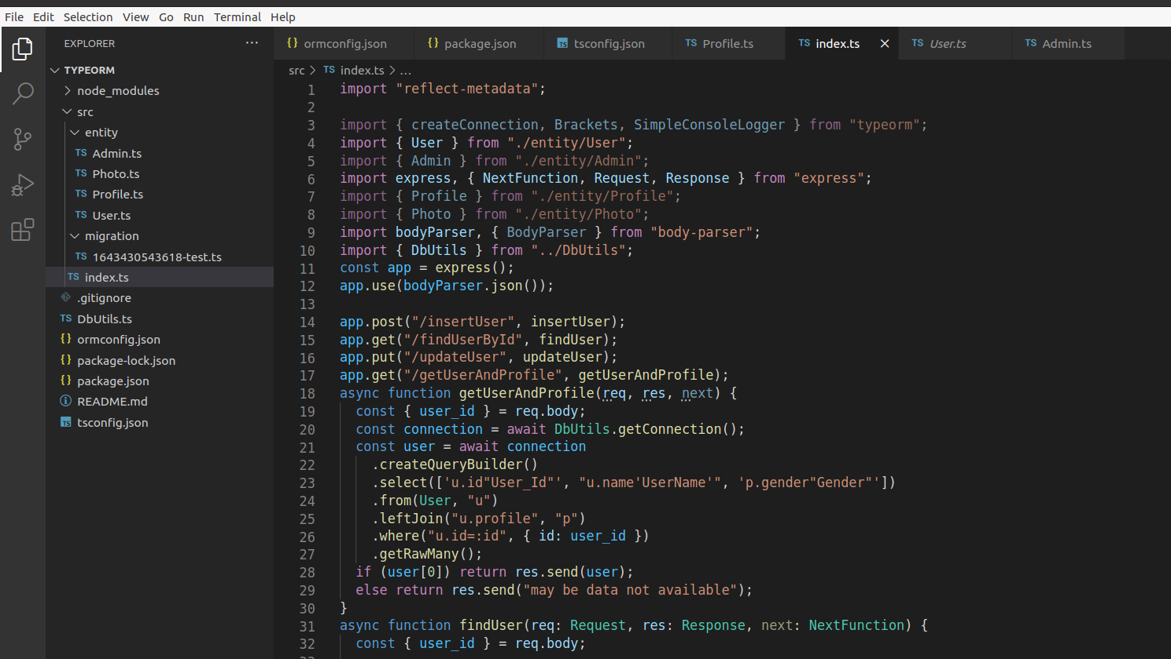
Training Work
Week 4

Slide 20
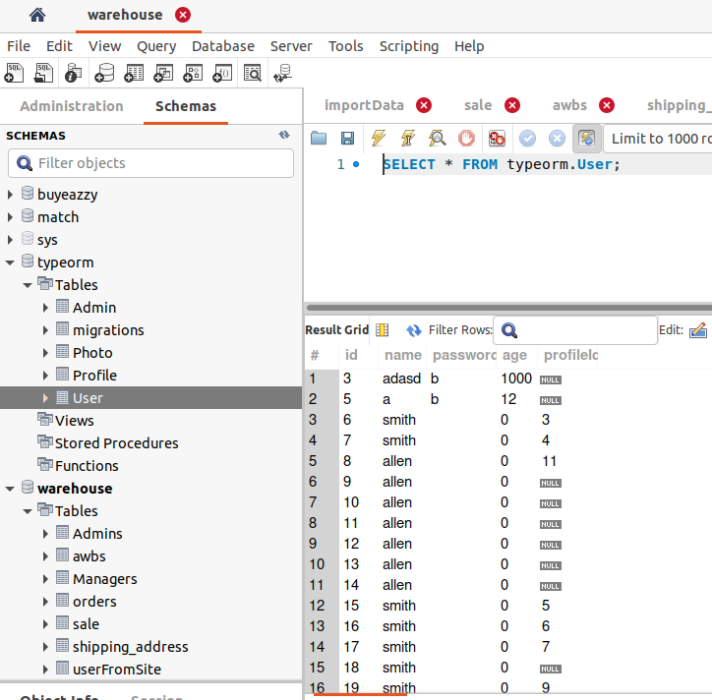
Training Work
Week 4

Slide 21
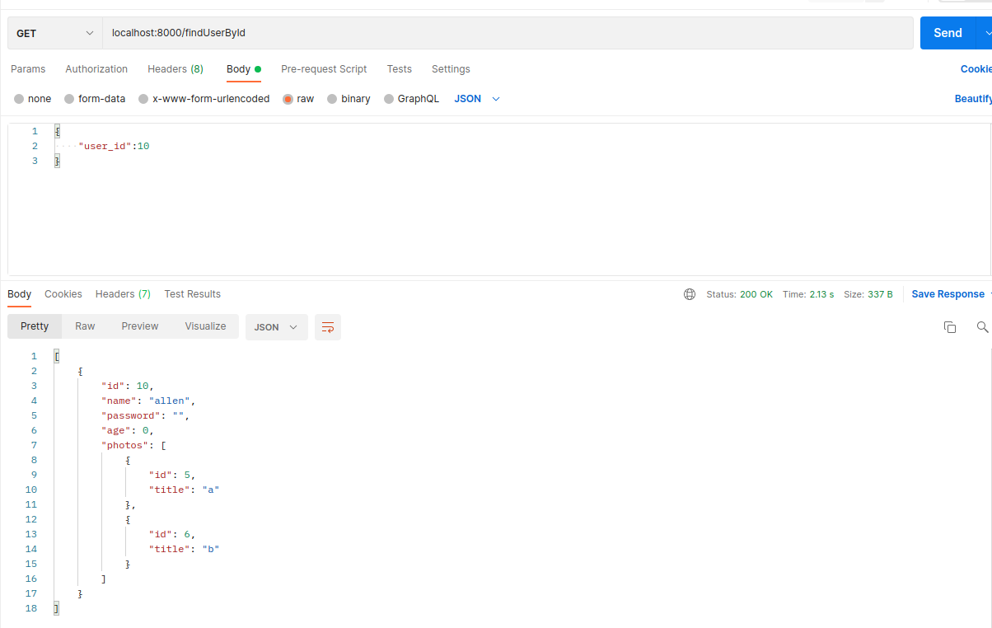
Training Work
Week 4

Slide 22
Training Work
Week 5
In fifth week get Introduction about the warehouse management project which client’s project.
This project basically based upon the delivery service by the agency for ex Ekart Logistics.
It has main three roles admin, warehouse manager and Delivery Boy.
Build the Register and Login api for the Delivery Boy and Warehouse manager which is used by the admin.
Create Delete, update,block, unblock api for the delivery boy and warehouse manager which is controlled by the Admin.

Slide 23
Training Work
Week 6
In 6th week build the API of create, get, update, delete for the warehouse.
Build the api for upoad excel file and file data insert into into the database.
Create the api for order assign by the warehouse manager to the Delivery Boy and Delivery Boy view the all assigned order.
Build api of view order between the from date and to date.

Slide 24
Training Work
Week 7
Build the status update of order by delivery boy api and solved error on it.
Working on changes in api and build the view all assigned order and status of order api.
Create the delivery boy wise and datewise api and changes on it.
Made the changes in view all order and assign order api and build the api of cash summery of delivery boy for the manager.
Working on excel sheet download of cash collection by delivery boy api.

Slide 25
Training Work
Week 8
Working on build get order by the status updated by the delivery boy and report of delivered order api.
Build the api for cash collection by delivery boy for the manager .
Create the track order as per order status for the delivery boy and changes in payment collection report.
Made the changes in api and fix issues.

Slide 26
Project Work
Project Defination :-Warehouse management
Warehouse Management is based upon delivery services.It has mainly three Roles are Admin, Warehouse Manager and Delivery Boy In which admin and warehouse manager uses the web app and delivery boy uses the mobile app.
Admin can add/edit/delete Warehouse Manager and Delivery Boy as well apart from that admin can view/ edit delivery boy and Warehouse Manager. Admin can Manage, view, Assign Orders to Managers and Delivery Boys.
Warehouse Manager will assign order to Delivery Boy and Download status of order and Payment Collection report.
Delivery Boy accept the order and Delivered the order and update the status of order and collect the payment.

Slide 27
Project Work
Technology required for the Project
For web application ReactJs used for the front-end and Nodejs used for the Backend those both framework of the javascript.
Mysql database used for database.
Mobile application build through the Flutter Technology which uses the
Dart programming language.

Slide 28
Project Work
Implementation of the Project Module
Build the api of admin can add/edit/delete/view/edit warehouse, warehouse manager and delivery boy.
Manager can manage, view, assign orders to managers and delivery boys.
Delivery boy can view its assigned order and update status of order and mark down the payment collection.
Manager can view and download report of delivery boy that status of order, payment collection report of particular delivery boy.
Delivery boy can view the history of its delivered order and payment collection.

Slide 29
Project Work
Implementation of the Project Module
Manager can view and download report of particular delivery boy that he can collect the payment from the particular delivery boy.

Slide 30
Project Work
Hardware and software requirement for development
Software requirement :
Nginx for deployment, Linux, git, nodejs ,reactjs for development.
Hardware requirement :
Ram : 8 gb ,Rom : 512 gb

Slide 31
Future Work
Learn more about on socketIO and other module which is used into the backend of the game development.

Slide 32
References
[1] https://www.udemy.com/course/the-complete-nodejs-developer-course- 2/learn/lecture/13729518#overview
[2] https://www.udemy.com/course/the-complete-nodejs-developer-course- 2/learn/lecture/13729538#overview
[3] https://www.udemy.com/course/microservices-with-node-js-and-react/learn/lecture/19225968#overview
[4] https://www.udemy.com/course/microservices-with-node-js-and-react/learn/lecture/19225975#overview

Slide 33
THANK YOU

