Slide 1
Stock Portfolio Suggestion Engine
Team Members: Guided By:
Darshil Kapadia: 013007280 Prof. Richard Sinn
Dhruvil Parikh: 013772720

Slide 2
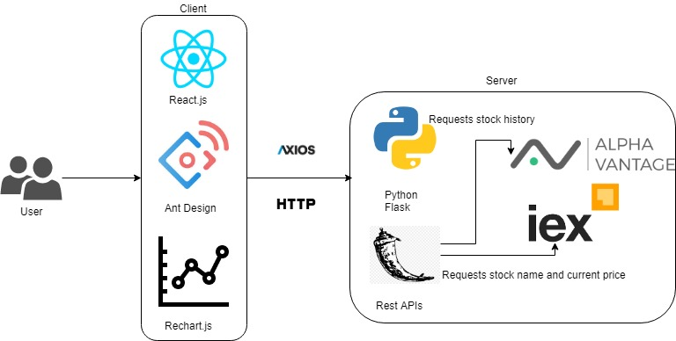
High-Level Architecture

Slide 3

Features
Suggest users the stocks to invest their money in.
Provides a brief introduction to each investment strategy.
Allows users to select different strategies to invest their money.
Divide the investment amount based on the stocks and strategy/s suggested.
Shows current price of each stock suggested

Slide 4
Extra Features
Used real time stock prices to suggest stocks for different strategies.
Used Ant Design for developing a clean UI.
Allows users to look at the trend for the last 50 days of each stock suggested.
Used Rechart.js for easy and clean integration with React.js
All the graphs shows the highest price and lowest price that the stock hit on any particular day.
Graphs allow users to study the data properly by showing them the tooltip containing data at every point.
Allows user to save the charts and tabular data.

Slide 5
Challenges
Researching about different investment strategies and gaining the required financial knowledge to carry out the project
Exploring the free APIs that can provide historical and real time stock data.
Preparing the chart data to give to Rechart.js

Slide 6
Use-Cases and Demo
Usecase | Input | Output
1. | Amount is empty and a strategy selected | Invest Button disabled and an error message
2. | Amount less than $1000 and a strategy selected | Invest Button disabled and an error message
3. | Amount $3600 and no strategy selected | Invest Button disabled
4. | Amount $3600 and 3 strategies selected | An alert which says only 2 strategies can be selected.
5. | Amount $3600 and Ethical Investment strategy selected | Suggestion Generated
6. | Amount $3000 and Growth Investment strategy selected | Suggestion Generated
7. | Amount $5670 and Index Investment strategy selected | Suggestion Generated
8. | Amount $1344 and Quality Investment strategy selected | Suggestion Generated
9. | Amount $5000 and Value Investment strategy selected | Suggestion Generated
10. | Amount $8400 and Ethical and Index Investment strategies selected | Suggestion Generated
11. | More than 2 requests within a minute | We’ll alert user to refresh after a minute.

Slide 7
Thank You
GitHub Link: https://github.com/darshilpk3/CmpE285-Spring19

