Slide 1
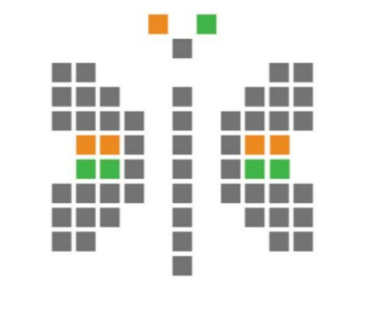
Smart City

Slide 2
Outline
Goal
Architecture
Implementation
Conclusion

Slide 3
Goal
Smart cities are a concoction of people, governance, technology and environment. Internet of Things or IoT plays a major role in cementing the distinct blocks of smart cities. Monitoring assets and managing resources, collecting data and pushing it to right target audience, analysing huge volumes of data for enhanced management and essentially connecting people, and things for an enhanced lifestyle are what an IoT platform intends to do.
Our goal is to create a web service which will help us to integrate any future IoT devices and can also work with the data provided by those IoT devices.

Slide 4
The web service should be able to
Show Heat Maps, Charts, History from the given dates, and location of Gateways on Map.
Restful APIs to communicate with the IoT data sensors.
Authentication key for particular user so that these logins can be charged.
Moreover Data will be stored on server that can also be given to clients for big data analysis.

Slide 5

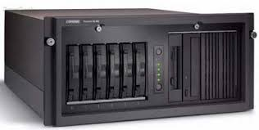

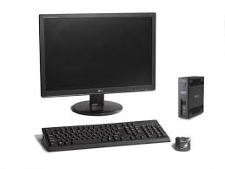
Architecture
Response
Request
Server
Response
Request
Database
Request
Client
Response
Server

Slide 6
Client to Server <–> Sending and receiving request and response respectively
Server to Database <–> Storing and fetching data from data base as per clients request
Monnit to Server <–> Fetching data from Monnit server
Server to Database –> Sending Data to Server as per Clients Request

Slide 7
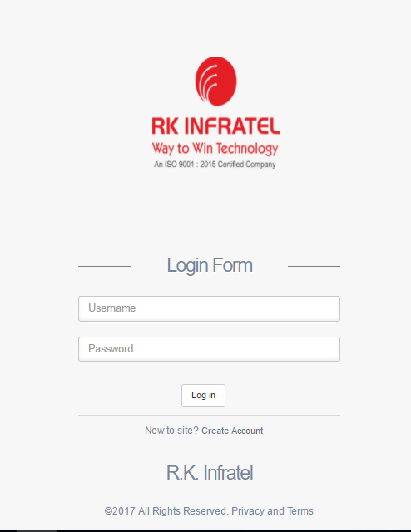
Implementation
Login Page

Slide 8
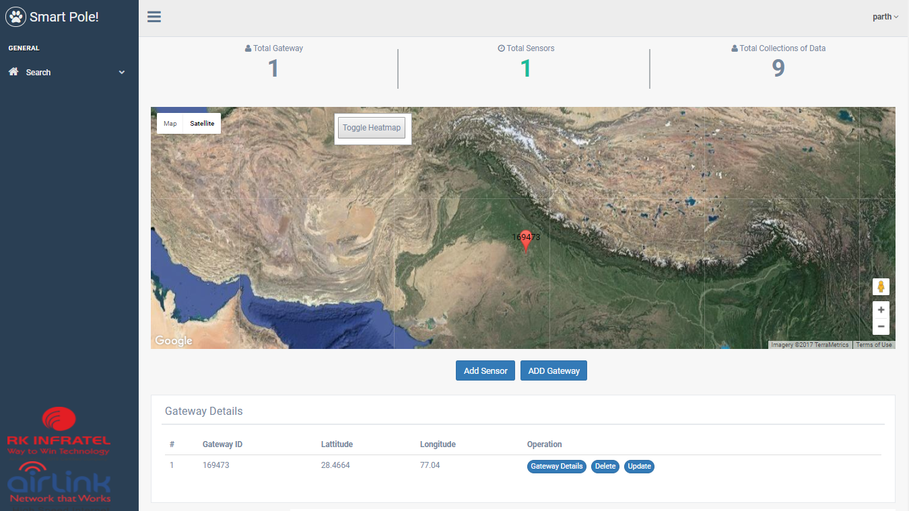
Home Page

Slide 9
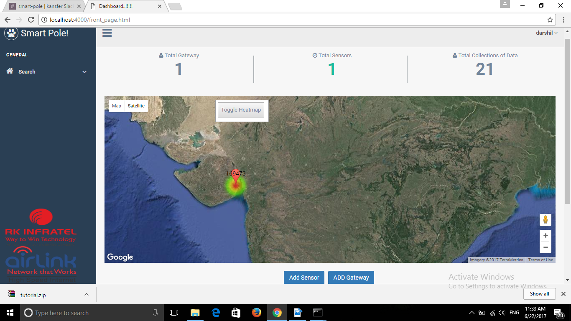
Heat Maps

Slide 10
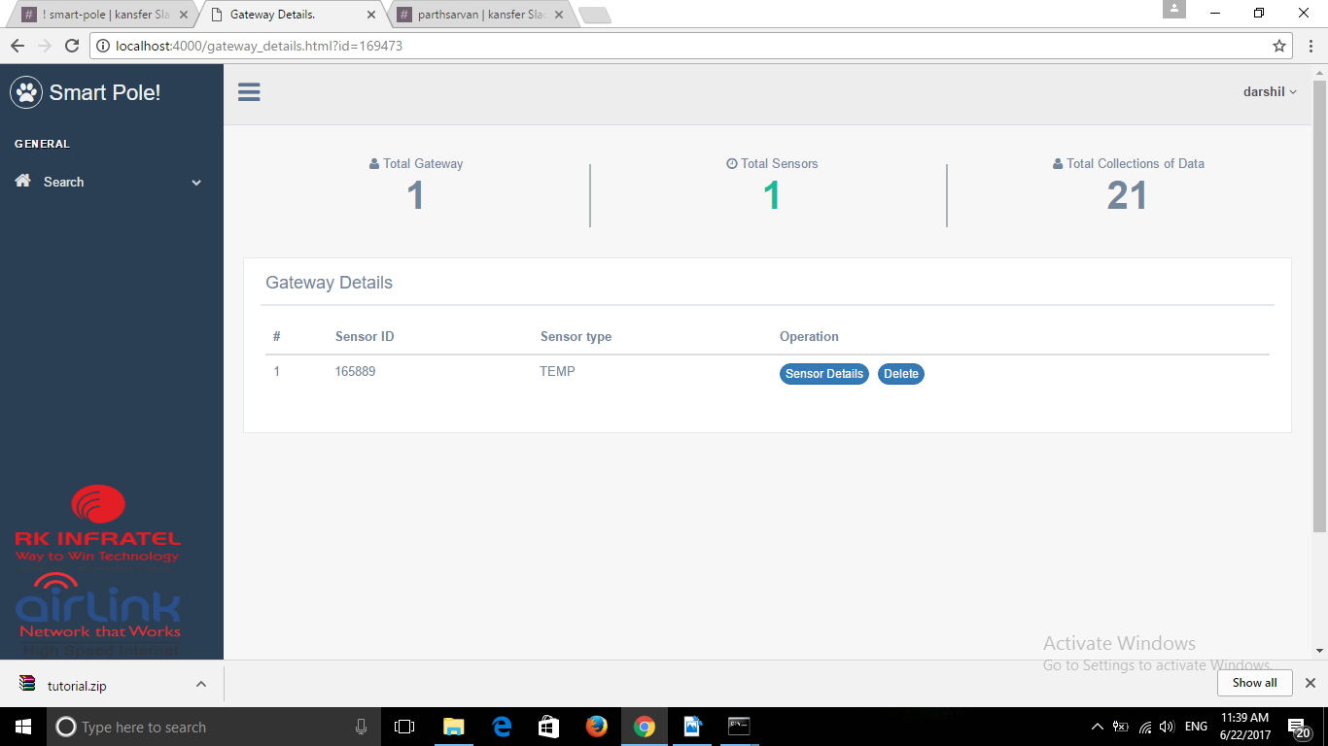
Gateway Details

Slide 11
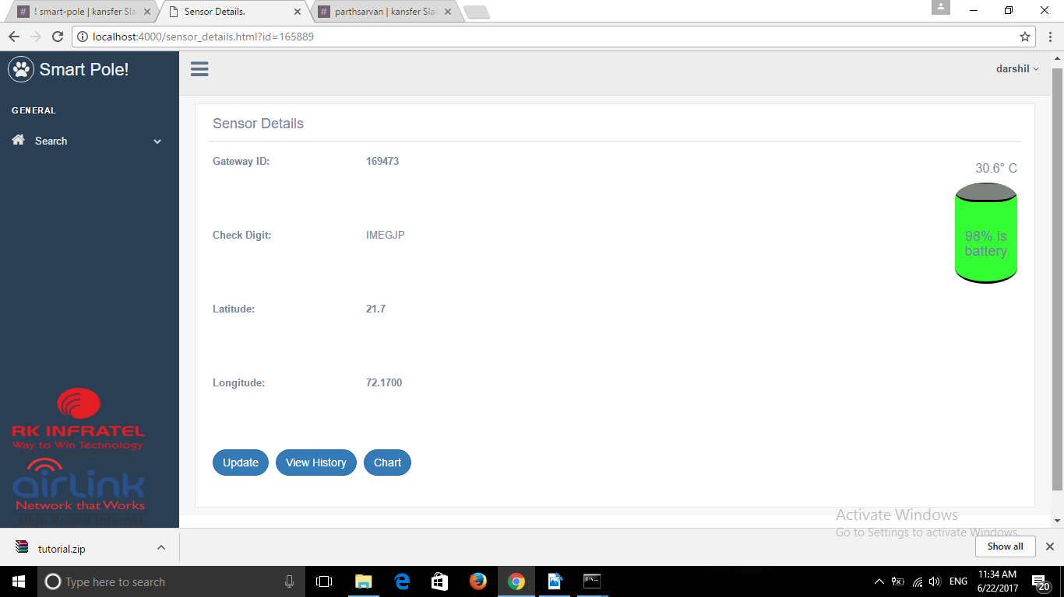
Sensor Details

Slide 12
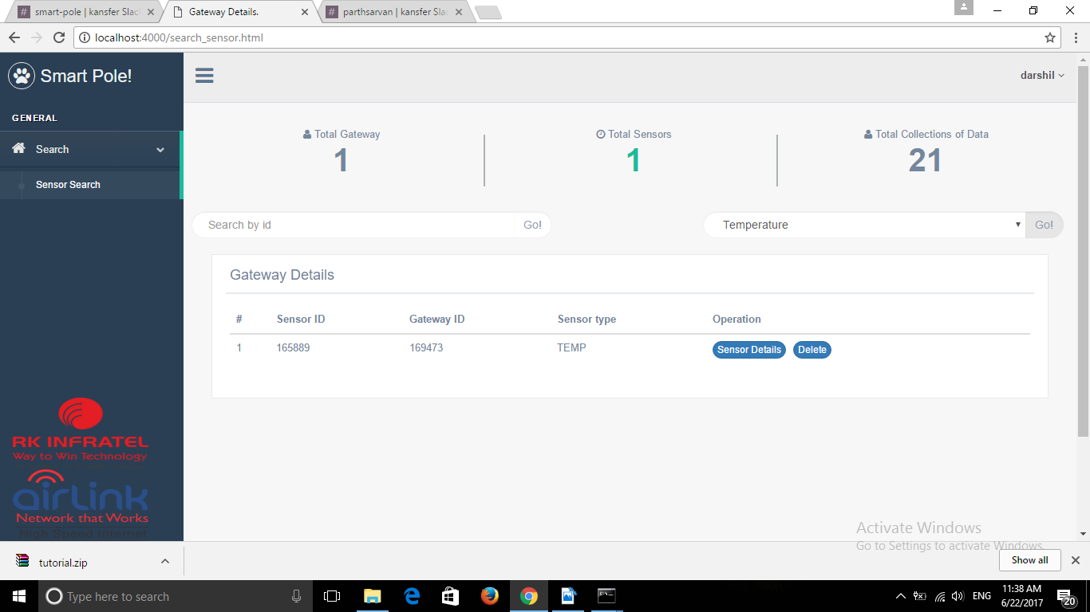
Searching Sensors

Slide 13
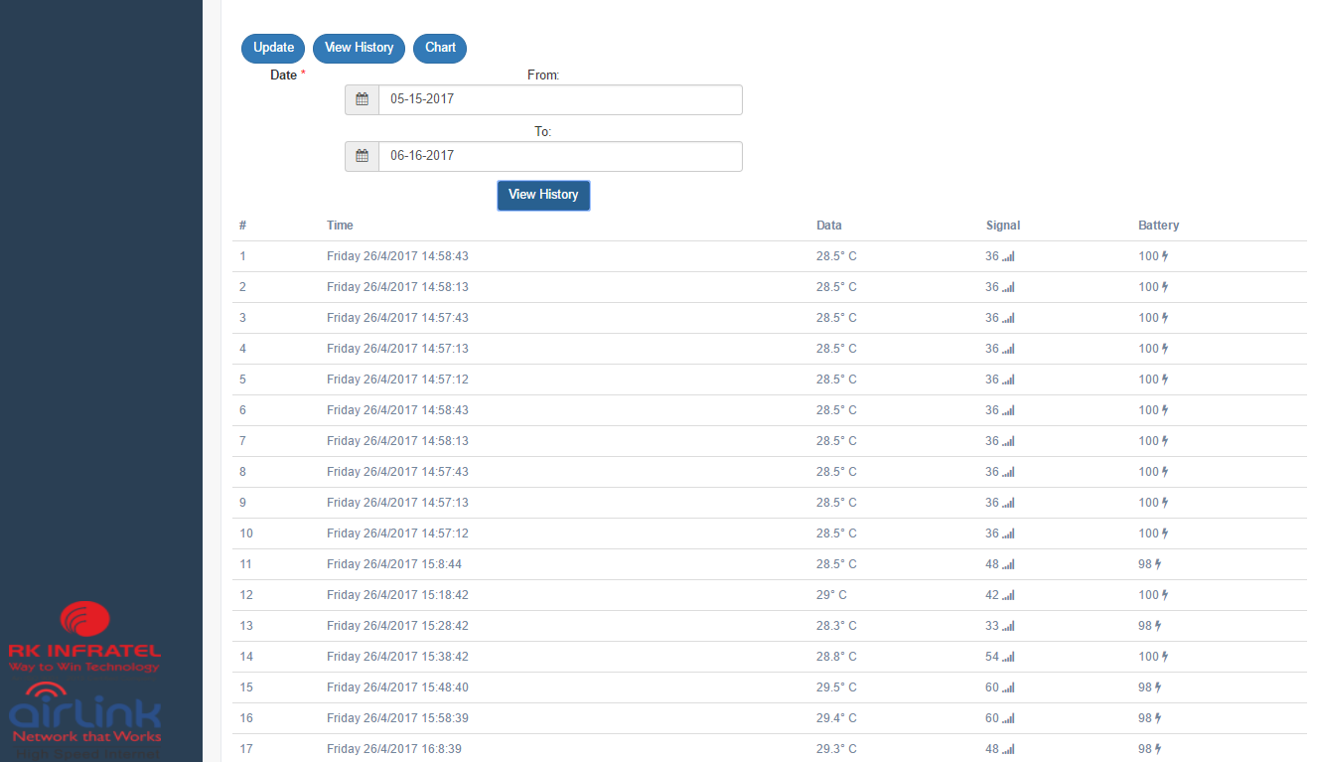
History

Slide 14
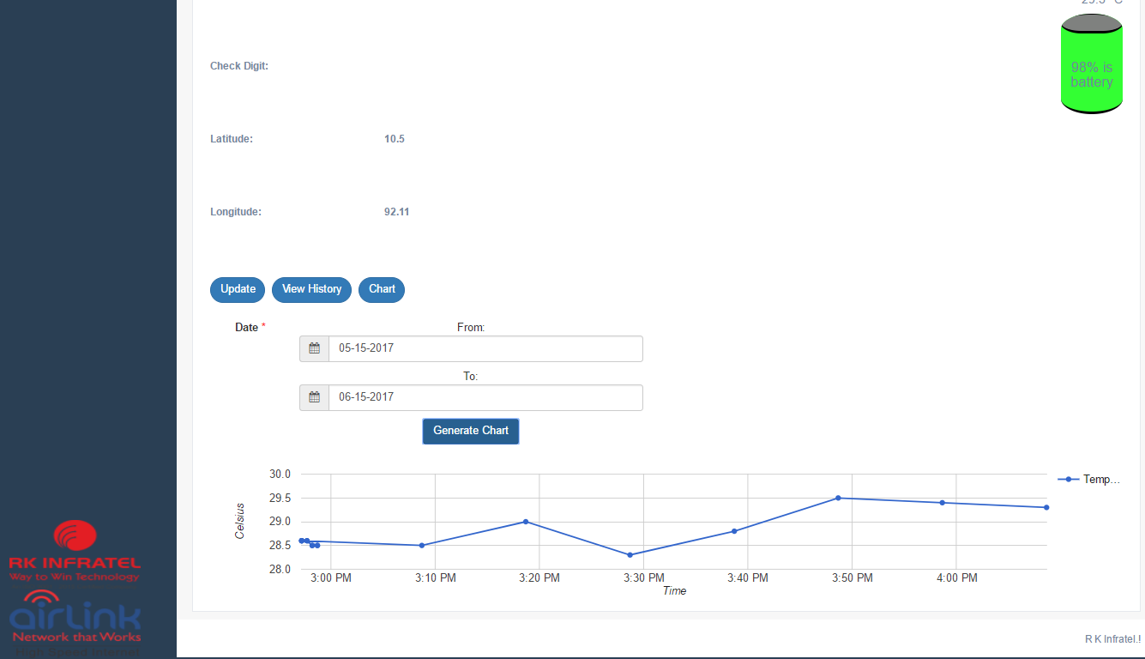
Generating Charts

