Slide 1


IE 406 - Machine Learning
Credit Card Fraud Detection
Group 10
Mentor: Prof. Manjunath Joshi

Slide 2
Group Members
Sudarshan Kundnani 201801140
Dhruv Chavda 201801151
Chirag Patel 201801225
Sanket Mistry 201801229
Darshil Rana 201801462

Slide 3

Problem Statement
Given any details of the transaction. Our model will try to Identify whether the transaction is fraudulent or not based on the various features provided in the transaction details.
Here, a fraudulent transaction means that the transaction is not authorized by the owner of the account .

Slide 4
Methodology

Slide 5
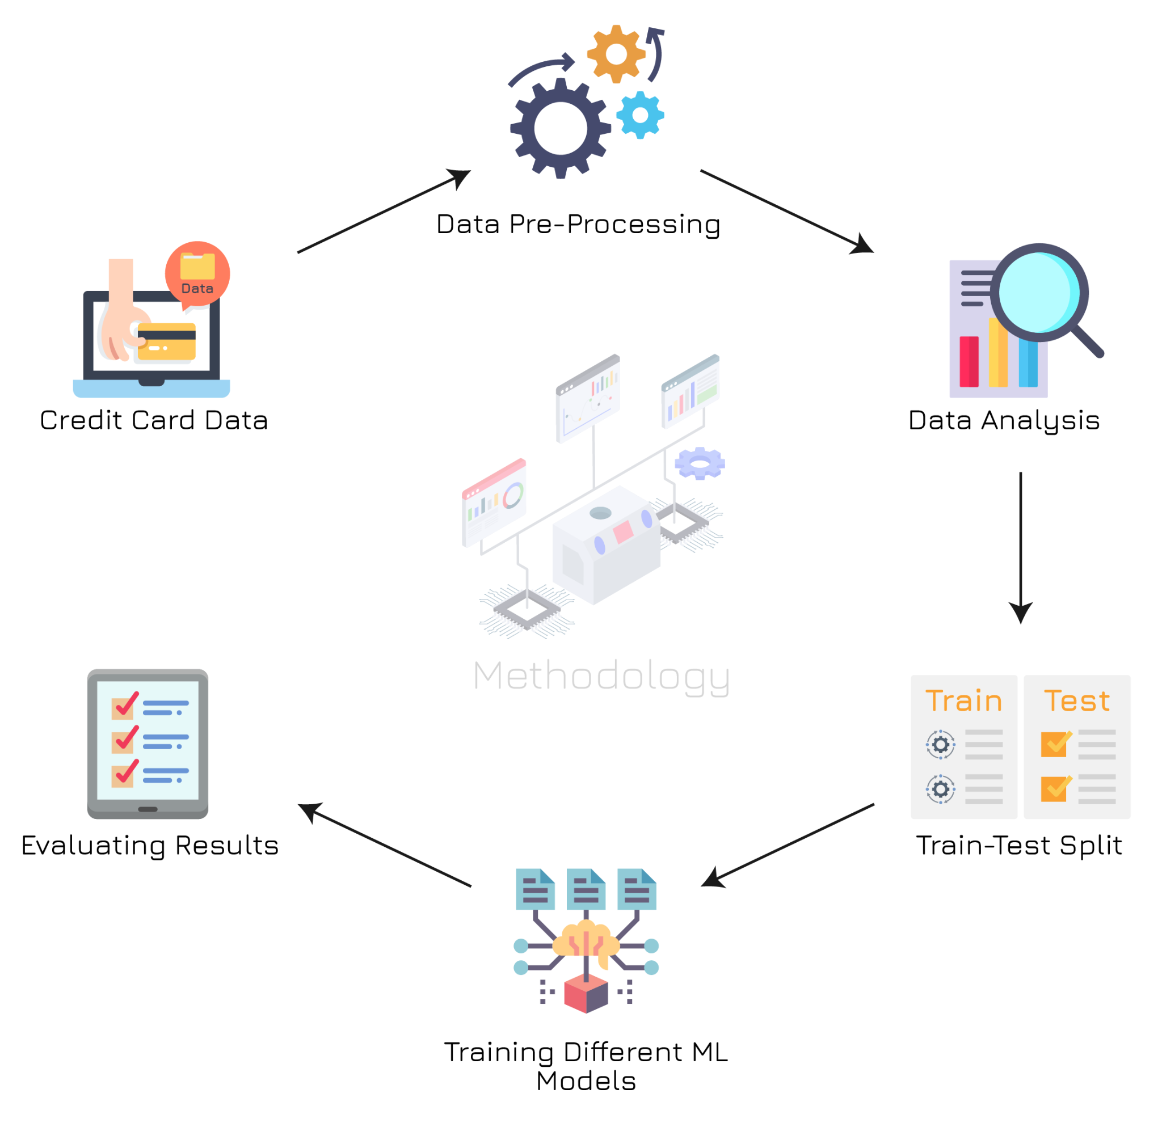

Slide 6
Data Set - Credit Card Fraud Detection Kaggle
Link: https://www.kaggle.com/mlg-ulb/creditcardfraud

Slide 7
Understanding the Data-Set
Dataset Size: 284807 x 31
Contains data of 284,807 transactions
Out of 31 columns, 28 columns are named V1, V2, … , V28.
The other three columns are named Time, Amount and Class.
Class 0 | Valid Transaction
Class 1 | Fraudulent Transaction

Slide 8
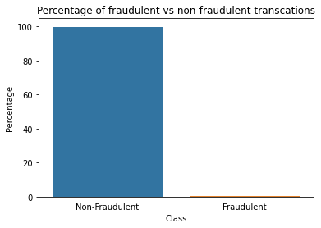
Data Classification
Total transactions: 284807
Number of valid transactions: 284315
Number of fraudulent transactions: 492

Slide 9
Data Analysis and Preprocessing

Slide 10
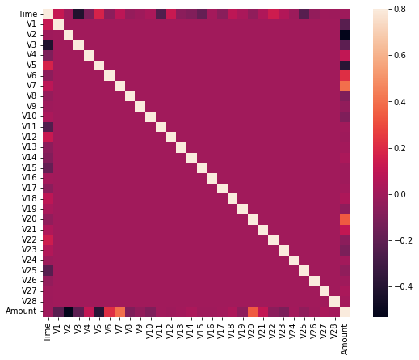
Features Refinement
All features are uncorrelated.
No feature refinement, due to non-zero mean difference.
All features are affecting the result

Slide 11
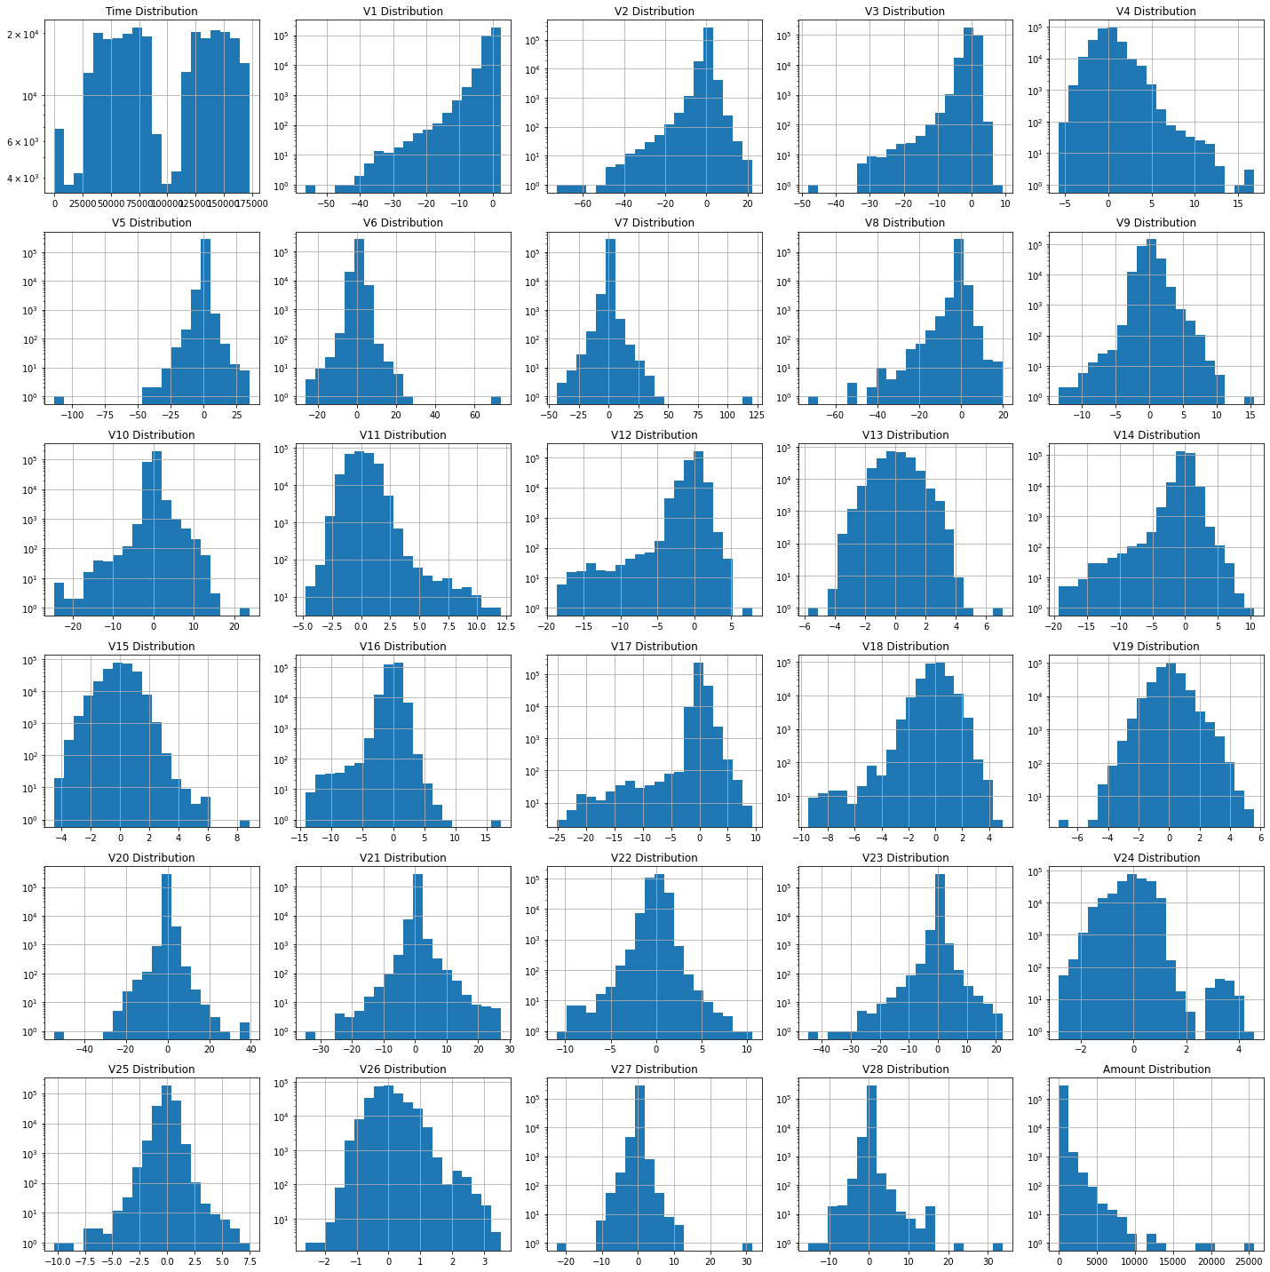
Histogram Plot for each feature
All the features, except Time and Amount are in standard normal form.
with approximately zero mean and unit variance.

Slide 12
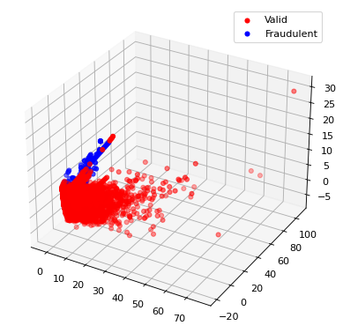
Visualization of final data in 3D
To visualize our data, we used PCA and converted it into 3-dimensional form.

Slide 13
Training and Testing Models

Slide 14

Models Used
We used the following 4 models for our problem
Logistic Regression
Support Vector Machine
Random Forest Classifier
Decision Tree Classifier
Data-Split: 75-25 split for training set and testing set

Slide 15
Evaluating Results

Slide 16

Results
For evaluation purposes, we plotted confusion matrix and classification report for each model.
Also, to verify that the model does not under-fits or over-fits the training data, we applied cross validation.

Slide 17
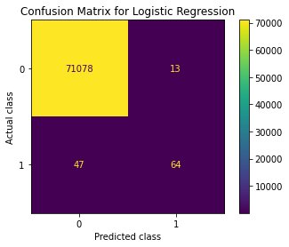
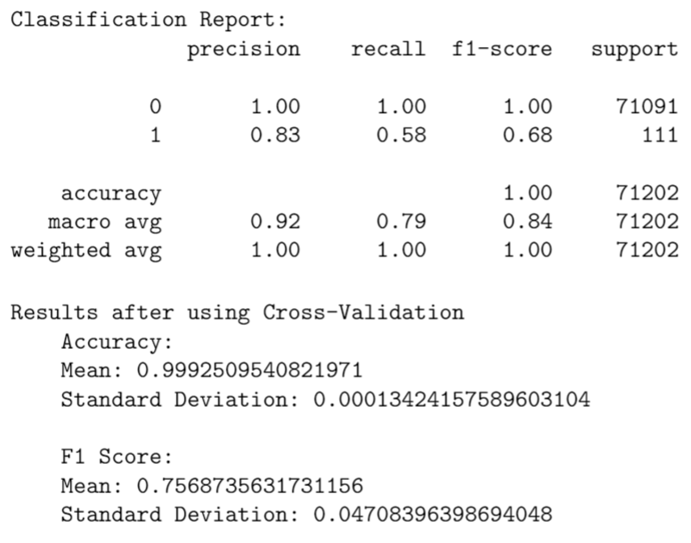
Results for Logistic Regression

Slide 18
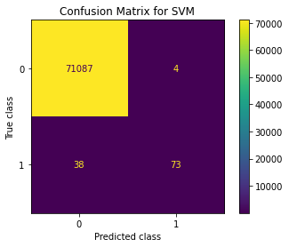
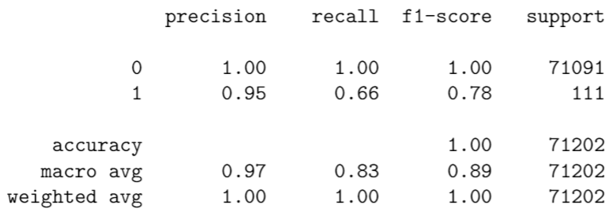
Results for SVM

Slide 19
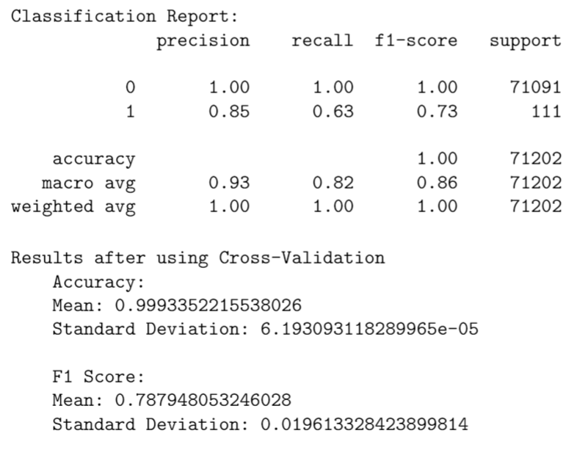
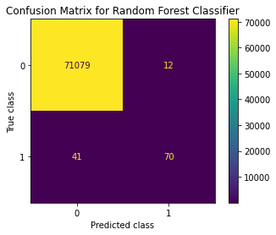
Results for Random Forest Classifier

Slide 20
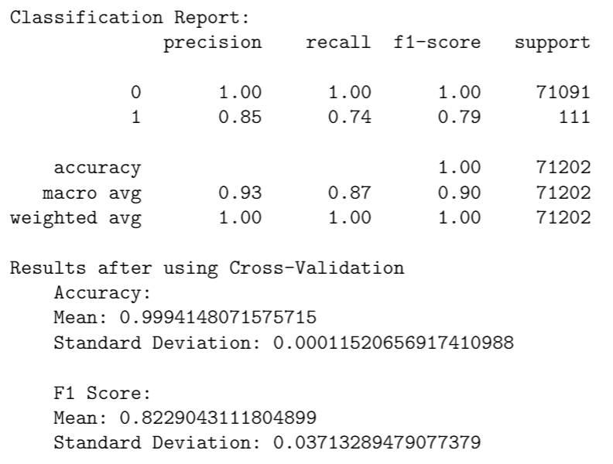

Results for Decision Tree Classifier

Slide 21
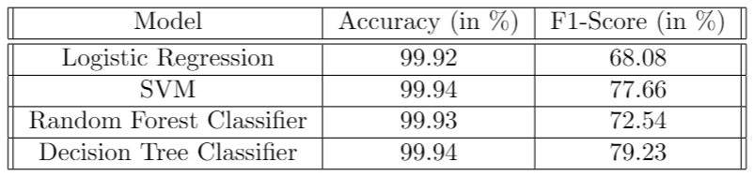
Comparison between models

Slide 22
Conclusion
From all the results, we finally conclude that Decision Tree Classifier gives the best accuracy and F1-score amongst the 4 models used
Models generally showed higher accuracy because the data was highly imbalanced ( ≈ 300, 000 : 500 for valid to fraudulent transactions)
Our data being imbalanced we showed that our model does not over-fits or under-fits the data and so we can say that we can use the data for real-life applications

Slide 23

Thank You

