Slide 1

Course Title
Data Mining

Slide 2
UNIT-1
Presentation

Slide 3
UNIT - I
Data Mining: Data–Types of Data– Data Mining Functionalities– Interestingness Patterns–Classification of Data Mining systems– Data mining Task primitives –Integration of Data mining system with a Data warehouse–Major issues in Data Mining–Data Preprocessing.

Slide 4
Data
Data sets are made up of data objects.
A data object represents an entity
Data objects are described by attributes.
An attribute is a property or characteristic of a data object an entity.
Attribute is also known as variable, field, characteristic, or feature
E.g., Customer -----Object
E.g., customer _ID, name, address --Attributes

Slide 5
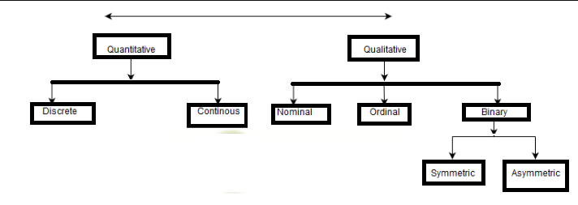
Types of Attributes

Slide 6
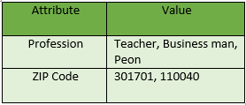
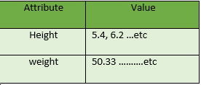
Quantitative Attributes
Discrete
Continuous
Numeric
Interval Scaled
Ratio Scaled

Slide 7

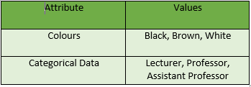
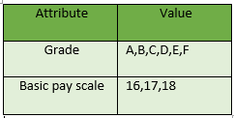
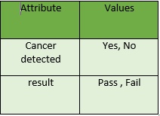
Qualitative Attributes
Binary
Nominal
Ordinal
Symmetric
Asymmetric

Slide 8
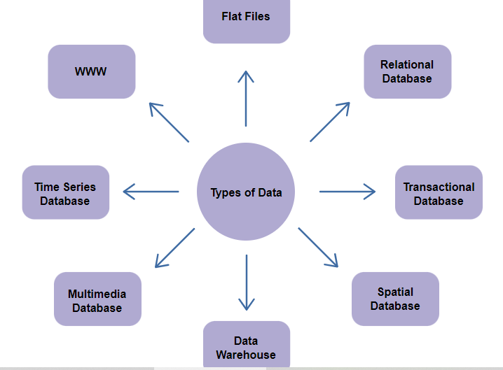
Types of Data
Condt.

Slide 9
Types of Data
Flat Files:
Flat files is defined as data files in text form or binary form with a structure that can be easily extracted by data mining algorithms.
Data stored in flat files have no relationship or path among themselves, like if a relational database is stored on flat file, then there will be no relations between the tables.

Slide 10
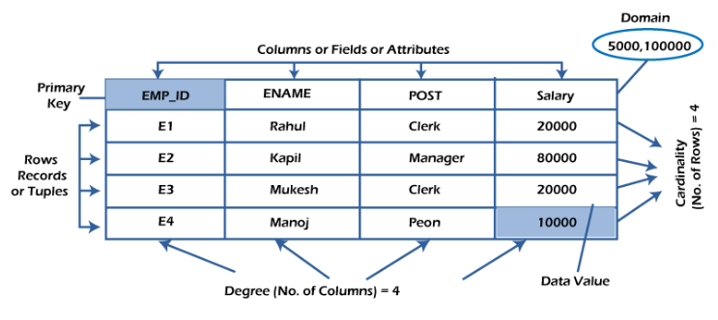
Types of Data
Relational Database

Slide 11
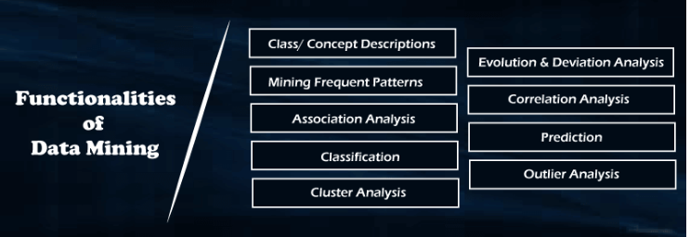
DataMining Functionalities

Slide 12
Class/Concept Descriptions
Data can be associated with class or concept.
For example, in the All Electronics store, classes of items for. sale include computers and printers and concepts of customers include big spender and budget spender.
Data characterization is a summarization of the general characteristics or features of a target class of data
Data discrimination is a comparison of the general features of the target class data objects against the general features of objects from one or multiple contrasting classes.

Slide 13
Mining Frequent Pattern
One of the functions of data mining is finding data patterns. Frequent patterns are things that are discovered to be most common in data. Various types of frequency can be found in the dataset.
Frequent item set
Frequent substructure
Frequent Subsequence

Slide 14
Association analysis
Way of identifying relation between various items.
Example : used to identify the sales of items that are frequently purchased together.

Slide 15
Correlation analysis
Mathematical technique.
Shows how strongly pair of attributes are related together.

Slide 16
Classification and regression for predictive analysis
Way of identifying relation between various items.
Example : used to identify the sales of items that are frequently purchased together.

Slide 17
Cluster analysis
Data items are clustered based on the principle of maximizing the intraclass similarity and minimizing the interclass similarity.

Slide 18
Outlier analysis
Among the data items in database there may be some data items which are not following the general behaviour of data called outliers.

Slide 19
Interestingness of patterns
What makes a pattern interesting :
Easily understood by humans.
Valid on new or old data.
Potentially useful.

Slide 20
Classification of data mining systems
Data mining systems classified based on different criteria :
Type of database that is been mined .
Based on type of knowledge mined[classification….]
Kinds of techniques used [ML,neural networks…]
Applications adapted [telecommunications, finance..]

Slide 21
Data mining task primitives
Data mining is represented in form of data mining query.
DM query presented in terms of data mining task primitives.
DM Task primitives :
Task relevant data.
Kind of knowledge to be mined.
The background knowledge .
Interestingness measures and thresholds for pattern evaluation.
Expected visualization of patterns

Slide 22
Integration of Data mining system with a Data warehouse
We have four integration models :
No coupling-DM system is independent here.
Loose coupling-Up to some extent DM integrated with DB. Suitable for small data sets.
Semitight coupling : Linked with DB and some of DM primitives are implemented in DB.
Tight Coupling :DM completely integrated with DB.All the DM functionalities can be implanted using DB.

Slide 23
Major issues in Data mining system
Mining different kinds of knowledge in database.
Mining of knowledge at multiple levels.
Incorporation of background knowledge of domain.
Presentation and visualization of DM results.
Handling noisy and incomplete data.

Slide 24
Data preprocessing
The process of transforming raw data into an understandable format.
Steps in data preprocessing :
Data cleaning.
Data integration.
Data reduction.
Data Transformation.

Slide 25
Data cleaning
Data cleaning : Process of removal of incorrect, inaccurate and incomplete data.
Handling missing values :
We can replace with NA or mean value or median value.
Some times replaced with most probable value.

Slide 26
Data cleaning
Data cleaning means fixing bad data in your data set.
Bad data could be:
Empty cells
Data in wrong format
Wrong data
Duplicates

Slide 27
Data cleaning
Handling noisy data :
1.Binning : First data is to be sorted.The sorted data is to
Be stored in bins.
Three methods to handle data in bins.
smoothing by means.
Smoothing by bin median.
Smoothing by bin boundary.

Slide 28
Data cleaning
Duration Date Pulse Maxpulse Calories
0 60 '2020/12/01' 110 130 409.1
1 60 '2020/12/02' 117 145 479.0
2 60 '2020/12/03' 103 135 340.0
3 45 '2020/12/04' 109 175 282.4
4 45 '2020/12/05' 117 148 406.0
5 60 '2020/12/06' 102 127 300.0
6 60 '2020/12/07' 110 136 374.0
7 450 '2020/12/08' 104 134 253.3
8 30 '2020/12/09' 109 133 195.1
9 60 '2020/12/10' 98 124 269.0
10 60 '2020/12/11' 103 147 329.3
11 60 '2020/12/12' 100 120 250.7
12 60 '2020/12/12' 100 120 250.7
13 60 '2020/12/13' 106 128 345.3
14 60 '2020/12/14' 104 132 379.3
15 60 '2020/12/15' 98 123 275.0

Slide 29
Data cleaning
16 60 '2020/12/16' 98 120 215.2
17 60 '2020/12/17' 100 120 300.0
18 45 '2020/12/18' 90 112 NaN
19 60 '2020/12/19' 103 123 323.0
20 45 '2020/12/20' 97 125 243.0
21 60 '2020/12/21' 108 131 364.2
22 45 NaN 100 119 282.0
23 60 '2020/12/23' 130 101 300.0
24 45 '2020/12/24' 105 132 246.0
25 60 '2020/12/25' 102 126 334.5
26 60 2020/12/26 100 120 250.0
27 60 '2020/12/27' 92 118 241.0
28 60 '2020/12/28' 103 132 NaN
29 60 '2020/12/29' 100 132 280.0
30 60 '2020/12/30' 102 129 380.3
31 60 '2020/12/31' 92 115 243.0

Slide 30
Data cleaning
The data set contains some empty cells ("Date" in row 22, and "Calories" in row 18 and 28).
The data set contains wrong format ("Date" in row 26).
The data set contains wrong data ("Duration" in row 7).
The data set contains duplicates (row 11 and 12).

Slide 31
Data cleaning
Empty cells :
One way to deal with empty cells is to remove rows that contain empty cells.
This is usually OK, since data sets can be very big, and removing a few rows will not have a big impact on the result.
Return a new Data Frame with no empty cells:
Remove all rows with NULL values:
import pandas as pd
df = pd.read_csv('data.csv’)
df.dropna(inplace = True)
print(df.to_string())

Slide 32
Data cleaning
Replace Empty Values:
Another way of dealing with empty cells is to insert a new value instead.
This way you do not have to delete entire rows just because of some empty cells.
The fillna() method allows us to replace empty cells with a value:
Replace NULL values with the number 130:
import pandas as pd
df = pd.read_csv('data.csv’)
df.fillna(130, inplace = True)

Slide 33
Data cleaning
Replace Using Mean, Median, or Mode
A common way to replace empty cells, is to calculate the mean, median or mode value of the column.
import pandas as pd
df = pd.read_csv('data.csv')
x = df["Calories"].mean()
df["Calories"].fillna(x, inplace = True)

Slide 34
Data cleaning
Data of Wrong Format
Cells with data of wrong format can make it difficult, or even impossible, to analyze data.
To fix it, you have two options: remove the rows, or convert all cells in the columns into the same format.
Convert Into a Correct Format
In our Data Frame, we have two cells with the wrong format. Check out row 22 and 26, the 'Date' column should be a string that represents a date:
import pandas as pd
df = pd.read_csv('data.csv')
df['Date'] = pd.to_datetime(df['Date'])
print(df.to_string())

Slide 35
Data cleaning
Discovering Duplicates
Duplicate rows are rows that have been registered more than one time.
Row 11 and 12 are duplicates in data set.
df.drop_duplicates(inplace = True)

Slide 36
Data Integration
Integrating data from multiple sources.
Issues :
1.Schema integration
2.Object matching
Mismatch of attribute names:
Example : table 1: Customer_id
table 2 :customer_number
Mismatch in structure of data :
table 1 : dollar
table 2 : rupees

Slide 37
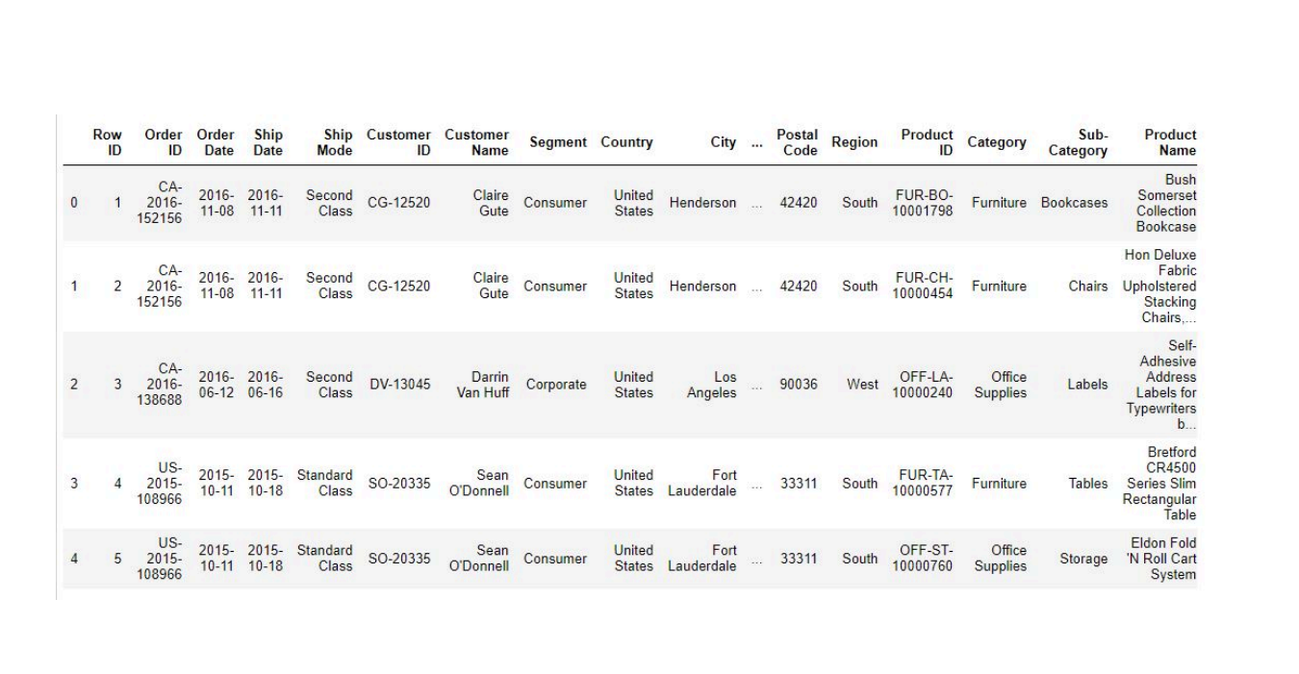
Source1 : orders data set

Slide 38
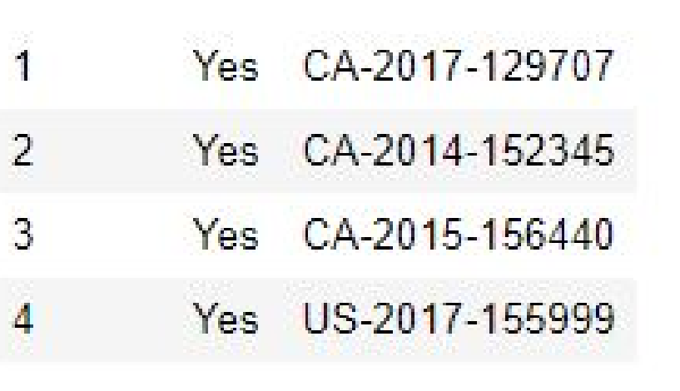
Data Integration
Source 2: returns returned order-id

Slide 39
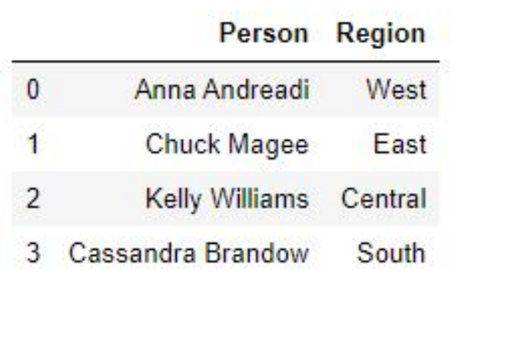
Data Integration
Source 3: person

Slide 40
Data Integration
import pandas as pd
orders = pd.read_excel('./data/input_data/superstore.xls', sheet_name='Orders')
returns = pd.read_excel('./data/input_data/superstore.xls', sheet_name='Returns')
people = pd.read_excel('./data/input_data/superstore.xls', sheet_name='People’)
Note :
Orders table shares common fields with both the returns (Order ID) and people (Region) tables.
These relationships mean that we can combine the three data sources into a single “master” table using a join.

Slide 41
Data Integration
Contd….
merged_df = orders.merge( returns, how='left', on='Order ID' ).merge(people, on='Region’)
not_returned_df = merged_df.loc[merged_df['Returned'].isna(), :]

Slide 42


