Slide 1




QONEQT AI CHALLENGE · PART 2 · CTRL FREAK 2026
Qoneqt Video Factory
Topic in. Global Feed short out.
Theme: Build an LLM-Powered Content Pipeline for Qoneqt. A repeatable system that turns a topic into a publish-ready, captioned vertical video for the Qoneqt Global Feed.
Three shorts generated by the pipeline tonight: Tech, Motivation, Hinglish presets
TEAM
[Team Name] · [Team ID]
COLLEGE
[College Name]
Qoneqt × CTRL FREAK 2026
Notes:
Title slide. Team details on the left, three real outputs from tonight's run on the right.

Slide 2

PROBLEM + EXISTING GAP
02 / 07
The Global Feed is hungry. Video is slow.
What is the problem?
?
Who is affected
A social feed lives on fresh video every day. Making one 30-second short by hand means writing a script, finding visuals, recording a voice, editing, and adding captions. A creator manages one a day. The Global Feed needs hundreds.
Qoneqt creators and community admins who must post daily, and the platform, whose Global Feed runs on steady video.
~
Current solutions
2–4 hrs
0
Manual editing apps (CapCut, Canva), one-shot AI video generators on paid credits, or hiring an agency. All produce one video at a time.
to hand-make one 30-second short
Qoneqt-native topic-to-video tools
!
Key gaps
Result: thin, repetitive video content, creators who burn out, and communities that go quiet between posts.
Not repeatable: no batch, no pipeline
Not community-aware: generic tone
Paid per video; no enforced hook or captions
Qoneqt × CTRL FREAK 2026 · Qoneqt Video Factory
Notes:
Problem: feeds need constant video; hand-made shorts take hours. Gap: no repeatable, community-aware, zero-cost pipeline exists for Qoneqt.

Slide 3

PROPOSED SOLUTION
03 / 07
A video factory, not a video button
Type a topic. Pick a community. Get a publish-ready short and its post text in about a minute.
1
Plan
2
Produce
3
Publish
The LLM writes 3 hooks, scores them, keeps the best, then a 5–7 scene script with a stock-search query per scene, plus caption and hashtags.
An AI voice reads each scene. An AI still is generated per scene, or a photo fetched, then given motion. Whisper gives word timings for word-pop captions.
ffmpeg assembles a 1080×1920 MP4 with burned-in captions. The app hands you the video, caption, and hashtags ready to paste into Qoneqt.
What makes it better than existing options
 | Manual editing | One-shot AI tools | Video Factory
Repeatable at scale | No | No | Yes, batch of 10 per click
Community-aware tone | By hand | No | 6 presets, one dict entry each
Hook, captions, post text | By hand | Partly | Built in, every video
Cost per video | Hours | Paid credits | ₹0 on free tiers
Qoneqt × CTRL FREAK 2026 · Qoneqt Video Factory
Notes:
Solution in one line, then three steps, then a comparison table against manual editing and one-shot AI tools.

Slide 4

ARCHITECTURE + TECH STACK
04 / 07
Input → Process → Output
Input
1 Plan
2 Images
3 Voice
4 Visuals
5 Captions
6 Render
Output
Topic + community preset
Groq gpt-oss-120b
(fallback qwen, Gemini)
Pollinations FLUX
AI still per scene
ElevenLabs
(fallback edge-tts)
AI still or Wikimedia
photo, pan-zoom
Groq Whisper
word timestamps
ffmpeg 1080×1920
burned-in captions
MP4 + thumbnail + post text
Every stage has a fallback chain, so one flaky free API never kills a job. A single worker thread drains the job queue; batch mode is just N queued topics.
Frontend
Backend
AI layer
Data + deploy
One static HTML page. Textarea for topics (one per line), community dropdown, live stage progress, inline player, Copy post text, Download.
FastAPI. POST /generate, GET /jobs, static /out. In-memory job dict, one worker thread, files per job in out/<id>/.
LLM for plan JSON (validated, guided retry). TTS per scene. Photo or clip search per scene. Whisper word timings aligned to script words.
Outputs as files (mp4, jpg, json). Docker image with ffmpeg and Noto fonts. Deployed on a free Hugging Face Space, keys as secrets.
Stack Python 3.11 · FastAPI · httpx · ffmpeg · Docker · Groq (gpt-oss-120b, Whisper large-v3-turbo) · Pollinations FLUX · Hugging Face Spaces · ElevenLabs · edge-tts · Wikimedia Commons
Qoneqt × CTRL FREAK 2026 · Qoneqt Video Factory
Notes:
Five-stage pipeline with fallbacks. Frontend, backend, AI layer, data and deploy components. Stack line at the bottom.

Slide 5

KEY FEATURES
05 / 07
Five things that make it work
1
Community presets
2
Self-scored hooks
3
Word-pop captions
Six Qoneqt communities (General, Tech, Fitness, Motivation, Finance, Hinglish Fun). Each sets tone, language, narrator voice, caption style, hashtags, and caption colour. Adding one is a single dict entry.
The LLM writes three opening lines, scores each for scroll-stopping power, and the best one opens the video. Quality control inside the prompt, zero extra calls.
Whisper word timestamps drive karaoke-style captions: each spoken word lights up in the preset colour, aligned back to the script's own spelling. The look that performs on shorts.
4
Batch and fallbacks
5
Post-ready output
Real output frame
Ten topics per click, one worker, no babysitting. Every stage has a fallback (LLM, voice, stock, captions), so the factory keeps producing when a free API blinks.
Not just an MP4. Hook, caption, and hashtags come out together, with a one-click Copy post text button, so publishing to Qoneqt is a 30-second manual step.
Hinglish preset, edge-tts fallback voice, Whisper-timed captions, pink accent word. Generated, not mocked.
Qoneqt × CTRL FREAK 2026 · Qoneqt Video Factory
Notes:
Five features. The sixth slot shows a real frame from a Hinglish video generated tonight.

Slide 6

IMPACT + FEASIBILITY
06 / 07
Impact and feasibility
₹0
~1 min
10
6
API cost per video on free tiers
to make a 30–45 s short (measured tonight)
topics per click in batch mode
community presets, one dict entry to add more
Who benefits and how
Scalability and feasibility
Creators: turn ideas into daily shorts without editing skills or hours of work
Community admins: on-tone videos in their own voice, Hinglish included
Qoneqt: a steadier, higher-quality stream on the Global Feed, and a tool it can offer creators natively
Real-world: 100 topics in overnight, 100 publish-ready videos out
One free CPU: ~40–60 videos/hour per worker; scale by adding workers
Free tiers: Groq LLM + Whisper, ElevenLabs (edge-tts fallback), Wikimedia visuals
One Docker container on a free Hugging Face Space; keys stay secret
Working end to end today; live URL and Global Feed post by the finale
Qoneqt × CTRL FREAK 2026 · Qoneqt Video Factory
Notes:
Impact for creators, admins, and Qoneqt. Feasibility: measured timings, free-tier limits, one-container deploy.

Slide 7

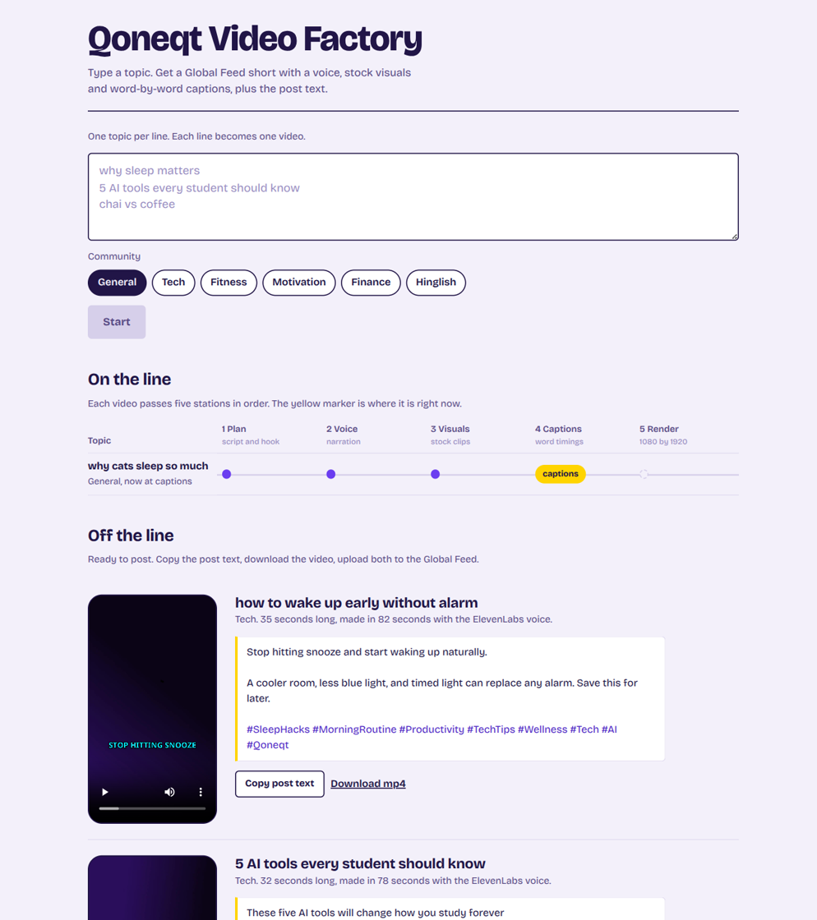
DEMO + CONCLUSION
07 / 07
Built and running tonight
What the prototype does today
Batch of three topics queued from the page; each ran plan → images → voice → visuals → captions → render with live progress
34-second videos produced in about 55 seconds each, ElevenLabs voice, word-pop captions, post text ready to copy
Hinglish preset verified on the fallback voice; every stage's fallback exercised
GitHub github.com/<user>/qoneqt-video-factory
Live demo
huggingface.co/spaces/<user>/qoneqt-video-factory
Qoneqt doesn't need one AI video. It needs a factory. We built the factory.
Why select this: it already ships, costs nothing to run, speaks each community's language, and is built on Qoneqt's real content format, not a concept.
Qoneqt × CTRL FREAK 2026 · Qoneqt Video Factory
Notes:
Live screenshot from tonight on the left. Links, one-line conclusion, and the selection case on the right.

