Slide 1
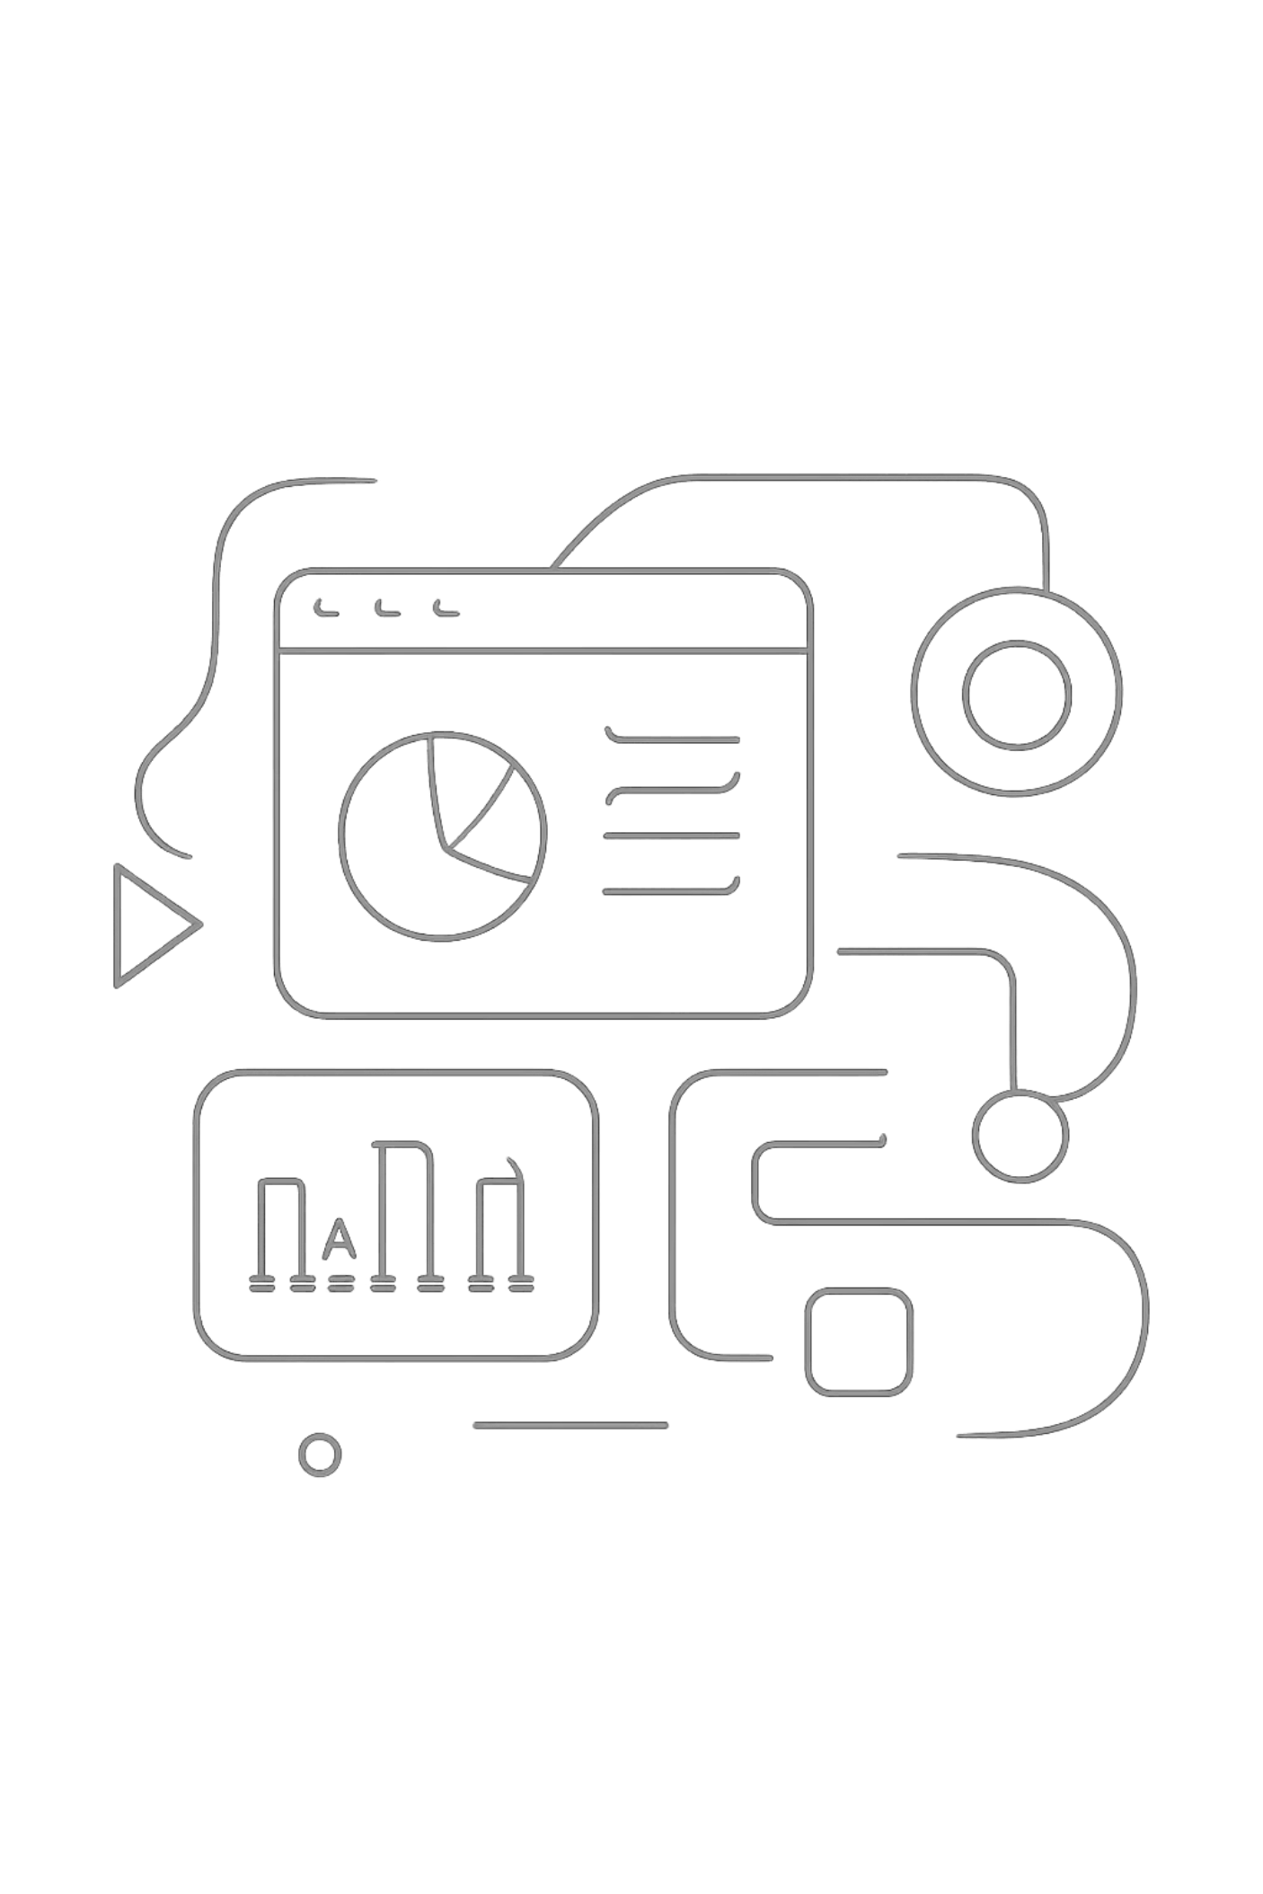
PRODUCT LAUNCH STRATEGY
Future-Ready: Product Launch & Roadmap Strategy
From strategic concept to market dominance — this playbook defines how we move from a bold vision to a product that reshapes the competitive landscape. Built for the modern SaaS era, every decision, milestone, and metric is designed to accelerate our path to category leadership.

Slide 2

STRATEGIC CONTEXT
The Vision: Why Now?
The market is at an inflection point. Legacy tools are failing to meet the demands of modern teams, and customer expectations have shifted irreversibly toward intelligent, integrated, and intuitive platforms. This is our window.
Market Shift
The Ambition
Competitive Impact
Industry research confirms a critical gap between what users need and what existing solutions deliver. Fragmented workflows, manual processes, and poor data visibility are driving demand for a unified platform.
Our North Star is clear: become the default operating layer for high-performing teams. Every feature, integration, and experience must serve this ambition with precision.
This launch is not an iteration — it is a repositioning. By addressing the deepest unmet needs in the market, we create a defensible lead that compounds over time.

Slide 3

PROBLEM DEFINITION
The Core Problem
Users are drowning in complexity. Current tools create friction at every step — from onboarding to daily workflows to scaling operations. Our research reveals three critical pain clusters that define the status quo.
The Cost of Inaction
Every quarter without a solution represents lost revenue, eroding customer trust, and ceding ground to competitors. The opportunity cost is measurable — and it is growing.
1
Workflow Fragmentation
Teams juggle an average of 8+ disconnected tools, losing 2.4 hours per day to context switching and manual data transfer.
Our solution directly addresses each friction point with purpose-built capabilities designed for the modern enterprise.
2
Delayed Time-to-Value
Onboarding cycles stretch to 6+ weeks, with 40% of users never reaching meaningful feature adoption.
3
Infrastructure Ceiling
Existing platforms collapse under scale, forcing costly migrations and creating operational risk during growth phases.

Slide 4

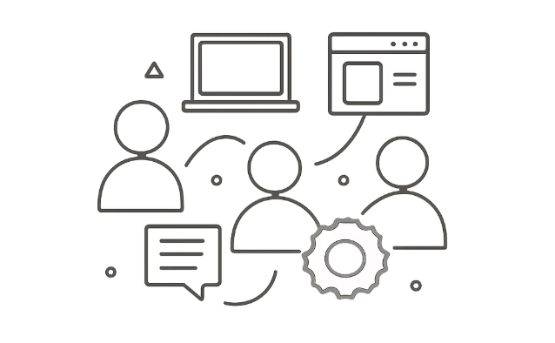

FEATURE SPOTLIGHT
The Solution: Three Pillars of Capability
Each feature is engineered to eliminate a specific class of user friction, delivering measurable impact from day one. Together, they form a cohesive platform that scales with the customer.
Intelligent Automation
Unified Workspace
Enterprise-Grade Scalability
AI-driven workflows eliminate manual processes, surfacing insights and triggering actions without human intervention. Users reclaim up to 10 hours per week, redirecting effort toward high-value decisions.
A single, cohesive environment replaces fragmented toolchains. Real-time collaboration, shared context, and integrated data flows reduce switching costs and accelerate team alignment.
Built on a cloud-native architecture designed to handle millions of transactions without performance degradation. Infrastructure upgrades happen seamlessly, with zero downtime for customers.

Slide 5
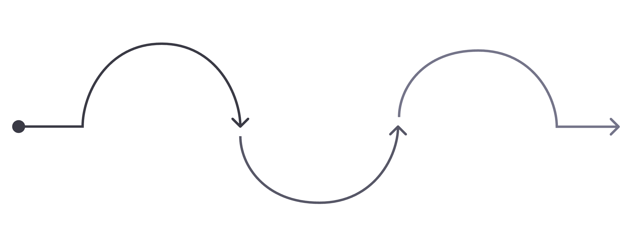
USER EXPERIENCE
How It Works: The User Journey
The product experience is structured around three progressive phases, each designed to deepen value realization and increase user dependency. From first login to power-user mastery, every touchpoint is intentional.
Onboarding
Optimization
Guided setup; first win in 24h
Integration
Custom dashboards and API access
Daily workflows, team collaboration
Phase 1 focuses on rapid time-to-value — users experience their first meaningful outcome within 24 hours. Phase 2 embeds the product into daily workflows through smart integrations and team collaboration features. Phase 3 unlocks the full power of the platform for advanced users, with custom configurations, API access, and predictive analytics that drive strategic decisions.

Slide 6
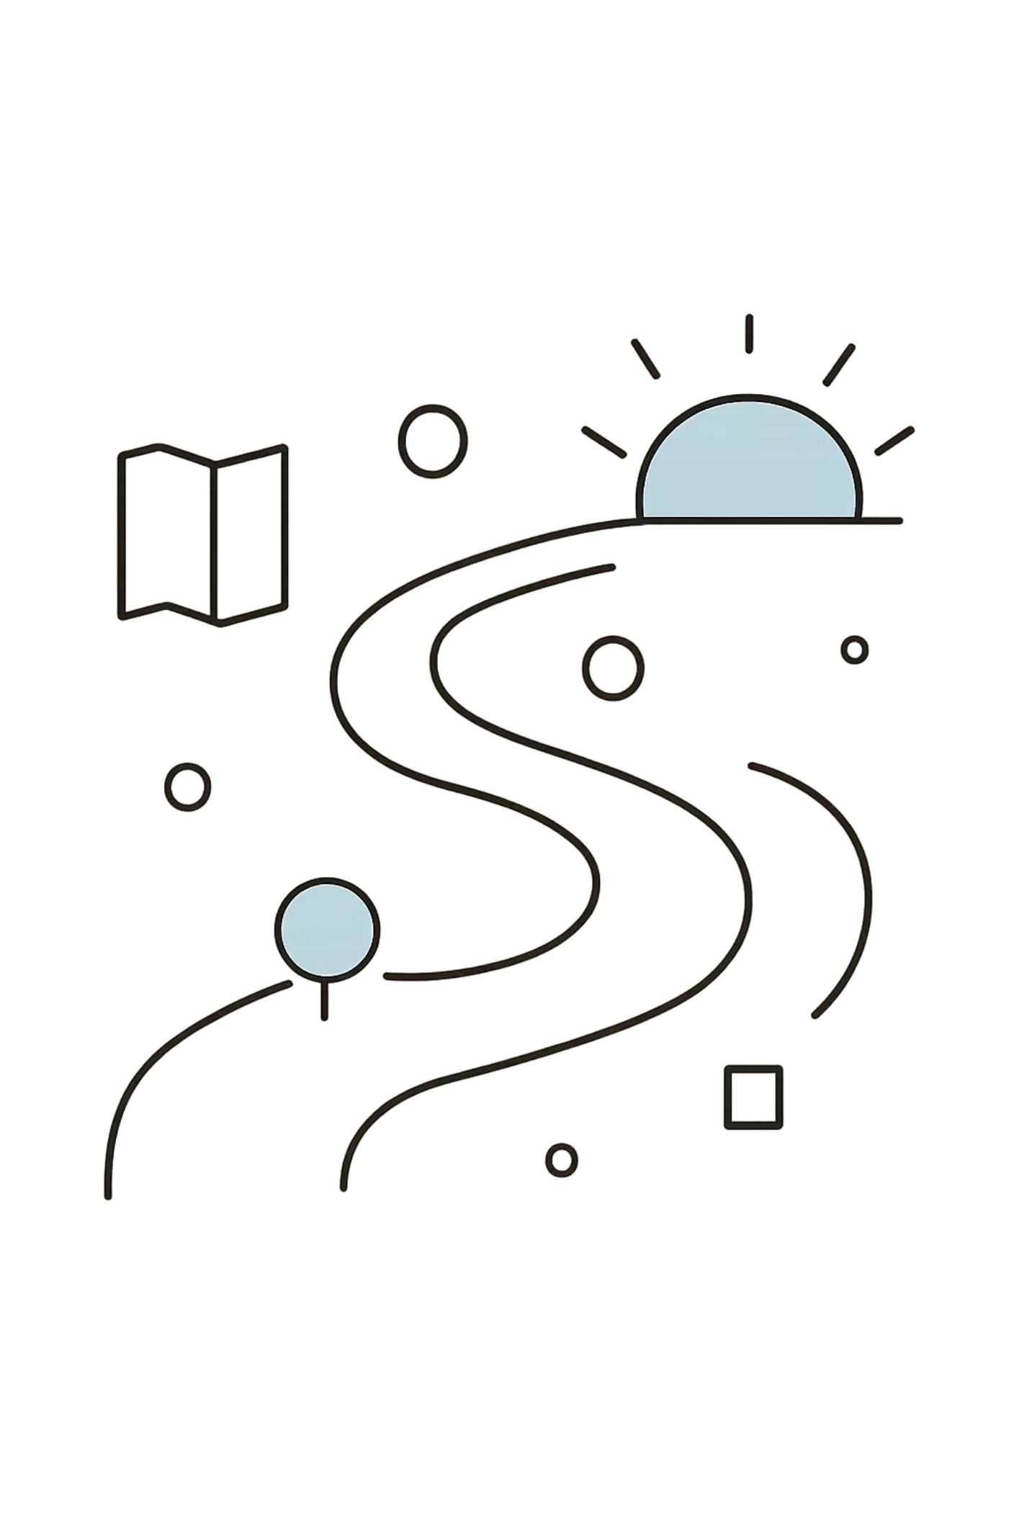
STRATEGIC ROADMAP
The Path Forward
Our roadmap is structured to deliver immediate value while building toward a category-defining platform. Each phase unlocks new capabilities, expands our addressable market, and deepens our competitive moat.
1
Q1 / Q2 — Launch Phase
Core product release, critical third-party integrations, beta customer onboarding, and initial feedback loops. Focus: prove product-market fit and establish early advocacy.
2
Q3 / Q4 — Scale Phase
Enterprise expansion, advanced automation features, multi-team workspaces, and dedicated customer success infrastructure. Focus: accelerate ARR growth and reduce churn.
3
Long-Term — Vision Phase
AI-native capabilities, marketplace ecosystem, industry-specific verticals, and global compliance frameworks. Focus: shape the market and define the category.

Slide 7


LAUNCH EXECUTION
Launch Countdown & Milestones
T-8 to T-4 Weeks
Internal build freeze, QA cycles, and closed beta with select customers. All critical bugs resolved. Performance benchmarks validated against SLA targets.
T-2 Weeks
Go-to-market readiness review. Marketing assets, sales enablement, support documentation, and customer success playbooks finalized. Final executive sign-off.
Launch Day
Public release across all channels. Global availability announced. Real-time monitoring dashboards active. War room staffed for immediate issue resolution.
Launch Readiness Gate: All milestones must be green before advancing. No feature ships until quality, security, and performance thresholds are met.

Slide 8
METRICS SCORECARD
Measuring Success
We track a disciplined set of metrics across the customer lifecycle. These scorecards drive weekly reviews, inform product decisions, and ensure accountability across every team.
1,000+
24hrs
Target Signups
Time-to-Value
New user registrations in the first 30 days post-launch, measured across all acquisition channels.
Target for users to reach their first meaningful outcome — a key activation milestone that predicts long-term retention.
80%
<5%
Activation Rate
Monthly Churn
Percentage of users who complete onboarding and engage with core features within the first week.
Target churn rate by end of Q2, driven by feature adoption, proactive support, and continuous product improvement.

Slide 9



GROWTH STRATEGY
Growth Dynamics
Revenue Expansion
Expansion Revenue
Tier-based pricing drives natural upgrade paths. As teams grow and use cases expand, the platform's value becomes self-evident — converting free users to paid, and paid users to enterprise.
Upsell and cross-sell motion built into the product experience. Usage-based triggers prompt timely upgrade conversations, increasing LTV without friction.
Competitive Moat
Infrastructure Readiness
Continuous iteration and customer feedback loops ensure we stay ahead. Every release compounds our advantage, making migration increasingly costly for customers.
Our architecture is built to absorb rapid adoption without degradation. Auto-scaling, distributed databases, and CDN optimization ensure performance at any volume.
Ecosystem Growth
Strategic integrations and partner programs extend our reach into adjacent markets, creating network effects that accelerate organic growth.

Slide 10
CONCLUSION
The Road Ahead
This launch is not a destination — it is the beginning of a sustained journey toward market leadership. Every feature shipped, every metric tracked, and every customer conversation brings us closer to defining the future of our industry.
Our Path to Leadership
Cross-Functional Alignment
Shaping the Industry
A clear roadmap, validated product-market fit, and a team aligned on a shared vision. The foundation is built. Now we execute.
Engineering, product, marketing, sales, and customer success must move as one. Weekly syncs, shared metrics, and transparent communication are non-negotiable.
We are not just building a product — we are setting the standard. Every decision should reflect the ambition to lead, not follow.
The best product launch is not a single event — it is the start of a movement. Let's build it together.

